Slide 1
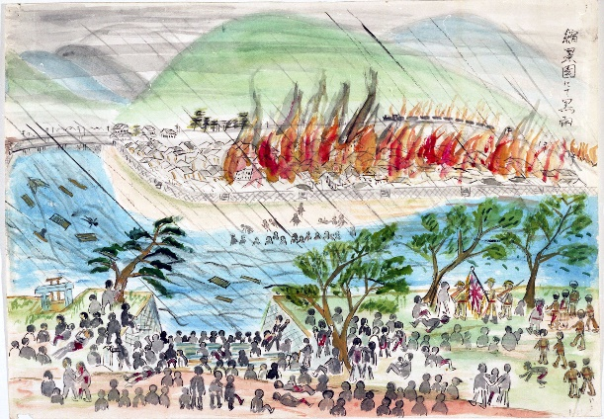

Hibakusha and Art
[School name]
[Date of session]
Notes:
Be aware that Hibakusha is pronounced: he-back-sha

Slide 2
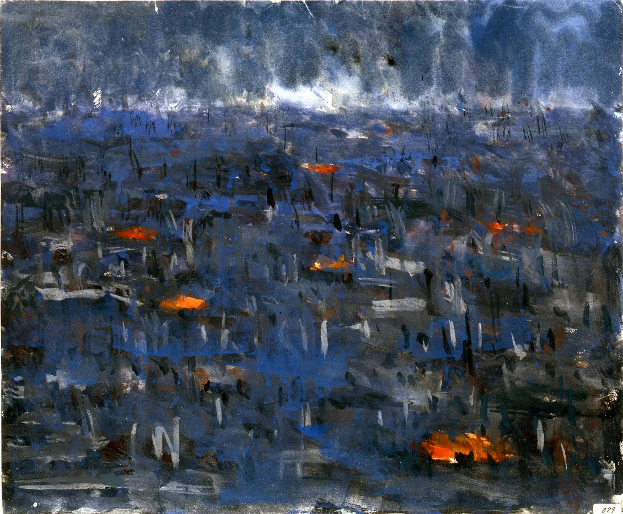
What we’ll do in this workshop:
Learn about the bombings of Hiroshima and Nagasaki, and their effects
Make artwork based on an eye-witness account of the bombing
Compare our artwork with art by Hibakusha

Slide 3
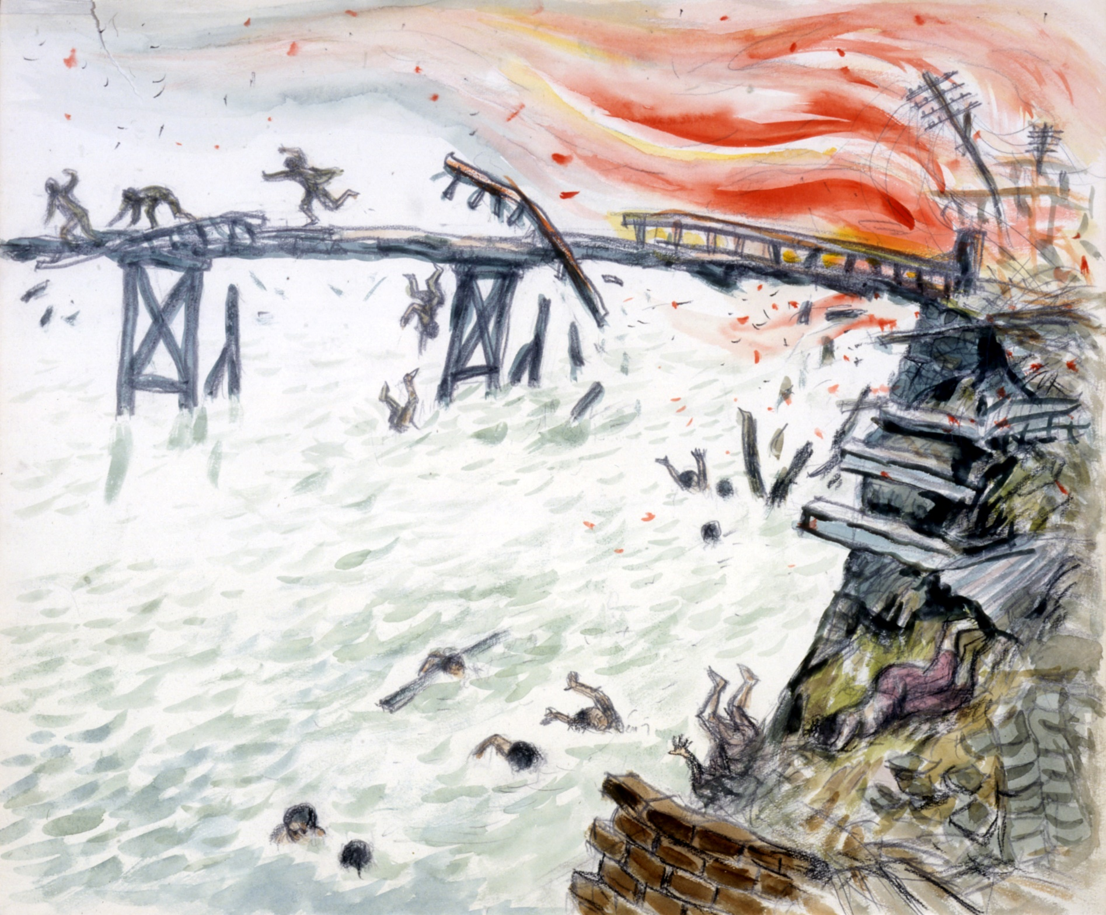
We’re going to read one person’s account of experiencing an atomic bomb exploding.
There will be talk of injury, destruction, and death
You don’t have to join in, and can leave the room if you need to.
Would anyone like to begin reading?
Notes:
Akihiro Takahashi’s testimony is available p.34-35 of our teaching pack (via our website), Critical Mass. See: https://cnduk.org/education/free-teaching-resources/critical-mass-lessons-on-gender-race-and-nuclear-weapons/
It’s recommended that you look at the following illustrations beforehand, and take out any that you believe might be unsuitable for your students.

Slide 4
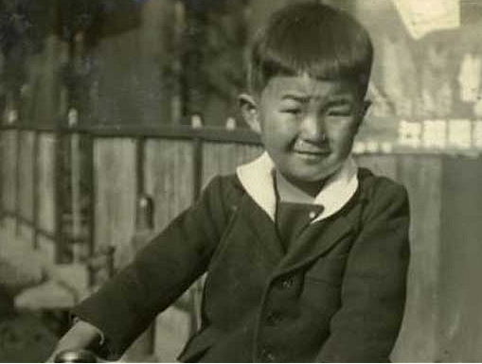
On August 6th, 1945 at 8.15 am, the world's first atomic bomb exploded over Hiroshima. I was 14 years old then. I was in a playground about 1.4 kilometers away from the hypocenter when the bomb exploded…
Akihiro Takahashi witnessed the bombing of Hiroshima in 1945. This picture was taken before the bomb fell.

Slide 5
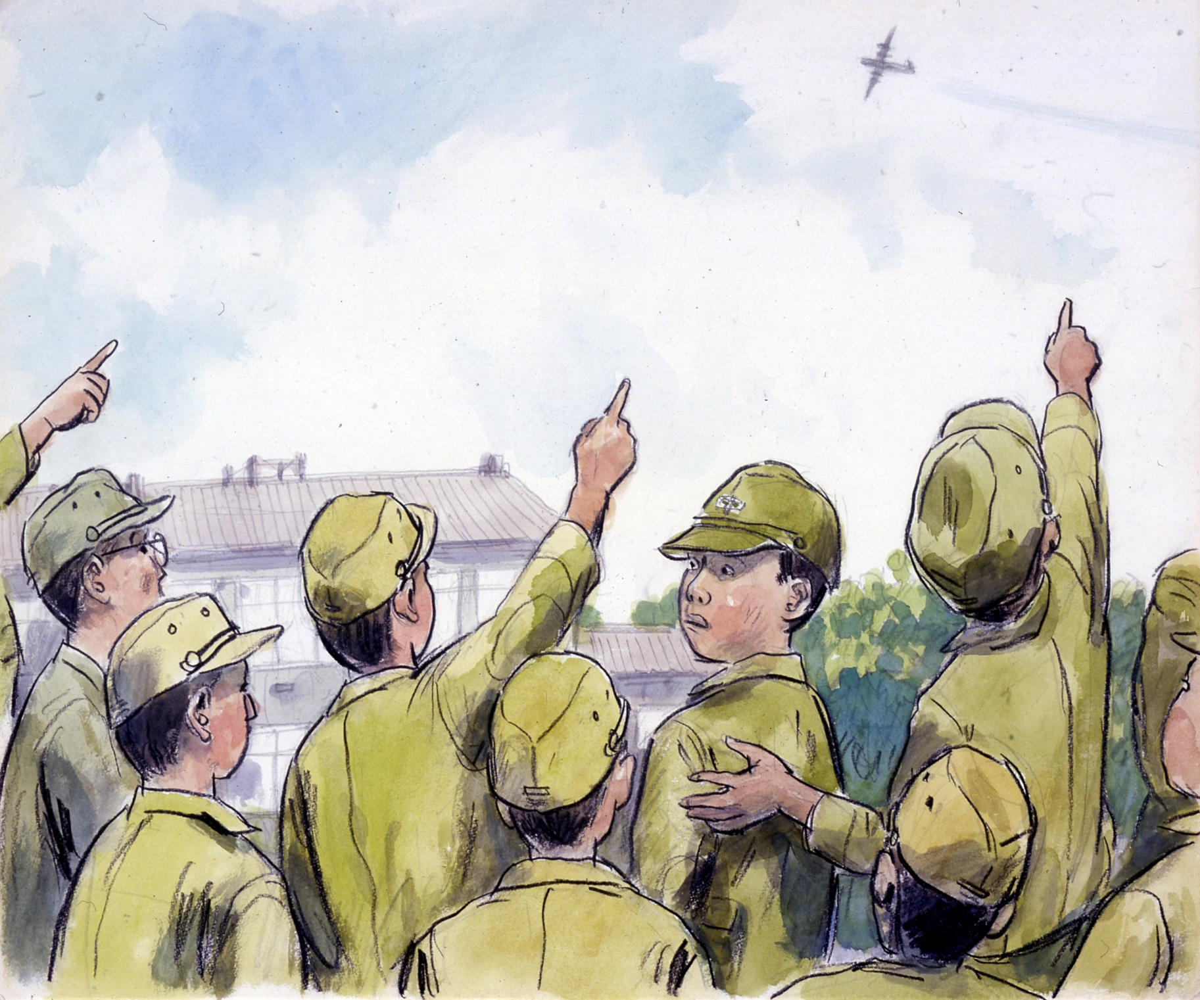

Slide 6
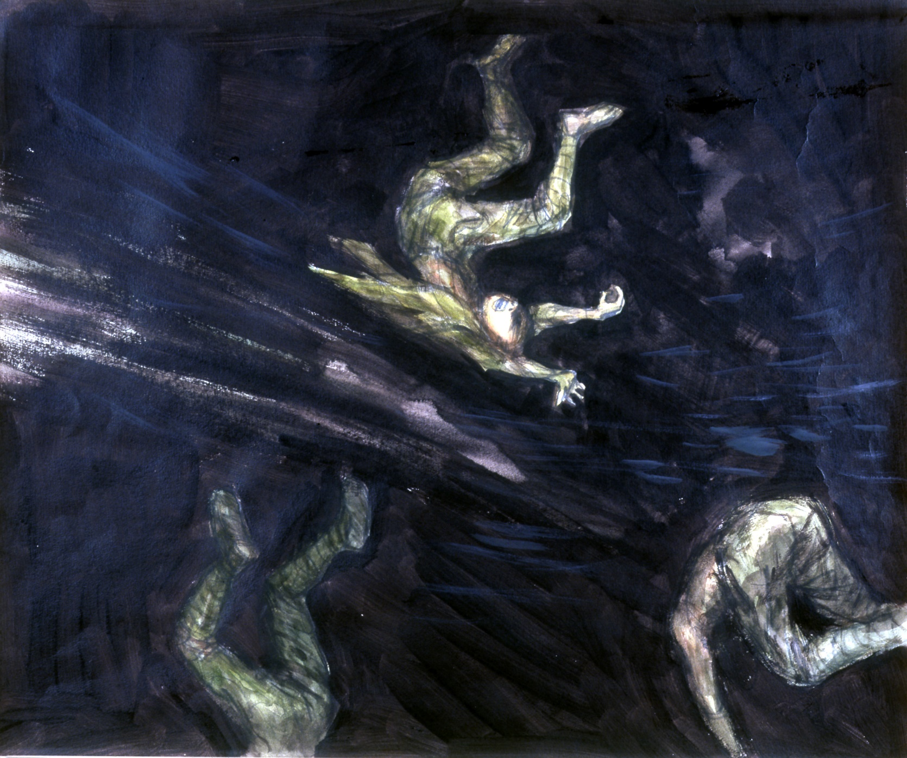

Slide 7
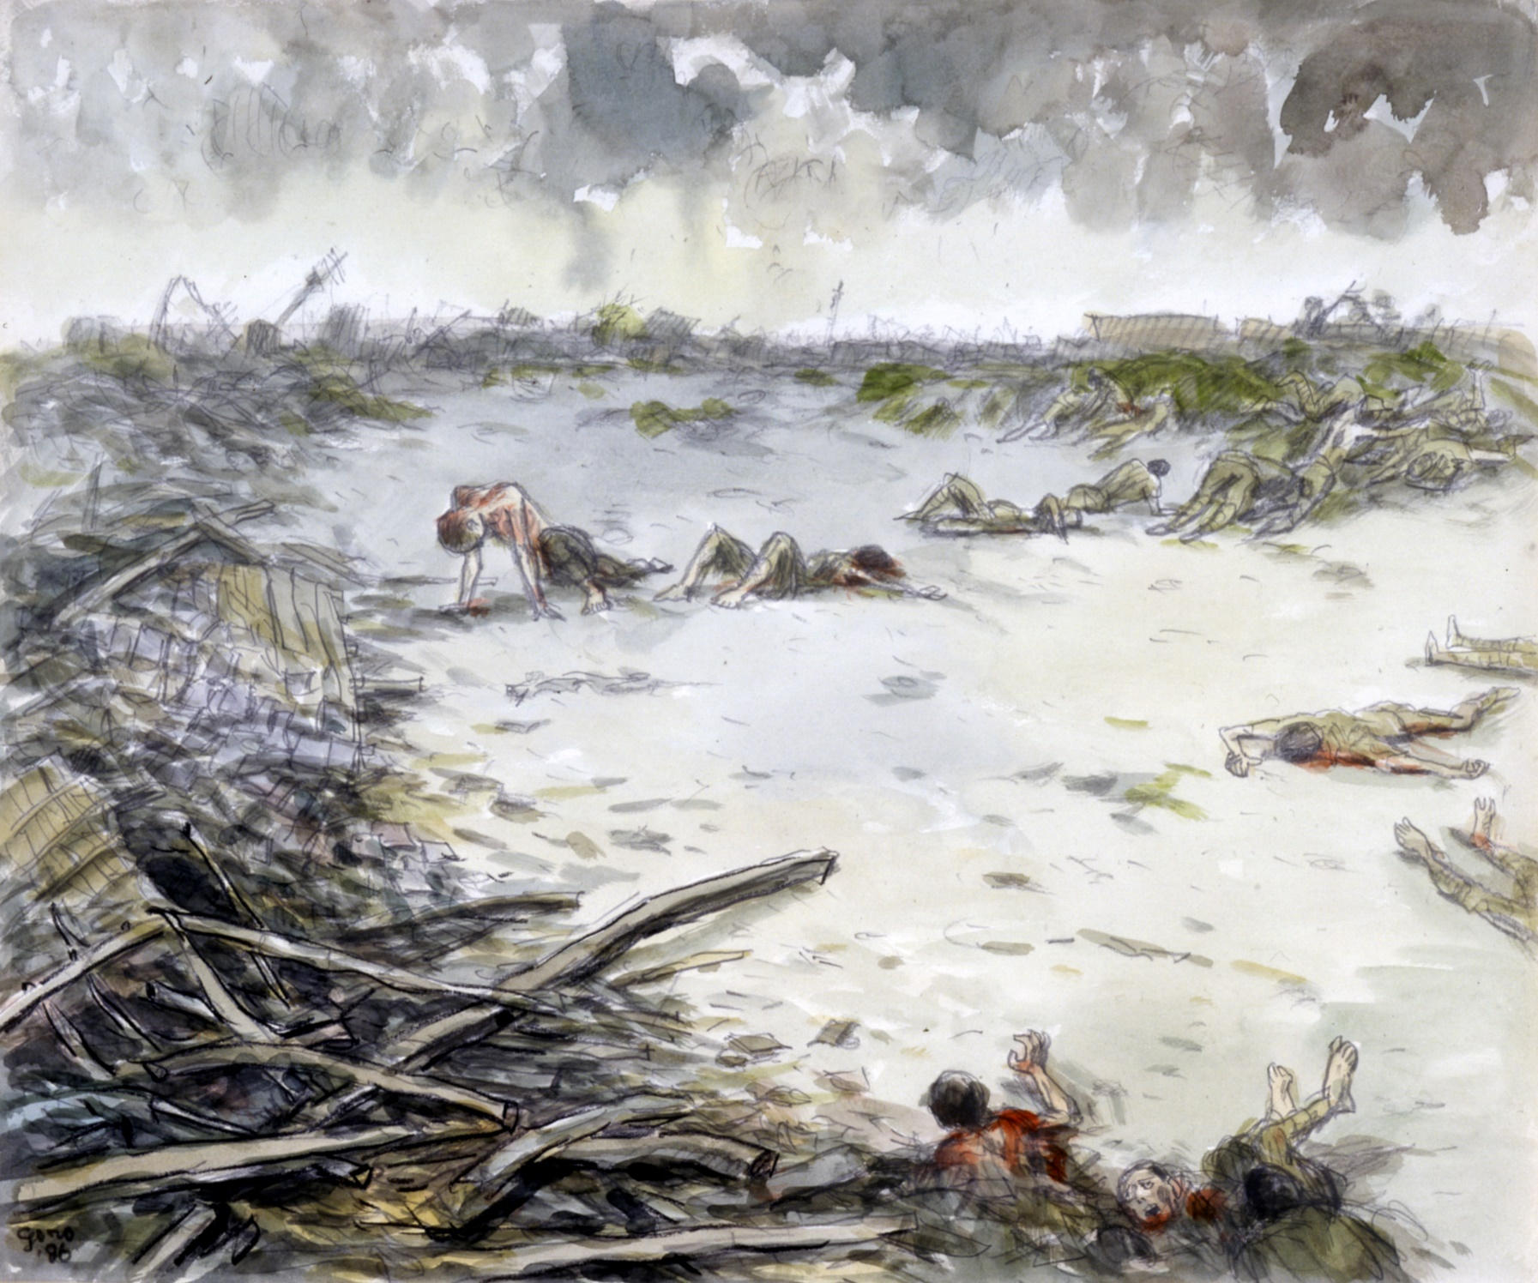

Slide 8
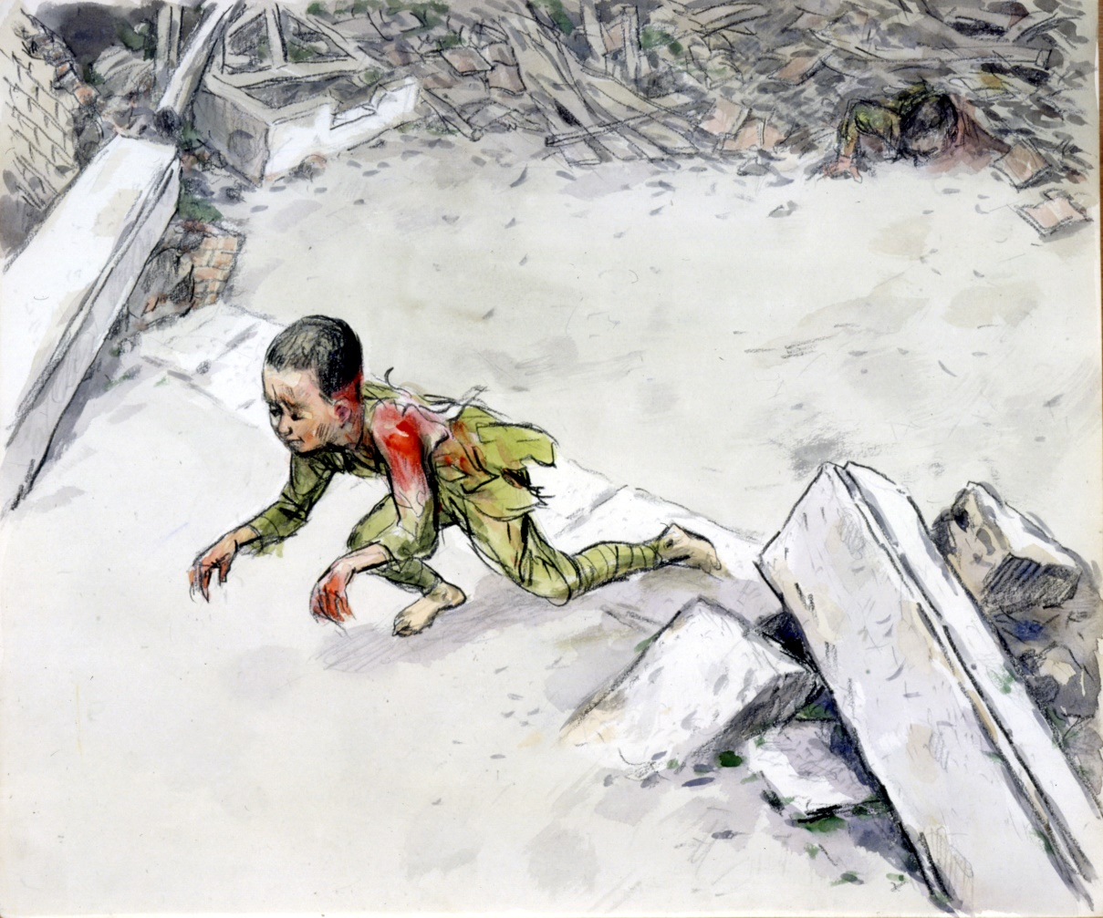
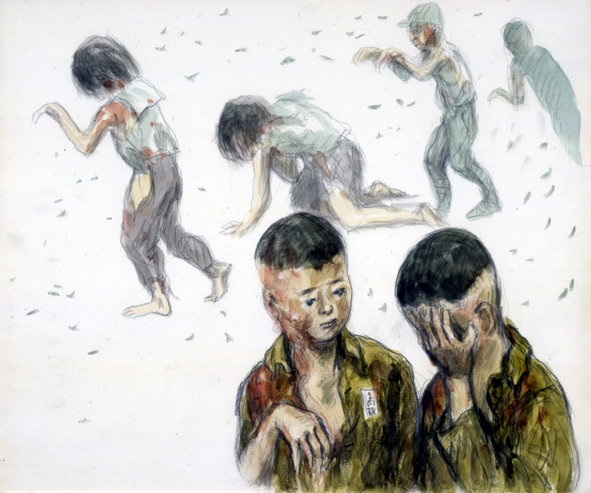

Slide 9
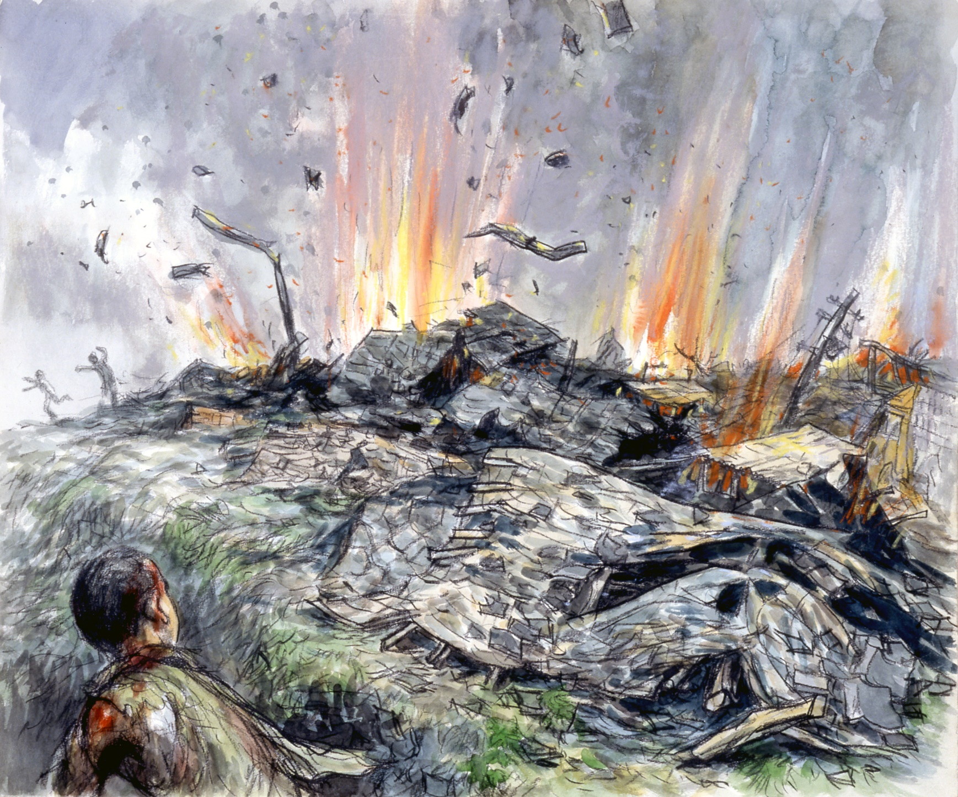

Slide 10
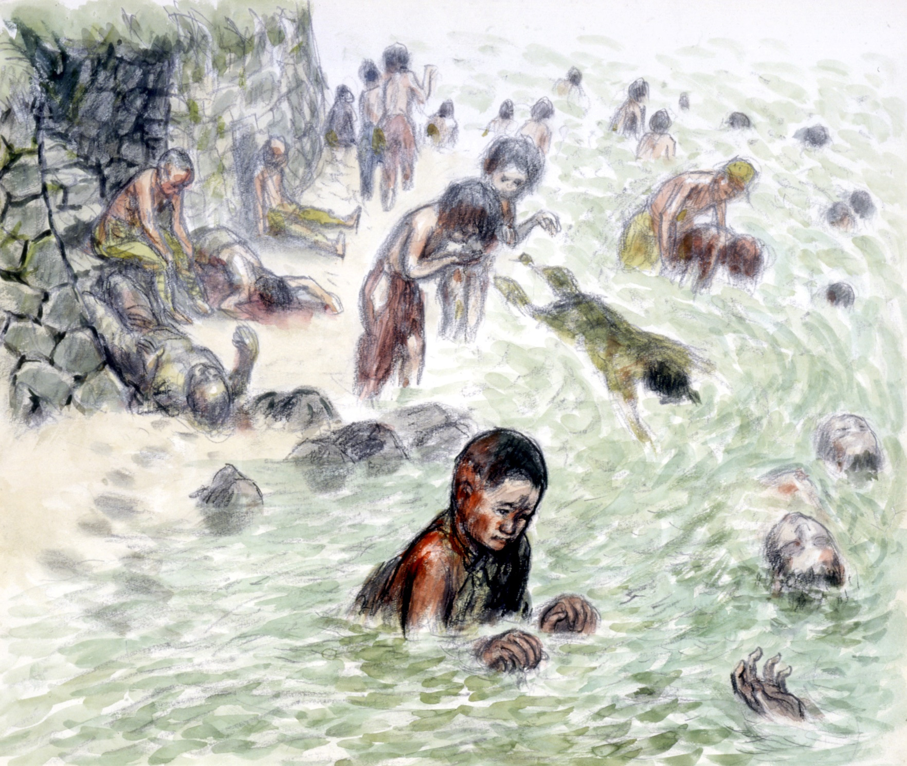

Slide 11
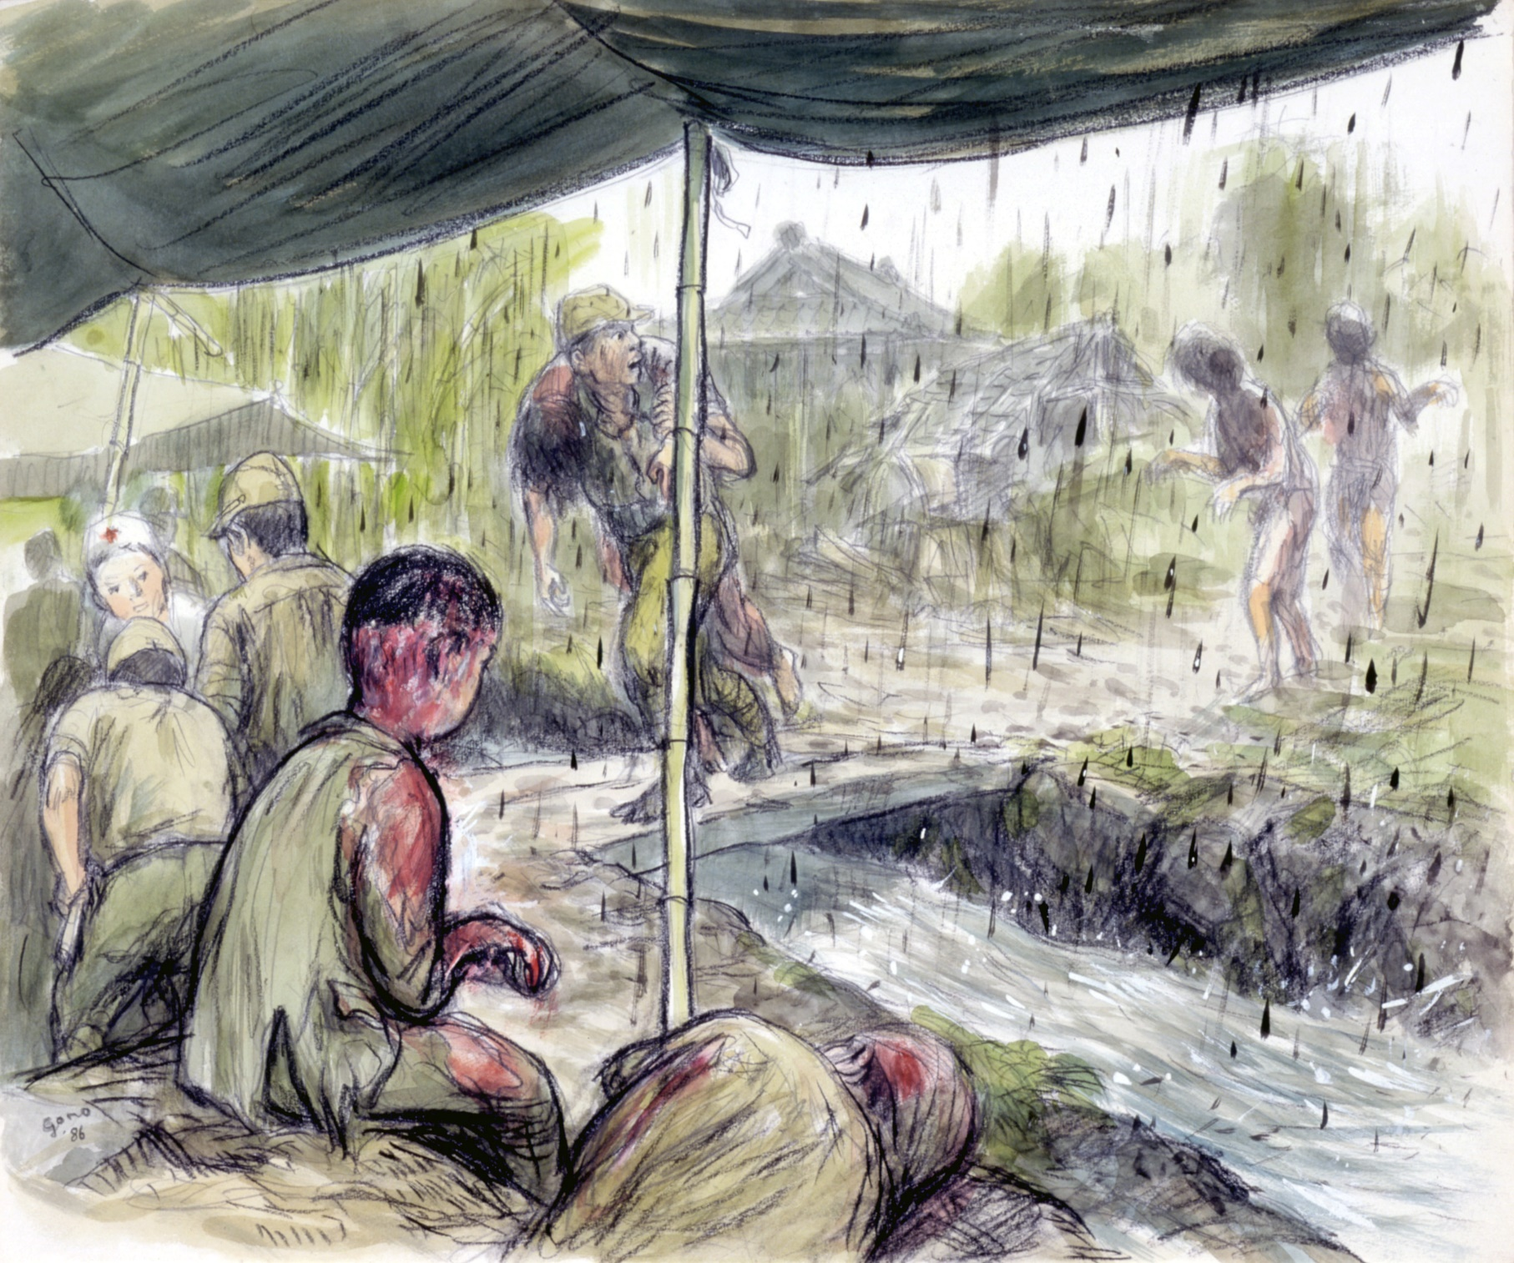

Slide 12
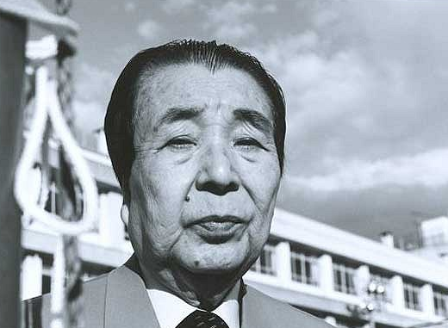

Slide 13
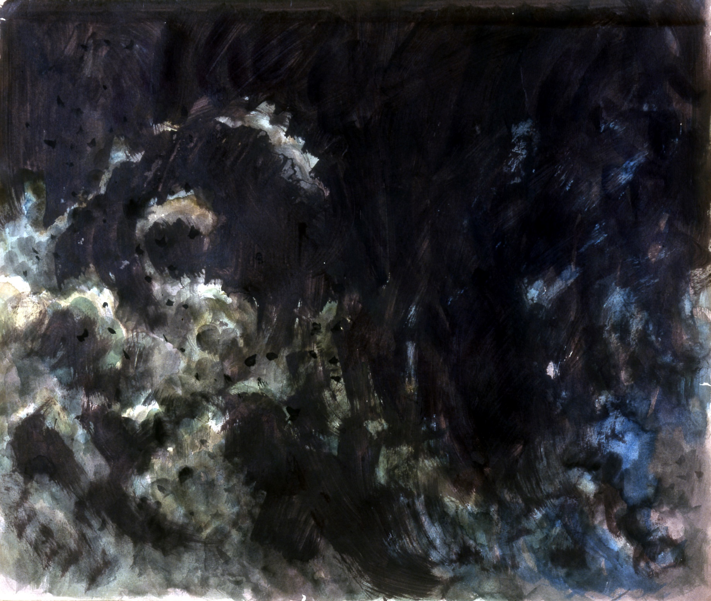
What do you think?
Take 1-minute to silently reflect on what you’ve heard
Write down one word that comes to mind.
    It could describe the atomic bombing of Hiroshima or you own feelings.
    It could also be a bigger concept that you’re thinking about e.g. survival
Notes:
Feedback and write any key concepts on the board.

Slide 14
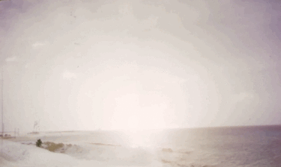
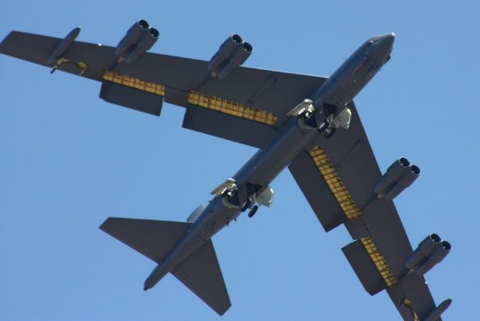
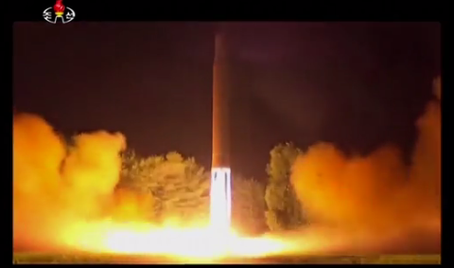
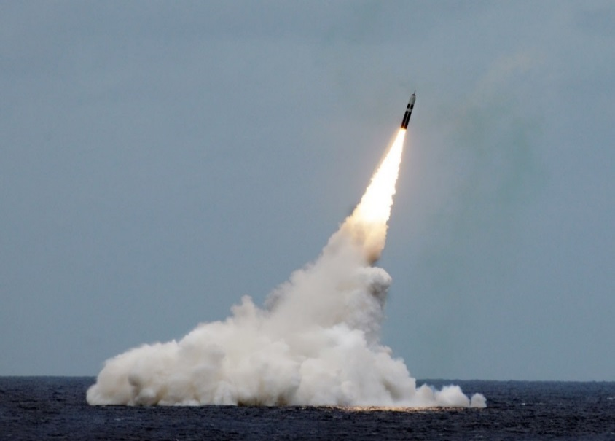
What is a nuclear weapon?
Paul L. McCord Jr. ; https://creativecommons.org/licenses/by-nd/2.0/legalcode
Public domain ; National Museum of the US Navy

Slide 15
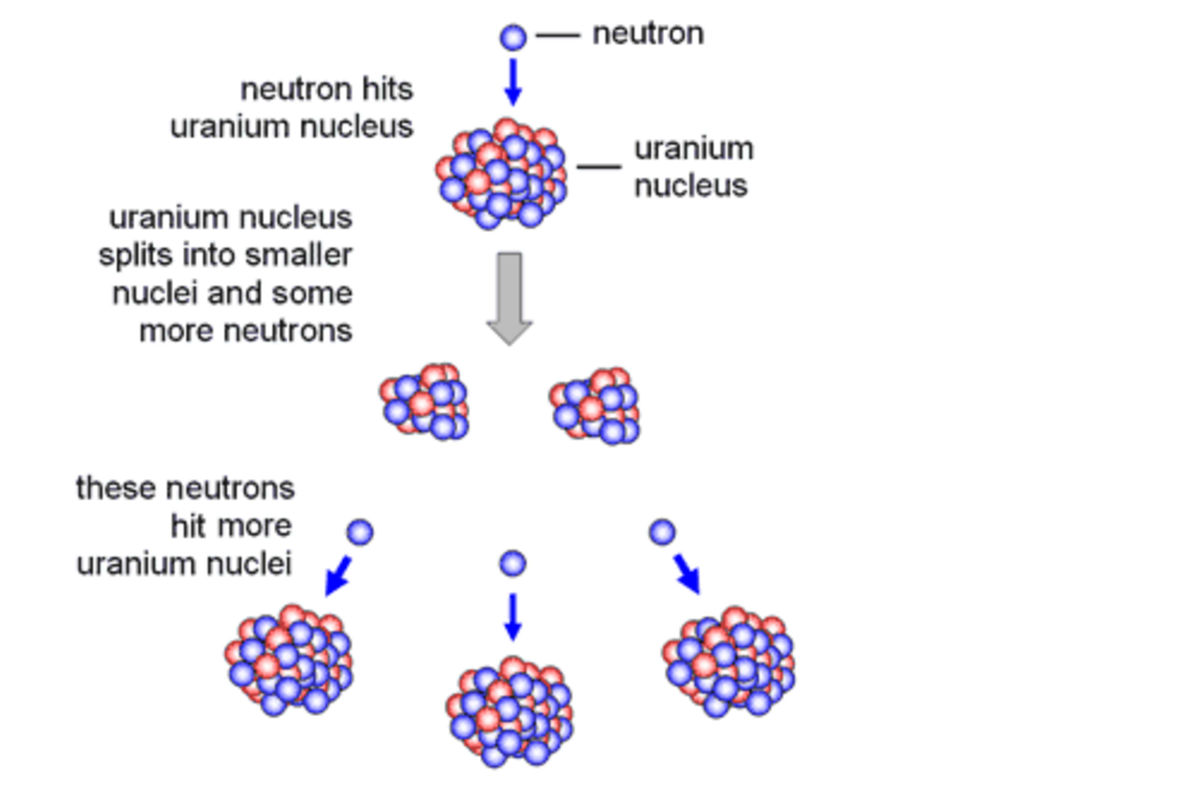
Notes:
Nuclear fission = the splitting of a (heavy) uranium atom by firing a neutron into it. When the uranium splits, more neutrons are released, creating an uncontrollable chain reaction. This occurs in an atomic bomb.

Slide 16
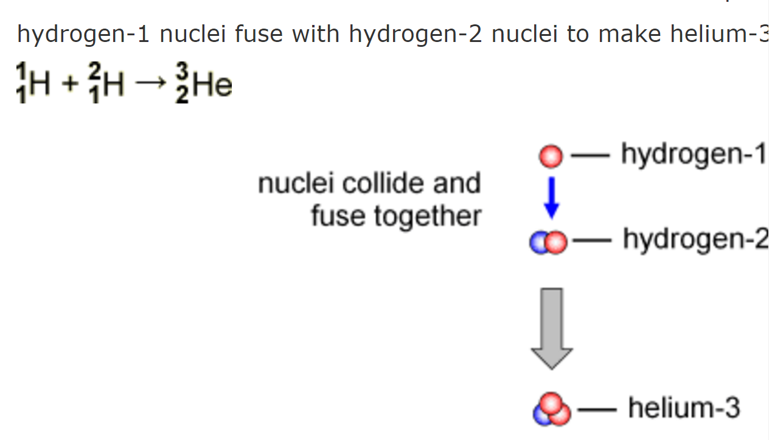
Notes:
Nuclear fusion = the fusing of two hydrogen atoms to make a helium atom. This occurs in the sun, but also in a hydrogen bomb.

Slide 17
Name the 9 countries that have nuclear weapons
Notes:
17

Slide 18
Name the 9 countries that have nuclear weapons
UK
US
France
China
Russia
Israel
India
Pakistan
North Korea
Notes:
18

Slide 19
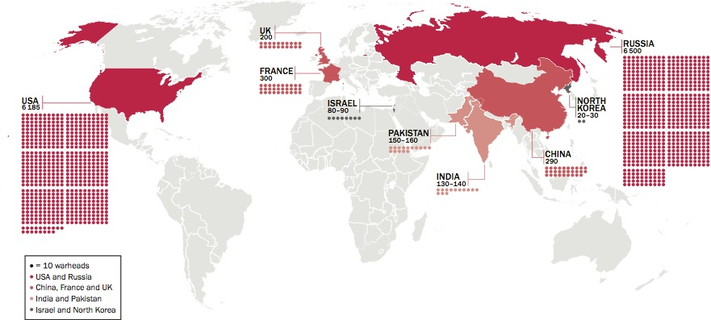
= 13,865 in total!
It’s a lot less than in 1980s, when there were 70,000 warheads (nuclear bombs)!
5000 of the warheads are ‘retired’ and will be got rid of in the next few years.
But lots of the countries are increasing or ‘upgrading’ theirs
Notes:
Graphic: SIPRI

Slide 20
When was the first nuclear bomb used against people?
Where was the first nuclear bomb used against people?
Notes:
A: 1945 (6th August 1945)
A: Hiroshima, Japan

Slide 21
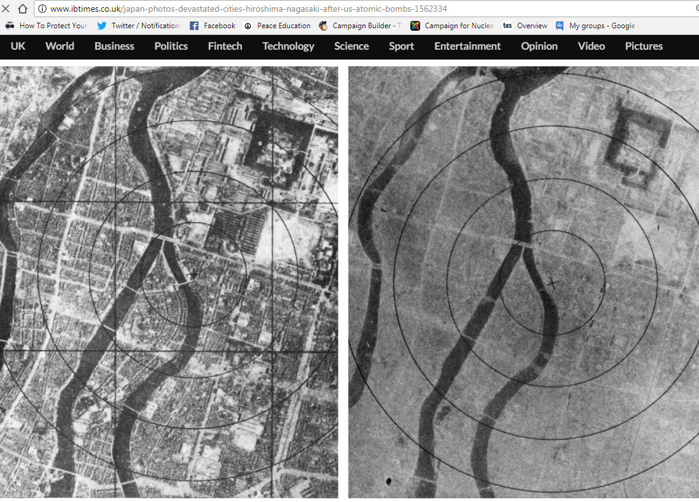
6th August 1945: The bomb is dropped on Hiroshima
Notes:
It was a similar scene in Nagasaki on 9th August.

Slide 22
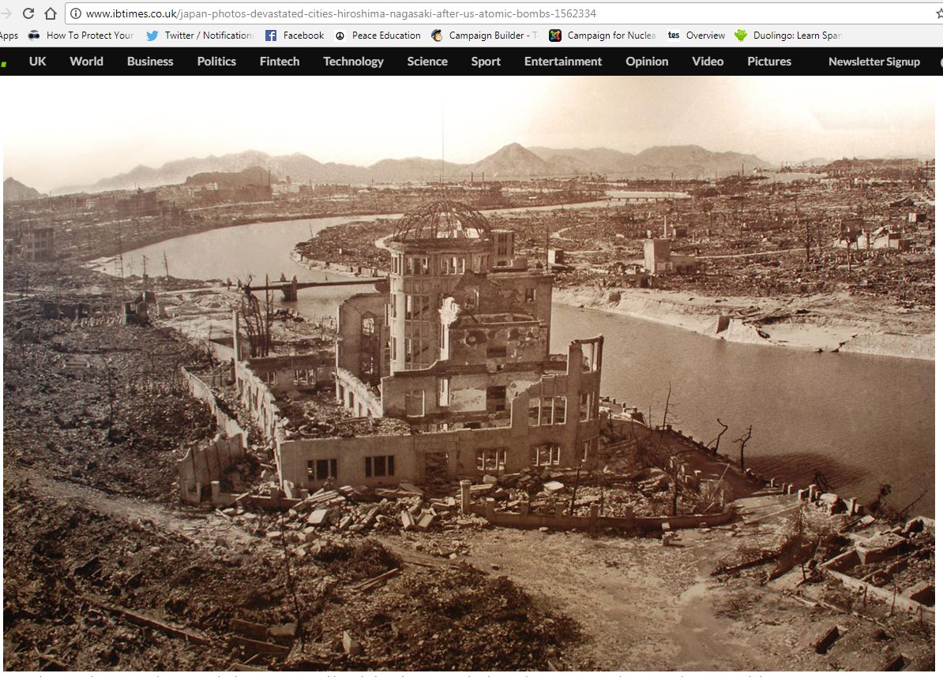
Notes:
This photo was taken after the bombing of Hiroshima. As you can see, only a few buildings are still standing. Between 150,000 and 600,000 people died – some died many years afterwards, from the effects of the radiation.

Slide 23
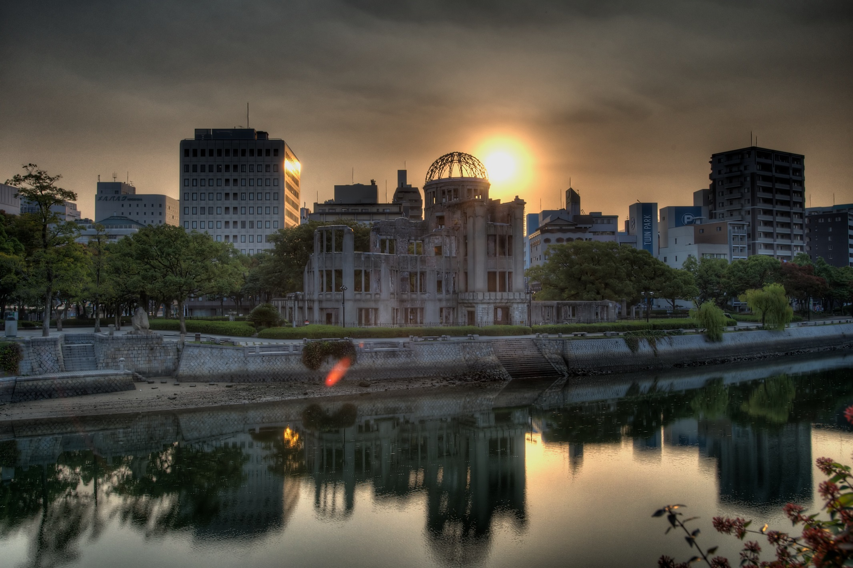
Hairyegg; https://creativecommons.org/licenses/by-sa/2.0/legalcode
Notes:
This shows the remains of the building today. Has anyone been to Hiroshima? Did you see this building, and the Peace Park that it’s in?

Slide 24
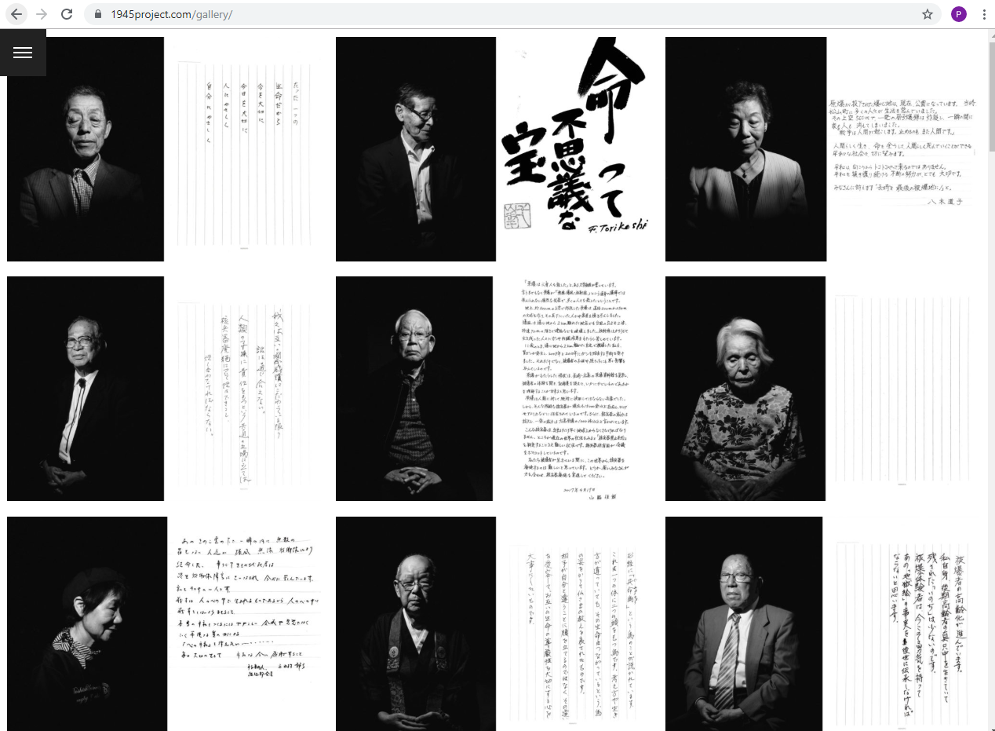
Notes:
www.1945project.com – even people who weren’t alive during the bombings have been affected by the bombs, as the impacts of the radiation have been passed through generations (because radiation can change a person’s DNA).

Slide 25
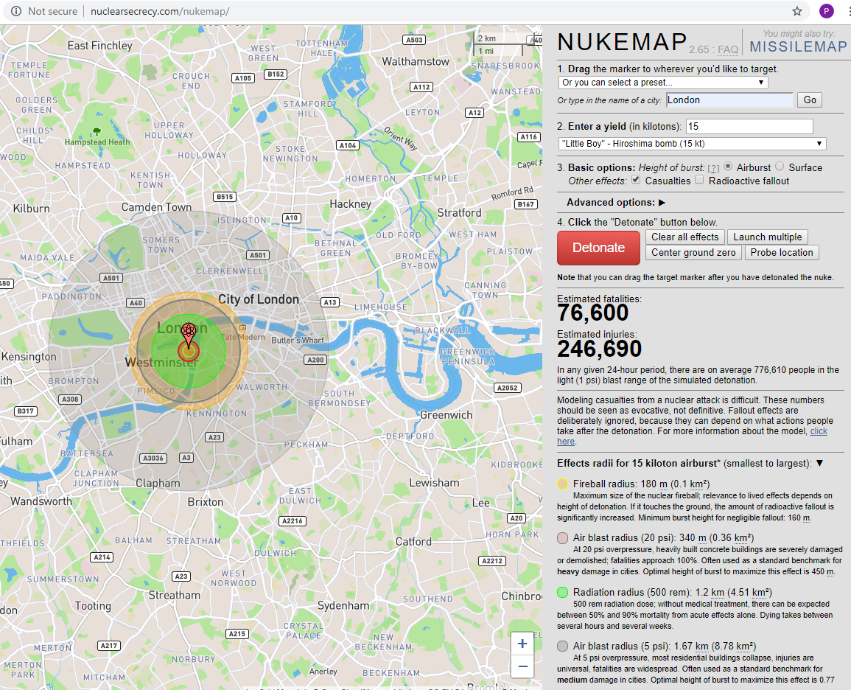
Notes:
Consider using ‘Nuke Map’ (www.nuclearsecrecy.com/nukemap) to simulate a nuclear bomb dropping on your school: how far do the after effects stretch? Pictured is a simulation of the Hiroshima bomb exploding on Big Ben.

Slide 26
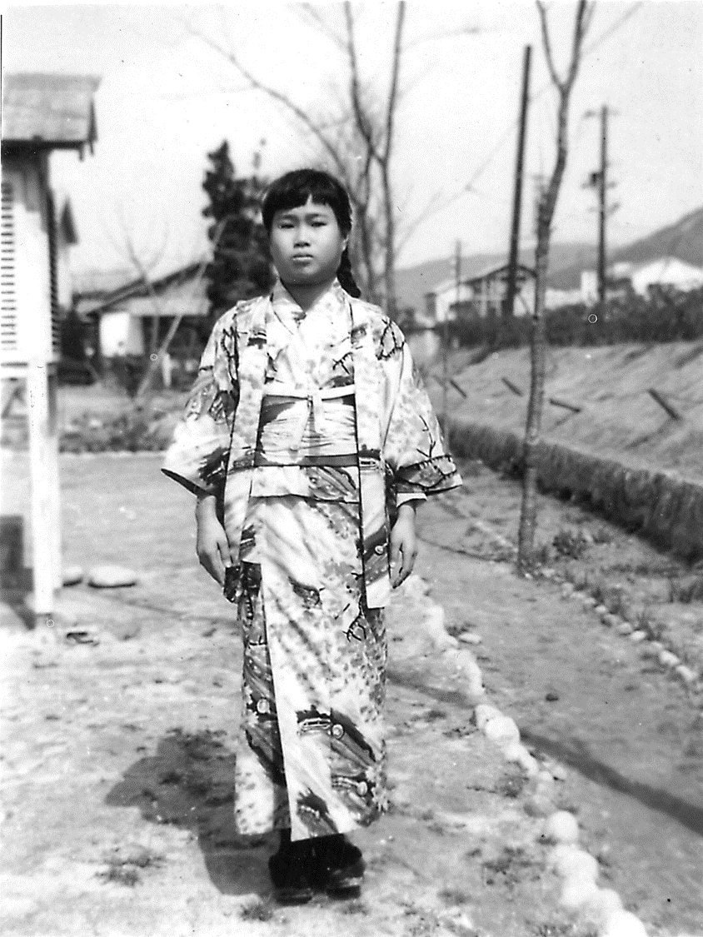
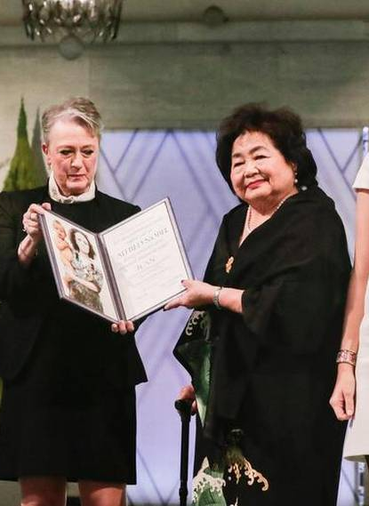
被爆者
Hibakusha
Person affected by the (Hiroshima or Nagasaki) bomb
Notes:
Pictured: Sadako Sasaki, Setsuko Thurlow (accepting the Nobel Peace prize on behalf of the International Campaign to Abolish Nuclear Weapons (ICAN))

Slide 27
被爆者
How many Hibakusha are alive today?
180
1,900
17,000
150,000
The government of Japan have recognised 145,000 living Hibakusha.
But there are Hibakusha in Korea, and all over the world!
Notes:
There is some additional information on Hibakusha in our teaching pack, Critical Mass, on p. 36

Slide 28
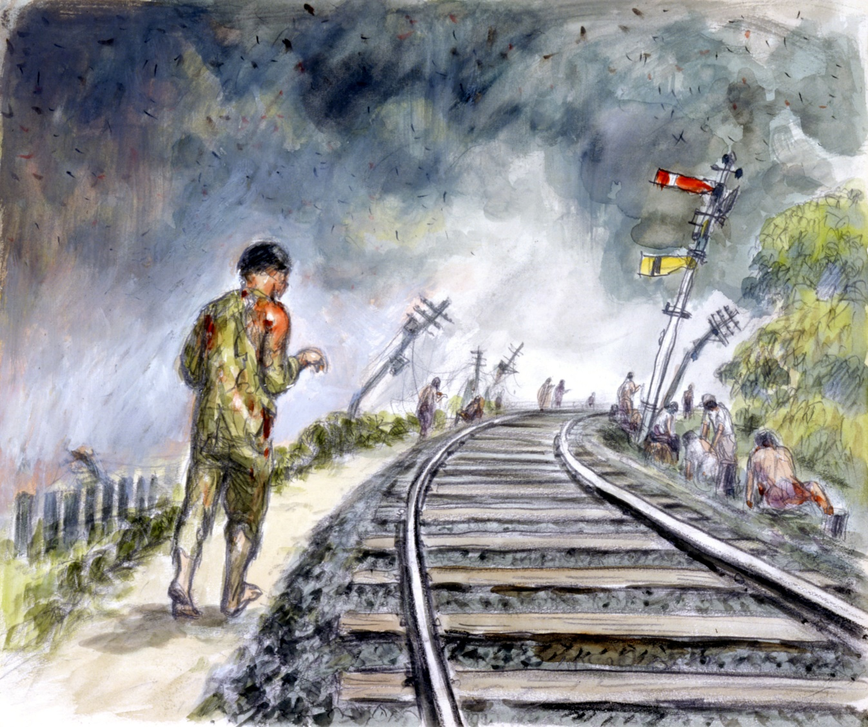
Your task
Reflecting on the testimony we have just read, produce your own artwork in response
You could draw what happened when the bomb exploded, or you could produce something that reflects your feelings about the bombings.
Why not focus on a ‘key concept’ written on the board?
Notes:
You can leave this slide up on the board for the activity, or use one of the illustrations from the testimony, or use the testimony itself, or turn the projector off.

Slide 29
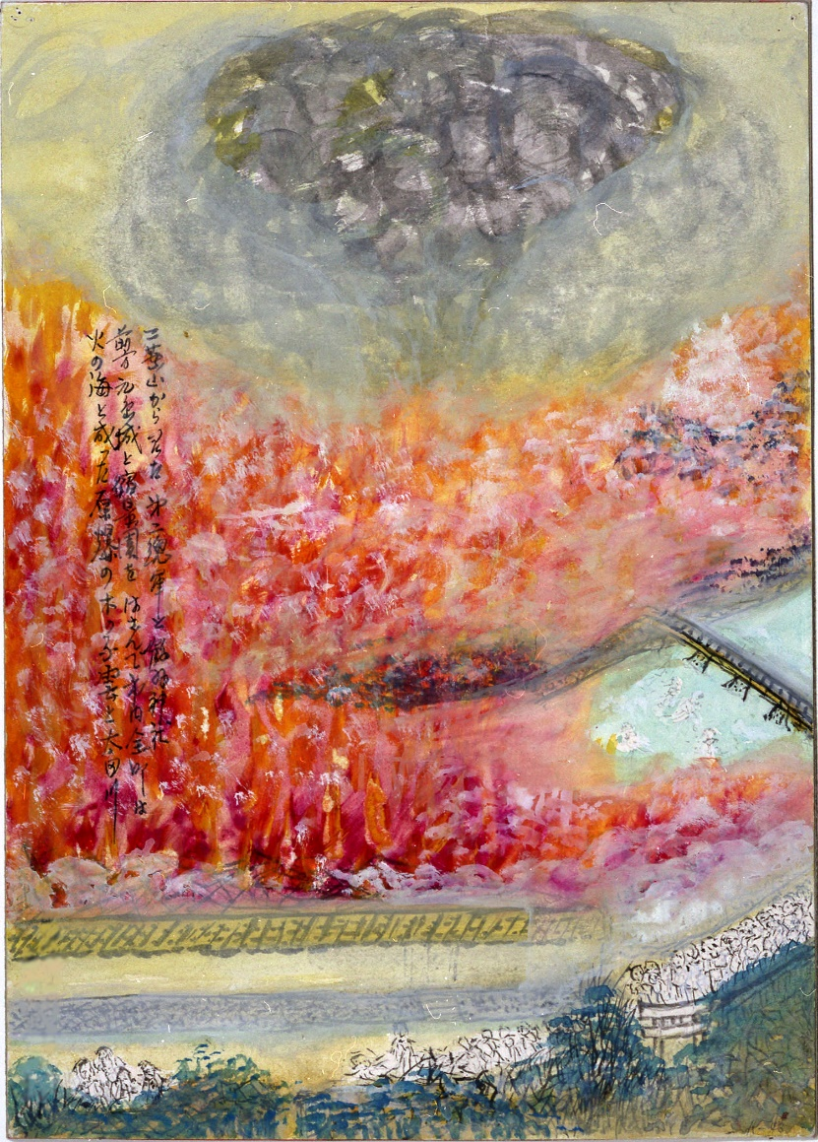
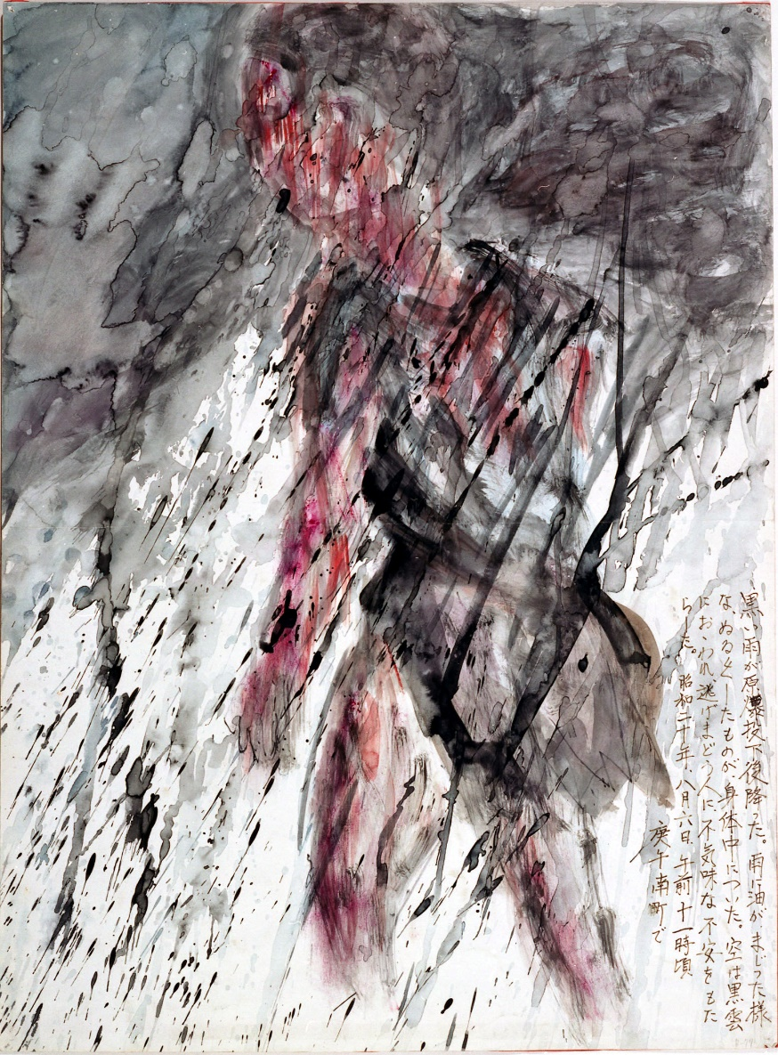
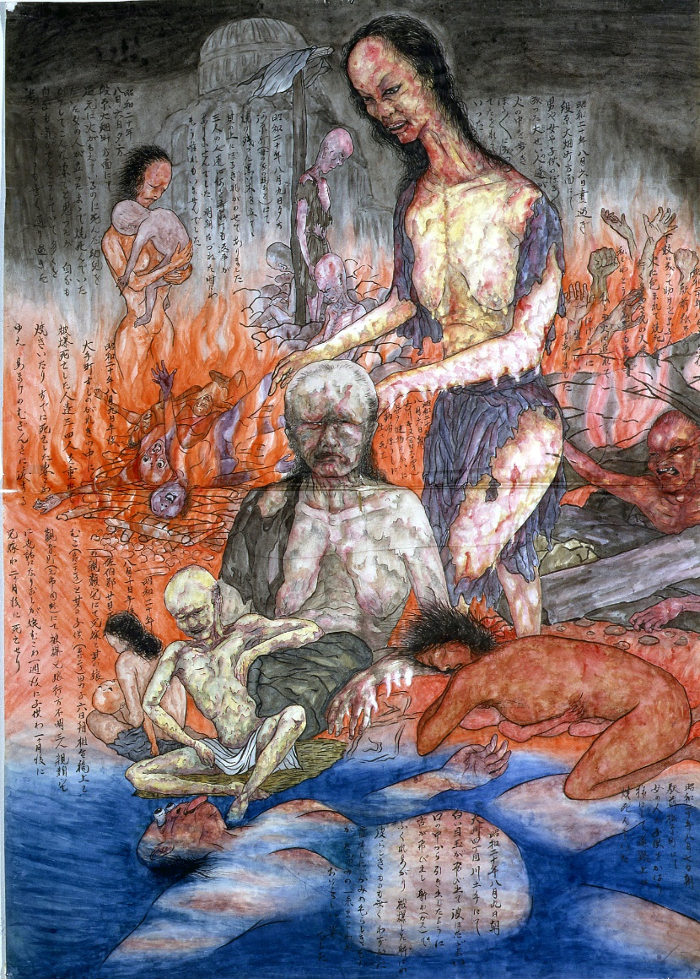
How did your artwork compare to the art of some Hibakusha?

Slide 30
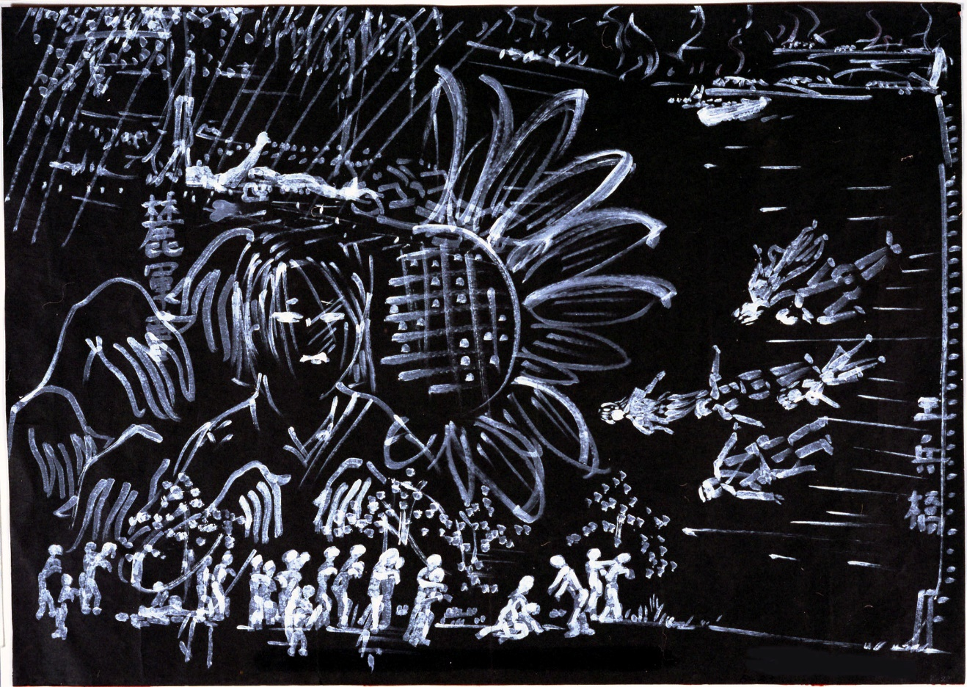
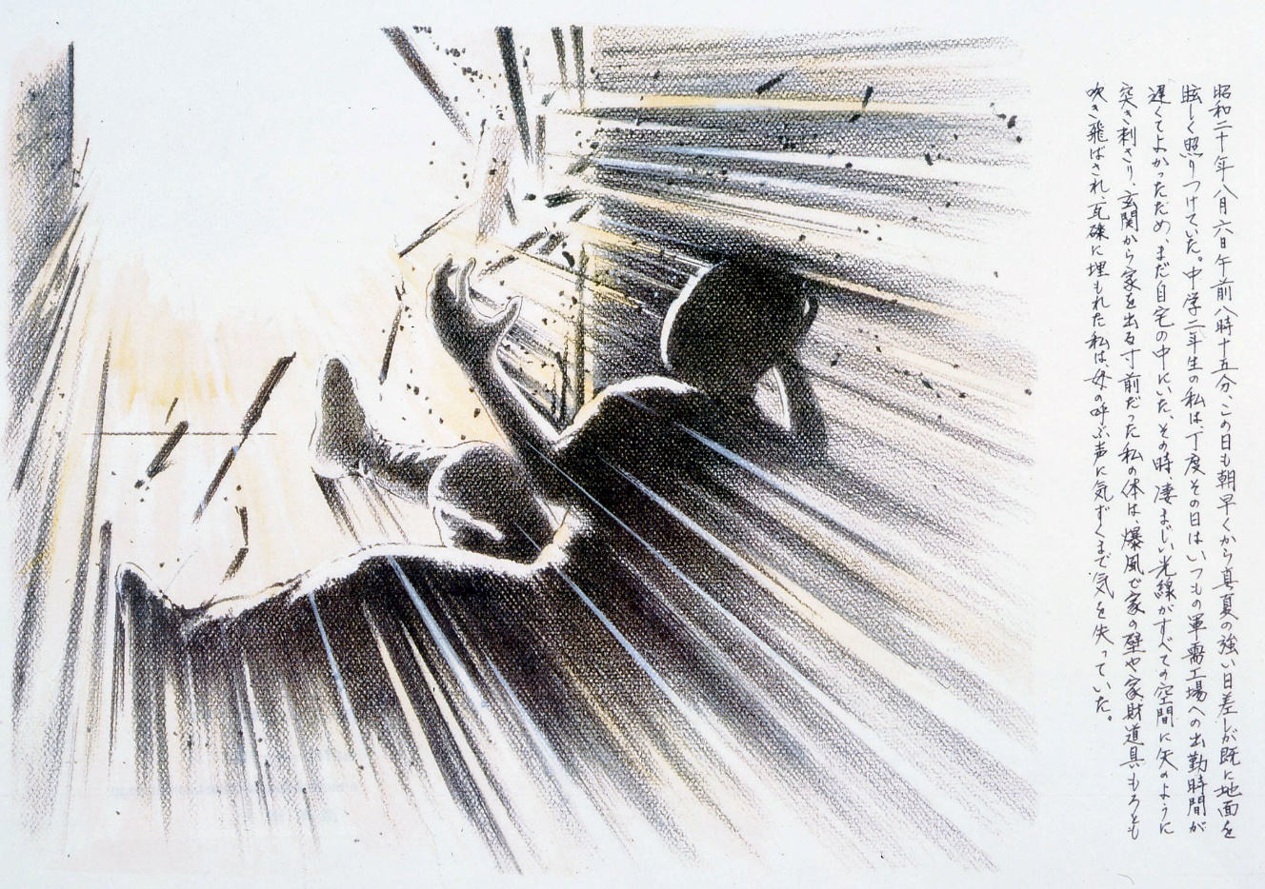
How did your artwork compare to the art of some Hibakusha?

Slide 31
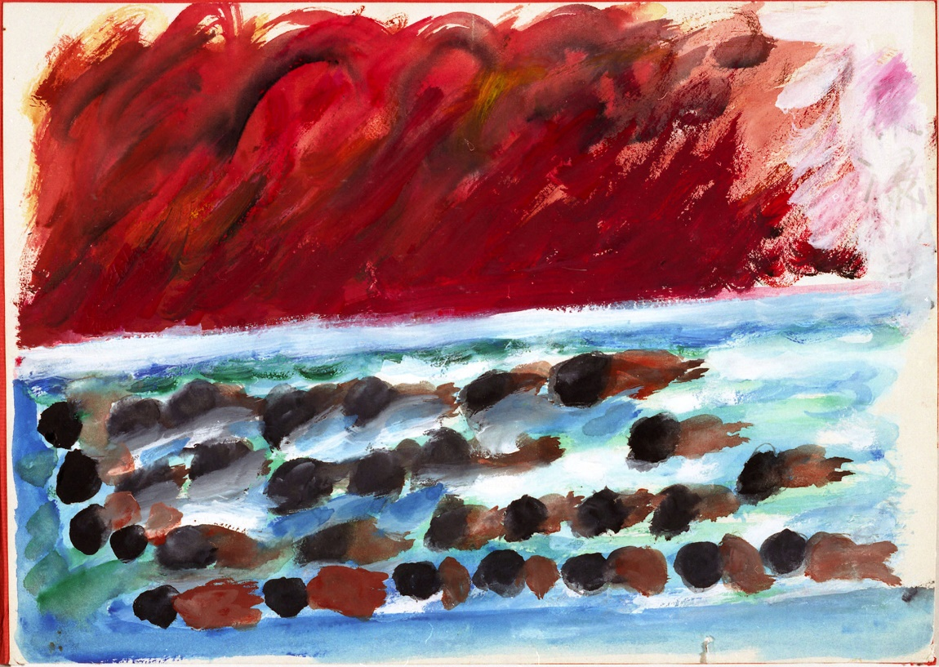
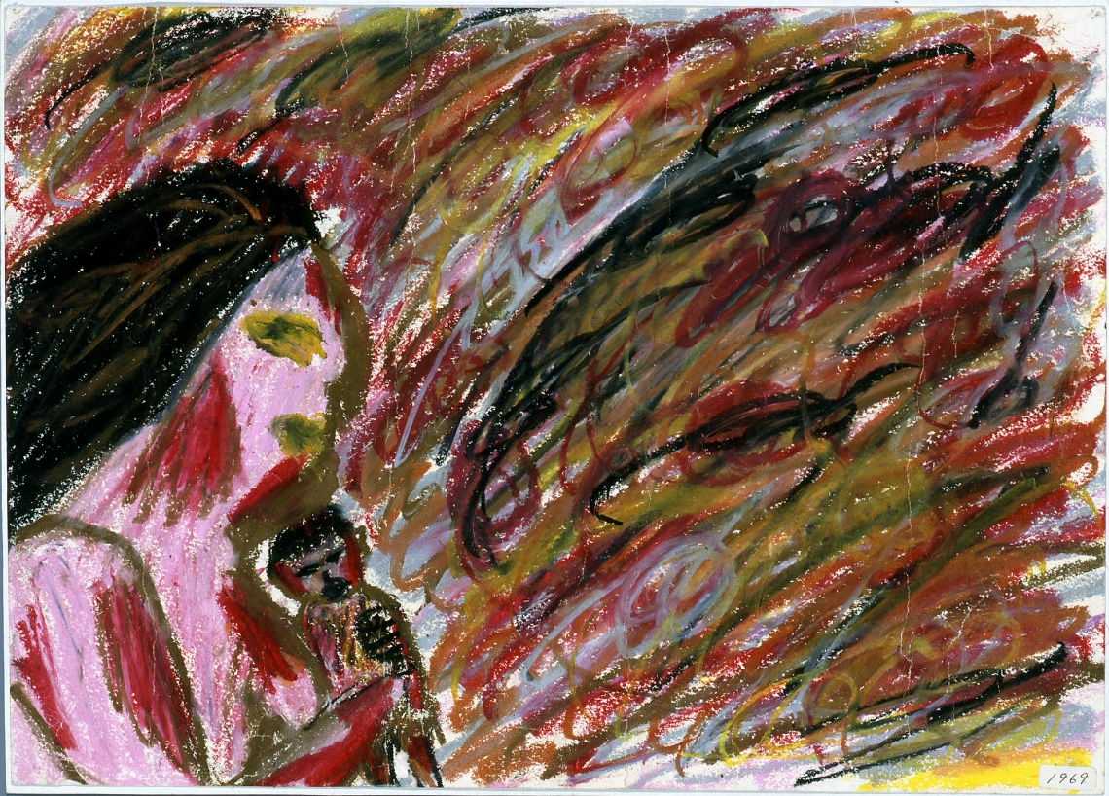
How did your artwork compare to the art of some Hibakusha?

Slide 32
Are these artworks political or personal?

Slide 33
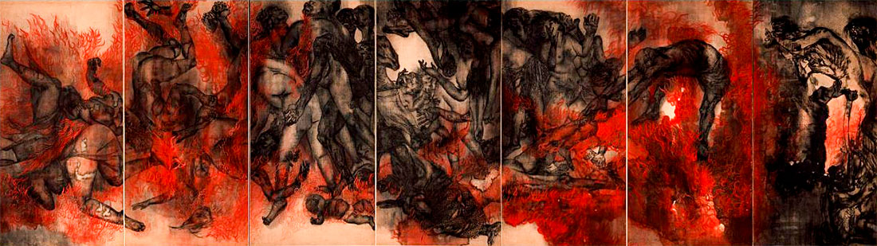
The Hiroshima Panels
15 painted folding-panels made between 1950 and 1982, by Iri and Toshi Maruki.
Notes:
More info in Critical Mass (p. 37)

Slide 34
What do you think?
Notes:
Why did the bombings happen? Should the bombings have happened?

Slide 35
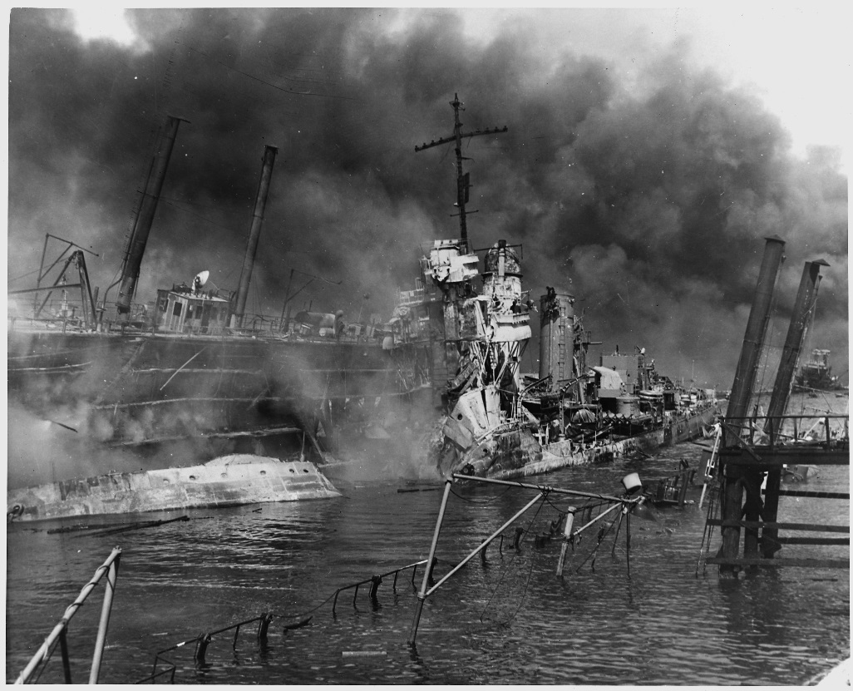
What are the arguments for the atomic bombings?
Saved lives: ended the war ASAP, saving lives overall by avoiding a land invasion
Revenge for Japan’s attack on Pearl Harbour, and for the torture of American prisoners by Japanese soldiers
Once the bomb was developed, it was always going to be used
US National Archives
Notes:
.

Slide 36
What are the arguments against the atomic bombings?
Immoral: Killed 185,000-600,000 people - mostly civilians
Surrender was possible: The US knew that some of the Japanese government wanted to surrender
More about sending a message to the world (and especially the Soviet Union) about how powerful America was
Notes:
.

Slide 37
What we’ve done :
Learnt about the bombings of Hiroshima and Nagasaki, and their effects
Made artwork based on an eye-witness account of the bombing
Compared our artwork with art by Hibakusha

Slide 38
Any Questions?
Notes:
Be aware that Hibakusha is pronounced: he-back-sha

