Slide 1
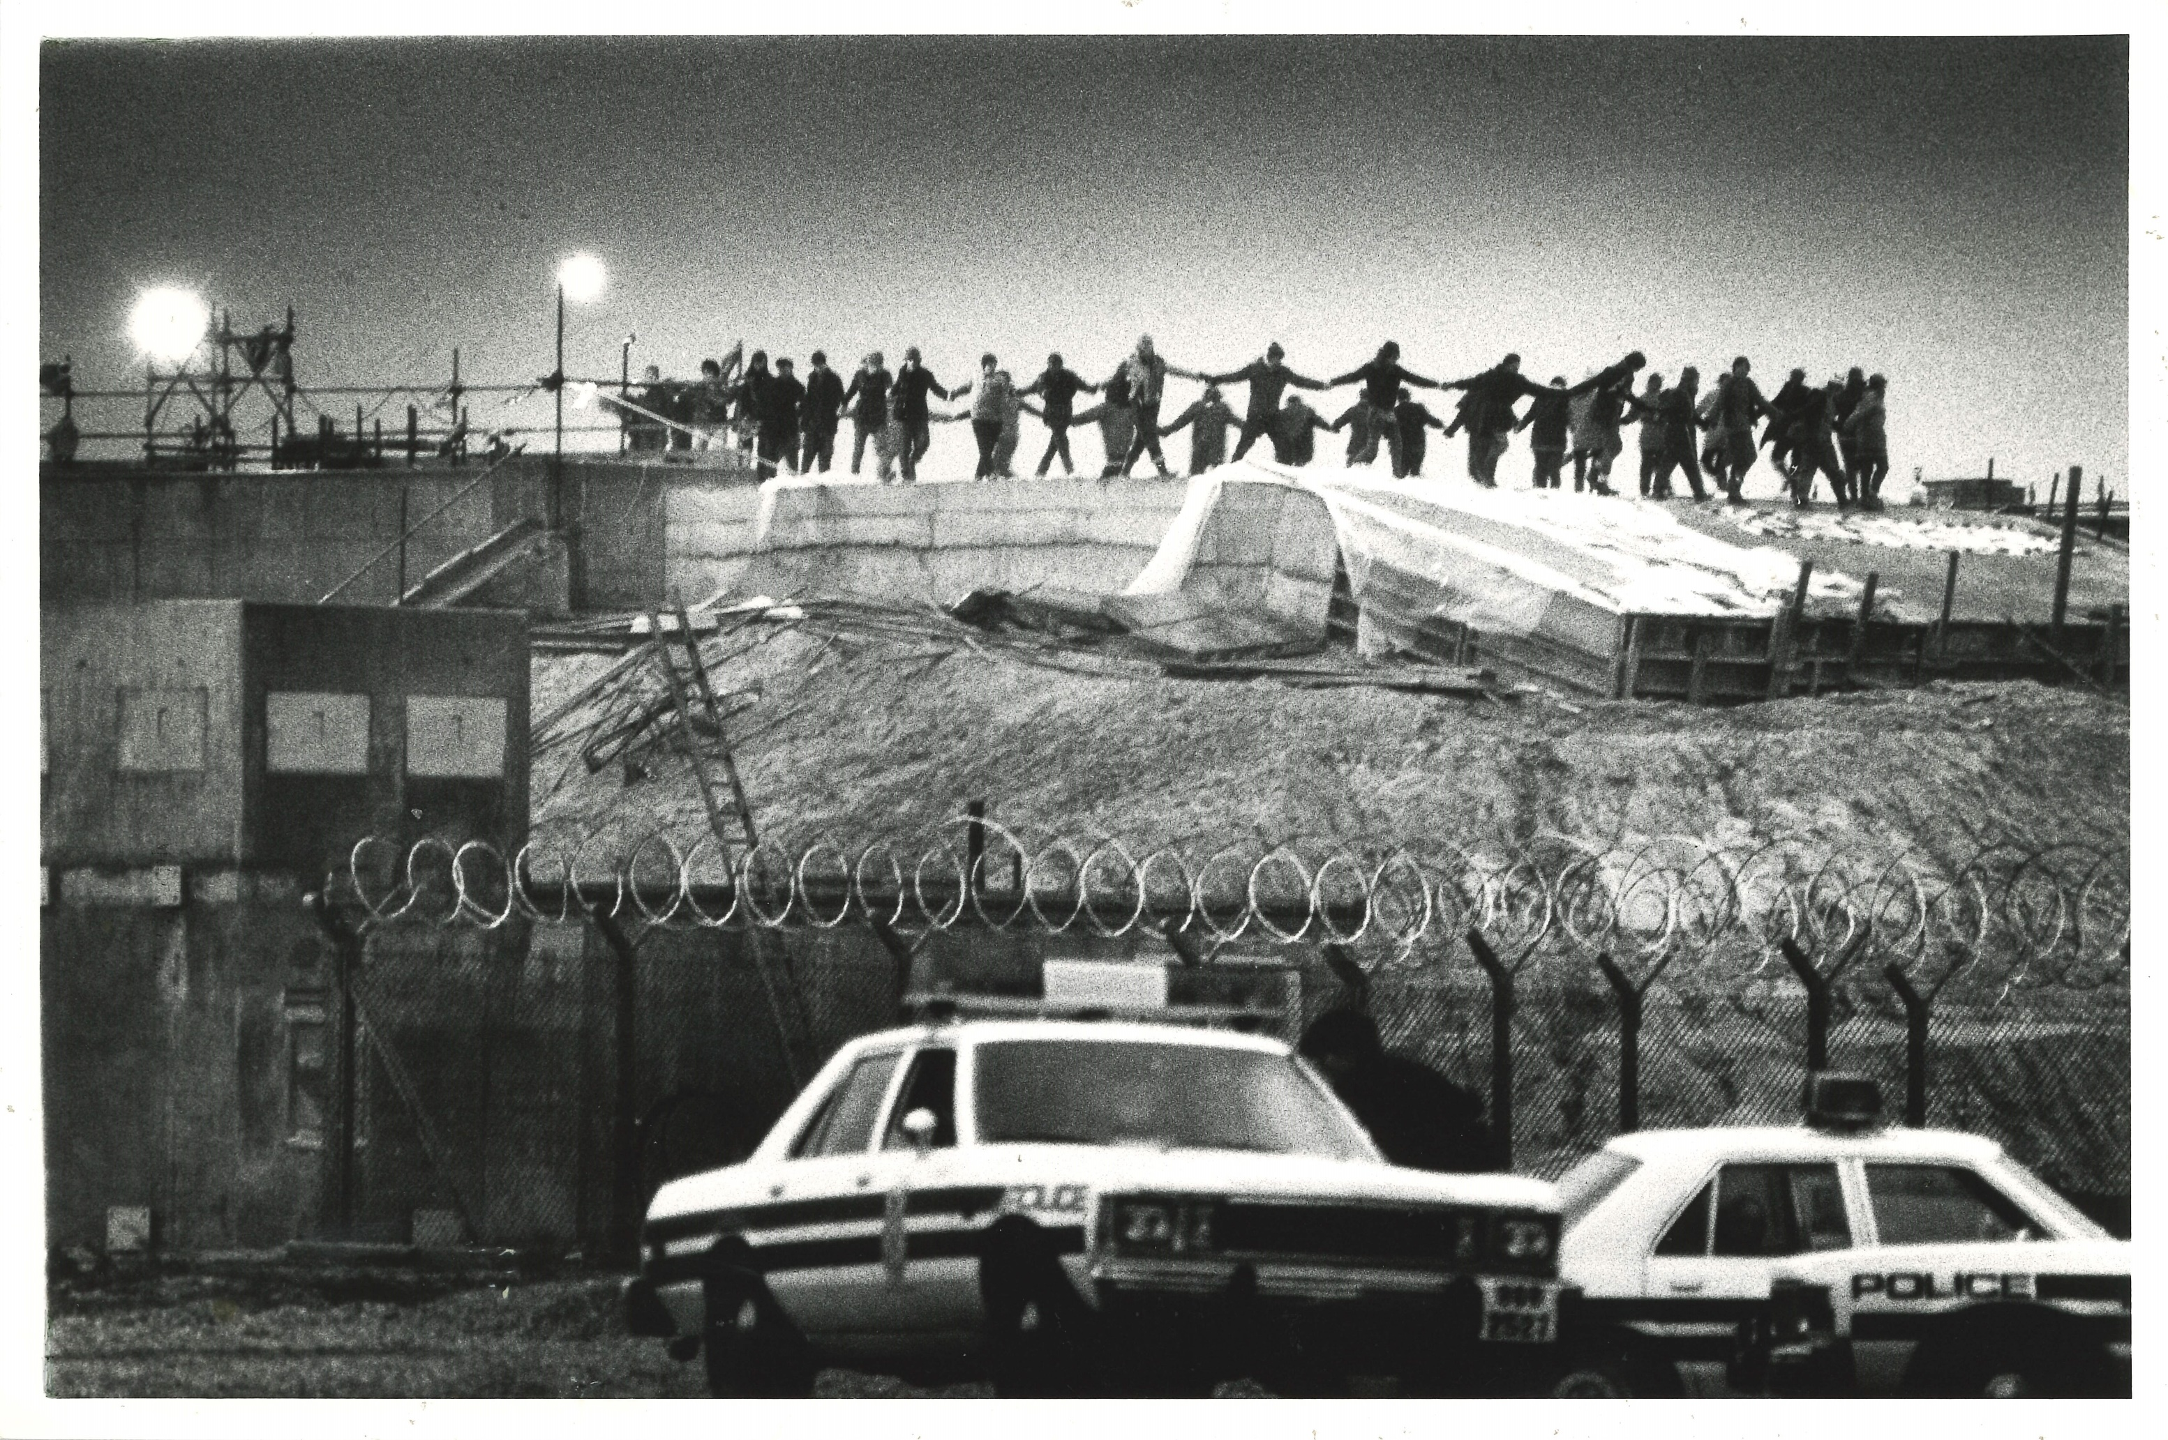
The Women of Greenham Common

Slide 2
Aims of the day
Learn about Greenham Common Peace Camp
Look at historic materials, and explore the key themes in them.
Devise and perform our own short pieces.

Slide 3
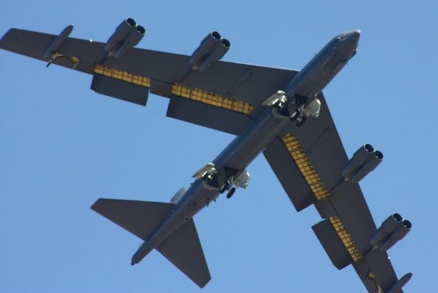
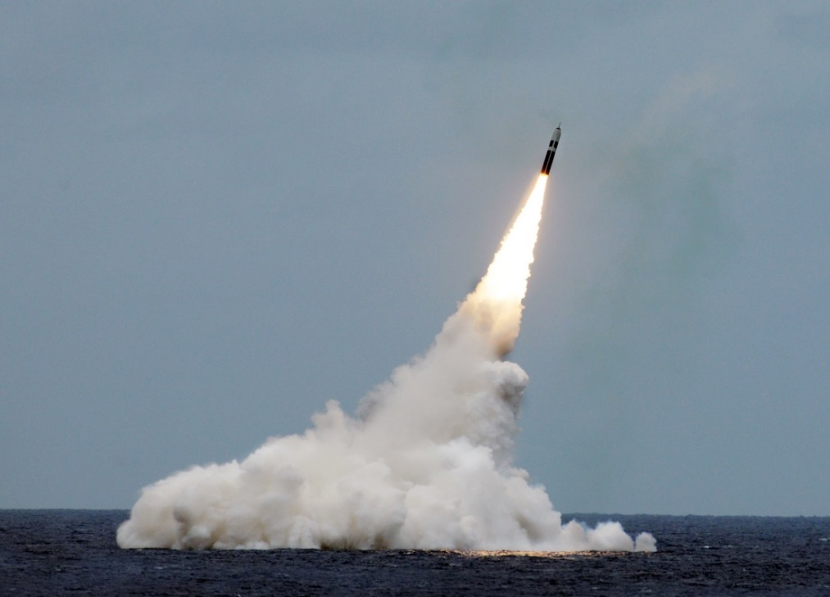
Paul L. McCord Jr. ; https://creativecommons.org/licenses/by-nd/2.0/legalcode ; cropped
Public domain ; National Museum of the US Navy
Notes:
Nuclear weapons can be launched from the ground, air and sea.

Slide 4
5. How many countries in the world have nuclear weapons?
12
9
5
114
Notes:
4

Slide 5
6. Name the 9 countries that have nuclear weapons
Notes:
5

Slide 6
Name the 9 countries that have nuclear weapons
UK
US
France
China
Russia
Israel
India
Pakistan
North Korea
Notes:
6

Slide 7
7. How many nuclear weapons are there in the world?
200
1250
14,000
67,000
Notes:
7

Slide 8
= 12,121 in total
Almost 4000 of them could be used at short notice; 5600 are in storage; and 2500 are ‘retired’ and will be dismantled in the coming years.
Big decrease since the 1980s (70,000 warheads!), and 400 less than last year
This is the first time since 1999 that India’s stockpile has surpassed Pakistan’s. China is expanding its nuclear arsenal faster than any other country (from 410 in 2023 to 500 in 2024

Slide 9
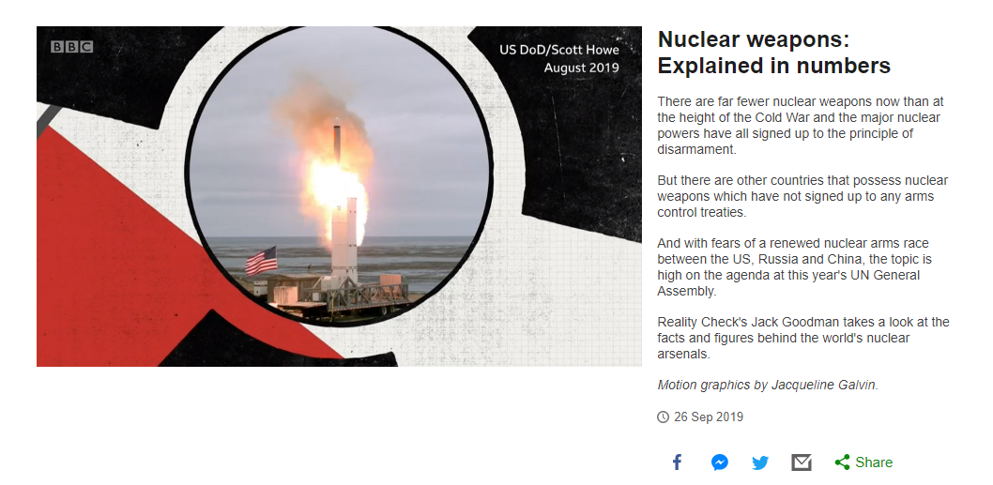
Notes:
https://www.bbc.co.uk/news/av/world-49755995/nuclear-weapons-explained-in-numbers
Play from 0.30-2.26

Slide 10
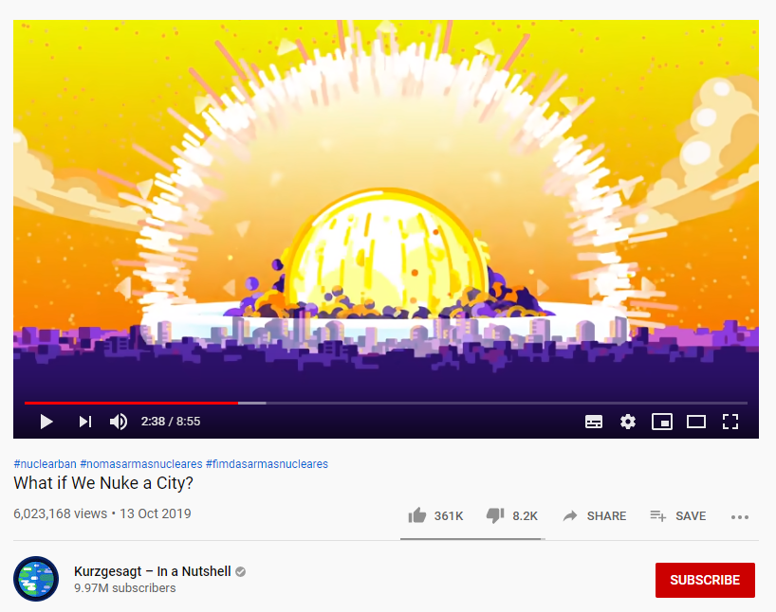
Notes:
https://www.youtube.com/watch?v=5iPH-br_eJQ
Watch first 4.5 mins or so.
We recommend watching this video before the lesson to decide whether it is appropriate for your classroom.
This video simulates a 150-200kt nuclear weapons explosion, which is the strength of an ‘average’ modern nuclear weapon.

Slide 11
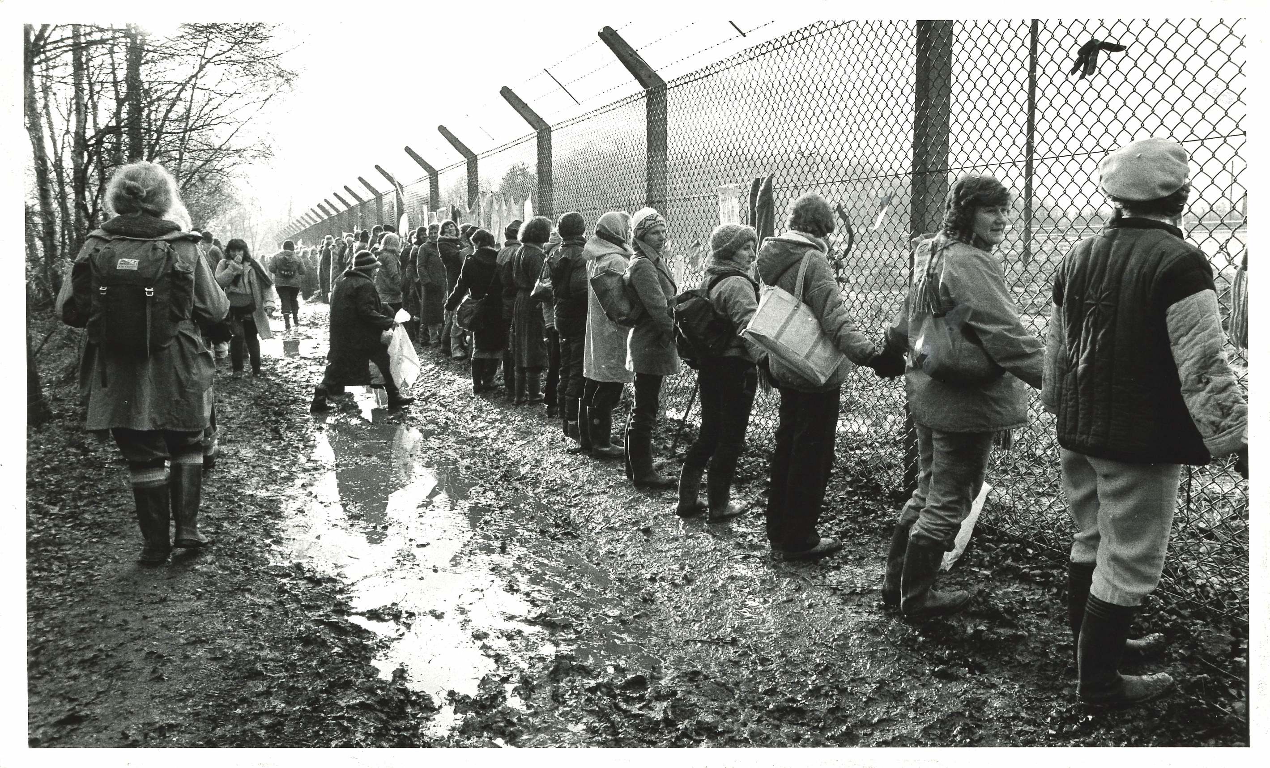
Starter:
Consensus Building

Slide 12
Building Consensus Task
By yourself and in silence, answer the following question in your head (1 minute):
In groups of three, decide which of your animals is the best answer to the question (3 mins). You can only take one answer forward!
Repeat this process in larger groups…
Which animal would host the best dinner party?
Notes:
You can repeat the exercise either until 10 minutes have elapsed, or until the whole class is talking as one big group.

Slide 13
What was good about this form of decision-making?
How did you find that?
Can you think of any limitations to make decisions using consensus?

Slide 14
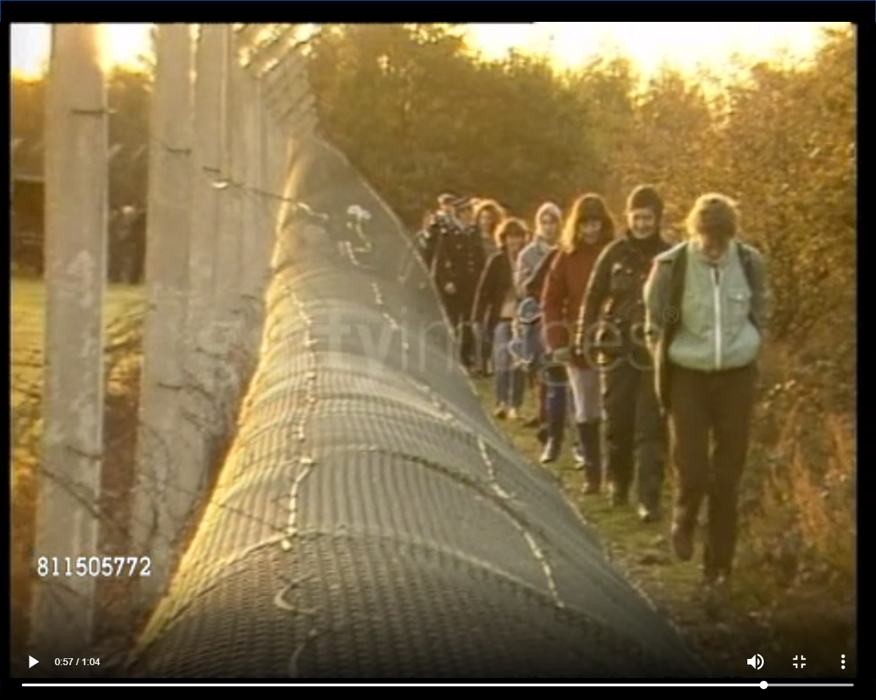
Notes:
https://www.gettyimages.co.uk/detail/video/greenham-common-england-berks-greenham-common-women-news-footage/811505772

Slide 15
A Peace Camp
Notes:
What is direct action?

Slide 16
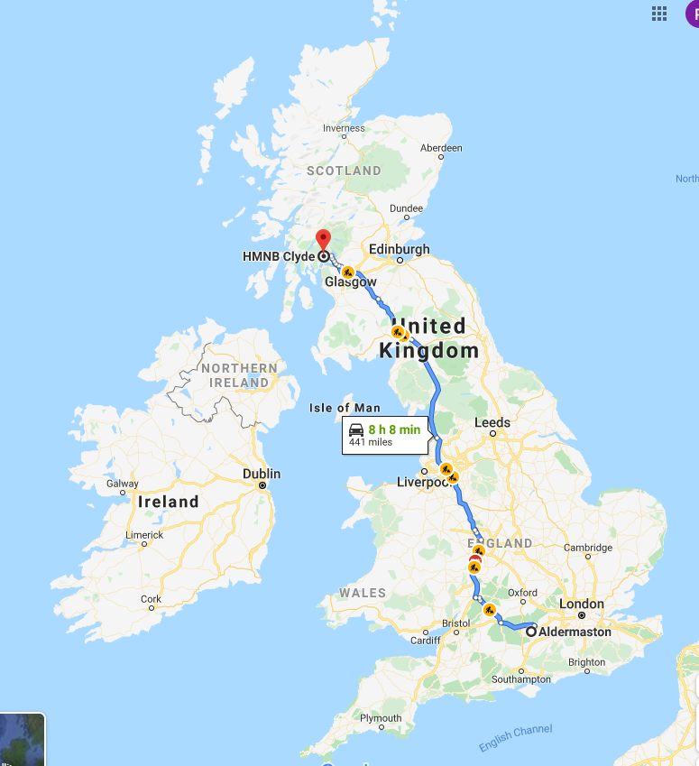
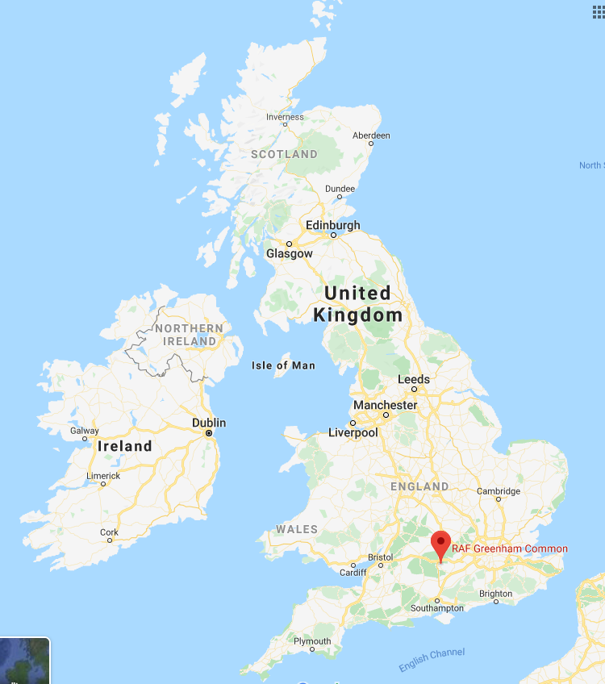
Greenham and Crookham Commons form the largest continuous tract of open heath in Berkshire. It is special for the mix of purple and pink heathers and golden yellow gorse, wildflower-filled grasslands and expanses of bare gravels
Notes:
Image shows Greenham Common now (well, a part of it!). The map shows the route from nearby Aldermaston (where UK nuclear weapons are produced), to HMNB Clyde, near Faslane, where UK nuclear weapons are mounted on to submarines.

Slide 17
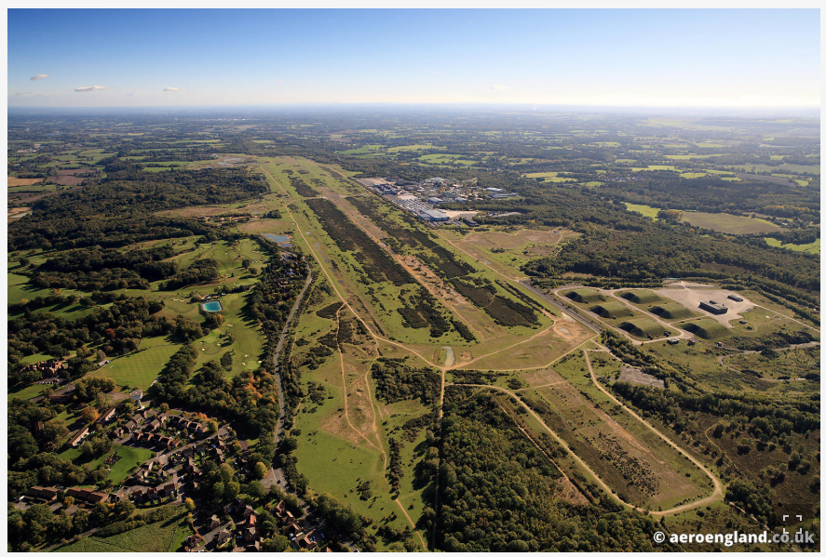
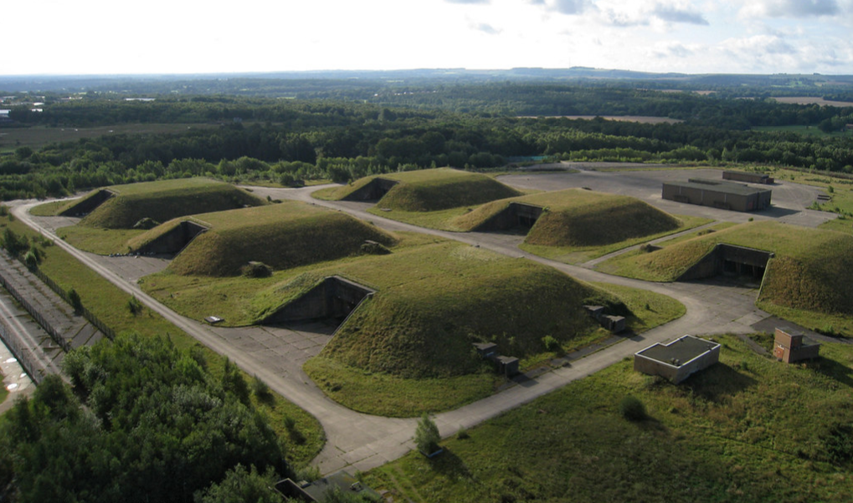
Notes:
This is also what Greenham Common looks like today: can you see the runways and bunkers?

Slide 18
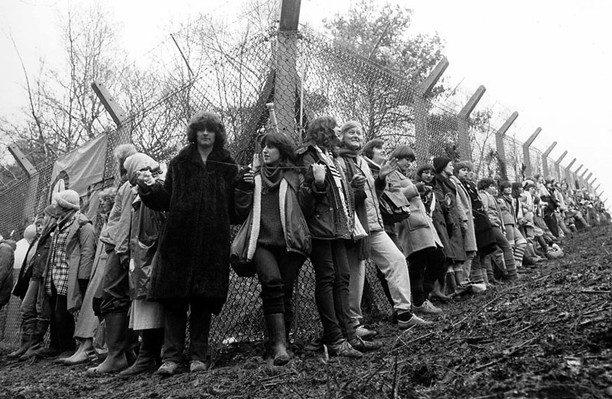
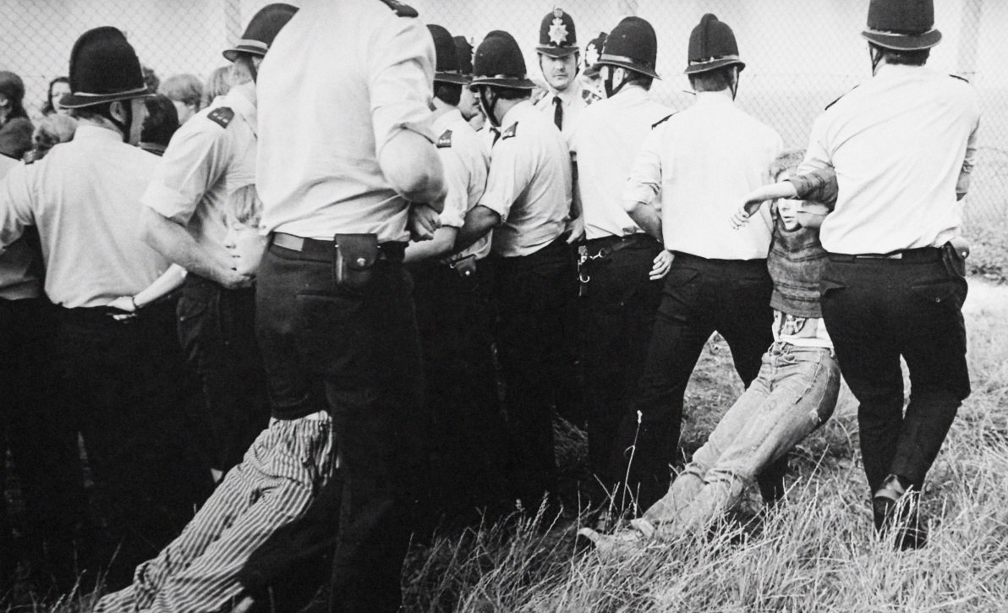
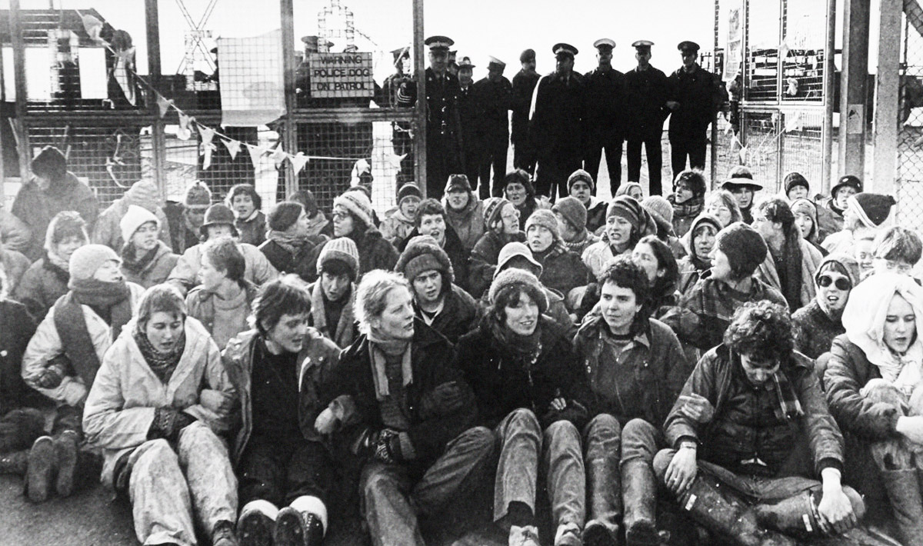
Greenham Common wasn’t always so quiet!

Slide 19
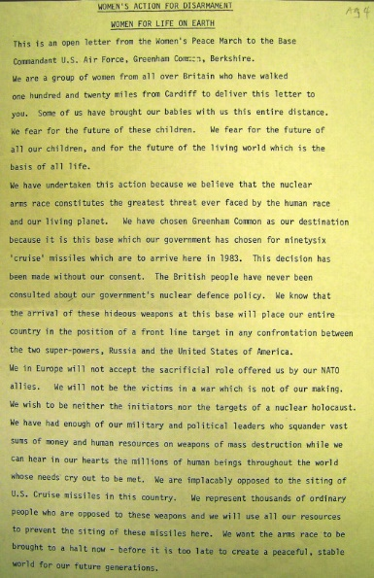
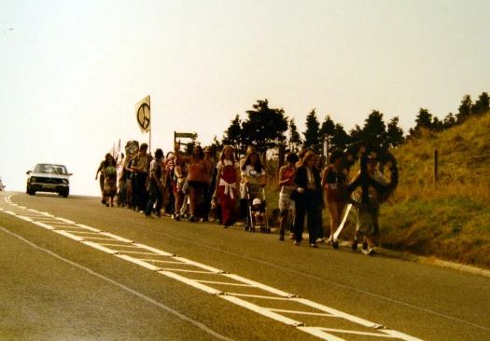
5th September 1981: The Women for Life on Earth march reaches Greenham Common to protest about NATO's decision to site cruise missiles at Greenham Common.
Notes:
Upon arrival some women chain themselves to the fence, and decide to set up a camp so that they can continue opposing the arrival of the Cruise missiles. More and more people join them and the camp grows in size.

Slide 20
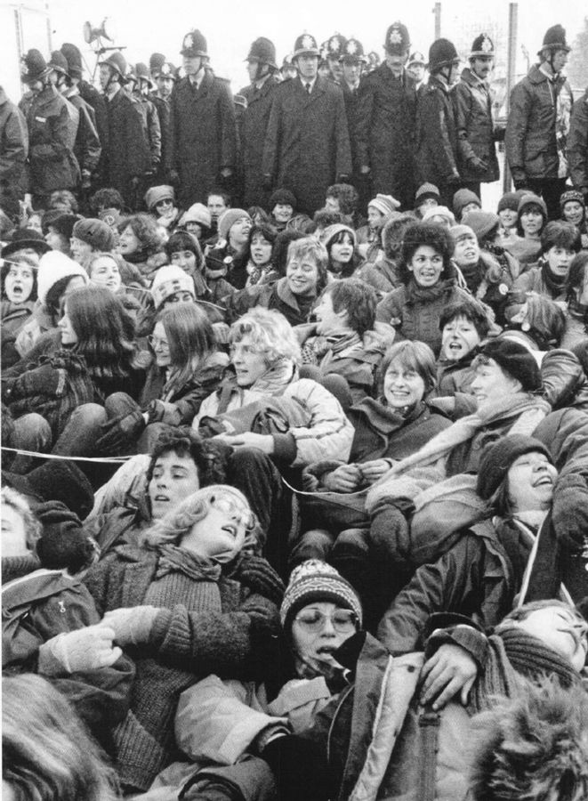
March 1982: The first blockade of the base is staged by 250 women and 34 arrests are made.

Slide 21
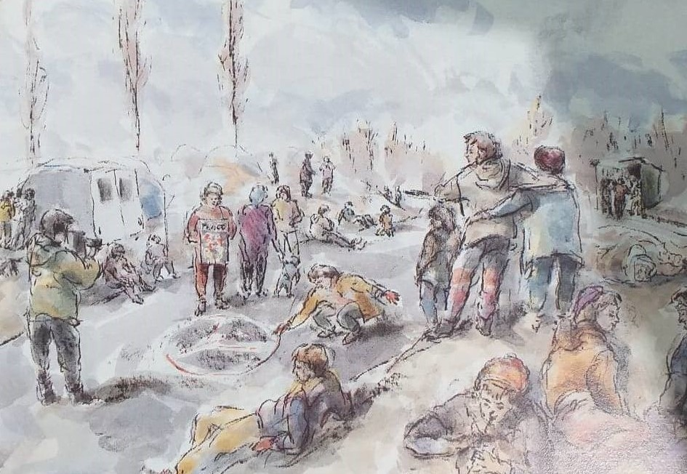
May 1982: The first eviction of the peace camp takes place and four arrests are made

Slide 22
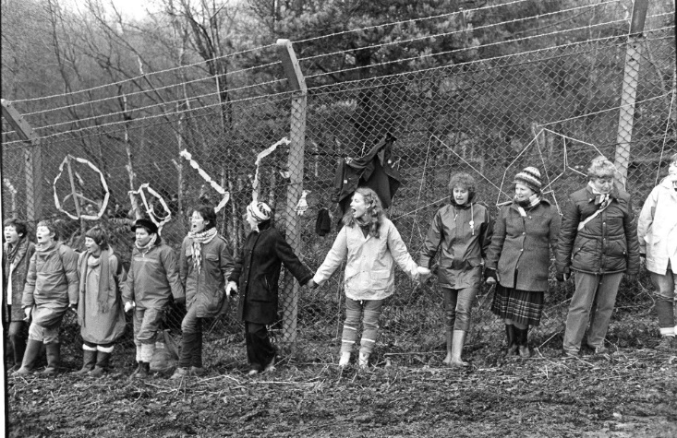
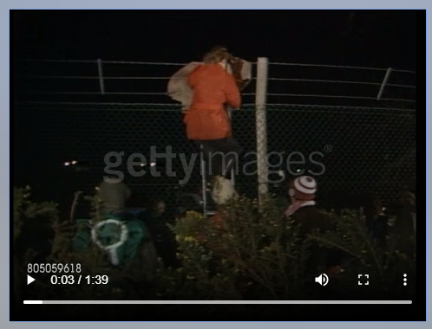
December 1982: 30,000 women join hands to 'embrace the base'. The next day, a mass blockade occurs again.
January 1983: On New Year’s Day, women enter the base and dance on top of the nuclear silos.
Notes:
https://www.gettyimages.co.uk/detail/video/anti-nuclear-protesters-arresetd-by-police-after-breaking-news-footage/805059618

Slide 23
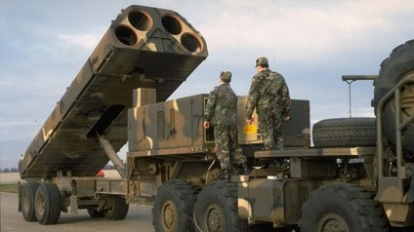
November 1983 The first cruise missiles arrives at Greenham Common airbase. A total of 95 missiles are to follow in the coming months.

Slide 24
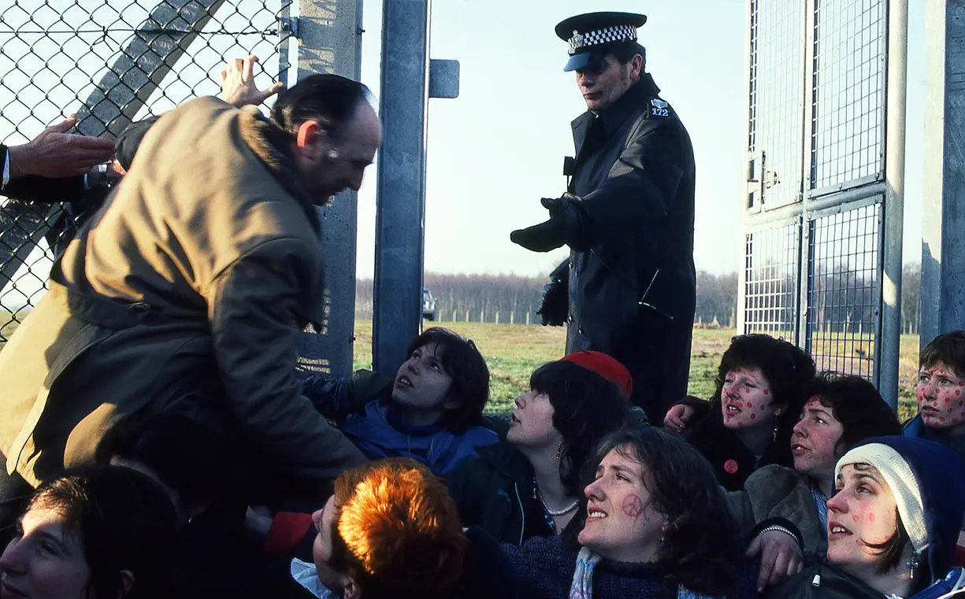
December 1983: 50,000 women encircle the base, holding up mirrors. Parts of the fence are brought down and hundreds of arrests are made.

Slide 25
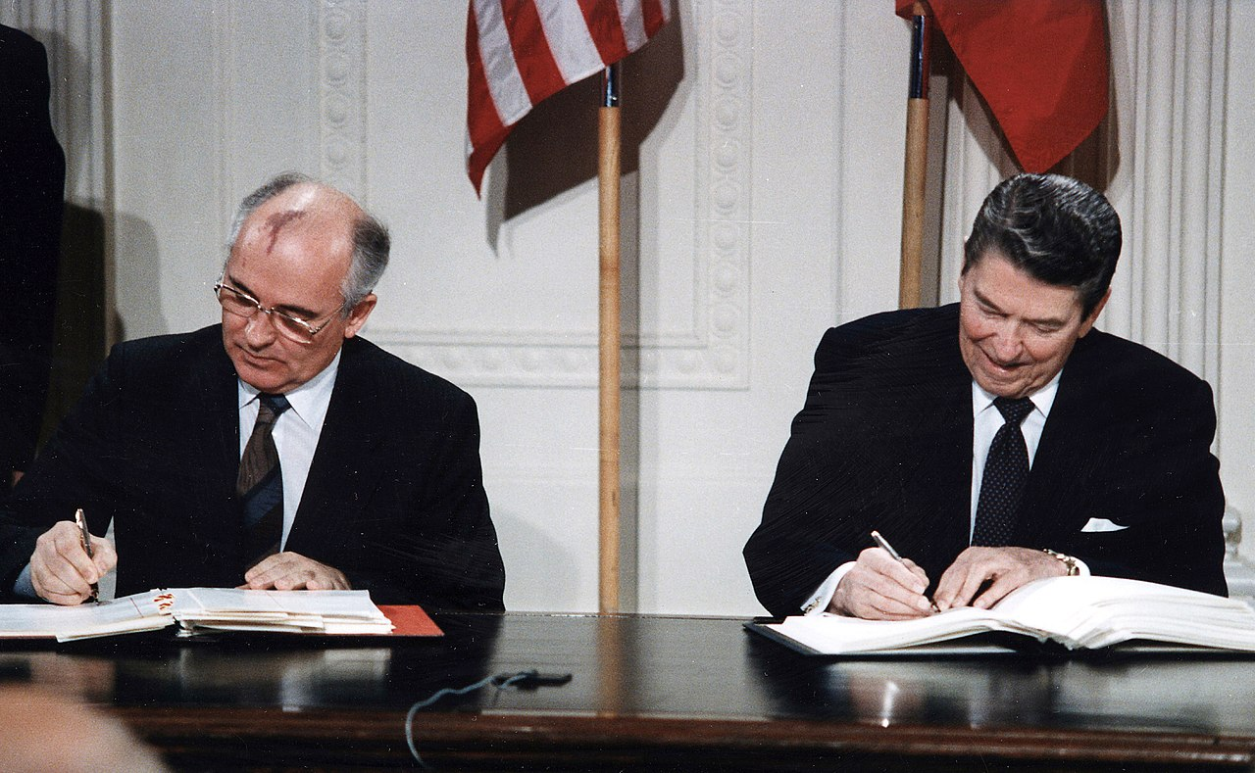
August 1989: The first cruise missile leaves Greenham Common.
Notes:
This is because a treaty called the INF was signed.

Slide 26
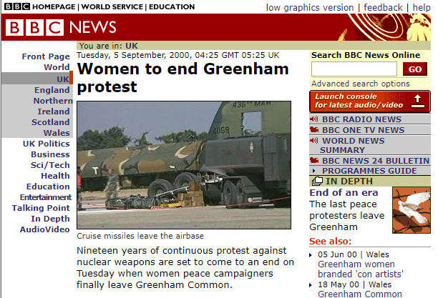
1 January 2000: Those who had remained at Greenham Common campaign to return the site to common land.
Once this was achieved, remaining Greenham women began to leave
Notes:
DANCING ON SILOS: https://www.gettyimages.co.uk/detail/video/anti-nuclear-protesters-arresetd-by-police-after-breaking-news-footage/805059618

Slide 27
Any thoughts or remarks?
Is anyone missing from these images?
Notes:
Students may well have already spotted that almost all the protesters depicted in these images are women

Slide 28
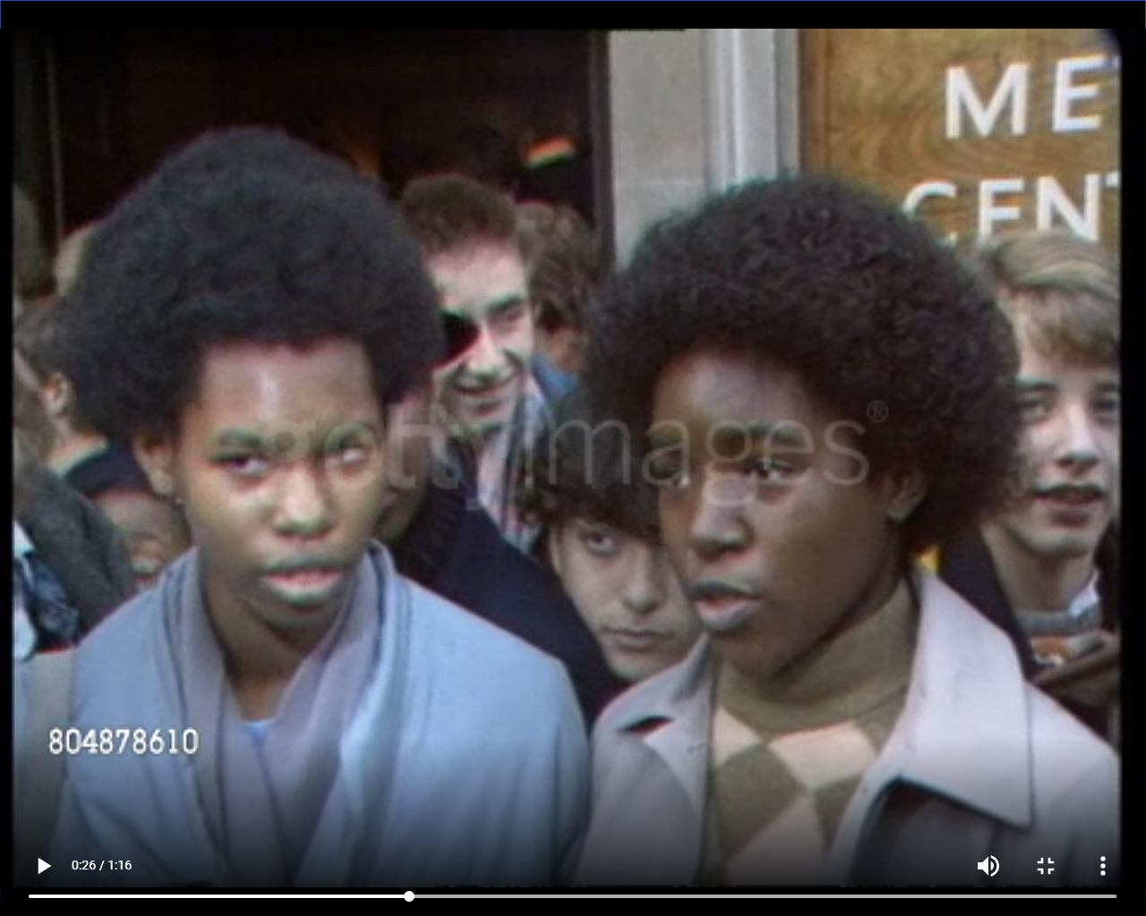
The women’s tactics caused a lot of controversy
Notes:
They were a very controversial camp – people were supportive and resentful https://www.gettyimages.co.uk/detail/video/greenham-common-demonstrations-england-london-central-news-footage/804878610

Slide 29
Main Activity:
Silent conversations

Slide 30
Silent conversations
Split into groups and divide yourselves between the different ‘source stations’ in the room.
Annotate the materials at your station using the marker pens, write down any:
You will rotate to the station to your left after 4 minutes, and you will be given a specific question to think about each time:
Thoughts
Comments or responses to others’ thoughts/questions
Questions
Notes:
You may wish to play music during this activity

Slide 31
Silent conversations
Split into groups and divide yourselves between the different ‘source stations’ in the room.
Annotate the materials at your station using the marker pens, write down any thoughts, questions, comments or replies
You will rotate to the station to your left after 4 minutes, and you will be given a specific question to think about each time:
Does the material talk more about men or women?
How is gender being used here?
Notes:
Choose which question you think will best stretch your class (the second of the two questions is suited to a higher-attaining, or older, group)

Slide 32
Silent conversations
Split into groups and divide yourselves between the different ‘source stations’ in the room.
Annotate the materials at your station using the marker pens, write down any thoughts, questions, comments or replies
You will rotate to the station to your left after 4 minutes, and you will be given a specific question to think about each time:
What don’t you know about the material?
How can you tell if the material is biased?
Notes:
Choose which question you think will best stretch your class (the second of the two questions is suited to a higher-attaining, or older, group)

Slide 33
Silent conversations
Split into groups and divide yourselves between the different ‘source stations’ in the room.
Annotate the materials at your station using the marker pens, write down any thoughts, questions, comments or replies
You will rotate to the station to your left after 4 minutes, and you will be given a specific question to think about each time:
What imagery is being used?
Are these linked to gender, class, or race?
Notes:
Choose which question you think will best stretch your class (the second of the two questions is suited to a higher-attaining, or older, group)

Slide 34
Are there any themes or key concepts that came up during the silent conversations?
Feedback
Notes:
When you facilitate discussion, try to pick up on when students voice essentialising or generalizing ideas (e.g. all women are [x]) – push them to think about ‘gender’ (expectations, stereotype, gender roles), rather than just one idea of womanhood.

Slide 35
What’s the INF?
The Intermediate-Range Nuclear Forces treaty
The International Nuclear Federation
Invincible Nuclear Force
Incredible Neutron Firepower
Notes:
You may wish to skip these slides for the sake of time, or to make the main activity longer. However, the provide an overview of what’s happened since Greenham Common.
https://www.bbc.co.uk/news/av/world-45995982/a-new-nuclear-arms-race (to 1.55)

Slide 36
Notes:
The INF came about in large part due to the huge resistance of the Greenham Common women (and other peace camps in UK and Europe)

Slide 37
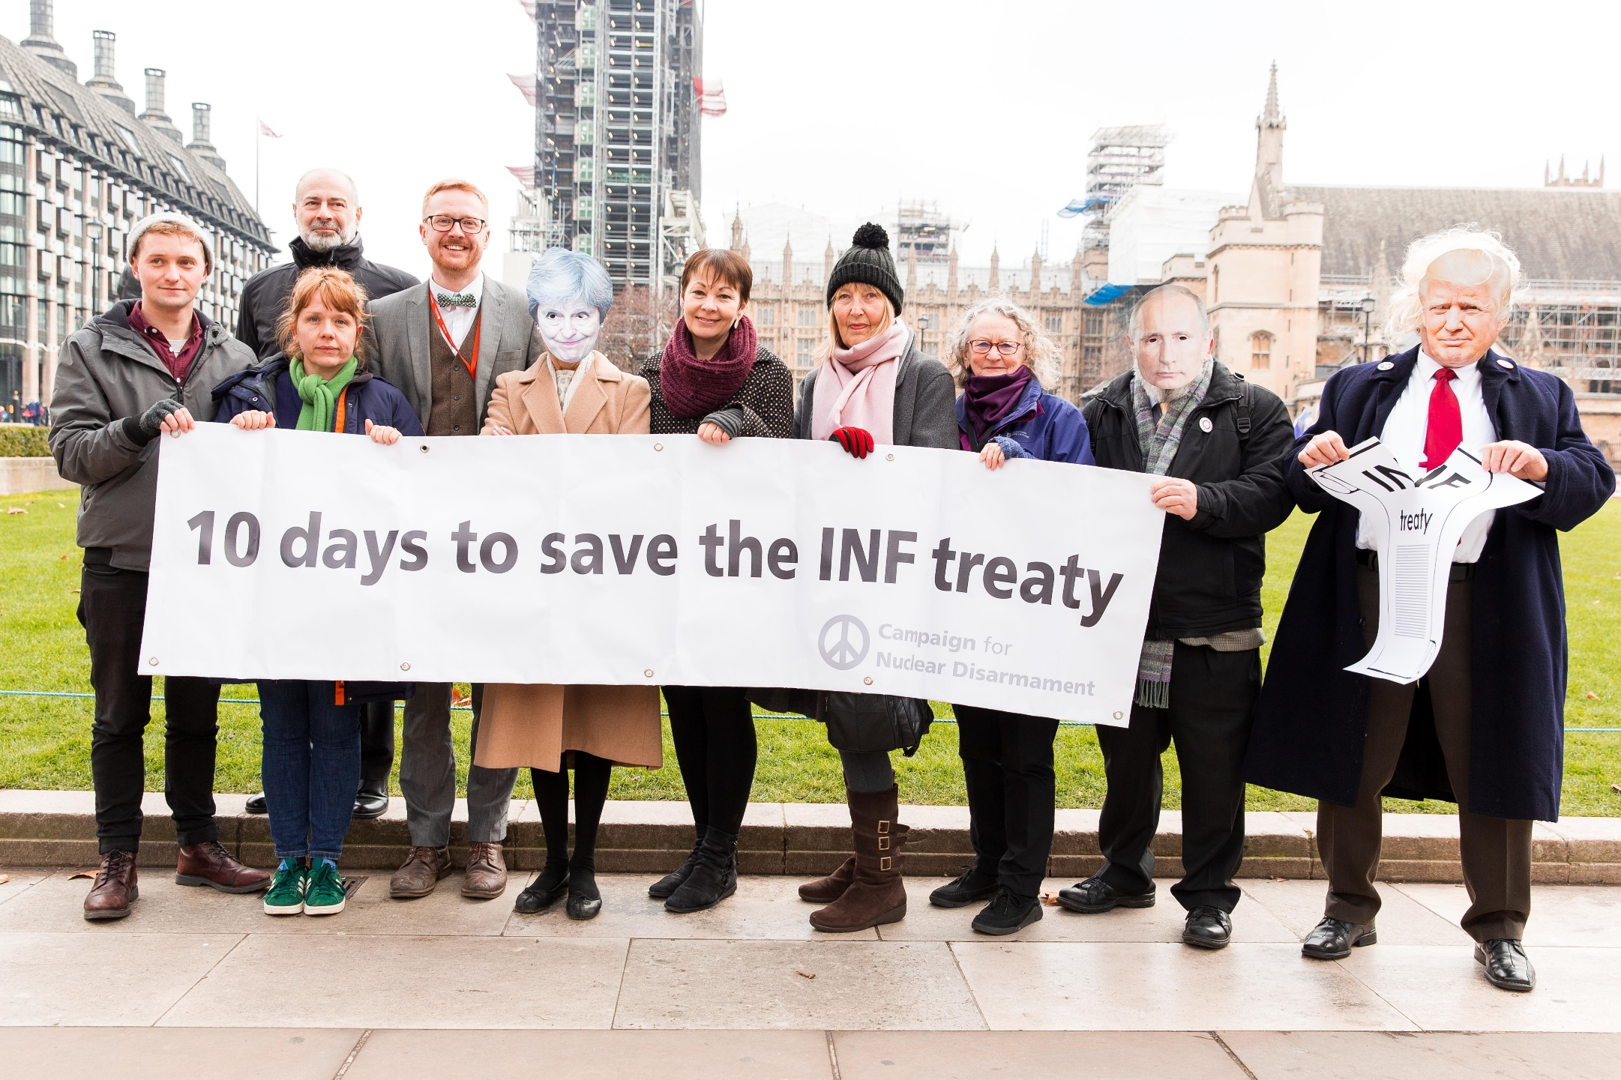
What’s the INF?
Notes:
In February 2019, Trump announced his withdrawal from the INF Treaty, effectively negating the successes of the Greenham Common peace camp. Putin announced Russia would also withdraw from the treaty.
Watch at https://www.youtube.com/watch?v=UJP15ntoFog

Slide 38
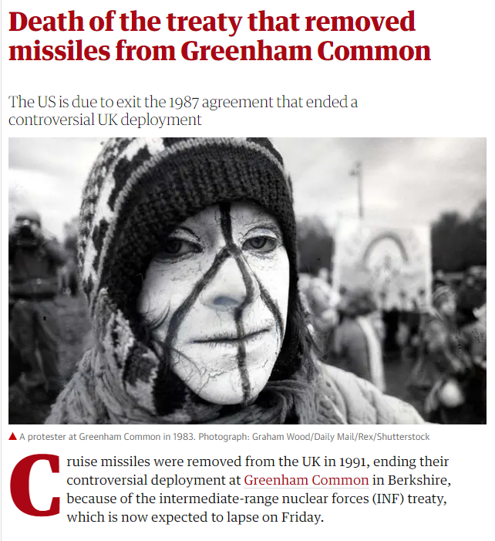

Slide 39
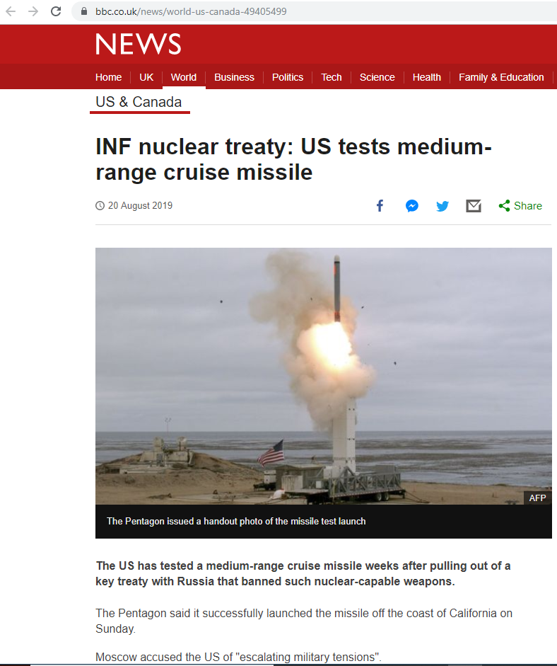
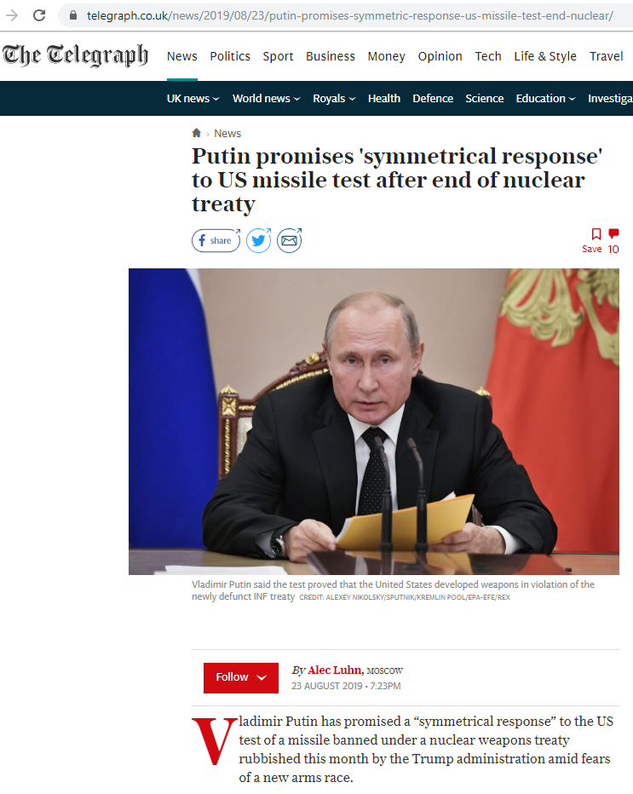
Notes:
Both countries are now making intermediate-range missiles (similar to the Cruise missiles, the women opposed).
Source (with INF video): https://www.bbc.co.uk/news/world-us-canada-49405499 (added 21/08/2019)
Fact: Trump has committed an *additional* $500billion in his Nuclear Posture Review (2018), including 17 billion for low-yield,tactical nukes which will become operational in Sept. (source: https://www.theguardian.com/world/2019/aug/17/nuclear-arms-race-is-back-and-more-dangerous-than-before). US military spending will be 750 billion dollars next year.

Slide 40
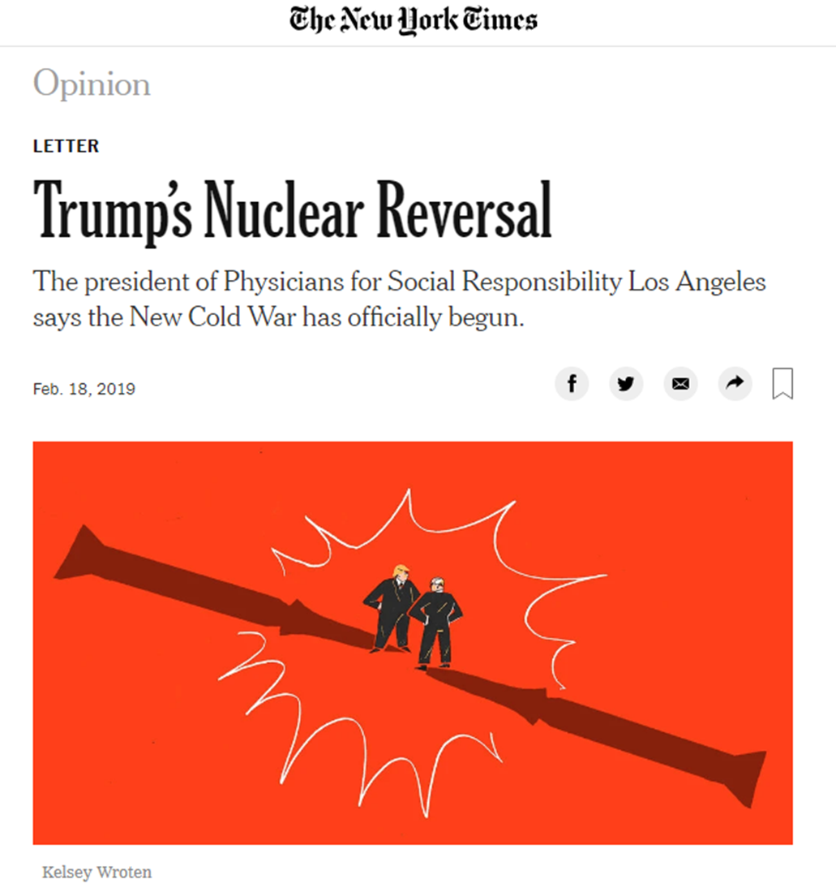
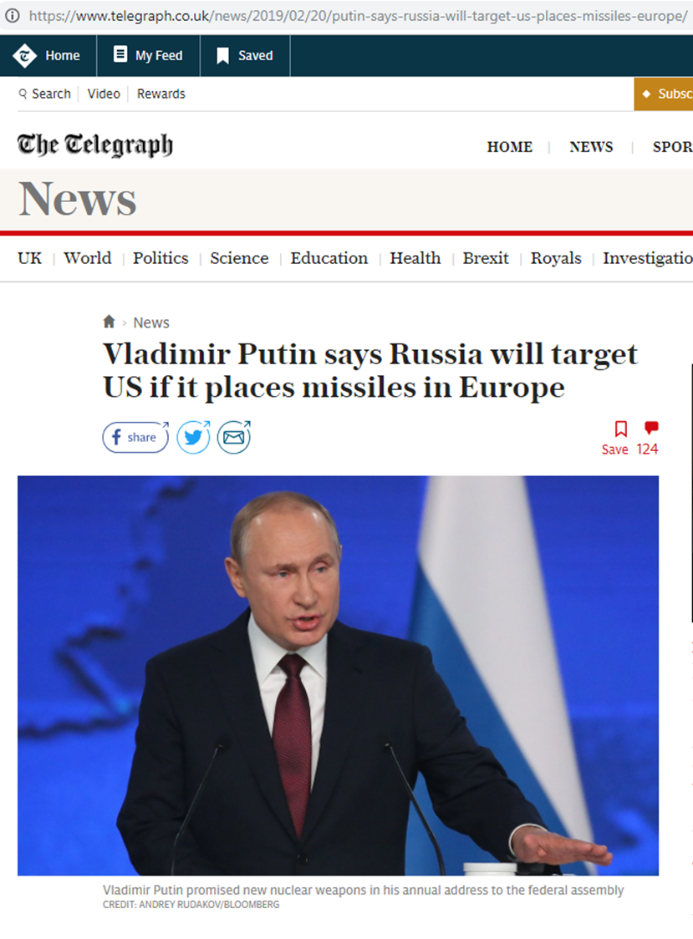
Notes:
This has led some commentators to say that a New Cold War is beginning!

Slide 41
Is there a connection between gender and conflict?
Or gender and peace?

Slide 42
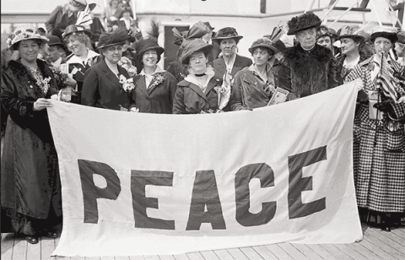
A long history of women and peace campaigning:
Women’s International League for Peace and Freedom
Established in 1915 and still around today!
Aims to bring women together to work for peace by non-violent means
Legal and political approach

Slide 43
Of course, peace means different things to different people, though!
Women have used their identities in different ways in response to conflict.
E.g. The YPJ – Kurdish Women’s Protection Unit, in the Syrian conflict have taken up arms to fight for peace.

Slide 44
The Women of Greenham Common
What do you think about the Greenham Common Women’s Peace Camp?
Was it successful? Or not?
Did you learn anything new?
Do you have any questions?

Slide 45
What we’ve done today
Learnt about Greenham Common Peace Camp
Explored some materials by silent conversations
Learnt about consensus and tried to build our own consensus
Thought about links between gender, peace, and conflict.

