Slide 1
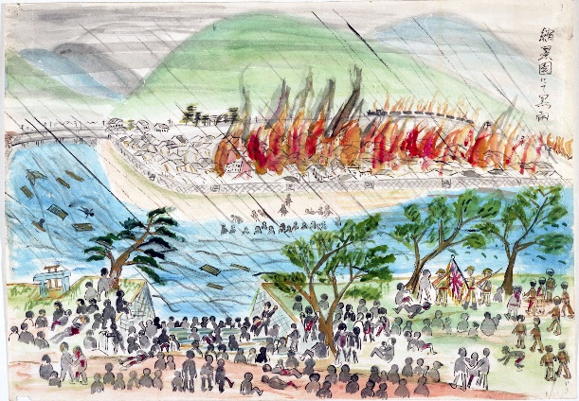
Hibakusha and Art
Notes:
Be aware that Hibakusha is pronounced: he-back-sha

Slide 2
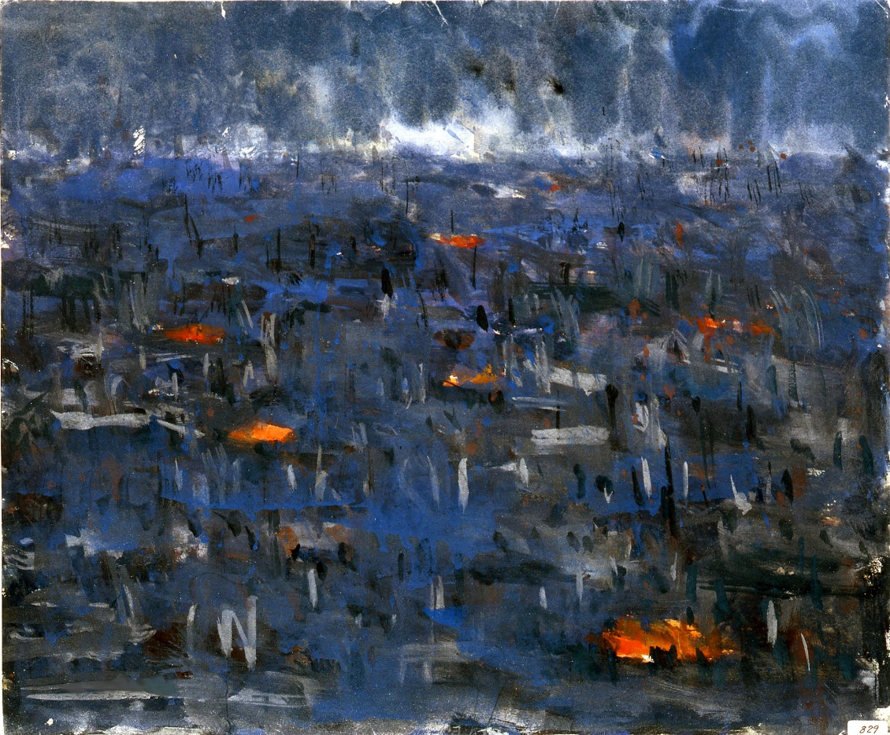
What we’ll do in this workshop:
Learn about the bombings of Hiroshima and Nagasaki, and their effects
Make artwork based on an eye-witness account of the bombing
Compare our artwork with art by Hibakusha

Slide 3
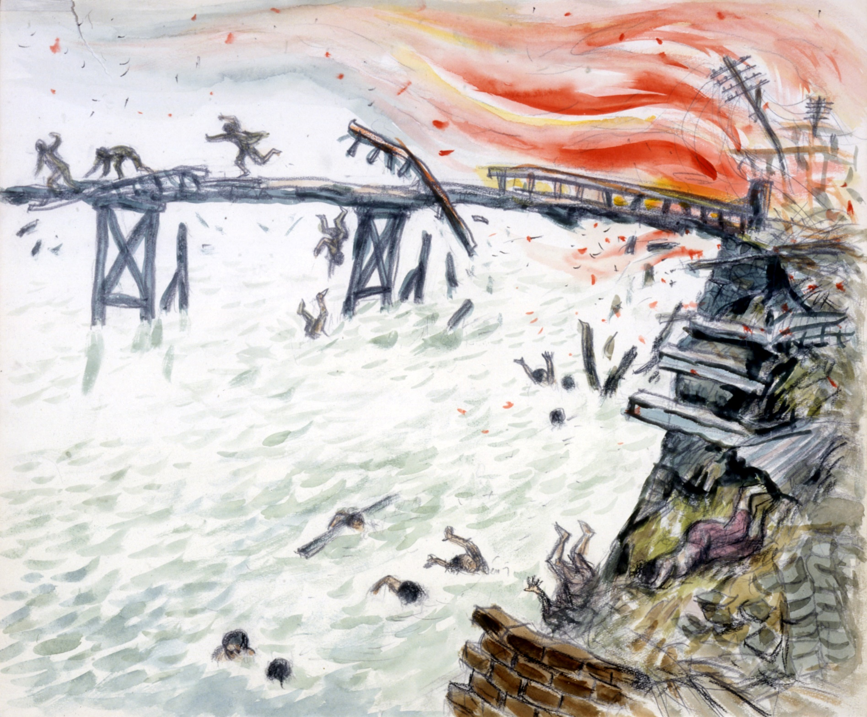
We’re going to read one person’s account of experiencing an atomic bomb exploding.
There will be talk of injury, destruction, and death
You don’t have to join in, and can leave the room if you need to.
Would anyone like to begin reading?
Notes:
Akihiro Takahashi’s testimony is available p.34-35 of our teaching pack (via our website), Critical Mass. See: https://cnduk.org/education/free-teaching-resources/critical-mass-lessons-on-gender-race-and-nuclear-weapons/
It’s recommended that you look at the following illustrations beforehand, and take out any that you believe might be unsuitable for your students.

Slide 4
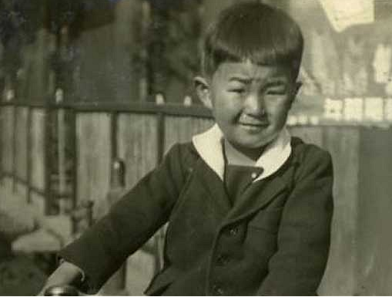
On August 6th, 1945 at 8.15 am, the world's first atomic bomb exploded over Hiroshima. I was 14 years old then. I was in a playground about 1.4 kilometers away from the hypocenter when the bomb exploded…
Akihiro Takahashi witnessed the bombing of Hiroshima in 1945. This picture was taken before the bomb fell.

Slide 5
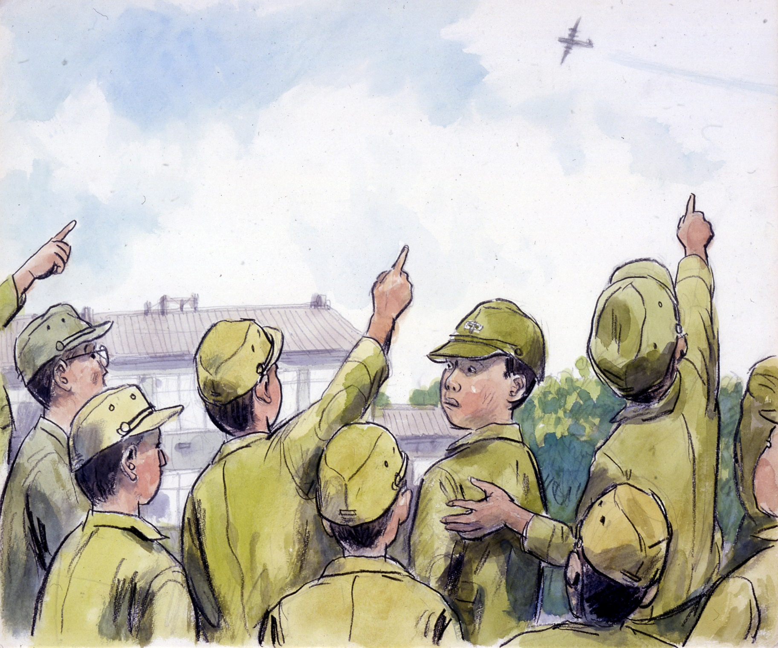

Slide 6
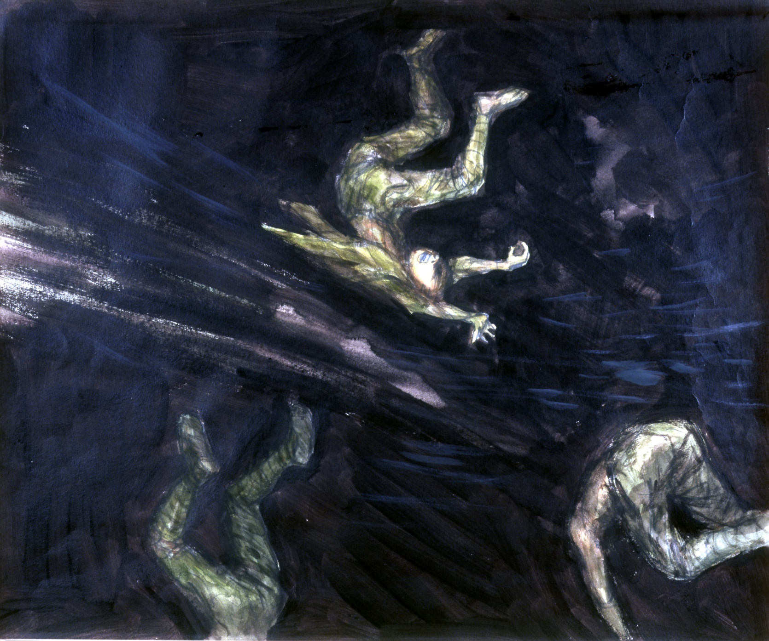

Slide 7
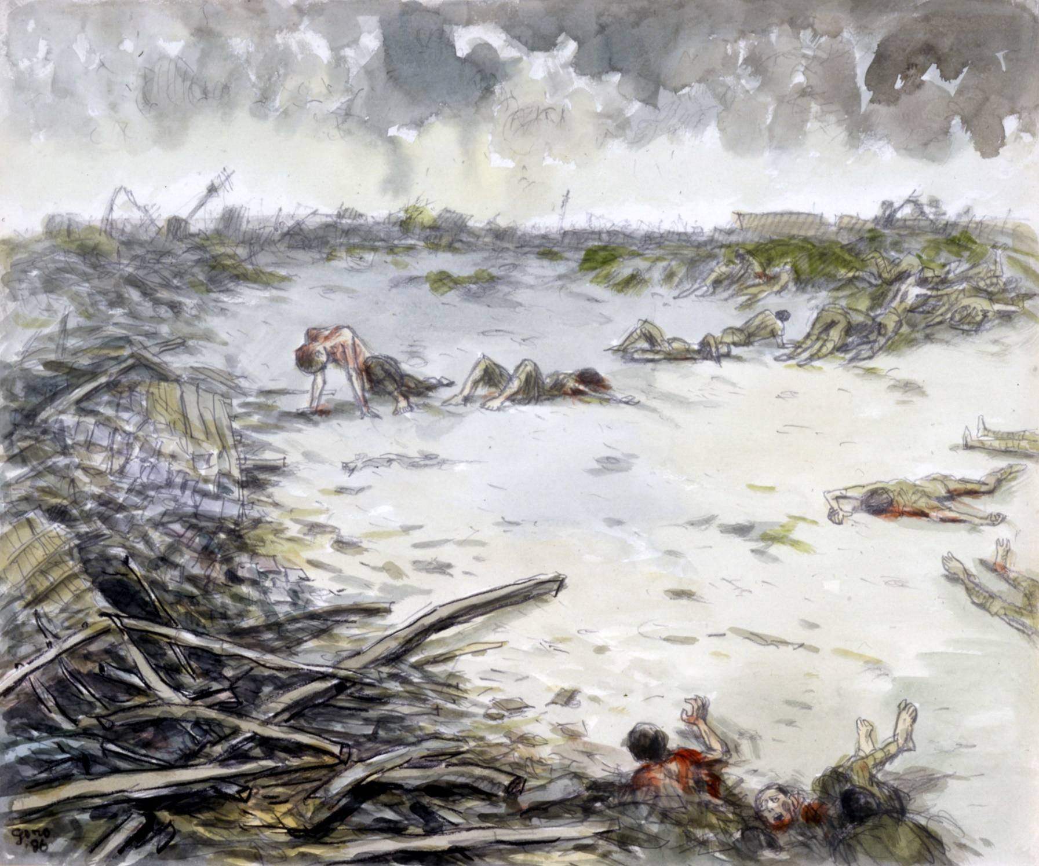

Slide 8
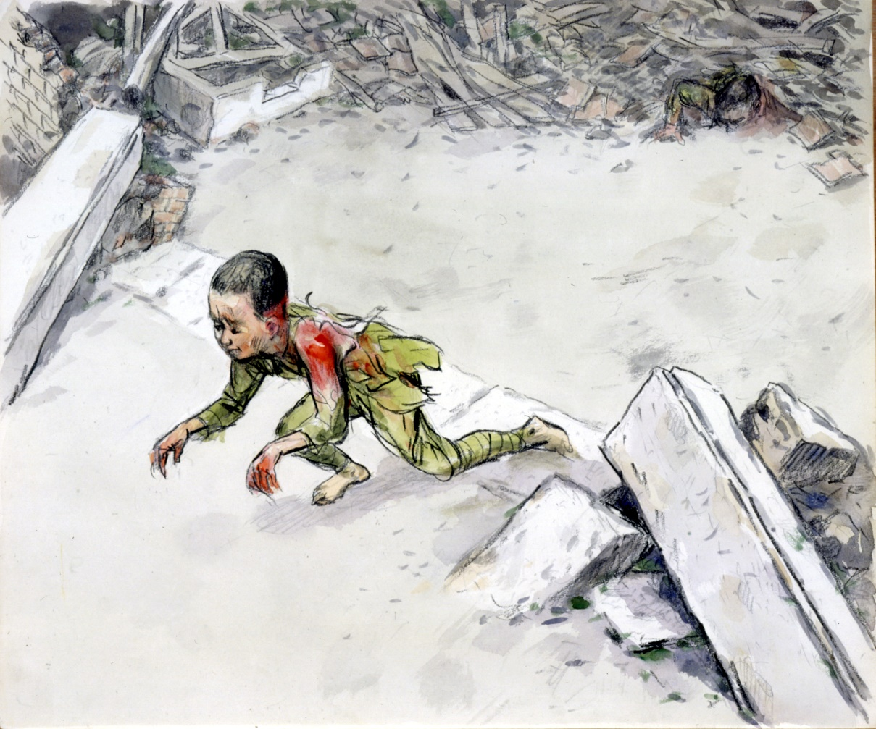
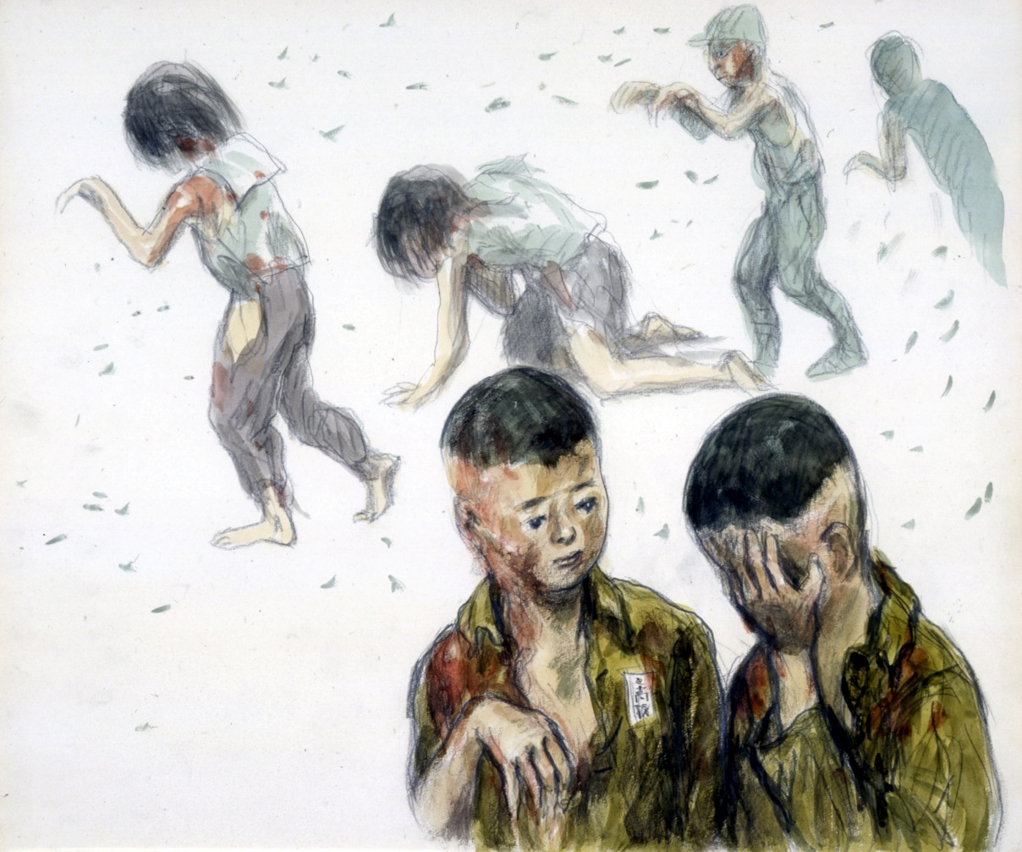

Slide 9
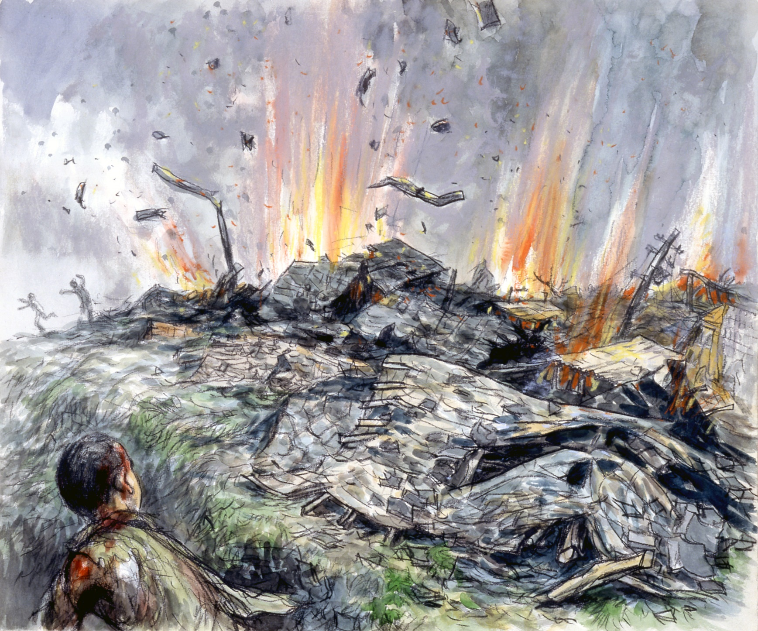

Slide 10
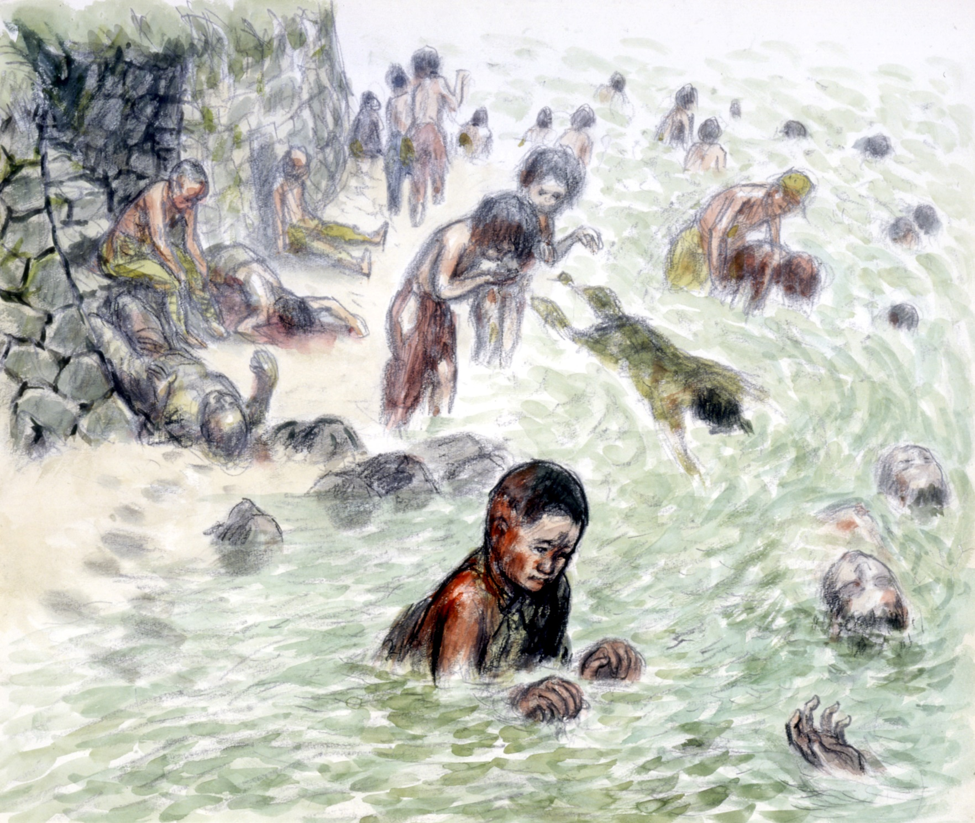

Slide 11
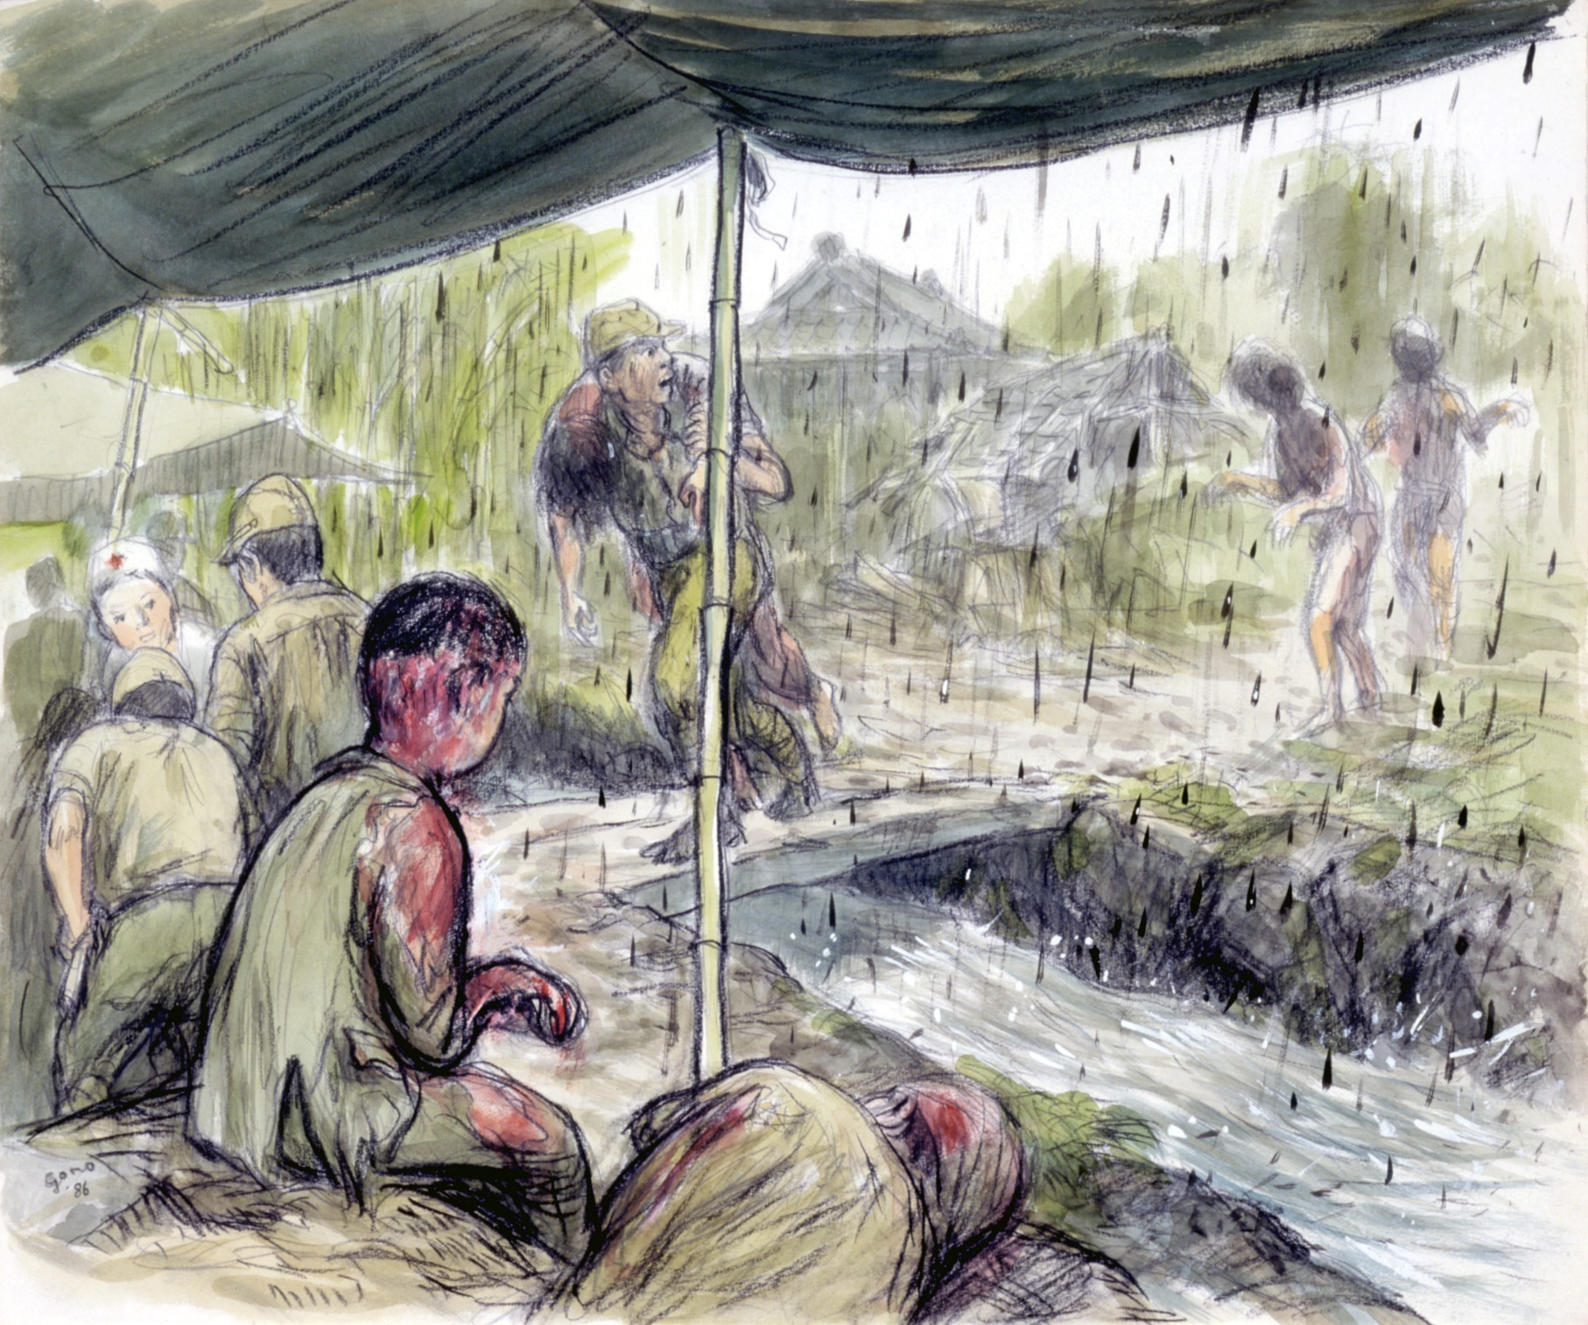

Slide 12
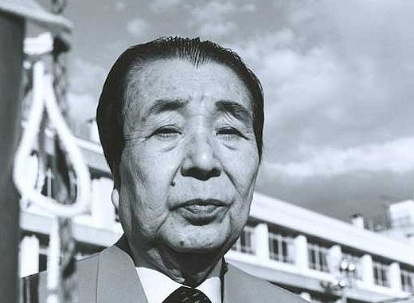

Slide 13
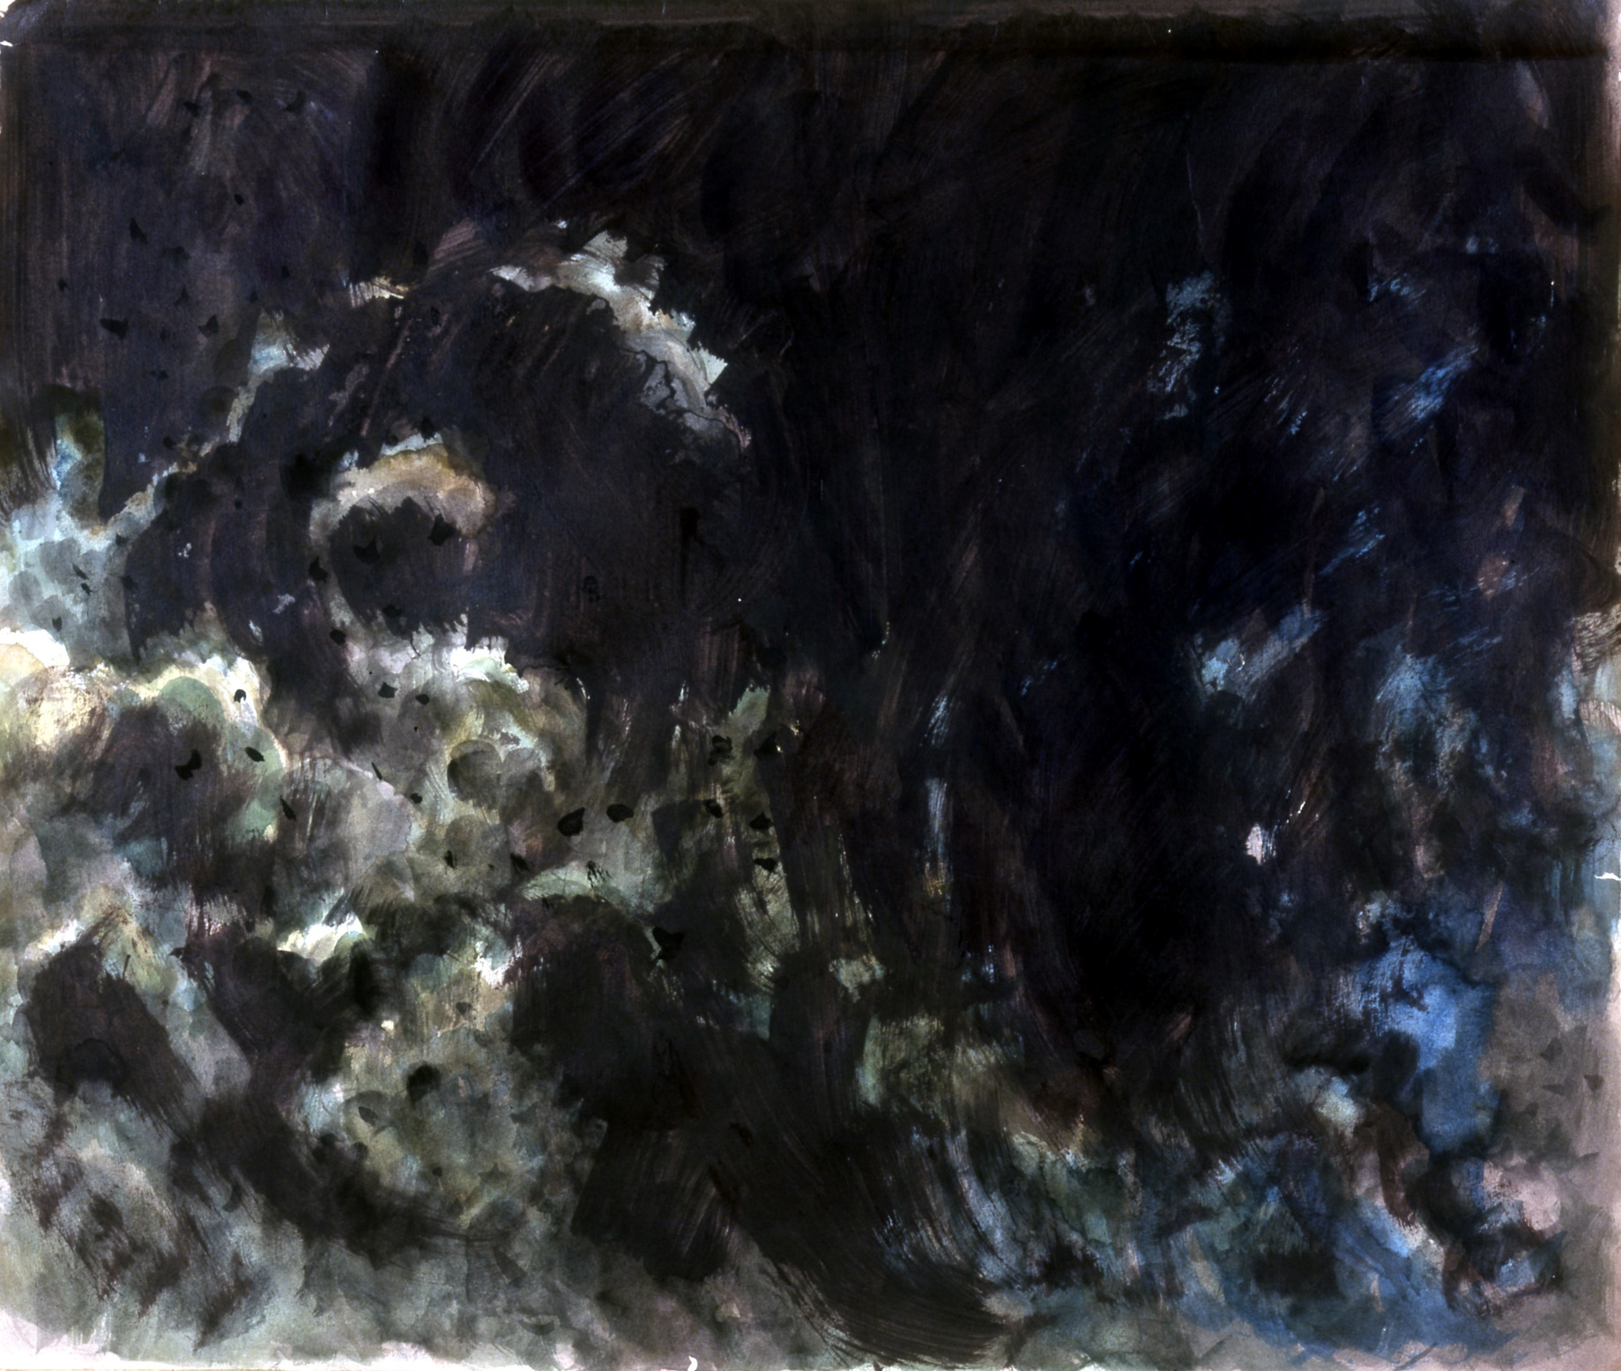
What do you think?
Take 1-minute to silently reflect on what you’ve heard
Write down one word that comes to mind.
It could describe the atomic bombing of Hiroshima or you own feelings.
It could also be a bigger concept that you’re thinking about e.g. survival
Notes:
Feedback and write any key concepts on the board.

Slide 14
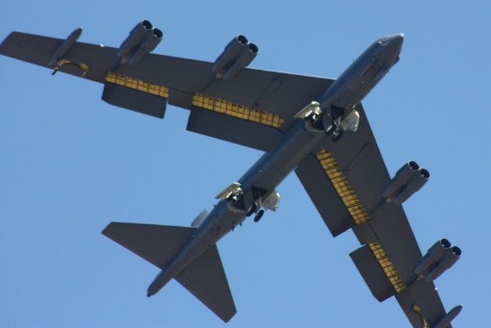
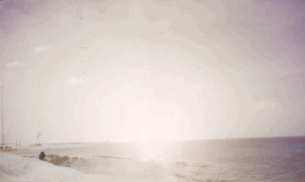
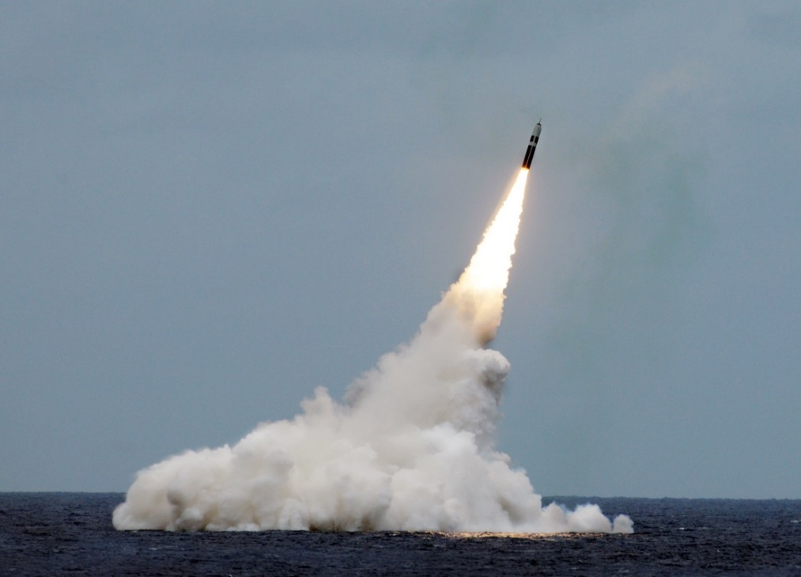
Paul L. McCord Jr. ; https://creativecommons.org/licenses/by-nd/2.0/legalcode ; cropped
Public domain ; National Museum of the US Navy
Notes:
Nuclear weapons can be launched from the ground, air and sea.

Slide 15
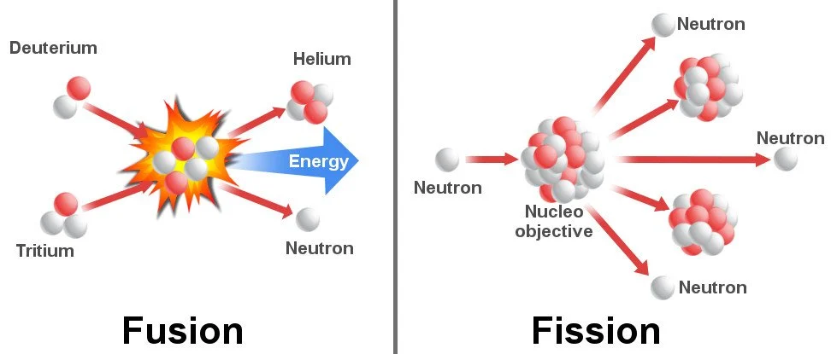
Notes:
Image source: https://www.scienceabc.com/eyeopeners/why-arent-we-using-nuclear-fusion-to-generate-power-yet.html
Nuclear fusion – two smaller atoms are brought together, usually hydrogen or hydrogen isotopes (deuterium, tritium), to form a larger one (helium isotopes); this is how the sun produces energy. Hydrogen bombs, which use nuclear fusion, have higher destructive power and greater efficiencies than atomic bombs.
Nuclear fission – the nucleus of an atom is split into two smaller fragments by a neutron. This method usually involves isotopes of uranium (uranium-235, uranium-233) or plutonium (plutonium-239). When a single free neutron strikes the nucleus of an atom of radioactive material like uranium or plutonium, it knocks two or three more neutrons free. Energy is released when those neutrons split off from the nucleus, and the newly released neutrons strike other uranium or plutonium nuclei, splitting them in the same way, releasing more energy and more neutrons. This chain reaction spreads almost instantaneously. Nuclear fission produces the atomic bomb.

Slide 16
Name the 9 countries that have nuclear weapons
Notes:
16

Slide 17
Name the 9 countries that have nuclear weapons
UK
US
France
China
Russia
Israel
India
Pakistan
North Korea
Notes:
17

Slide 18
= 12,121 in total
Almost 4000 of them could be used at short notice; 5600 are in storage; and 2500 are ‘retired’ and will be dismantled in the coming years.
Big decrease since the 1980s (70,000 warheads!), and 400 less than last year
This is the first time since 1999 that India’s stockpile has surpassed Pakistan’s. China is expanding its nuclear arsenal faster than any other country (from 410 in 2023 to 500 in 2024

Slide 19
When was the first nuclear bomb used against people?
Where was the first nuclear bomb used against people?
Notes:
A: 1945 (6th August 1945)
A: Hiroshima, Japan

Slide 20
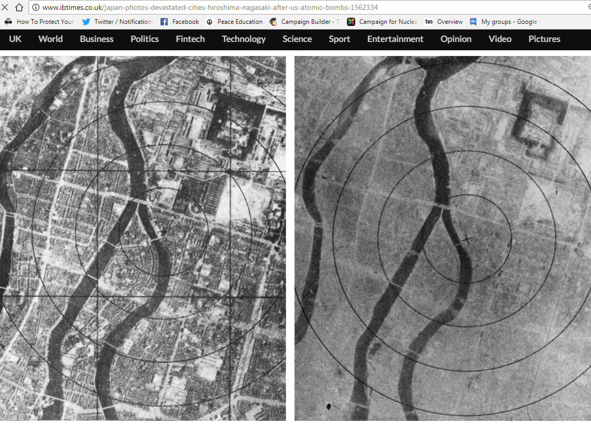
6th August 1945: The bomb is dropped on Hiroshima
Notes:
It was a similar scene in Nagasaki on 9th August.

Slide 21
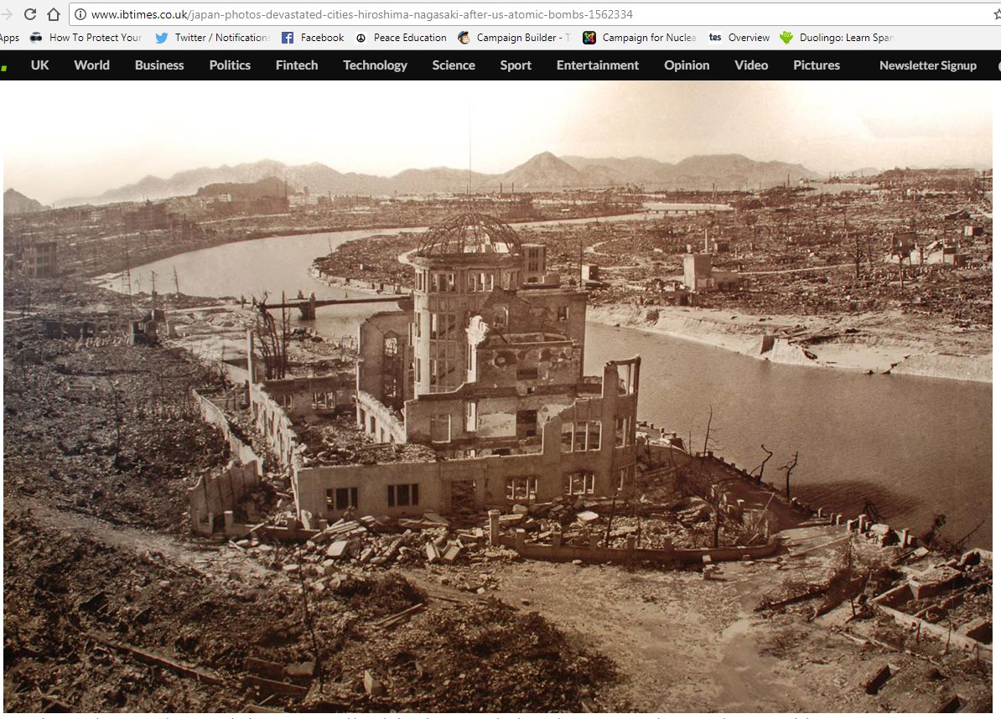
Notes:
This photo was taken after the bombing of Hiroshima. As you can see, only a few buildings are still standing. Between 150,000 and 600,000 people died – some died many years afterwards, from the effects of the radiation.

Slide 22
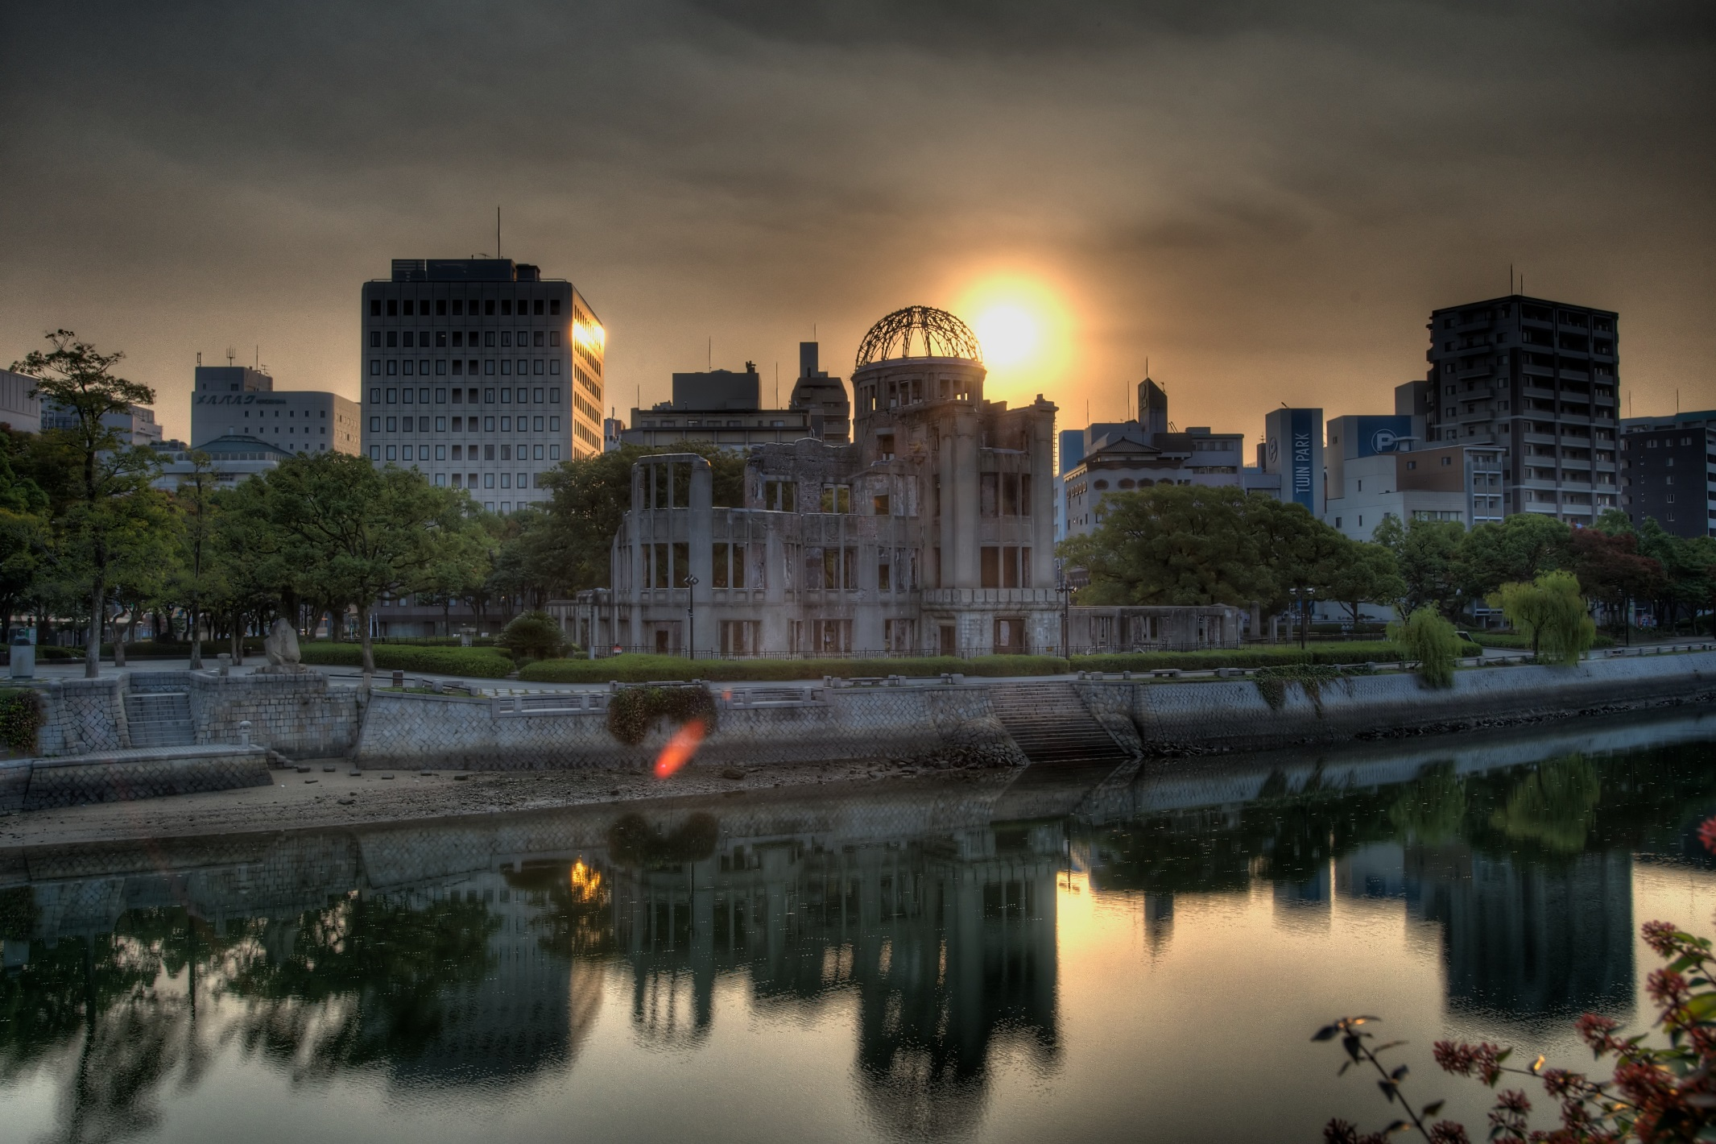
Hairyegg; https://creativecommons.org/licenses/by-sa/2.0/legalcode
Notes:
This shows the remains of the building today. Has anyone been to Hiroshima? Did you see this building, and the Peace Park that it’s in?

Slide 23
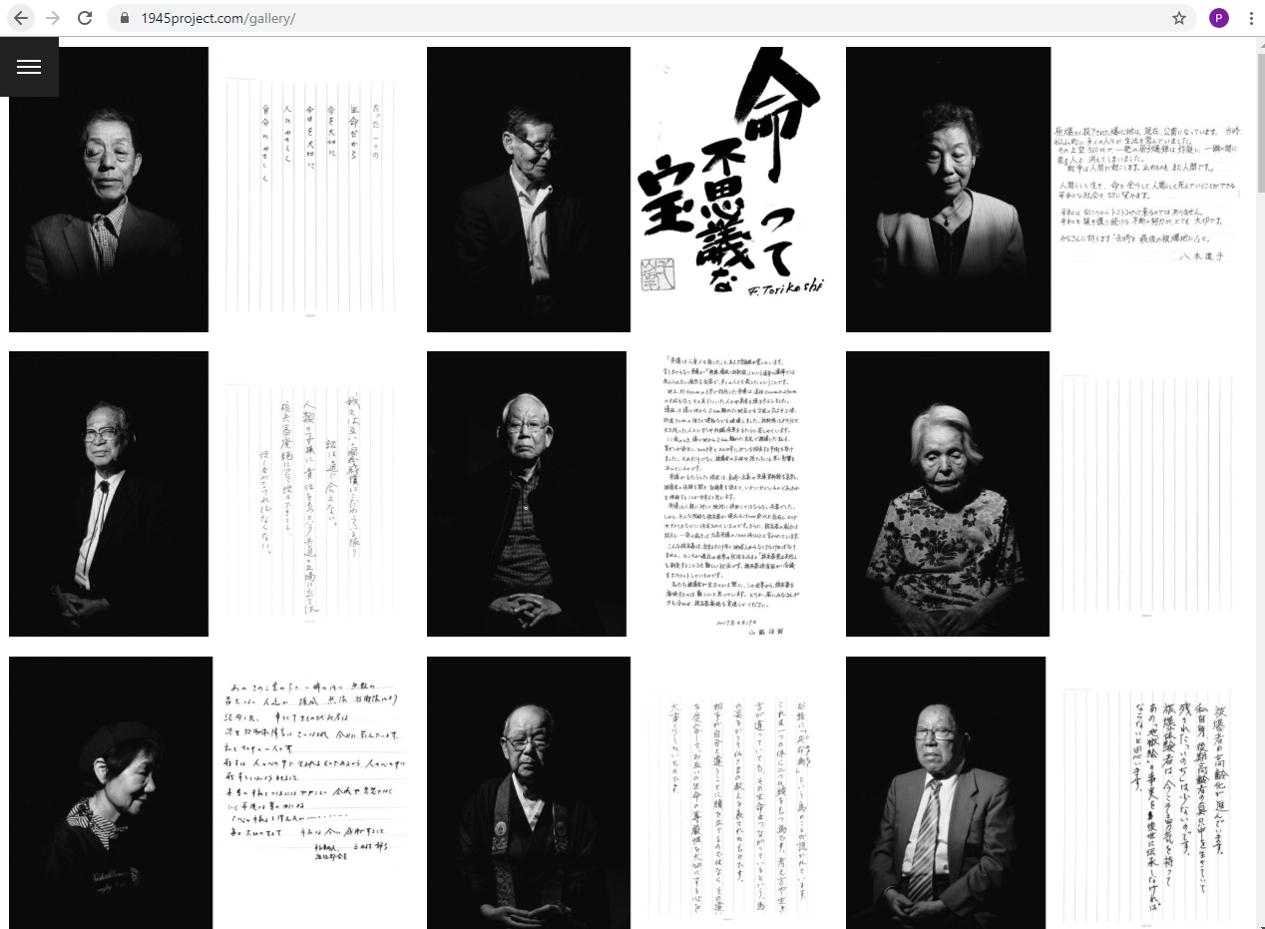
Notes:
www.1945project.com – even people who weren’t alive during the bombings have been affected by the bombs, as the impacts of the radiation have been passed through generations (because radiation can change a person’s DNA).

Slide 24
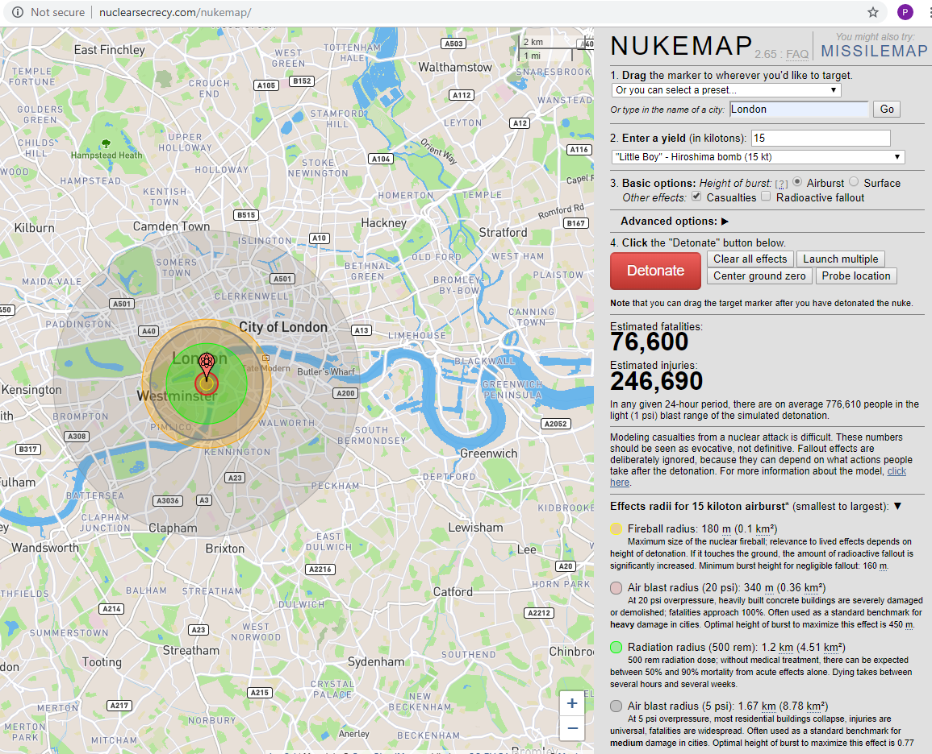
Notes:
Consider using ‘Nuke Map’ (www.nuclearsecrecy.com/nukemap) to simulate a nuclear bomb dropping on your school: how far do the after effects stretch? Pictured is a simulation of the Hiroshima bomb exploding on Big Ben.

Slide 25
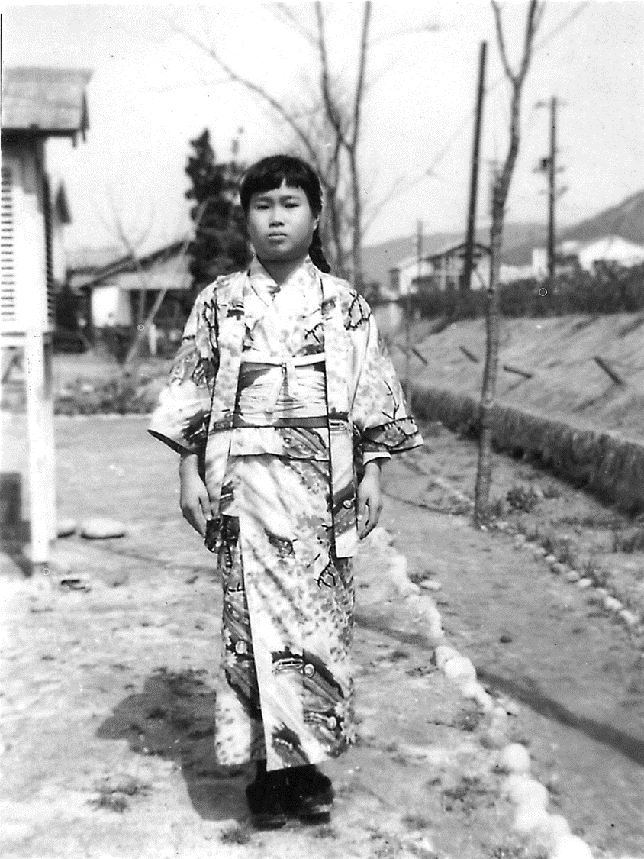
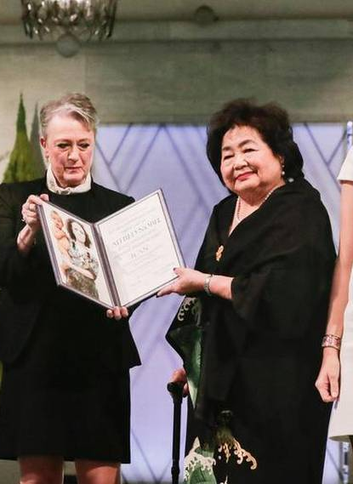
被爆者
Hibakusha
Person affected by the (Hiroshima or Nagasaki) bomb
Notes:
Pictured: Sadako Sasaki, Setsuko Thurlow (accepting the Nobel Peace prize on behalf of the International Campaign to Abolish Nuclear Weapons (ICAN))

Slide 26
被爆者
How many Hibakusha are alive today?
180
1,900
17,000
150,000
The government of Japan have recognised 145,000 living Hibakusha.
But there are Hibakusha in Korea, and all over the world!
Notes:
There is some additional information on Hibakusha in our teaching pack, Critical Mass, on p. 36

Slide 27
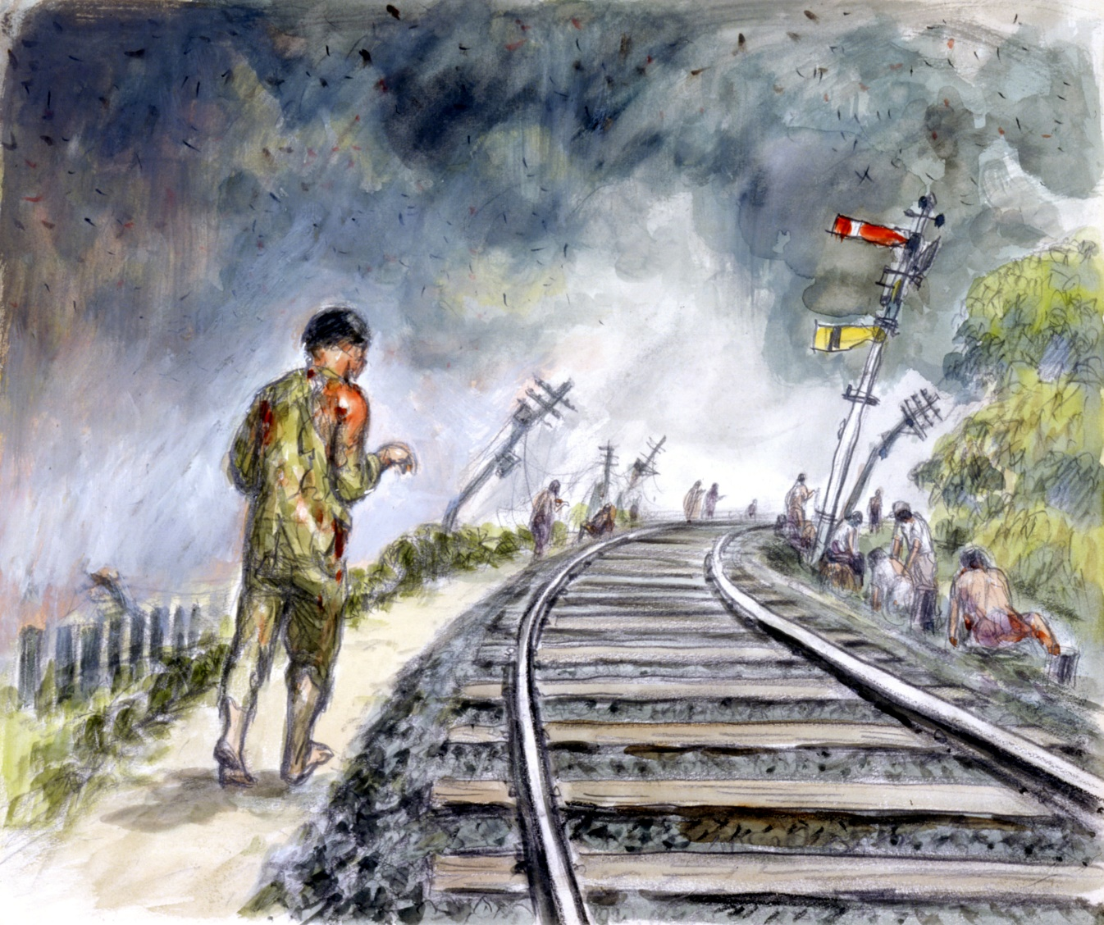
Your task
Reflecting on the testimony we have just read, produce your own artwork in response
You could draw what happened when the bomb exploded, or you could produce something that reflects your feelings about the bombings.
Why not focus on a ‘key concept’ written on the board?
Notes:
You can leave this slide up on the board for the activity, or use one of the illustrations from the testimony, or use the testimony itself, or turn the projector off.

Slide 28
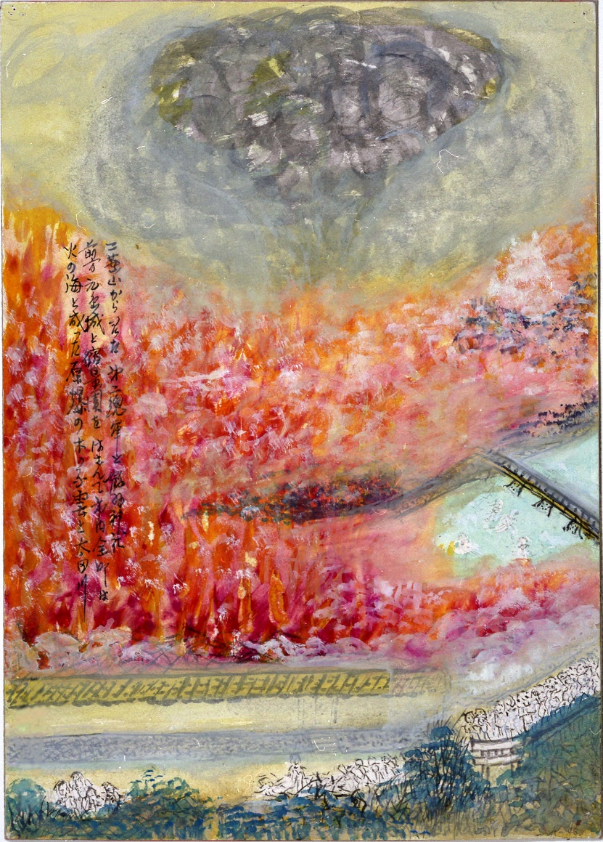
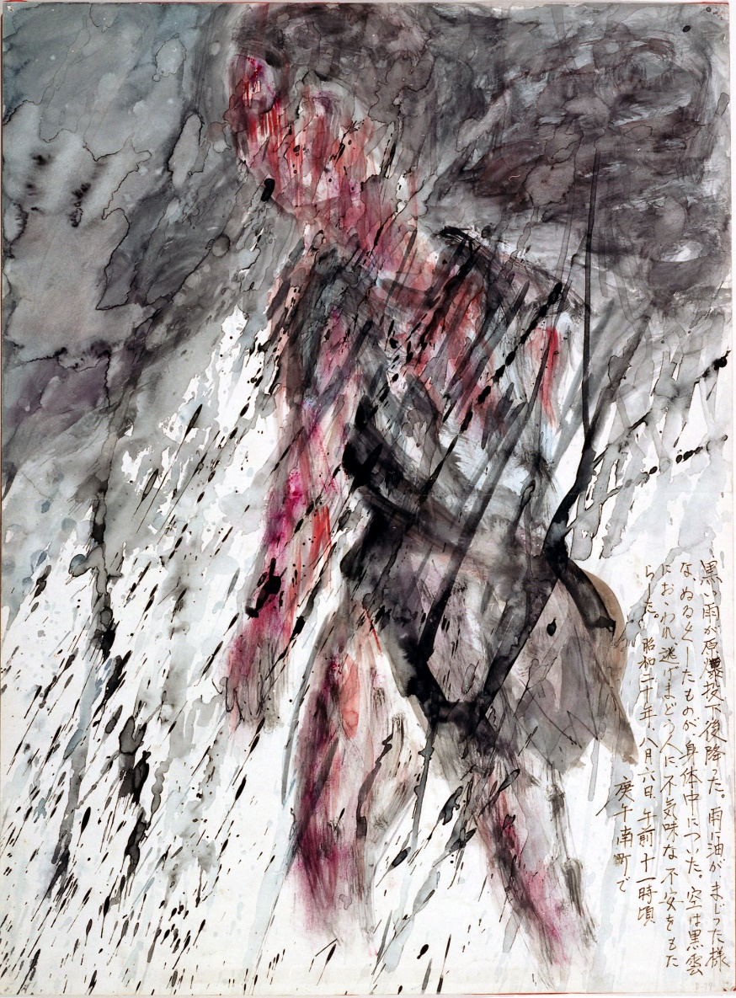
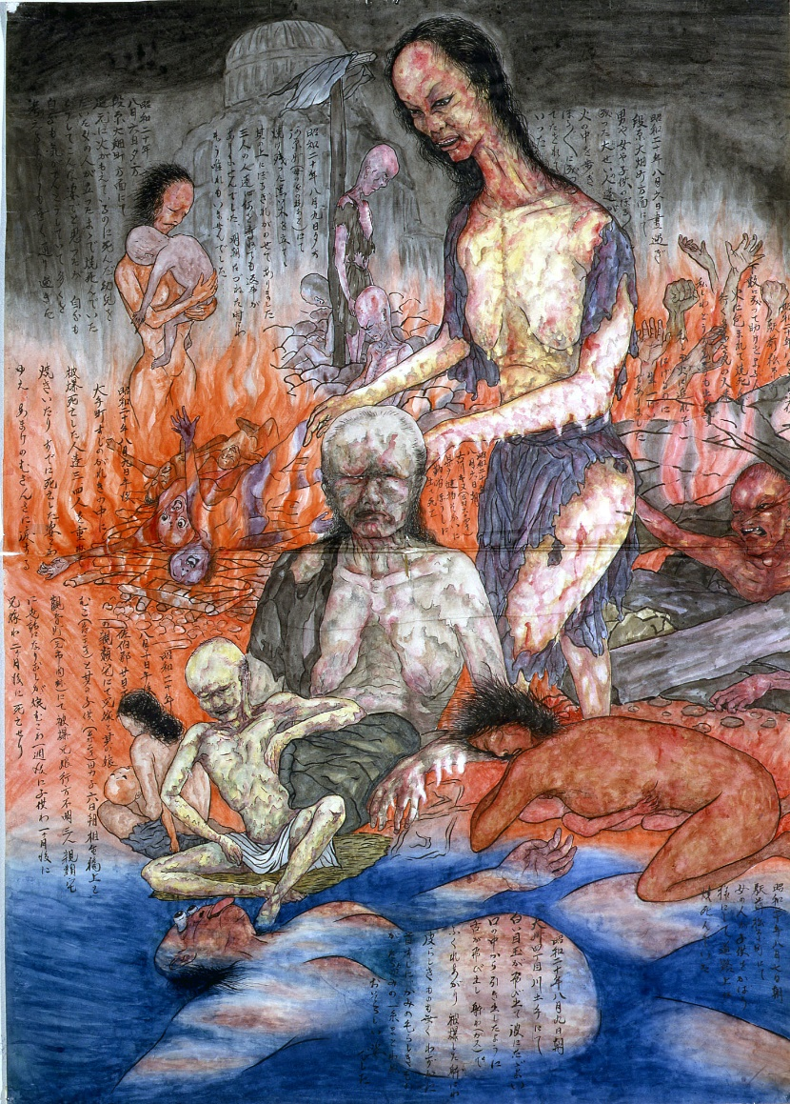
How did your artwork compare to the art of some Hibakusha?

Slide 29
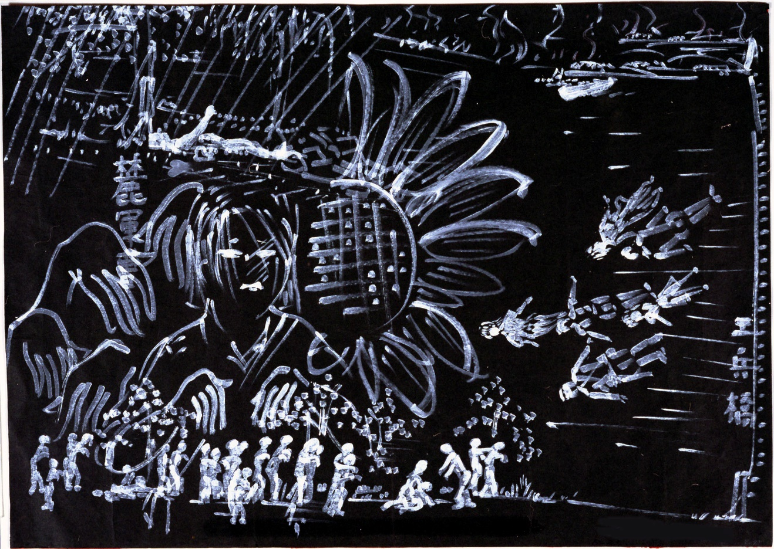
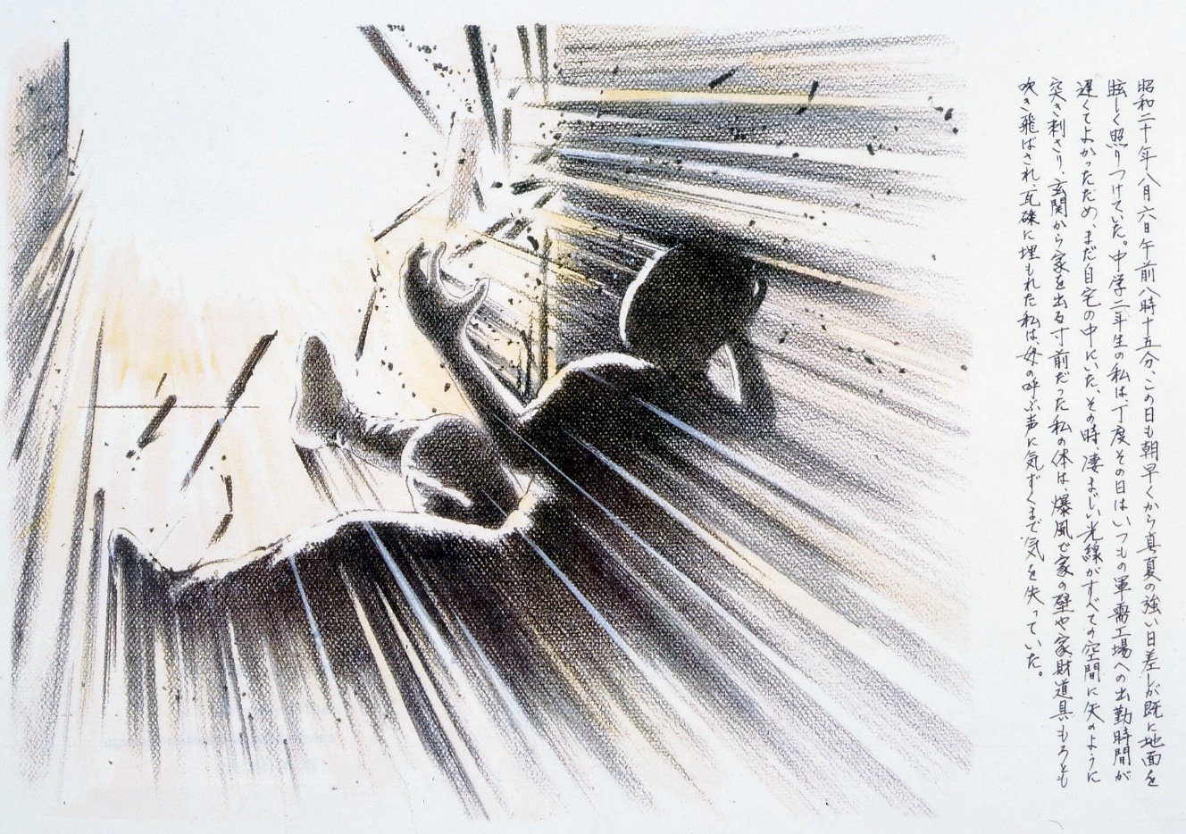
How did your artwork compare to the art of some Hibakusha?

Slide 30
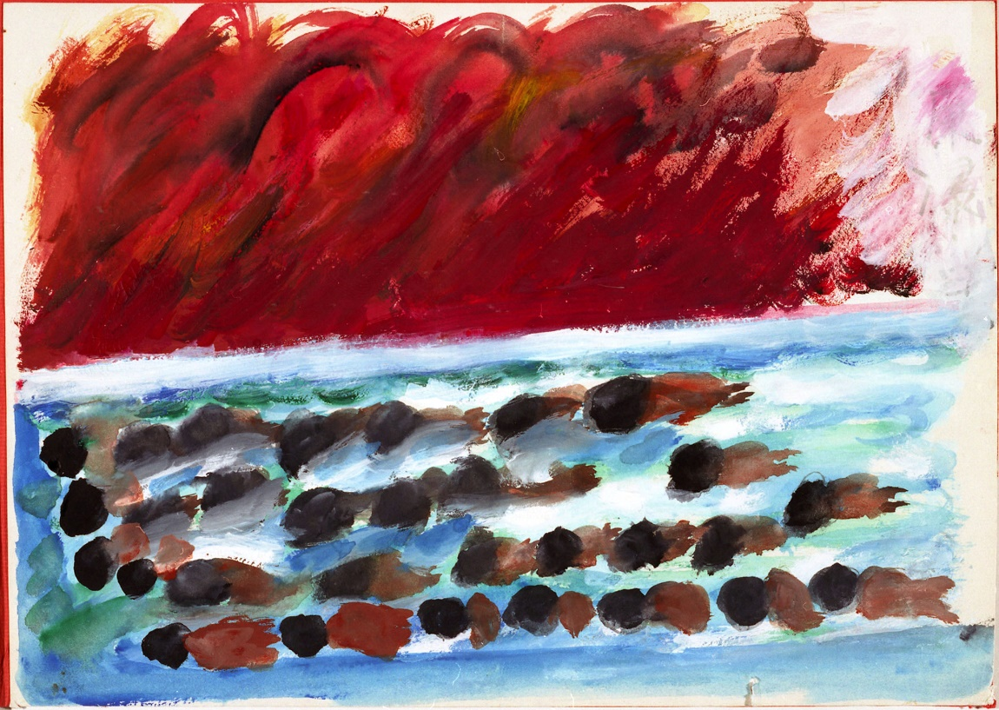
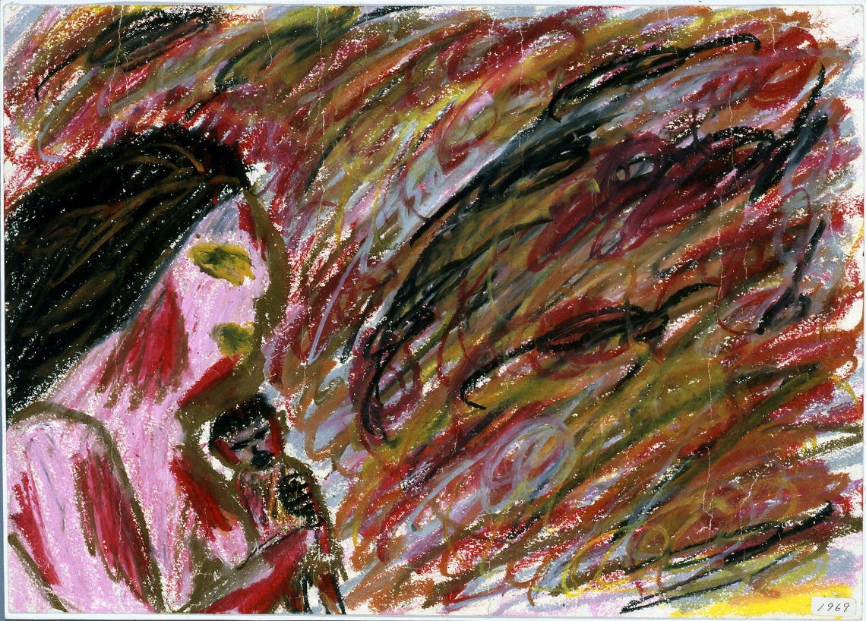
How did your artwork compare to the art of some Hibakusha?

Slide 31
Are these artworks political or personal?

Slide 32
The Hiroshima Panels
15 painted folding-panels made between 1950 and 1982, by Iri and Toshi Maruki.
Notes:
More info in Critical Mass (p. 37)

Slide 33
What do you think?
Notes:
Why did the bombings happen? Should the bombings have happened?

Slide 34
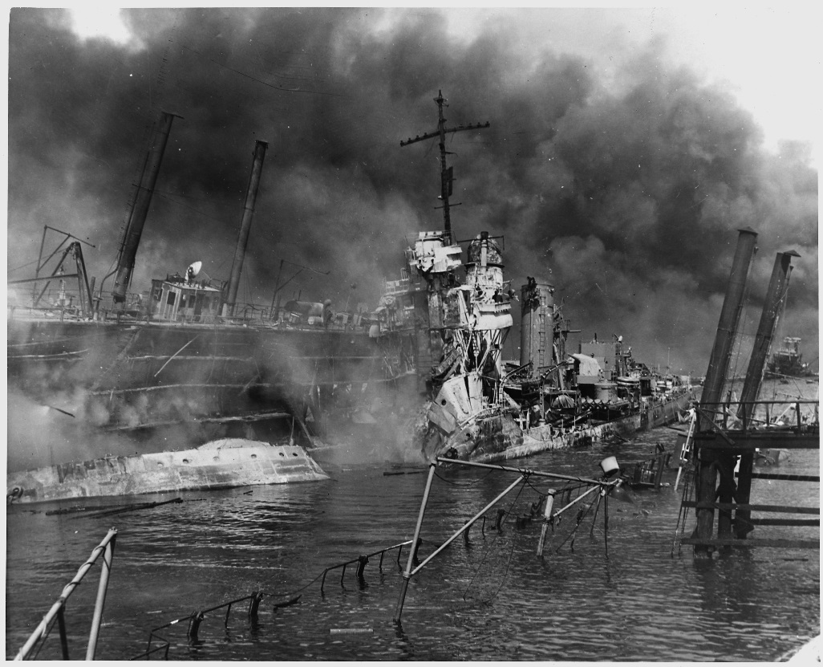
What are the arguments for the atomic bombings?
Saved lives: ended the war ASAP, saving lives overall by avoiding a land invasion
Revenge for Japan’s attack on Pearl Harbour, and for the torture of American prisoners by Japanese soldiers
Once the bomb was developed, it was always going to be used
US National Archives
Notes:
.

Slide 35
What are the arguments against the atomic bombings?
Immoral: Killed 185,000-600,000 people - mostly civilians
Surrender was possible: The US knew that some of the Japanese government wanted to surrender
More about sending a message to the world (and especially the Soviet Union) about how powerful America was
Notes:
.

Slide 36
What we’ve done :
Learnt about the bombings of Hiroshima and Nagasaki, and their effects
Made artwork based on an eye-witness account of the bombing
Compared our artwork with art by Hibakusha

Slide 37
Any Questions?
Notes:
Be aware that Hibakusha is pronounced: he-back-sha

