Slide 1
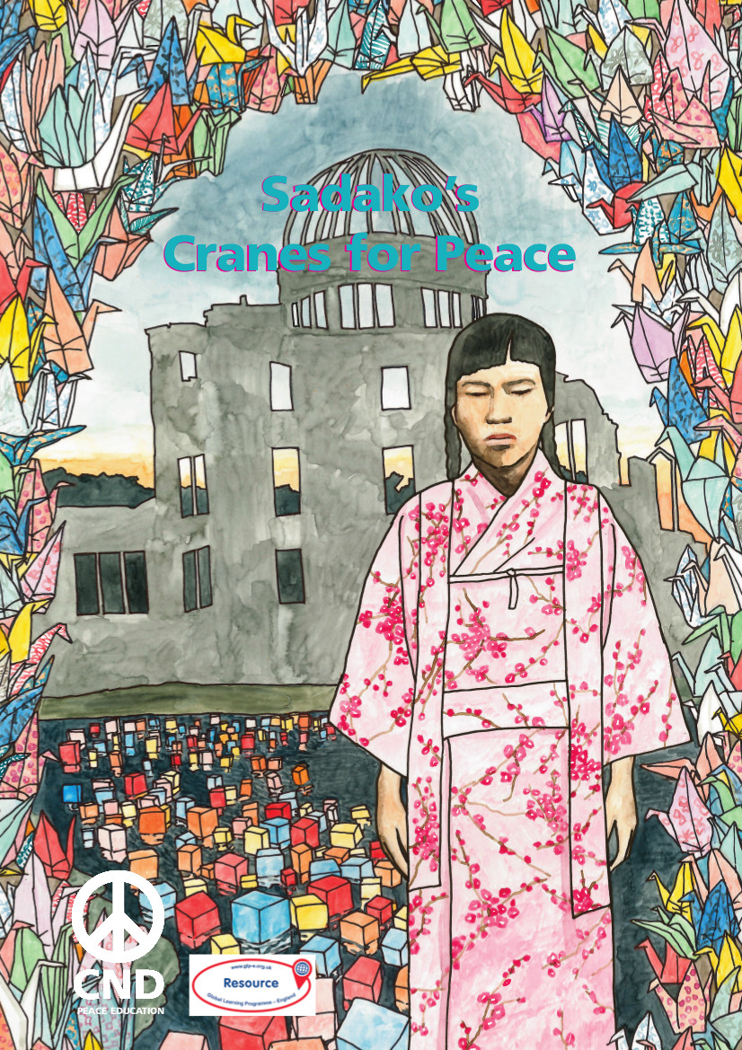

Slide 2
What we’ll do in this workshop:
Discuss what peace is
Do a quiz on peace symbols
Learn about Sadako Sasaki
Make our own origami peace cranes!

Slide 3
What is peace?

Slide 4
What peace symbols do you know?

Slide 5
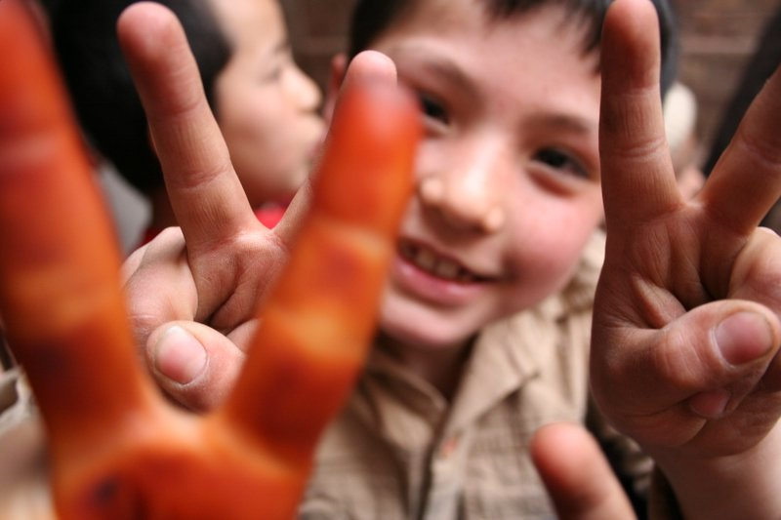
Sheila ; https://creativecommons.org/licenses/by-nd/2.0/legalcode

Slide 6
When was this hand gesture first used?
World War 1
(1914 - 1918)
b) World War 2
(1939 - 1945)
c) The Vietnam War
(1955 - 1975)
d) The Iraq War
(2003 - 2011)
Sheila ; https://creativecommons.org/licenses/by-nd/2.0/legalcode
Notes:
It’s b) World War 2. Winston Churchill made it famous, though others had used it before him as part of the ‘V For Victory’ campaign. For many people in 1939-1945, victory in the war meant peace. There is a popular myth that the gesture dates from the Hundred Years War between England and France, but there is no historical evidence for this (see https://bshistorian.wordpress.com/2007/07/02/two-fingers-up-to-english-history/)

Slide 7
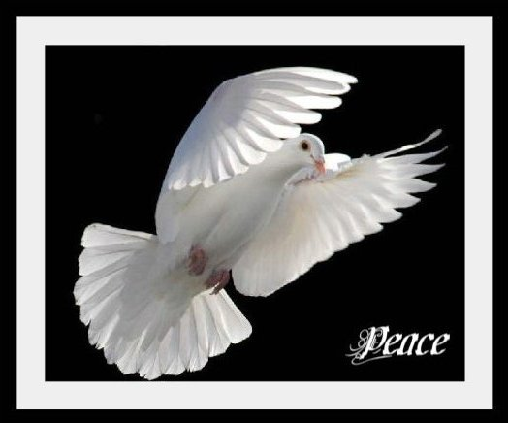
Sara D ; https://creativecommons.org/licenses/by-nd/2.0/legalcode
Nick Kenrick ; https://creativecommons.org/licenses/by-nd/2.0/legalcode

Slide 8
From which religion does this peace symbol originate?
a) Christianity
b) Islam
c) Buddhism
d) Judaism
Sara D ; https://creativecommons.org/licenses/by-nd/2.0/legalcode
Nick Kenrick ; https://creativecommons.org/licenses/by-nd/2.0/legalcode
Notes:
This is actually a trick question: all of the religions except Buddhism have the story of Noah’s Ark - and the dove carrying the olive branch (signifying hope and a future for humans and land-animals) – as part of their faith.

Slide 9
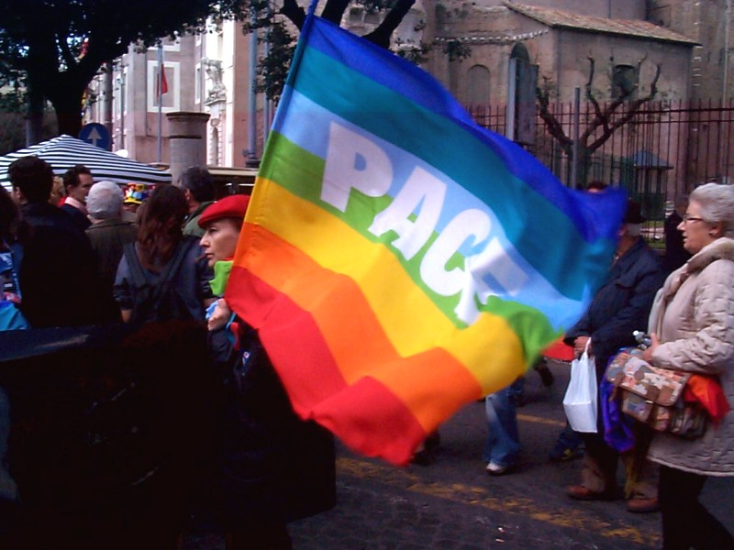
Nick Kenrick ; https://creativecommons.org/licenses/by-nd/2.0/legalcode

Slide 10
‘Pace’ word means ‘Peace’ in which language?
a) Greek
b) Arabic
c) Spanish
d) Italian
Nick Kenrick ; https://creativecommons.org/licenses/by-nd/2.0/legalcode
Notes:
d) Italian. Pronounced ‘pah-chay’, it derives from the Latin: ‘Pax’. The rainbow flag is usually associated with the LGBT+ movement, but it is also used on the PACE peace flag. The order of the colours are reversed on the LGBT+ Pride flag, and indigo is removed.

Slide 11
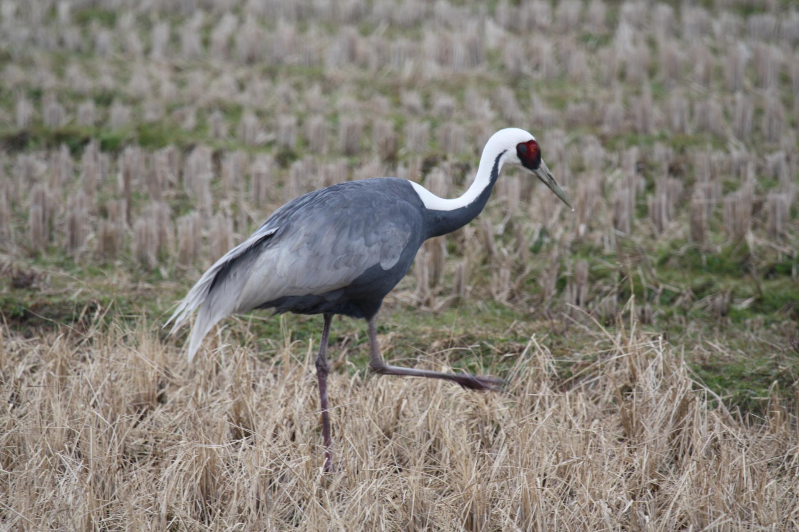
Alastair Rae ; https://creativecommons.org/licenses/by-nd/2.0/legalcode
Notes:
Does anyone know what bird this is? (A crane – a red-crested crane to be precise. This is not to be confused with the cranes that we use for making buildings!)
In Japan, this bird is very special. We’ll find out why in a few minutes.

Slide 12
JC Belmonte ; https://creativecommons.org/licenses/by-nd/2.0/legalcode ; cropped
Notes:
This is an origami crane – a crane made out of paper. What does origami mean? (The art of folding paper to make things like animals)
Where does origami come from? (Japan)
We’ll come back to this later.

Slide 13
Notes:
Who recognises this symbol?

Slide 14
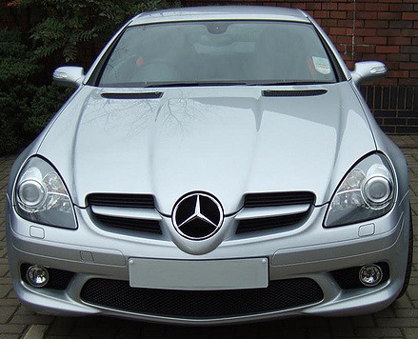
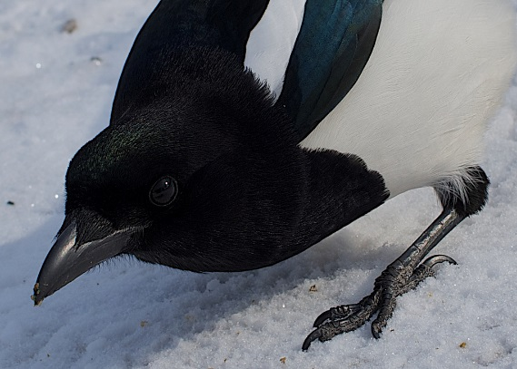
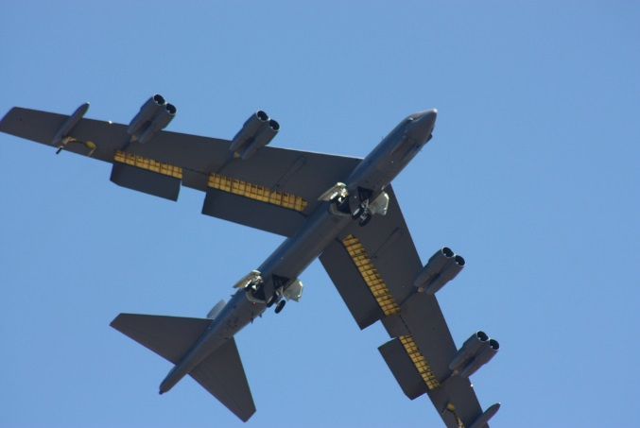
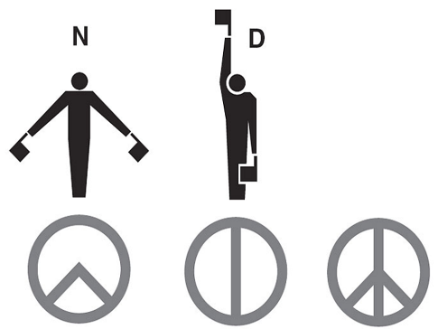
This symbol was designed based on…
a) The Mercedes-Benz symbol
b) Semaphore
c) A bird’s claw
d) A B-52 bomber aeroplane
Carl Spencer; https://creativecommons.org/licenses/by-nd/2.0/legalcode
Mark locchelli ; https://creativecommons.org/licenses/by-nd/2.0/legalcode
Paul L. McCord Jr. ; https://creativecommons.org/licenses/by-nd/2.0/legalcode ; cropped

Slide 15
Notes:
b) Semaphore. It was designed in 1958 by Gerald Holtam, for the first anti-nuclear weapons march in Britain. We’ll look at what nuclear weapons are in a minute.
The two signs for ‘N’ and ‘D’ together signalled ‘nuclear disarmament’.

Slide 16
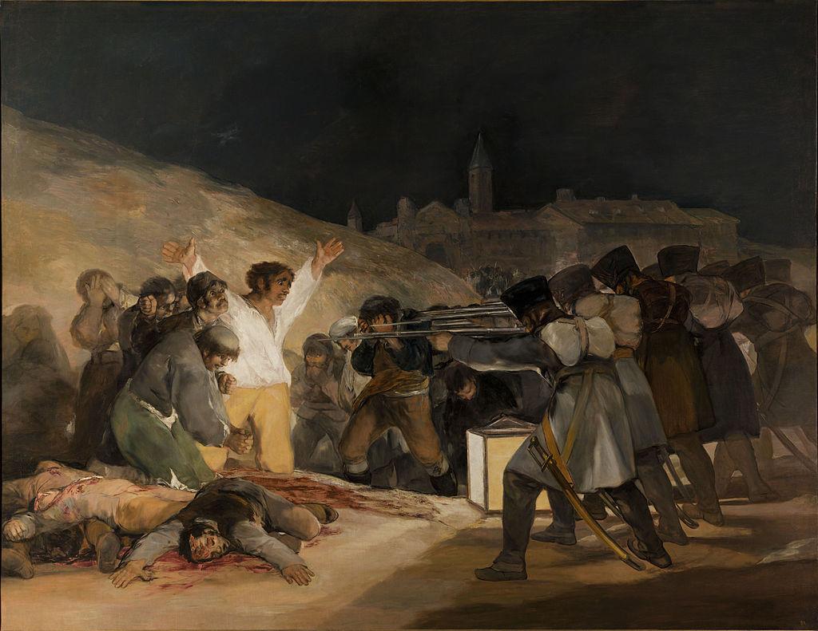
'I was in despair. Deep despair. I drew myself: the representative of an individual in despair, with hands palm outstretched outwards and downwards in the manner of Goya's peasant before the firing squad. I formalised the drawing into a line and put a circle round it.’ – Gerald Holtom, designer of the CND symbol
Public domain ; Wikimedia

Slide 17
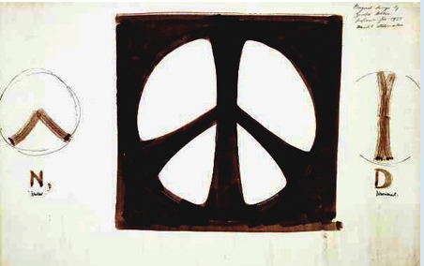
Notes:
This is Gerald’s first design of the symbol.

Slide 18
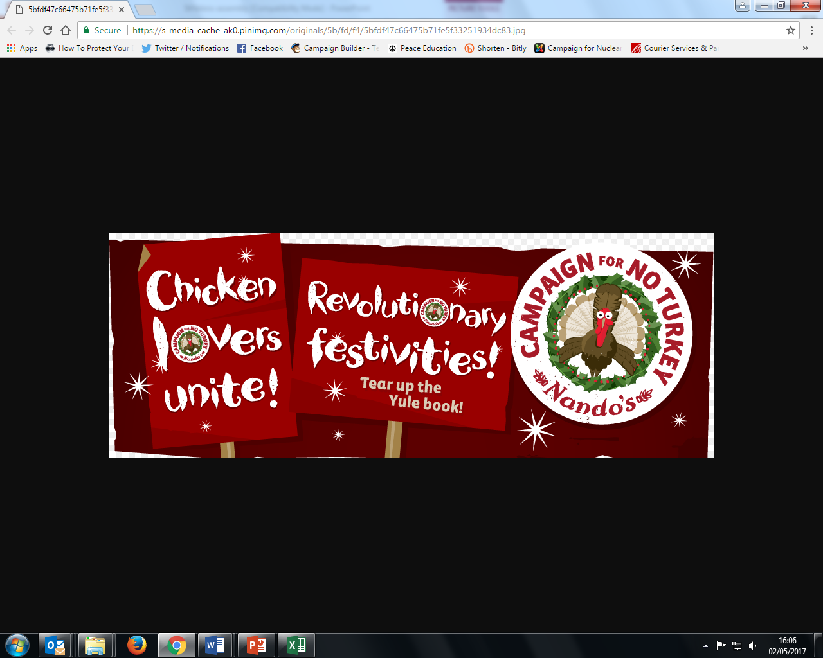
Notes:
CND decided not to copyright the symbol, which is why we see it so much everywhere: people (and companies) don’t have to pay – or request permission - to use it for themselves.

Slide 20
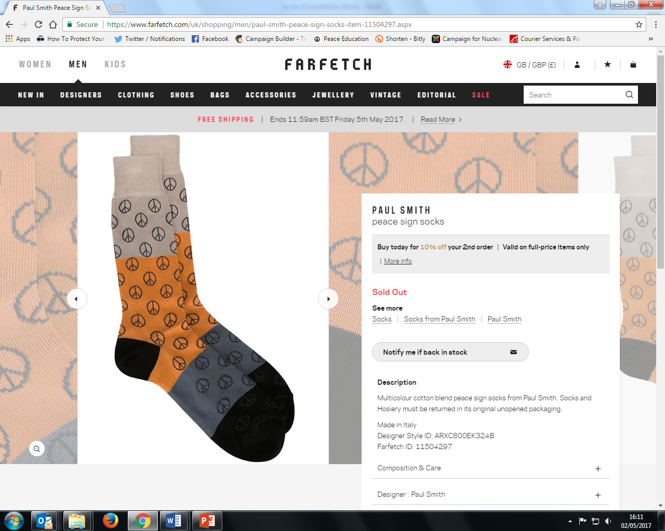

Slide 21
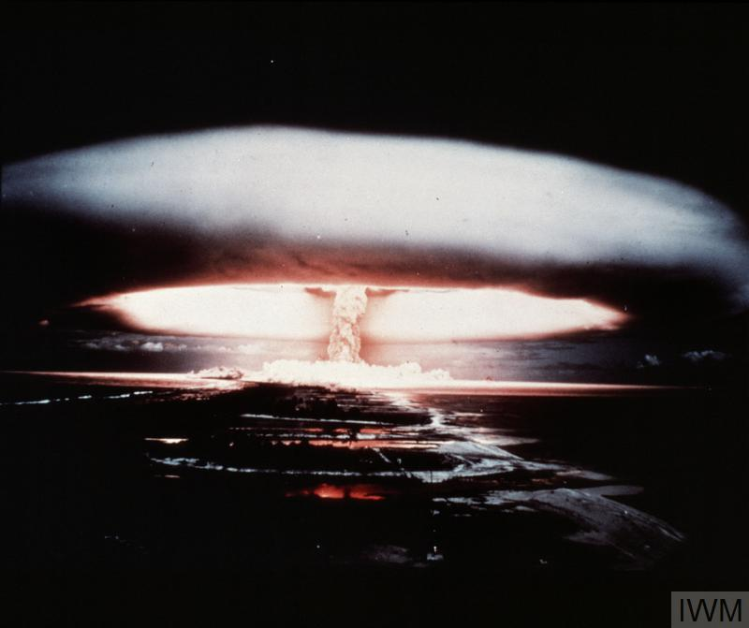
What is a nuclear weapon?
Notes:
Can anyone tell me what a nuclear weapon is, and how it works? [Repeat answers, in case not everyone heard. Add, if necessary:]
It’s an incredibly powerful bomb, known as a Weapon of Mass Destruction. There are two types: the first one discovered is the atomic bomb, which gets its huge explosive power when the nucleus of an atom is split by a neutron, releasing more neutrons, which split more nuclei, in a very fast chain reaction that releases enormous amounts of energy. This reaction is called ‘nuclear fission’.
What do we call the shape in this photo (which, like the photo on the first slide, is a British nuclear weapon test in the 1950s)? [Repeat answer, in case not everyone heard. If no-one knows, clarify:] We call it a mushroom cloud.
[For higher ability or older groups:] Nuclear fission involves isotopes of Uranium or Plutonium – isotopes are atoms of an element with a different number of neutrons. They can be very radioactive.
[Go to next slide]

Slide 22
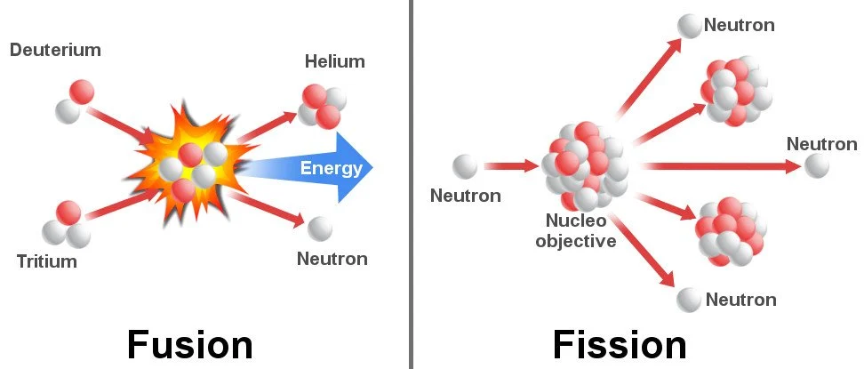
Notes:
Image source: https://www.scienceabc.com/eyeopeners/why-arent-we-using-nuclear-fusion-to-generate-power-yet.html
Nuclear fusion – two smaller atoms are brought together, usually hydrogen or hydrogen isotopes (deuterium, tritium), to form a larger one (helium isotopes); this is how the sun produces energy. Hydrogen bombs, which use nuclear fusion, have higher destructive power and greater efficiencies than atomic bombs.
Nuclear fission – the nucleus of an atom is split into two smaller fragments by a neutron. This method usually involves isotopes of uranium (uranium-235, uranium-233) or plutonium (plutonium-239). When a single free neutron strikes the nucleus of an atom of radioactive material like uranium or plutonium, it knocks two or three more neutrons free. Energy is released when those neutrons split off from the nucleus, and the newly released neutrons strike other uranium or plutonium nuclei, splitting them in the same way, releasing more energy and more neutrons. This chain reaction spreads almost instantaneously. Nuclear fission produces the atomic bomb.

Slide 23
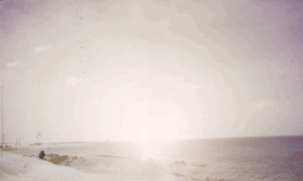
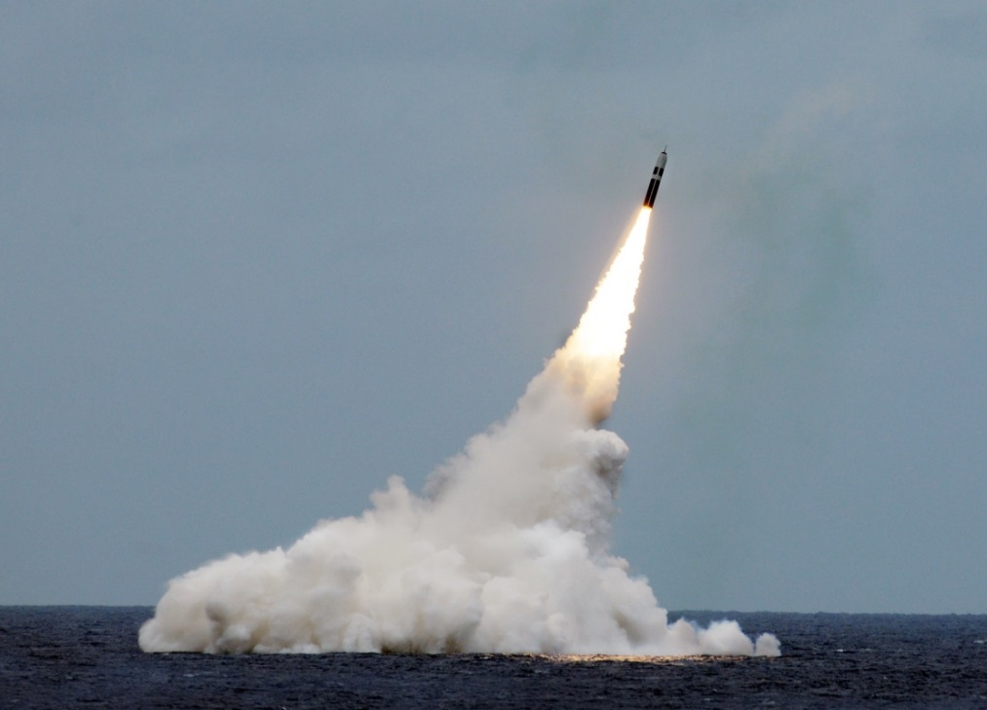
Paul L. McCord Jr. ; https://creativecommons.org/licenses/by-nd/2.0/legalcode ; cropped
Public domain ; National Museum of the US Navy
Notes:
Nuclear weapons can be launched from the ground, air and sea.

Slide 24
How many nuclear weapons are there in the world?

Slide 25
= 12,121 in total
Almost 4000 of them could be used at short notice; 5600 are in storage; and 2500 are ‘retired’ and will be dismantled in the coming years.
Big decrease since the 1980s (70,000 warheads!), and 400 less than last year
This is the first time since 1999 that India’s stockpile has surpassed Pakistan’s. China is expanding its nuclear arsenal faster than any other country (from 410 in 2023 to 500 in 2024

Slide 26
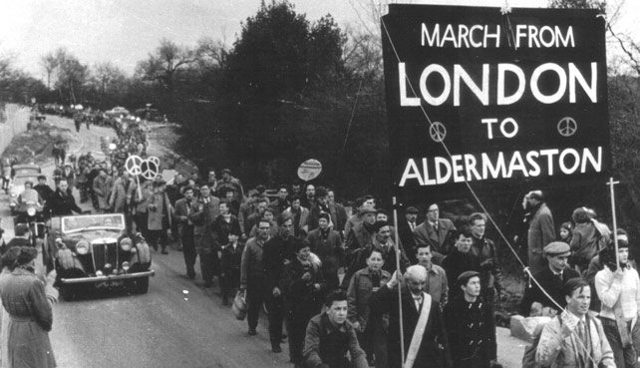
Notes:
The Campaign for Nuclear Disarmament (or CND for short) is a group of people who have been saying since 1958 that the UK shouldn’t have nuclear weapons. The UK has 215 nuclear warheads. This photo is of the first ever CND protest march. What do I mean by a ‘protest march’? People marched from London to Aldermaston (near Reading), where the UK’s nuclear weapons are made.

Slide 27
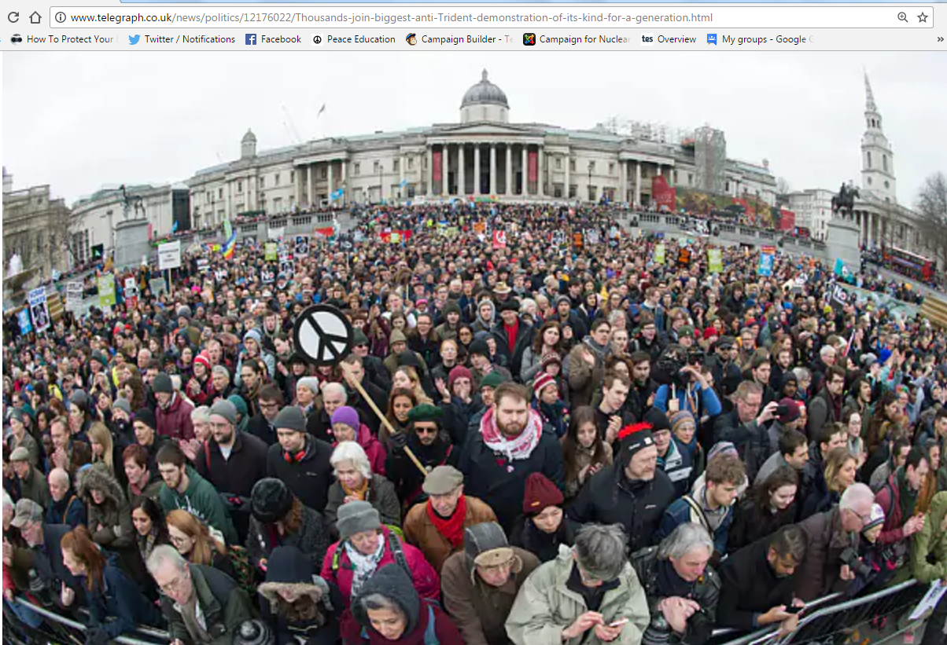
Notes:
This photo is a CND protest against nuclear weapons in 2016: this was the biggest ever in the UK. The people are in Trafalgar Square, in the centre of London.

Slide 28
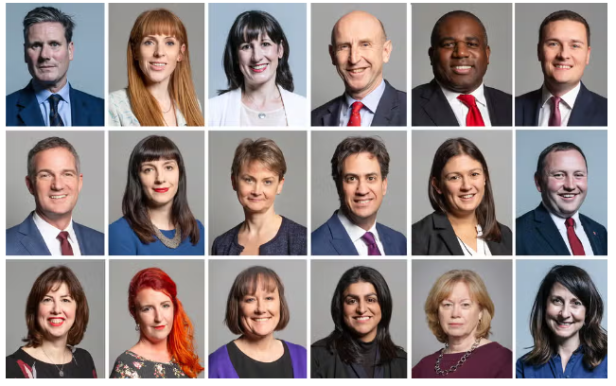
Keir Starmer’s cabinet 2024
Notes:
Lots of people think we need nuclear weapons. For example, the current UK government: the people who run the country.

Slide 29
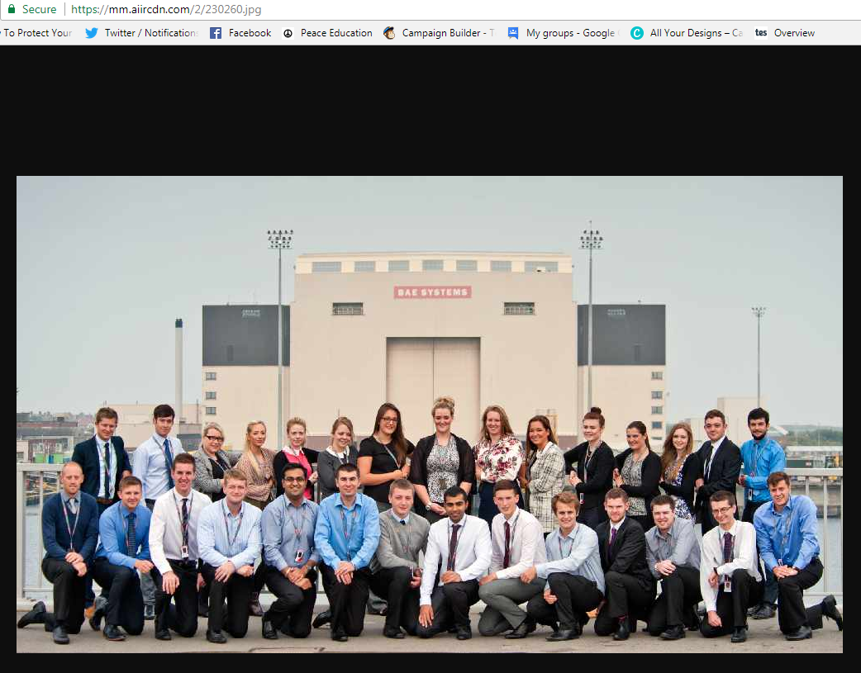
Notes:
… And the people who make the nuclear weapons for Britain, including these people.

Slide 30
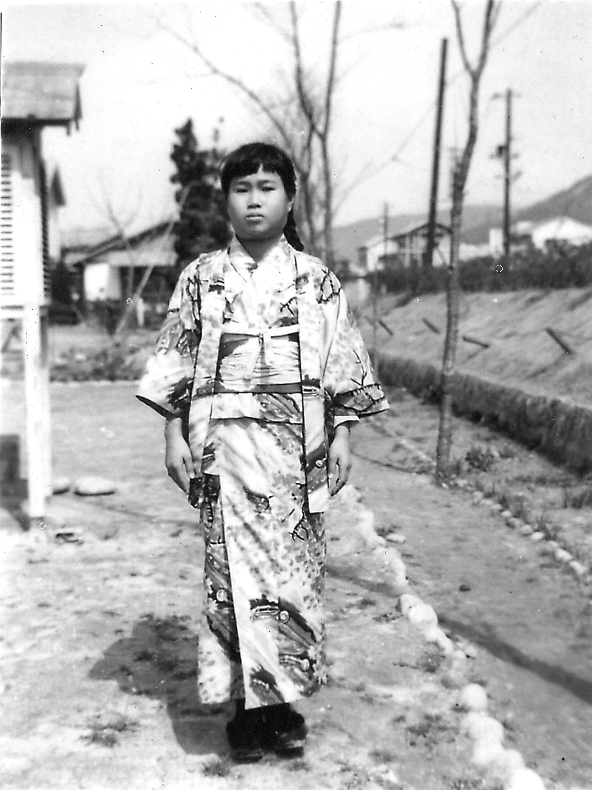
Image provided by Masahiro
Sasaki
Notes:
Does anyone recognise this girl? (The drawing in the first slide is based on this photo)
This is Sadako Sasaki. She was born in the city of Hiroshima, in Japan, in 1943. We’re going to learn about her story. Does anyone know what her dress is called? (A kimono)

Slide 31
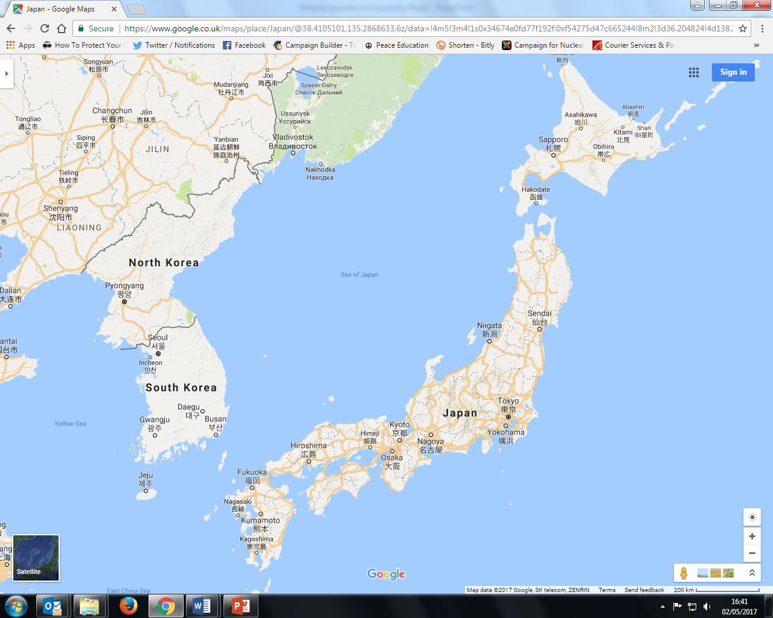
Notes:
At the end of World War 2, in August 1945, the USA dropped two nuclear bombs on Japan, first over the city of Hiroshima (where Sadako lived), and then 3 days later over the city of Nagasaki. [Point the two cities out on the map]
These are the only times nuclear weapons have been used in a war.

Slide 32
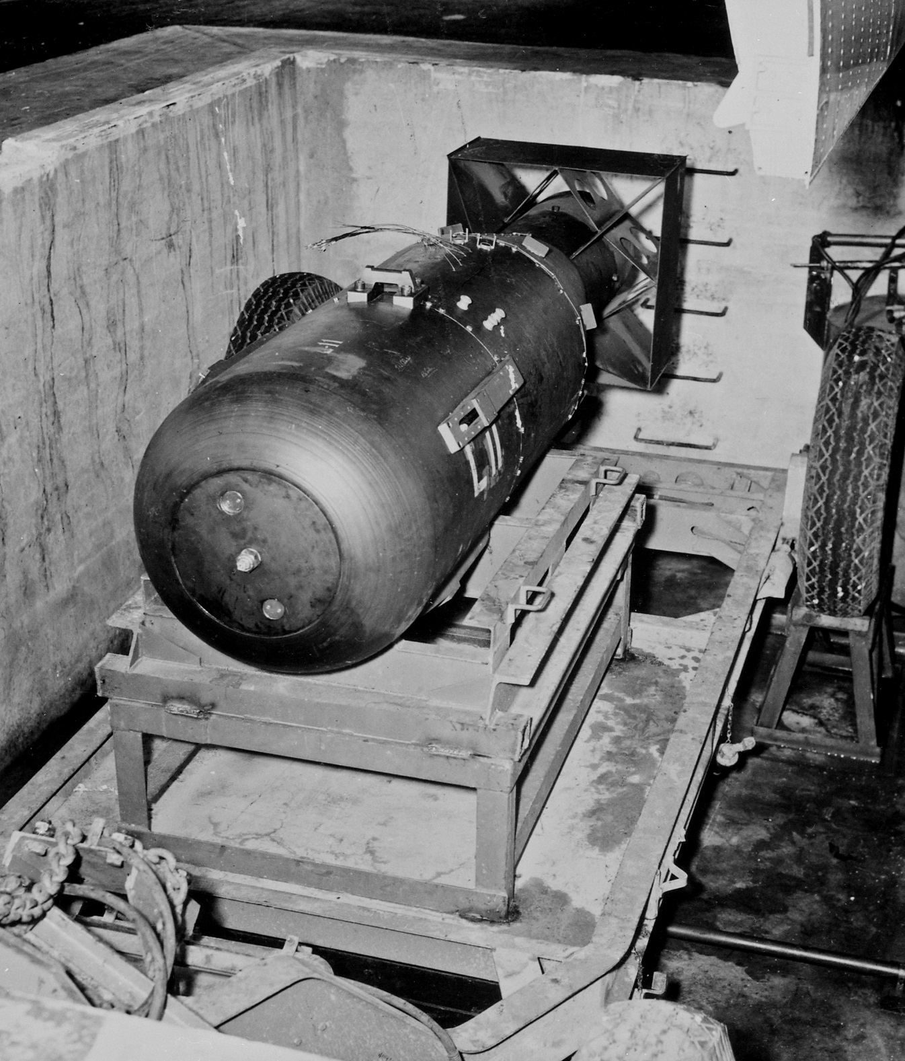
James Vaughan ; https://creativecommons.org/licenses/by-sa/2.0/legalcode
Notes:
‘Little Boy’: the bomb that was dropped on Hiroshima

Slide 33
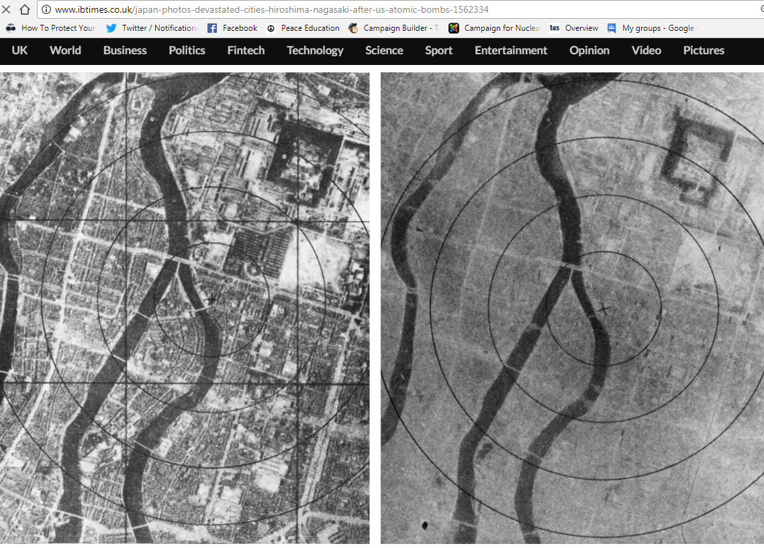
6th August 1945: The bomb is dropped on Hiroshima
Notes:
It was a similar scene in Nagasaki on 9th August.
Q: What has changed?
Q: How do you know it is the same place? (A: River, large building foundations, some roads)

Slide 34
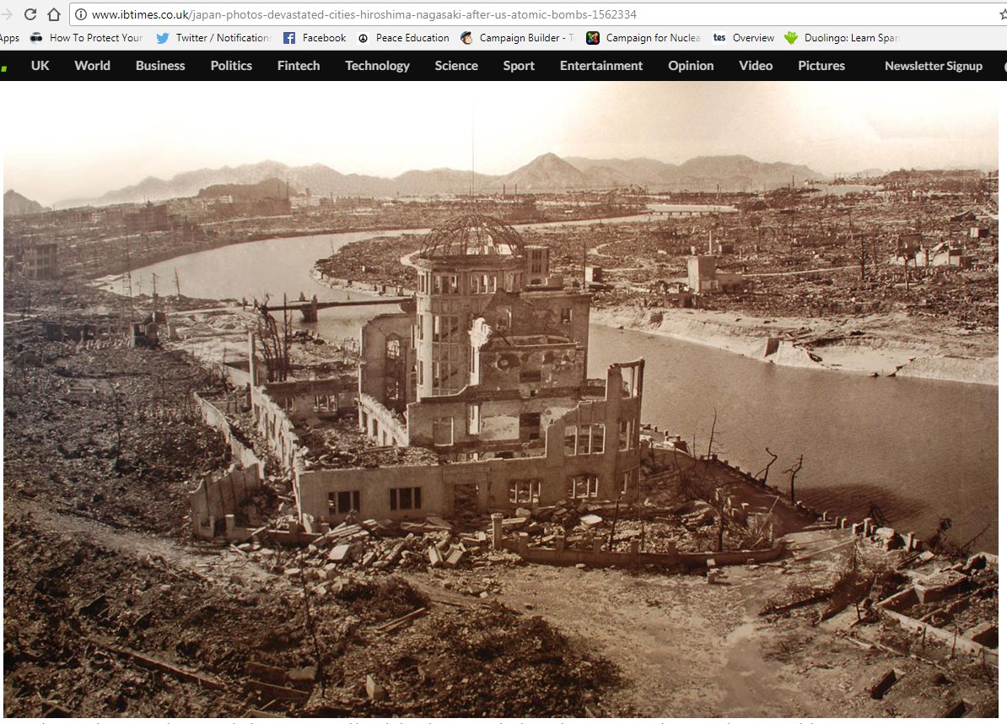
Notes:
This photo was taken after the bombing of Hiroshima. As you can see, only a few buildings are still standing. Between 150,000 and 600,000 people died – some died many years afterwards, from the effects of the radiation.

Slide 35
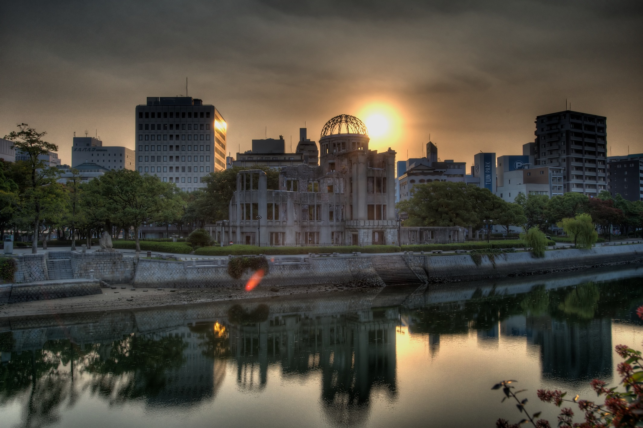
Hairyegg; https://creativecommons.org/licenses/by-sa/2.0/legalcode
Notes:
This shows the remains of the building today. Has anyone been to Hiroshima? Did you see this building, and the Peace Park that it’s in?

Slide 36
Notes:
These are the steps leading up to a bank in Hiroshima, where people were waiting at 8am for the bank to open when the bomb exploded at about 8:15.
The circular grey patch known as the ‘shadow’ is all that was left of a person who was sitting on the steps.
These steps are now in the Hiroshima Atomic Bomb Museum displayed along with many other artefacts left after the bomb.

Slide 37
Hiroshima video clip (reconstruction)
You may find the clip disturbing. Feel free to close your eyes/look away.
Notes:
37
https://www.youtube.com/watch?v=3wxWNAM8Cso (play from 2.30-3.35)
Hiroshima Dropping the Bomb, BBC

Slide 38
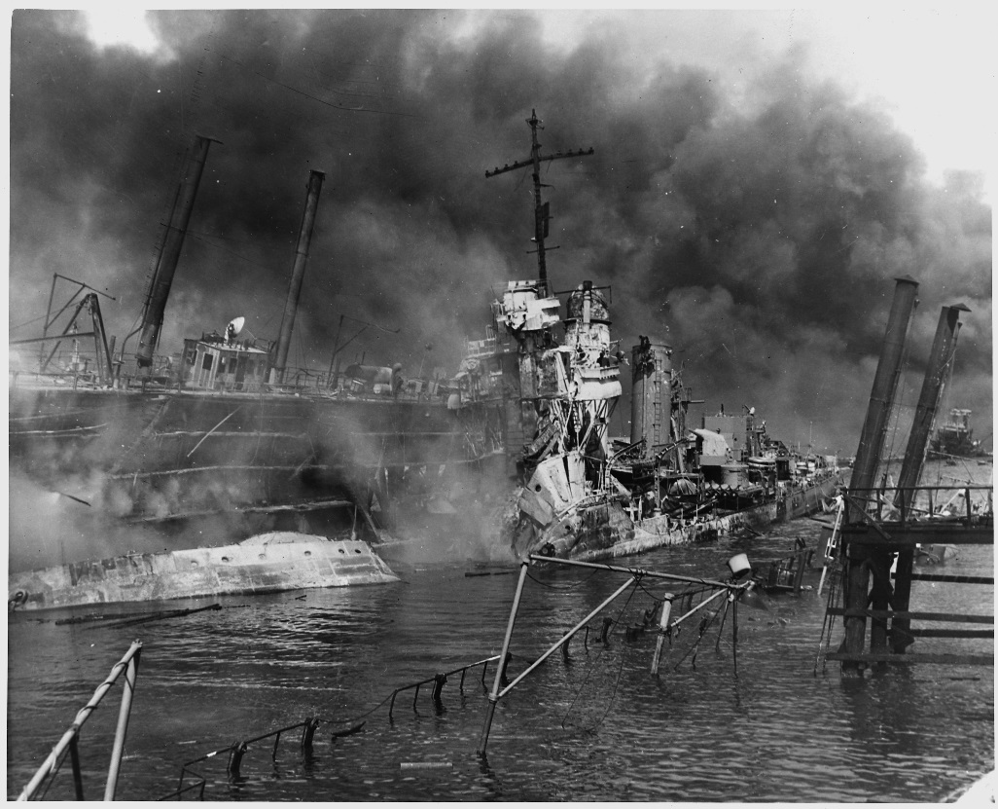
What are the arguments for the bombings?
Saved lives: ended the war ASAP, saving lives overall by avoiding a land invasion
Revenge for Japan’s attack on Pearl Harbour, and for the torture of American prisoners by Japanese soldiers
Once the bomb was developed, it was always going to be used
US National Archives
Notes:
.

Slide 39
What are the arguments against the bombings?
Immoral: Killed 185,000-600,000 people - mostly civilians
Surrender was possible: The US knew that some of the Japanese government wanted to surrender
More about sending a message to the world (and especially the Soviet Union) about how powerful America was
Notes:
.

Slide 40
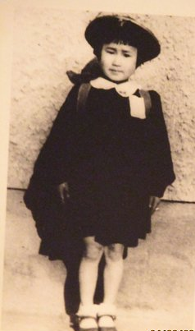
Image provided by Masahiro
Sasaki
Notes:
Sadako in 1949 (aged 6), at primary school.

Slide 41
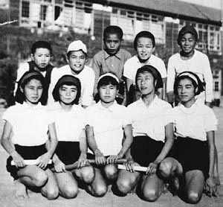
Image provided by Masahiro
Sasaki
Notes:
In this photo, taken in October 1954, Sadako is in the middle of the front row. She was a good student and she loved running – she was one of the fastest in her school. One day, when she was 12, she got strange lumps on some parts of her body. She went to hospital for tests, and the doctors told her and her parents that she had leukaemia. It had been caused by the atomic-bomb. Can anyone tell me what leukaemia is? (a type of cancer – of the blood)

Slide 42
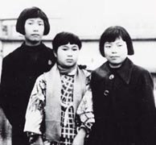
Image provided by Masahiro
Sasaki
Notes:
This is a photo of Sadako (she’s in the middle) being visited at the hospital by two of her classmates, in 1955. In Japan there is a legend that if you make 1000 origami paper cranes, you get a wish. When she was in hospital, Sadako’s Dad gave her a paper crane, telling her about this legend. Sadako started to try to make 1000, so that she could have a wish.

Slide 43
Two versions of the story.
Notes:
Sadako sadly died in 1945, aged 12. There are two versions of the end of the story. The first – and most famous - version is that Sadako folded around 600 cranes before she died, and her friends made the remaining 400 or so cranes and buried her with them. The second version of the story is that Sadako made all 1000 cranes, before folding another 600 or so. The second version is the true version: it’s what Sadako’s older brother Masahiro says – he’s still alive today.

Slide 44
‘Sadako's story spread on its own without any confirmation by any member of our family. So now, Sadako Legacy is conveying the [true] story worldwide... We do not have the exact number of Sadako's paper cranes, but… [it was] over sixteen hundred.’ – Sadako’s older brother Masahiro Sasaki, in 2018
Notes:
Would anyone like to read this out loud for me?

Slide 45
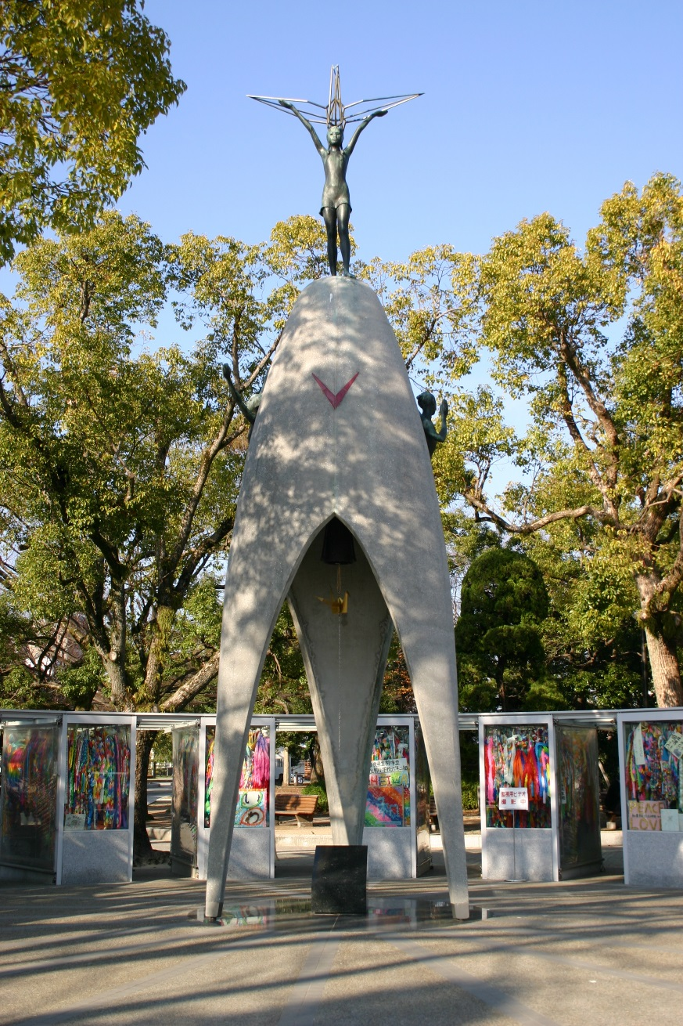
Lachlan O’Dea ; https://creativecommons.org/licenses/by-nd/2.0/legalcode
At the bottom of the statue it says:
‘This is our cry, this is our prayer: peace in the world’
Notes:
45
Sadako’s friends raised the money for this statue after she died.

Slide 46
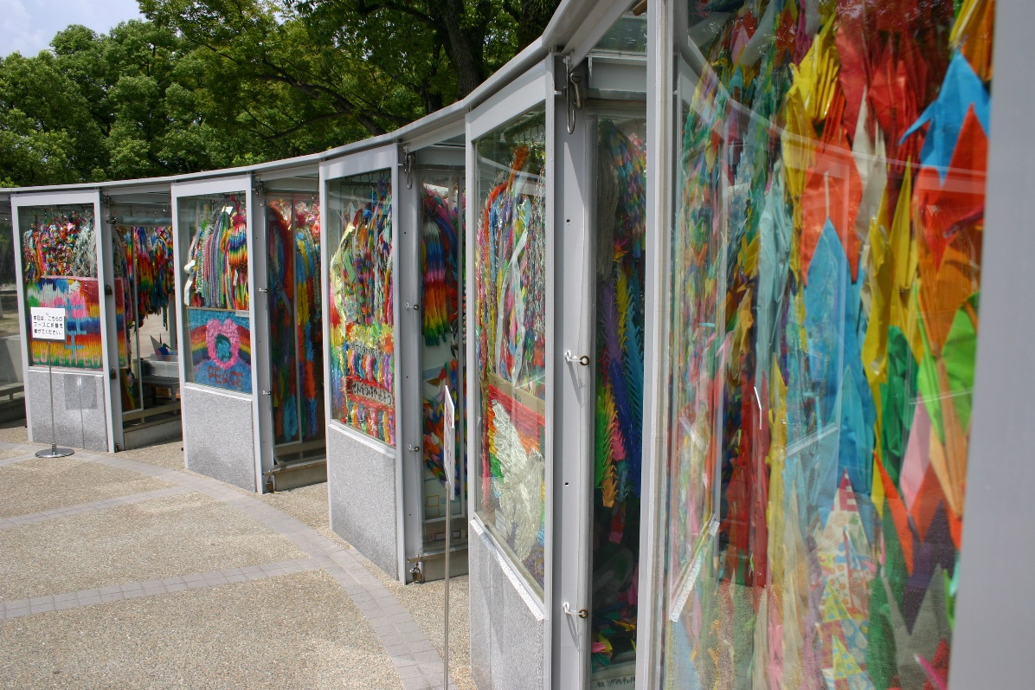
Tom Page ; https://creativecommons.org/licenses/by-nd/2.0/legalcode
Notes:
Sadako has become a world-famous symbol of hope, of doing amazing things in a really difficult situation, and also peace. This photo shows thousands upon thousands of cranes behind the Sadako statue, posted to Hiroshima from people around the world who are inspired by her story.

Slide 47
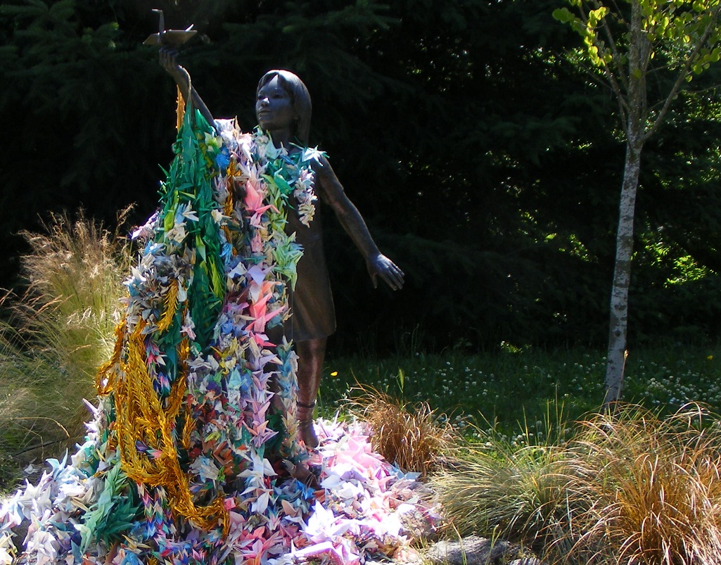
Dan B Seattle 2012 ; https://creativecommons.org/licenses/by-nd/2.0/legalcode
Notes:
This is another statue of Sadako, with thousands of cranes around it. This statue is in Seattle, in the USA. How does the story of Sadako make you feel?

Slide 48
‘Sadako's wish wasn’t concerned with such an important matter as world peace. As she folded paper cranes she wished for her parent's debts to disappear… she wished to get well soon and go home, and so on…
Fundamentally, what Sadako did - having wishes and folding paper cranes - is within reach of anyone, and orizuru have become a tool for all to express a common wish for peace. It is a simple story. Please let people know how the movement started.’
– Sadako’s older brother Masahiro Sasaki, in 2018
Notes:
Can I have a volunteer to read this out?
Does anyone have any thoughts about what Masahiro says here?

Slide 49
JC Belmonte ; https://creativecommons.org/licenses/by-nd/2.0/legalcode ; cropped
First: Write or draw something about peace on the plain side of your sheet of origami paper
Notes:
[Use a YouTube instruction video, if not instructing the class yourself! We recommend our own video: https://www.youtube.com/watch?v=hZ0PYZnrpdY
If you have time, you could start by making a swan, which is much simpler and quicker, but uses some of the same folds. See https://www.youtube.com/watch?v=bofHx6N9W1k&t=3s ]

