Slide 1
Lesson 1:
Hiroshima and Nagasaki carousel
Notes:
[CITIZENSHIP TEACHERS: Please note: We have created a collection of additional Citizenship classroom (and homework) activities and resources to extend and enrich the Citizenship content of the Truman On Trial lessons (including this one). To browse and download the materials, go to https://cnduk.org/education/truman-cit Where applicable, we have added advice and guidance on the additional activities and resources, in some of the slides notes in this PowerPoint.]

Slide 2
What we’ll do in this lesson:
Learn about the use of nuclear bombs in the Second World War
Look at photos, drawings, poems, songs and quotes about the bombs, and record and discuss what we think and feel about them
Notes:
[NB: If you’ve already taught background information on the atomic bombings (and don’t need to re-cap), or you would prefer students to engage with the stimuli first and then learn more about the context, skip to slide 23]

Slide 3
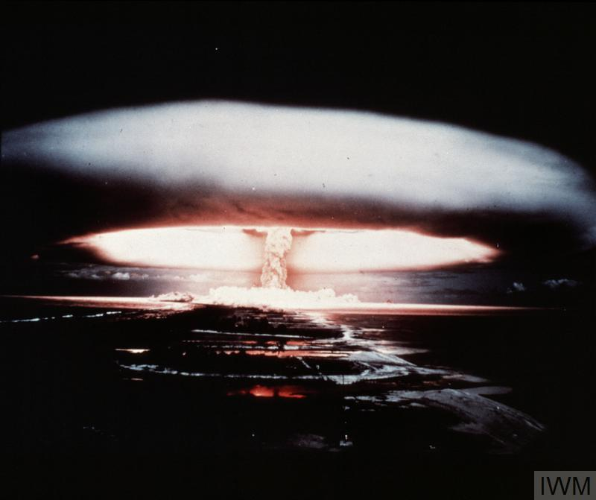
What is a nuclear weapon?
Notes:
[NB: If you’ve already taught background information on the atomic bombings (and don’t need to re-cap), or you would prefer students to engage with the stimuli first and then learn more about the context, skip to slide 23]
Can anyone tell me what a nuclear weapon is, and how it works? [Repeat answers, in case not everyone heard. Add, if necessary:]
It’s an incredibly powerful bomb, known as a Weapon of Mass Destruction. There are two types: the first one discovered is the atomic bomb, which gets its huge explosive power when the nucleus of an atom is split by a neutron, releasing more neutrons, which split more nuclei, in a very fast chain reaction that releases enormous amounts of energy. This reaction is called ‘nuclear fission’.
What do we call the shape in this photo (which, like the photo on the first slide, is a British nuclear weapon test in the 1950s)? [Repeat answer, in case not everyone heard. If no-one knows, clarify:] We call it a mushroom cloud.
[For higher ability or older groups:] Nuclear fission involves isotopes of Uranium or Plutonium – isotopes are atoms of an element with a different number of neutrons. They can be very radioactive.
[Go to next slide]

Slide 4
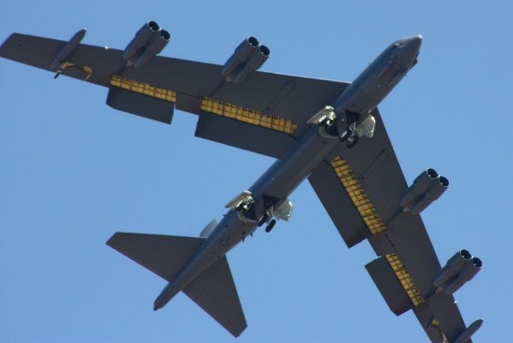
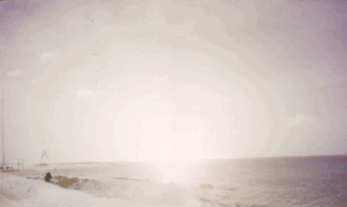
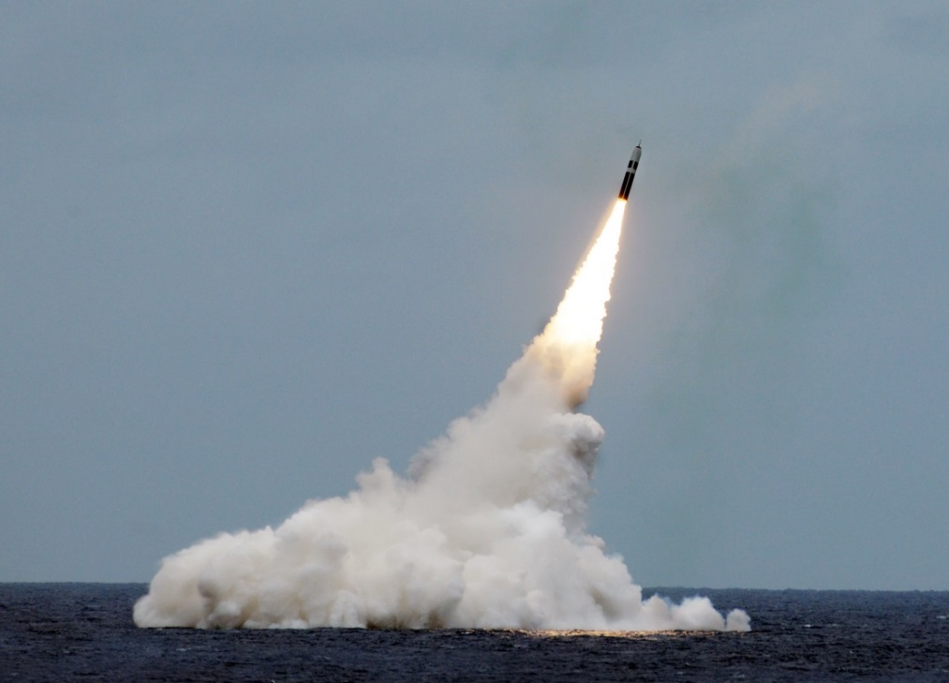
Paul L. McCord Jr. ; https://creativecommons.org/licenses/by-nd/2.0/legalcode ; cropped
Public domain ; National Museum of the US Navy
Notes:
Nuclear weapons can be launched from the ground, air and sea.

Slide 5
= 12,121 in total
Almost 4000 of them could be used at short notice; 5600 are in storage; and 2500 are ‘retired’ and will be dismantled in the coming years.
Big decrease since the 1980s (70,000 warheads!), and 400 less than last year
This is the first time since 1999 that India’s stockpile has surpassed Pakistan’s. China is expanding its nuclear arsenal faster than any other country (from 410 in 2023 to 500 in 2024

Slide 6
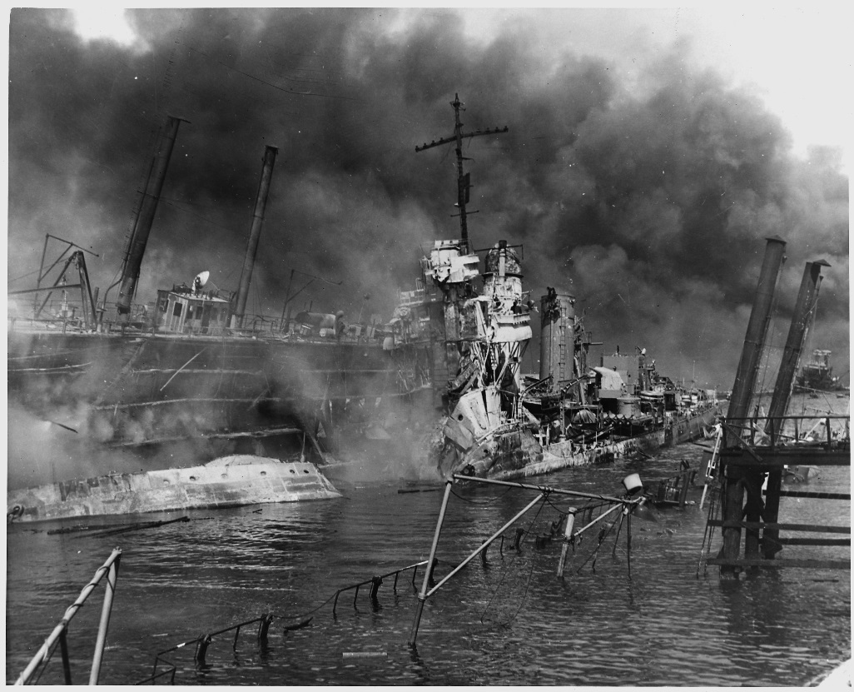
7th December 1941: Japan attacks Pearl Harbor (Hawaii). It’s a surprise attack that destroys or badly damages lots of US military ships and planes, and kills nearly 3000 Americans. The USA declares war against Japan the next day, thus entering the Second World War.
US National Archives
Notes:
.
President Roosevelt told Congress: “we will gain the inevitable triumph”. The text of the declaration included: ‘the President is hereby authorized and directed to employ the entire naval and military forces of the United States and the resources of the Government to carry on war against the Imperial Government of Japan; and, to bring the conflict to a successful termination.’
[For more information see http://avalon.law.yale.edu/subject_menus/decmenu.asp You can watch Roosevelt’s speech at https://www.youtube.com/watch?v=lK8gYGg0dkE]

Slide 7
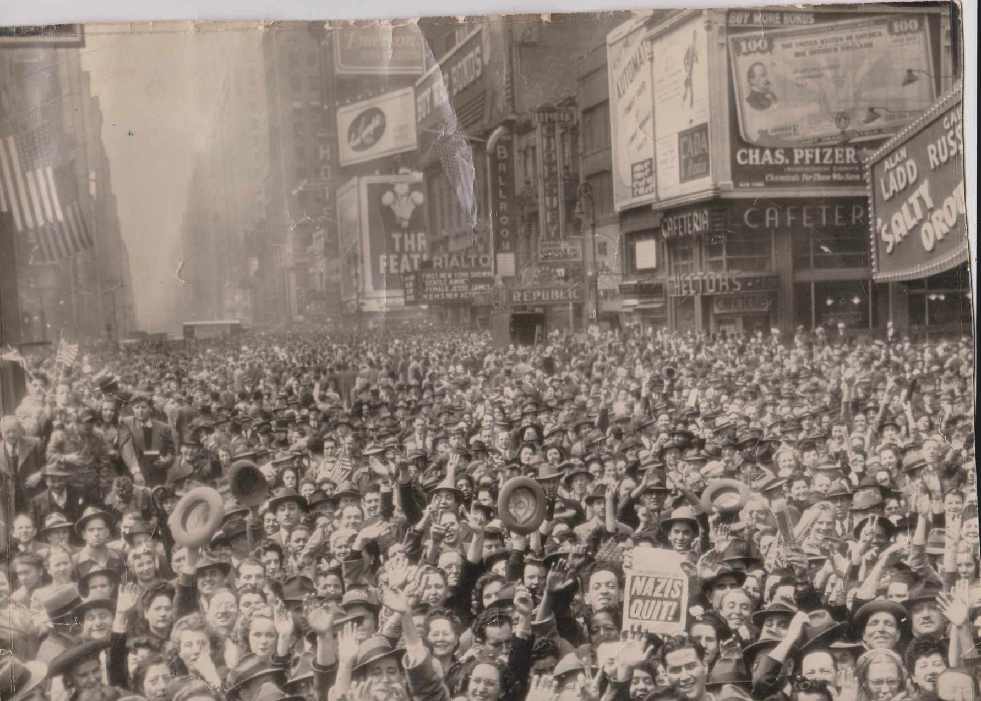
8th May 1945: Nazi Germany surrenders to the Allied Powers (Britain, USA, USSR, China, and others). This is known as Victory in Europe (VE) Day.
Robert Huffstutter; https://creativecommons.org/licenses/by-nc-sa/2.0/legalcode

Slide 8
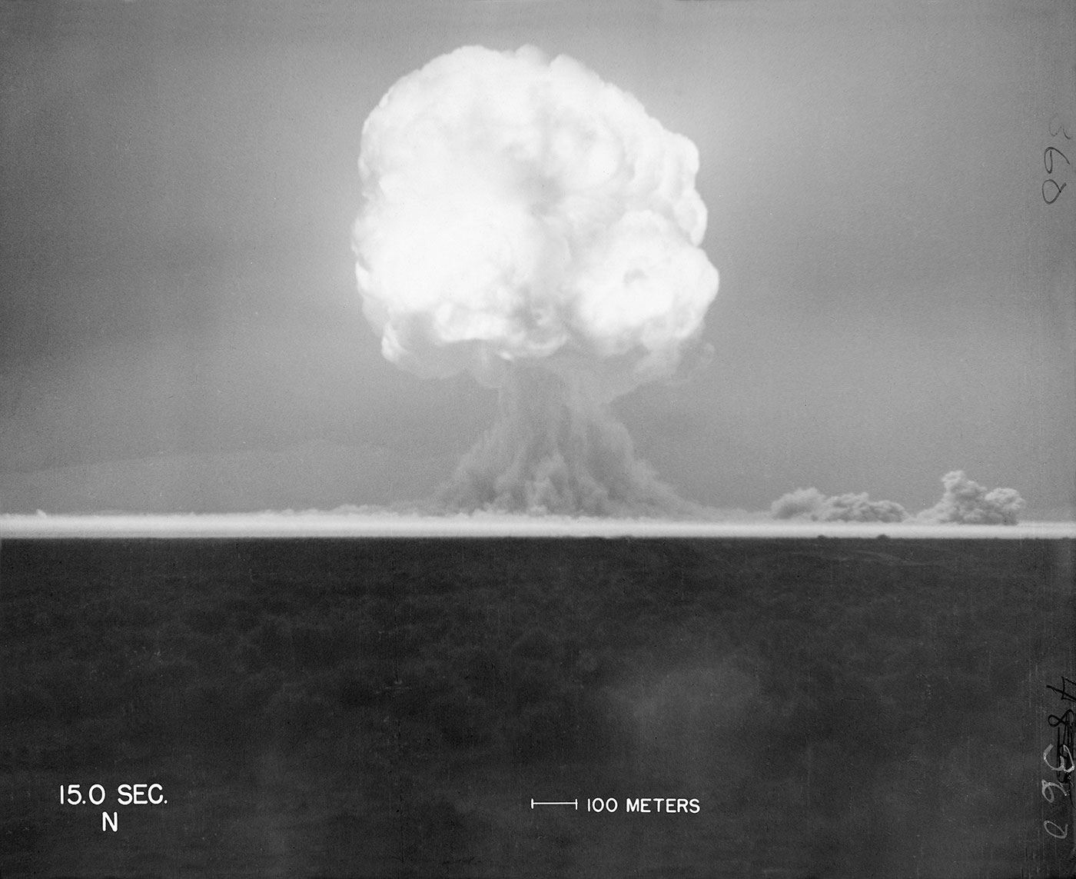
16th July 1945: The United States successfully tests the world’s first ever atomic bomb (researchers 6 miles away are knocked over by the blast wave, and those 10 miles away felt heat on their face. Then, an unbelievably bright flash of light, described as ''beautiful'', then a defeaning roar, and a mushroom cloud 8 miles high in minutes)
trinityremembered.com
Notes:
Nazi Germany was also developing an atomic bomb, but didn’t succeed before their defeat, and the Soviet Union began developing one in 1943 but didn’t finish it until after 1949.
The USA had spent six years and nearly $2 billion dollars on the ‘Manhattan Project’, which involved thousands of scientists, engineers and others.
[For more information see for example https://www.atomicheritage.org/history/manhattan-project and https://www.ctbto.org/nuclear-testing/history-of-nuclear-testing/manhattan-project/]

Slide 9
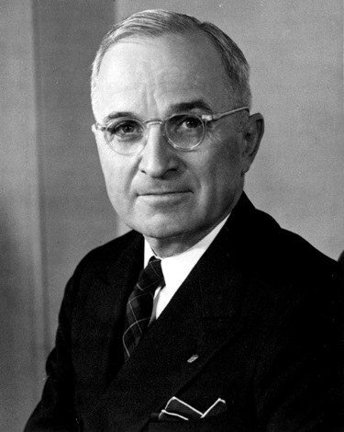
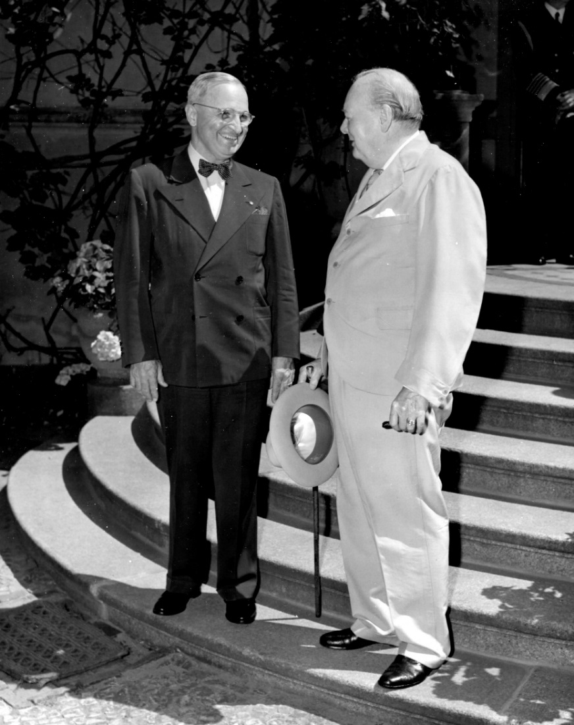
25th July 1945: President Truman gives the order to prepare to drop the atomic bomb on Japan (Britain gave its official consent on 4th July; Truman took over after Roosevelt died in April. The Manhattan Project was so secret that Truman hadn’t been told about it as Vice-President!)
Lord Mariser, https://creativecommons.org/licenses/by-sa/2.0/legalcode
Harry Kidd ; https://creativecommons.org/licenses/by-nc-sa/2.0/legalcode
Notes:
Not many people know about Britain having a say (at least on paper) on the atomic bomb being used. Prime Minister Winston Churchill said he gave our permission without hesitating, though he later had some doubts about whether it was the right thing to do.
[For more information see: http://www.dannen.com/decision/handy.html and https://www.atomicheritage.org/history/british-nuclear-program and https://history.state.gov/historicaldocuments/frus1945v02/d4 and https://richardlangworth.com/churchill-on-bombing-japan
Citizenship teachers: For ideas and resources on lesson activities exploring the varying stances of Theresa May, Jeremy Corbyn, Donald Trump, and Kim Jong-Un on using their country’s contemporary nuclear weapons (and the limits on their power to do so), follow the link at https://cnduk.org/education/truman-cit ]

Slide 10
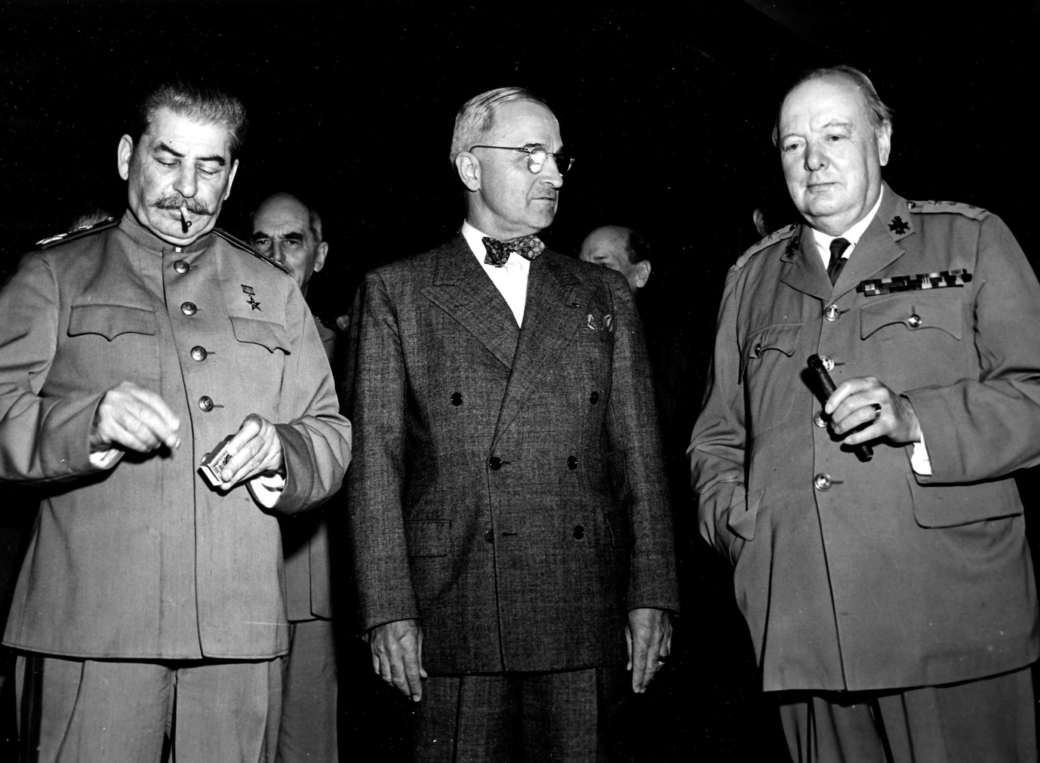
26th July 1945: Truman, Churchill and Chiang Kai-shek issue the ‘Potsdam Declaration’ to Japan, which finished with the words:
‘We call upon the government of Japan to proclaim now the unconditional surrender of all Japanese armed forces... The alternative for Japan is prompt and utter destruction.’
HarryKidd ; https://creativecommons.org/licenses/by-nc-sa/2.0/legalcode
Notes:
This declaration is usually seen as the USA’s warning to Japan, although it doesn’t specify about nuclear weapons (and it wouldn’t have made sense to most people if it had, as the atomic bomb had been kept very secret). Japan did not accept the demand to surrender, but some scholars argue that it didn’t exactly reject it either [see https://en.wikipedia.org/wiki/Mokusatsu] (The photo shows Soviet leader Joseph Stalin, alongside Harry Truman and Winston Churchill. Stalin didn’t sign the Declaration, as the Soviet Union wasn’t actually at war with Japan until 8th August: China’s leader Chiang Kai-Shek did sign it.) [For more information on the Potsdam Conference, and the ‘Declaration’, see https://history.state.gov/milestones/1937-1945/potsdam-conf and https://www.trumanlibrary.org/whistlestop/study_collections/naval/berlin/index.php?documentid=hst-naval_naid1701729-04&pagenumber=1 respectively (NB: the latter is a draft of the final text)]

Slide 11
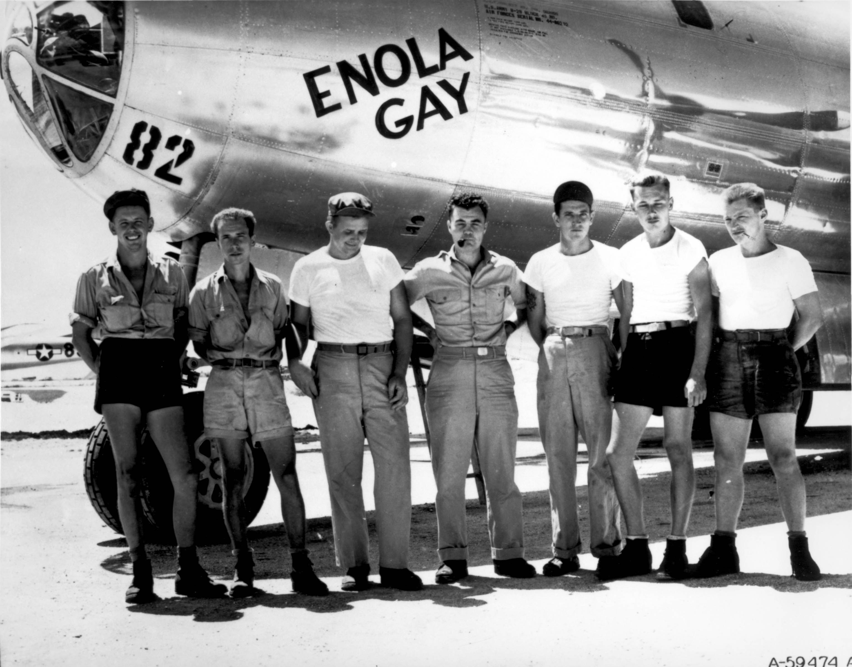
Public domain
Notes:
The crew of the plane that dropped the atomic bomb on Hiroshima.

Slide 12
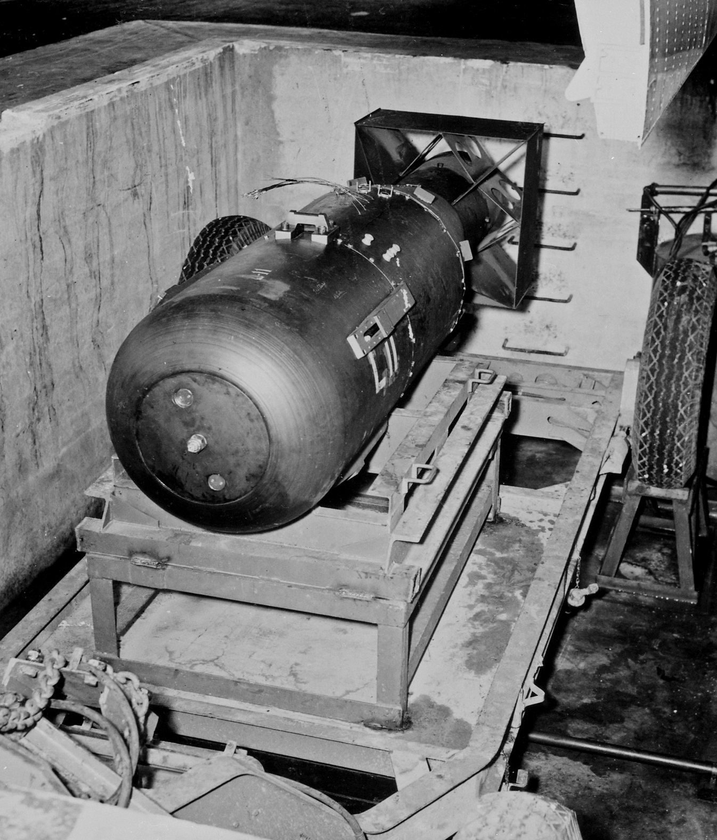
James Vaughan ; https://creativecommons.org/licenses/by-sa/2.0/legalcode
Notes:
Does anyone know what the bomb dropped on Hiroshima was called? [Little Boy]
As Hiroshima is very flat, there were no natural obstacles (like hills) to contain the explosion. It destroyed a huge proportion of the city.

Slide 13
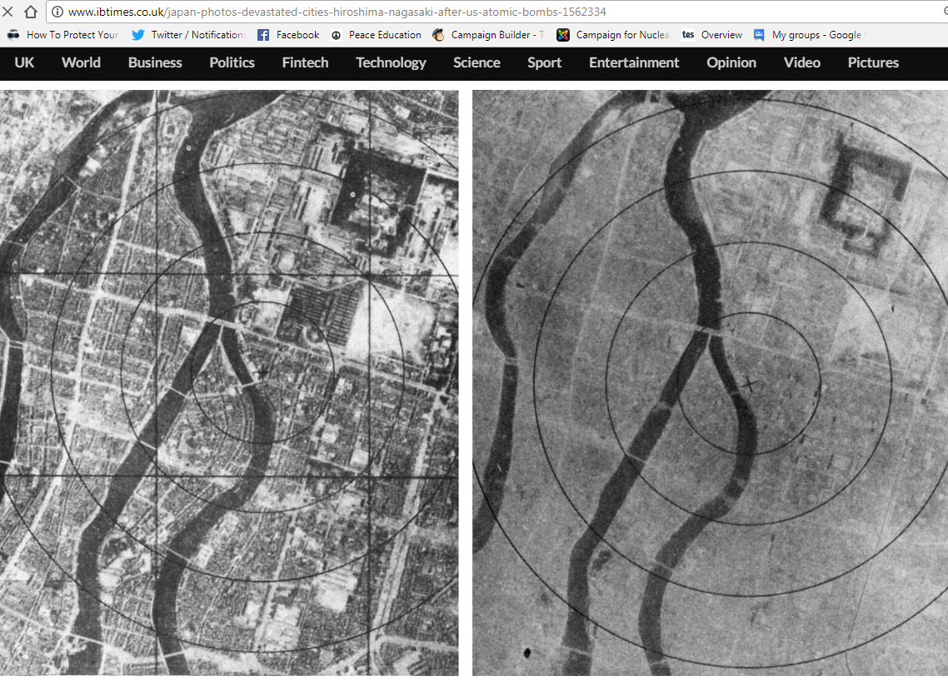
6th August 1945: The atomic bomb is dropped on Hiroshima
Notes:
The photo on the right was taken after the bomb exploded. How can you tell it’s the same place? [The river, plus a few faint outlines of streets and buildings] The ‘x’ marks the centre of the explosion. The bomb was made to explode 600 metres above ground, as it was expected that this would do more damage (although this also meant there was less radioactive fallout than there would have been from a ‘ground-burst’)

Slide 14
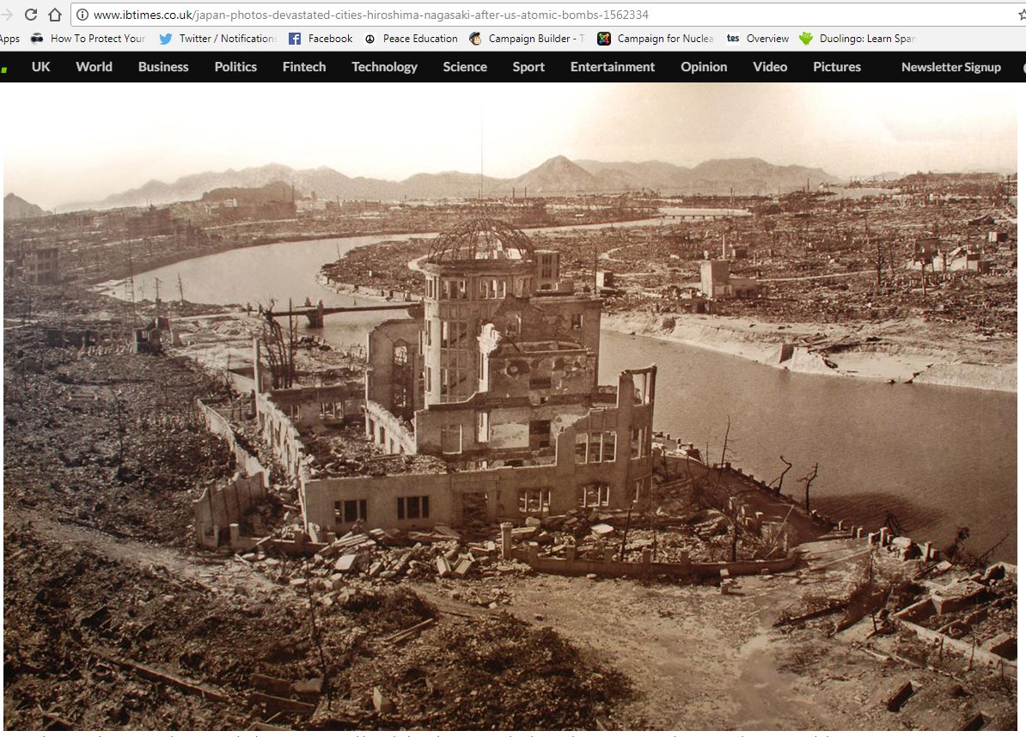
Notes:
This was one of the few buildings left standing in Hiroshima after the bomb. It used to be an industry exhibition hall.
It is difficult to determine the exact numbers of dead as exact population figures were also destroyed as the records were held in the city. But from nationwide records and medical records after the event, 75,000 died within the first few hours if not immediately. By the end of December 1945 this number had risen to 140,000 and by the end of 1950 to 200,000. The subsequent deaths were caused by radiation sickness, burns, and a lack of medical supplies for treatment of injuries.

Slide 15
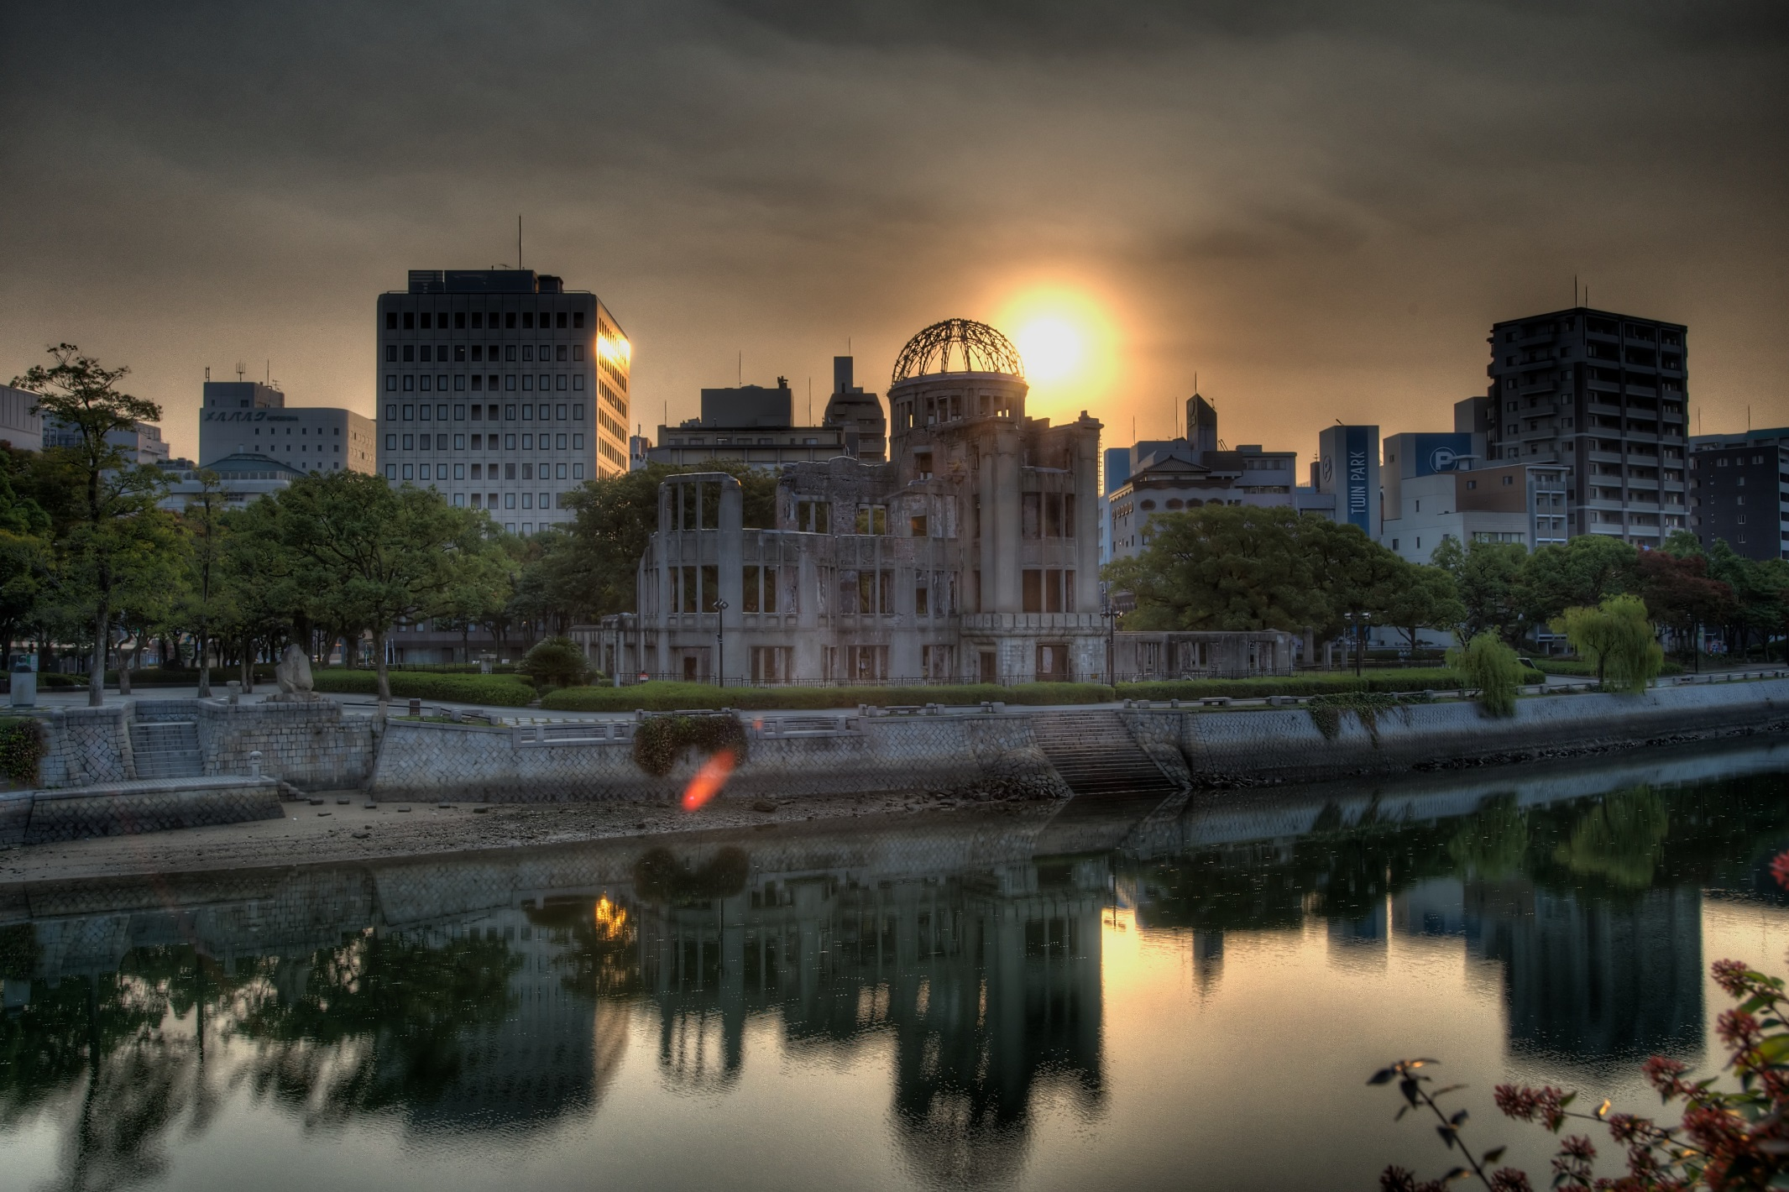
Hairyegg; https://creativecommons.org/licenses/by-sa/2.0/legalcode
Notes:
It’s been preserved to this day, and is part of the Hiroshima Peace Memorial Park.

Slide 16
Notes:
The patch or stain known as a ‘nuclear shadow’ is all that was left of someone who was sitting on the steps. They literally vaporised, because the heat of the bomb was so great: it reaches millions of degrees Centigrade very briefly, and remains at 1000s of degrees Centigrade for slightly longer. These steps are now in the Hiroshima Atomic Bomb Museum.

Slide 17
Hiroshima video clip (reconstruction)
You may find the clip disturbing. Feel free to close your eyes/look away.
Notes:
17
https://www.youtube.com/watch?v=3wxWNAM8Cso (play from 2.30-3.35)
Hiroshima Dropping the Bomb, BBC

Slide 18
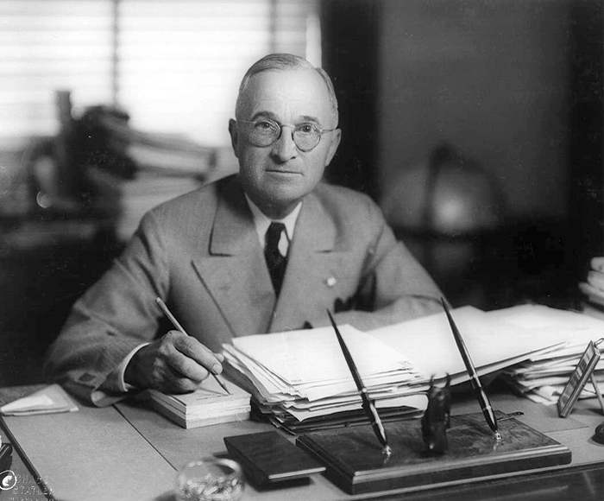
6th August 1945: President Truman gives a statement promising further bombs if Japan doesn’t surrender
Matthew Yglesias ;
https://creativecommons.org/licenses/by-sa/2.0/legalcode
Notes:
watch at https://www.youtube.com/watch?v=FN_UJJ9ObDs
[Citizenship teachers: For ideas and resources on lesson activities on analysing media reporting then and now, follow the link at https://cnduk.org/education/truman-cit ]

Slide 19
Atomic Heritage Project
Notes:
This is a replica of the bomb dropped on Nagasaki. Does anyone know what it was called? [Fat Man]

Slide 20
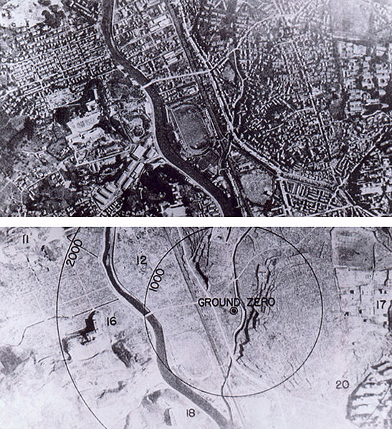
9th August 1945: The bomb is dropped on Nagasaki
Wikimedia Commons
Notes:
It was a different type of bomb to Little Boy, and was actually more powerful, though it killed fewer people, for various reasons (including that the bomb did not fall on the centre of the city)
[For more information on the Nagasaki (and Hiroshima) atomic bombing see for example https://www.atomicheritage.org/history/bombings-hiroshima-and-nagasaki-1945]

Slide 21
9th August 1945: At midnight, the USSR invades Manchuria, in Northern China, which since 1932 had been part of the Japanese Empire. They go on to capture Northern Korea and other Japanese-occupied territories.
histclo.com
Notes:
This was the last campaign of the Second World War. It lasted eleven days, and tens of thousands were killed or injured on both sides. Manchuria and Mengjiang – or Inner Mongolia - were returned to China, and Korea was partitioned along the ‘38th Parallel’, with the Soviet Union occupying the North and the USA the South. [Citizenship teachers: For ideas and resources on exploring the changing nuclear tensions (from 2017-2019) between the USA and Russia, and between the USA and North Korea, and also the UK’s role in these contexts, please go to https://cnduk.org/education/truman-cit ]

Slide 22
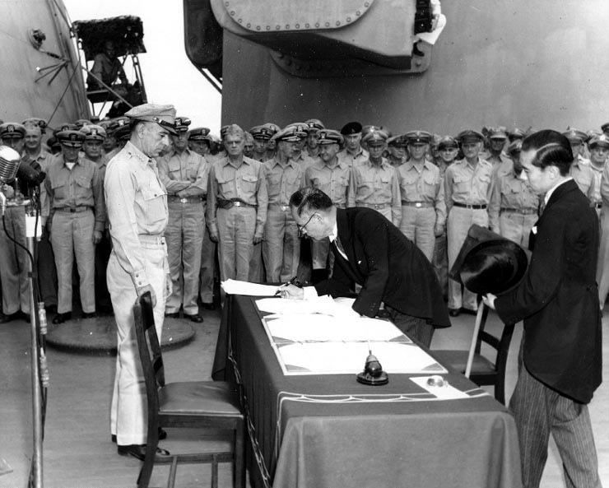
2nd September 1945: Japan formally surrenders. This is the end of the Second World War.
Public domain

Slide 23
YOUR TASK
Visit each table in the room. On each table you will find sources, a big sheet of paper, and pens.
At each table, look at the sources and the question about them.
3. Write your thoughts and feelings on the big sheet of paper, and when time is up move to the next table (leave the paper on the table).
4. Once everyone has been to each table, sit back at your original table. Discuss what other groups have written on the paper, and then feed back to the class.

Slide 24
CARTOON STRIP: The Answers!
Notes:
NB: Both sets of answers are included (cards A and B). Please delete the one you don’t need.

Slide 25
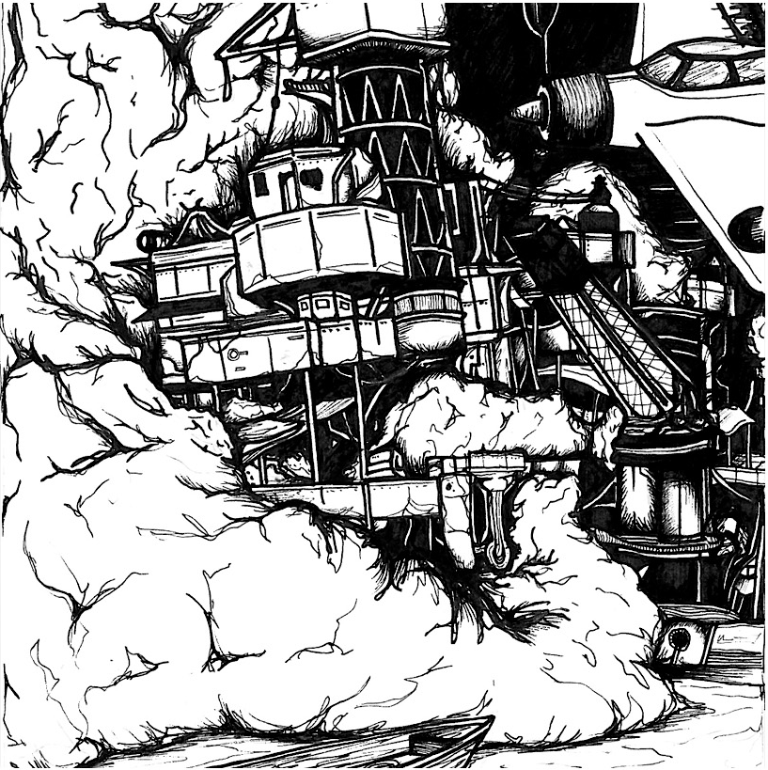
7 December 1941: Japanese air forces attack the United States naval base at Pearl Harbour, USA.

Slide 26
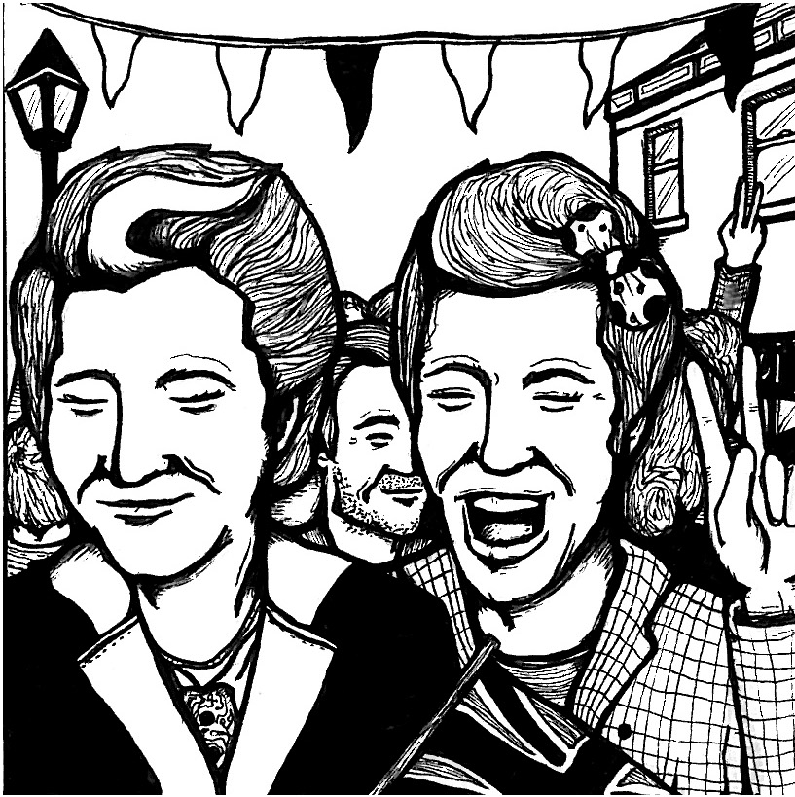
8 May 1945: The Allies accept the unconditional surrender of the armed forces of Nazi Germany. This is known as VE Day. In Europe at least, the Second World War is over.

Slide 27
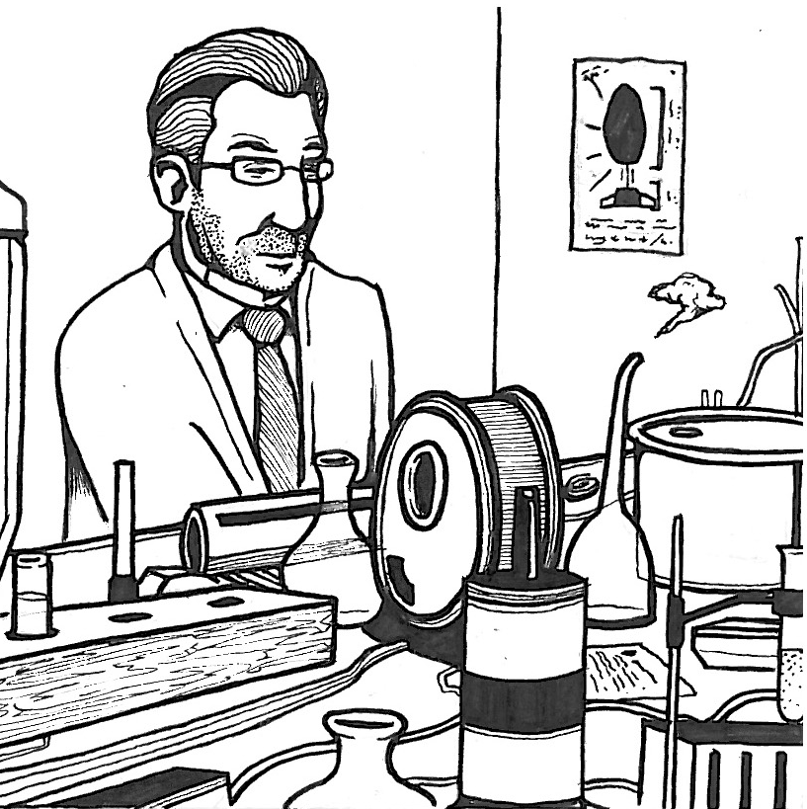
16 July 1945: The United States test the first ever atomic bomb. It had been developed in secret, deep in the New Mexico desert. The test was code-named ‘Trinity’.

Slide 28
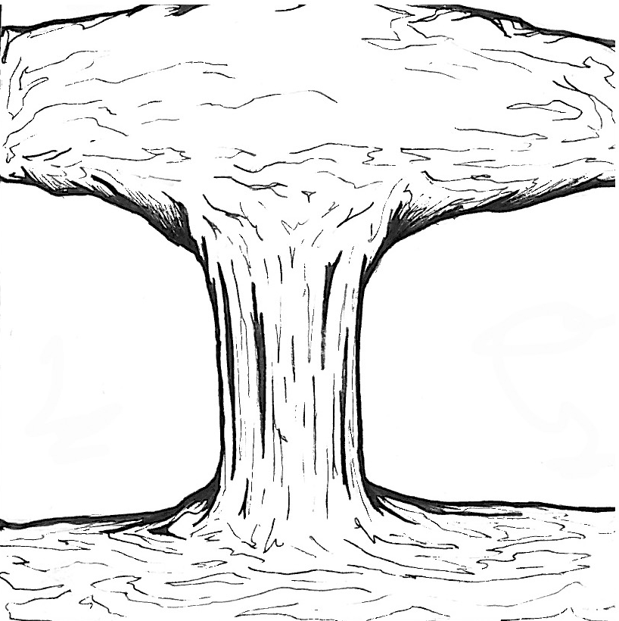
6 August 1945: At 8:16am a nuclear bomb is dropped on Hiroshima, Japan. It is code-named ‘Little Boy’.

Slide 29
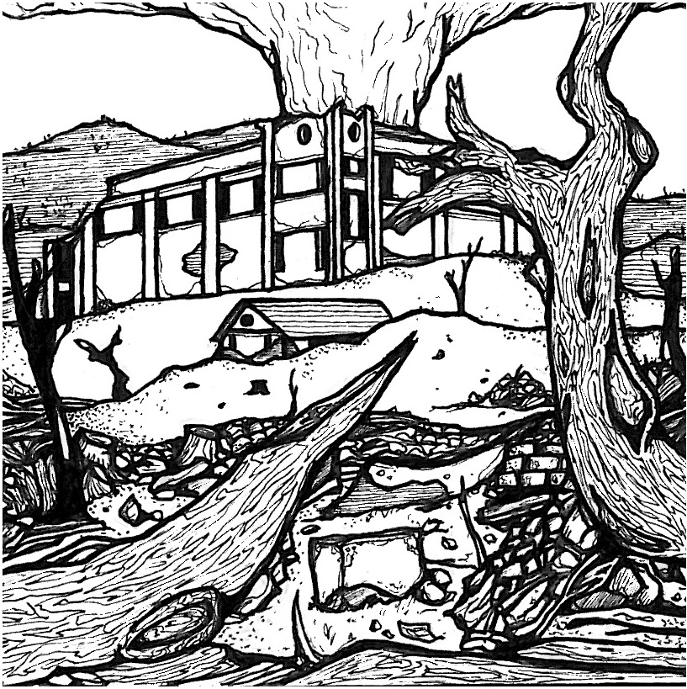
9 August 1945: At 11:02am a nuclear bomb is dropped on Nagasaki. The second bomb is code-named ‘Fat Man’.

Slide 30
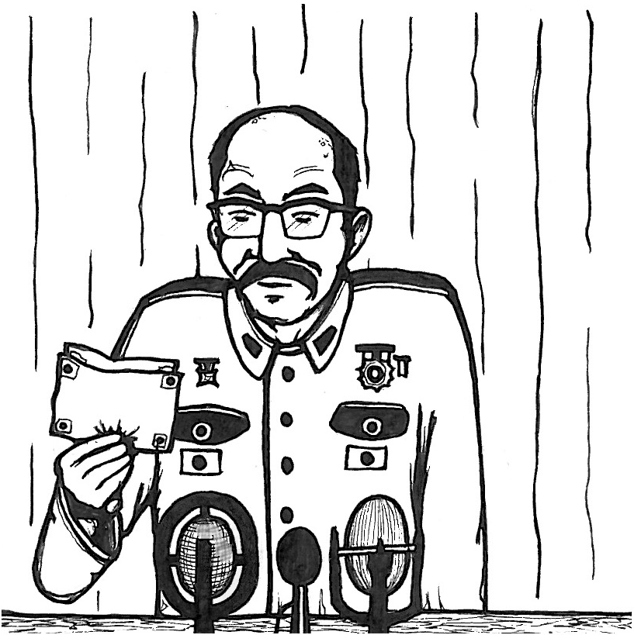
2 September 1945: Japan formally surrenders. The official surrender is signed on the deck of the USS Missouri, in Tokyo Bay. This is the end of the Second World War.

Slide 31
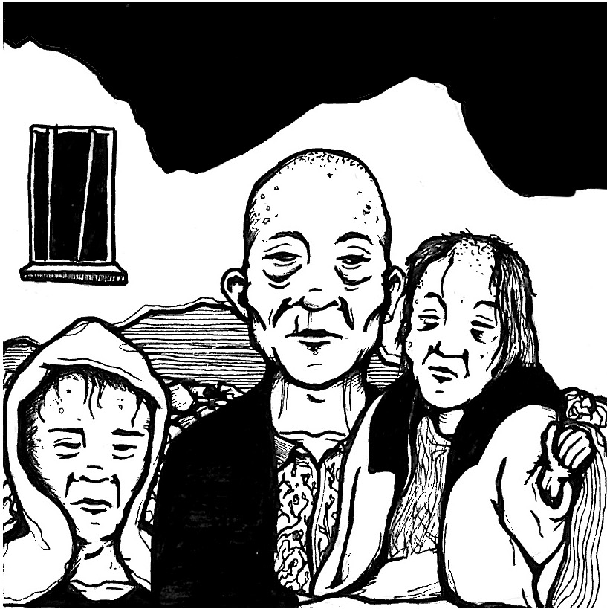
Shortly after the bombing: Radiation sickness makes people very unwell. Symptoms include bleeding from the mouth, hair loss, vomiting and fever. There is no effective treatment, and you can die within days.

Slide 32
Years after the bombing: Survivors develop illnesses many years later. Children especially develop leukaemia, a cancer of the blood or bone marrow. For decades, even more survivors develop cancers of the breast, lung and salivary gland.

Slide 33
7 December 1941: Japanese air forces attack the United States naval base at Pearl Harbour, USA.

Slide 34
8 May 1945: The Allies accept the surrender of Germany. This is known as VE Day. WWII is over in Europe.

Slide 35
16 July 1945: The United States test the first ever atomic bomb. It had been developed in secret.

Slide 36
6 August 1945: At 08:16 am a nuclear bomb is dropped on Hiroshima, Japan. It is code-named ‘Little Boy’.

Slide 37
9 August 1945: At 11:02am a nuclear bomb is dropped on Nagasaki. The second bomb is code named ‘Fat Man’.

Slide 38
2 September 1945: Japan formally surrenders. This is the end of the WWII.

Slide 39
Shortly after the bombing: Radiation sickness makes people very unwell. People are sick, their hair falls out, they have very high fevers, etc. It can kill within days.

Slide 40
Years after the bombing: Survivors continue to get ill many years later, developing a variety of different cancers.

