Slide 1
Lesson 2: What would you tell
President Truman to do?
Notes:
[CITIZENSHIP TEACHERS: Please note: We have created a collection of additional Citizenship classroom (and homework) activities and resources to extend and enrich the Citizenship content of the Truman On Trial lessons (including this one). To browse and download the materials, go to https://cnduk.org/education/truman-cit Where applicable, we have added advice and guidance on the additional activities and resources, in some of the slides notes in this PowerPoint.]

Slide 2
What we’ll do in this lesson:
Learn about the history of nuclear weapons
Decide whether or not USA President Harry Truman was justified in using nuclear weapons against Japan in 1945
Notes:
[NB: If you’ve already taught background information on the atomic bombings (and don’t need to re-cap), skip to slide 21]

Slide 3
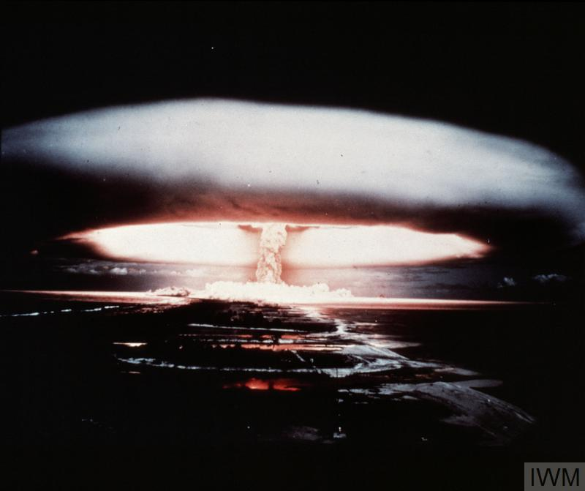
What is a nuclear weapon?
Notes:
Can anyone tell me what a nuclear weapon is, and how it works? [Repeat answers, in case not everyone heard. Add, if necessary:]
It’s an incredibly powerful bomb, known as a Weapon of Mass Destruction. There are two types: the first one discovered is the atomic bomb, which gets its huge explosive power when the nucleus of an atom is split by a neutron, releasing more neutrons, which split more nuclei, in a very fast chain reaction that releases enormous amounts of energy. This reaction is called ‘nuclear fission’.
What do we call the shape in this photo (which, like the photo on the first slide, is a British nuclear weapon test in the 1950s)? [Repeat answer, in case not everyone heard. If no-one knows, clarify:] We call it a mushroom cloud.
[For higher ability or older groups:] Nuclear fission involves isotopes of Uranium or Plutonium – isotopes are atoms of an element with a different number of neutrons. They can be very radioactive.
[Go to next slide]

Slide 4
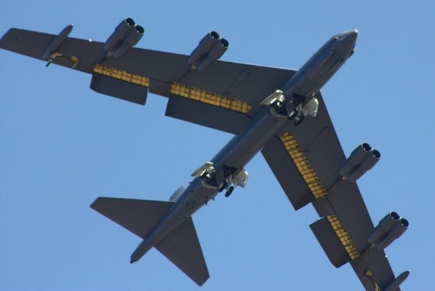
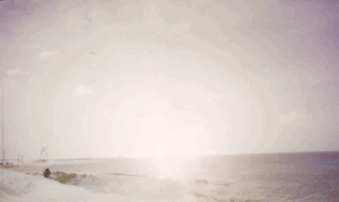
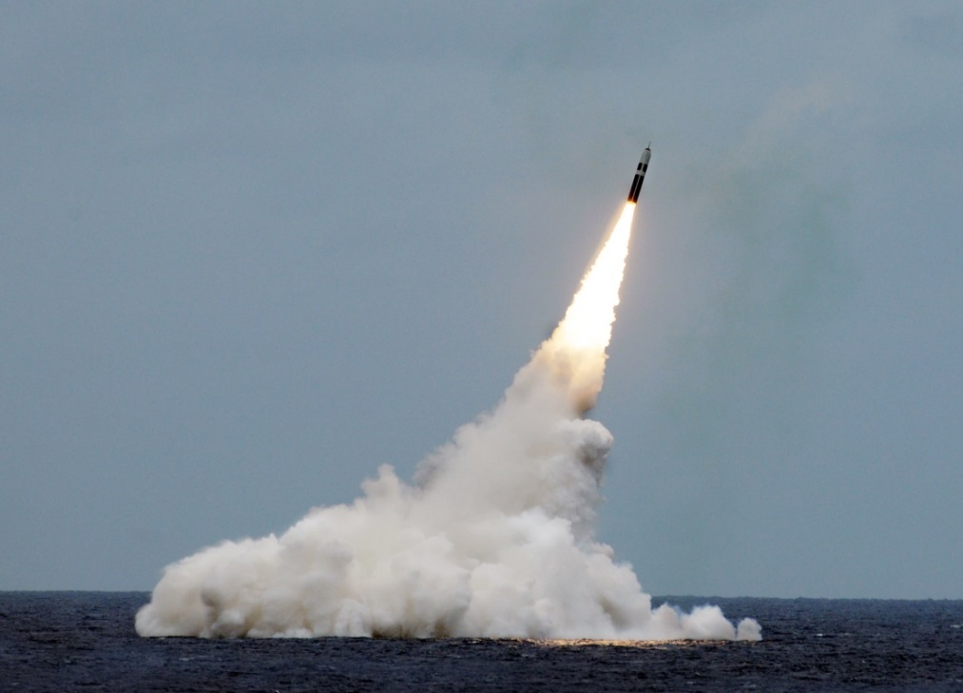
Paul L. McCord Jr. ; https://creativecommons.org/licenses/by-nd/2.0/legalcode ; cropped
Public domain ; National Museum of the US Navy
Notes:
Nuclear weapons can be launched from the ground, air and sea.

Slide 5
= 12,121 in total
Almost 4000 of them could be used at short notice; 5600 are in storage; and 2500 are ‘retired’ and will be dismantled in the coming years.
Big decrease since the 1980s (70,000 warheads!), and 400 less than last year
This is the first time since 1999 that India’s stockpile has surpassed Pakistan’s. China is expanding its nuclear arsenal faster than any other country (from 410 in 2023 to 500 in 2024

Slide 6
You are advisors to President Truman in 1945. You have to help him decide: Should he drop atomic bombs on Japan?

Slide 7
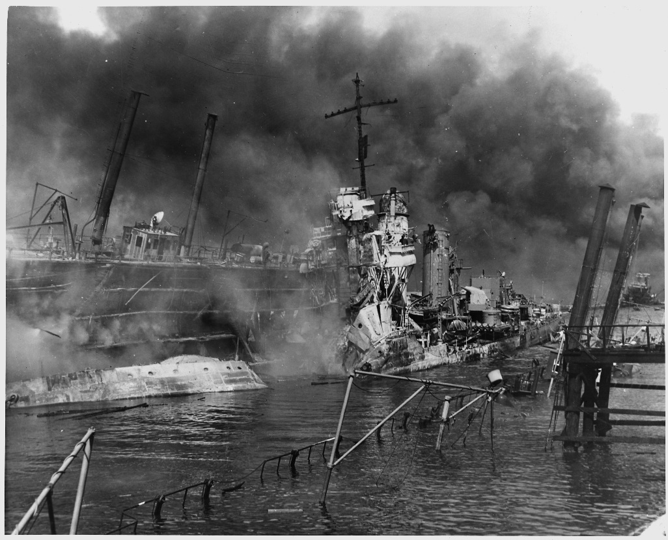
7th December 1941: Japan attacks Pearl Harbor (in Hawaii). It’s a surprise attack that destroys or badly damages lots of US military ships and planes, and kills nearly 3000 Americans. The USA declares war against Japan the next day. This means it is now in the Second World War.
US National Archives
Notes:
.

Slide 8
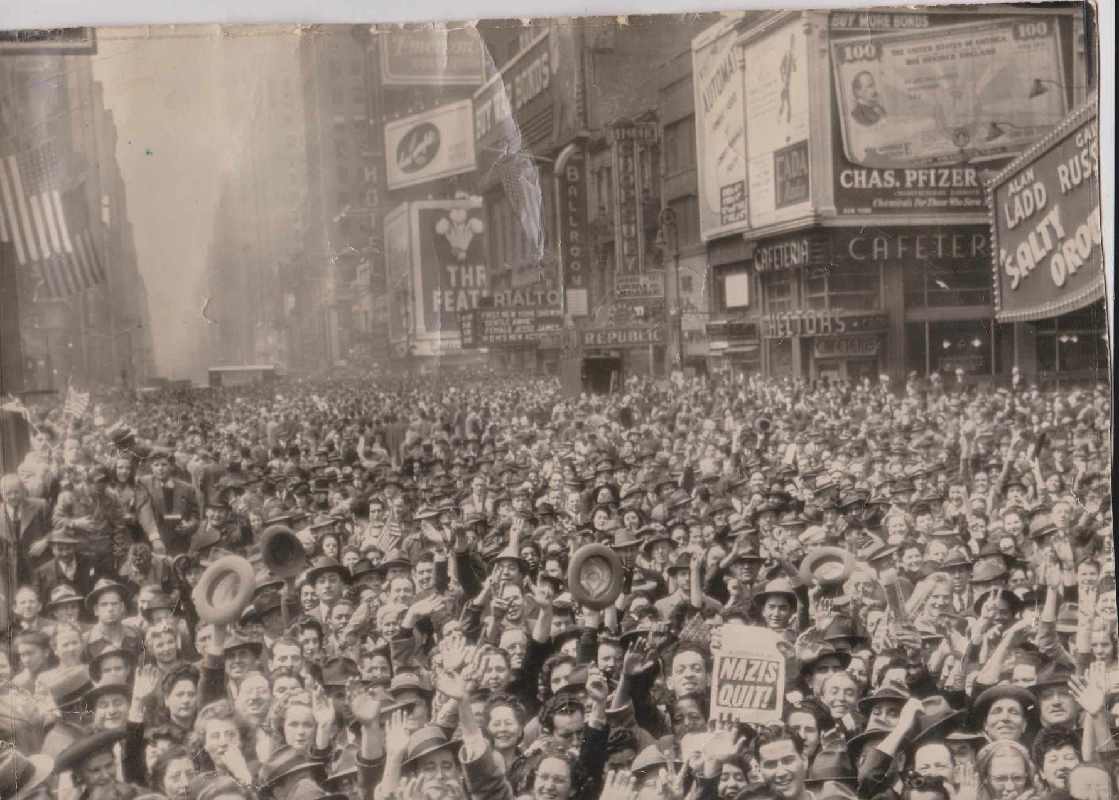
8th May 1945: Nazi Germany surrenders to the Allied Powers (Britain, USA, USSR, China, and others). This is called Victory in Europe (VE) Day.
Robert Huffstutter; https://creativecommons.org/licenses/by-nc-sa/2.0/legalcode

Slide 9
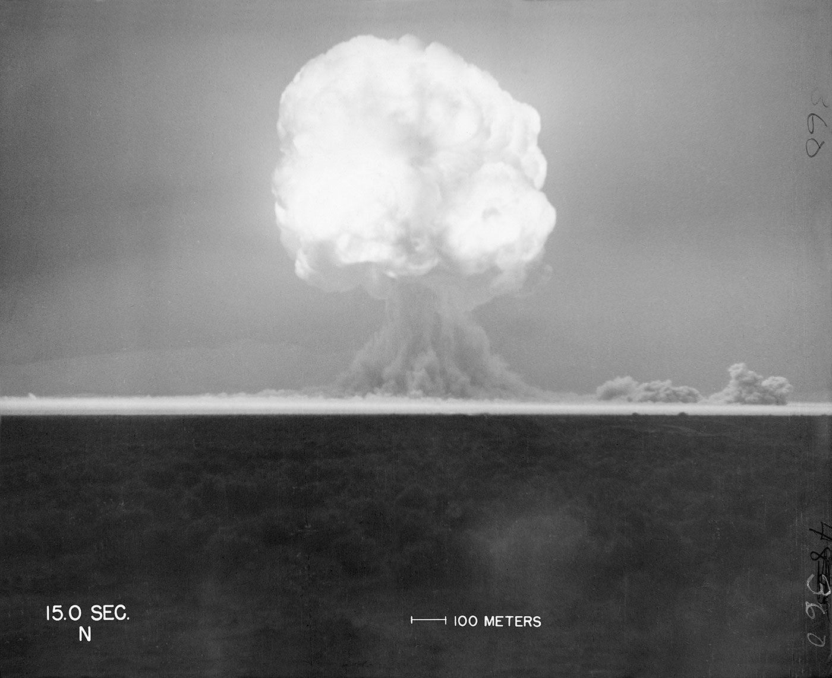
16th July 1945: The United States tests the first ever atomic bomb.
trinityremembered.com
Notes:
Nazi Germany was also developing an atomic bomb, but didn’t succeed before their defeat, and the Soviet Union began developing one in 1943 but didn’t finish it until after 1949.
The USA had spent six years and nearly $2 billion dollars on the ‘Manhattan Project’, which involved thousands of scientists, engineers and others.

Slide 10
TIME TO DECIDE! You have 1 minute
Reasons to advise Truman to drop the atomic bomb on Japan: * Revenge for the Pearl Harbor attack
* It should end the war quicker than invading Japan by land, and might save lives overall (and will certainly save the lives of American soldiers)
* Japan will be warned of the destruction that it will face, so it will still have a chance to surrender before the atomic bombs are dropped
Reasons to advise Truman not to drop the atomic bomb on Japan:
* It would kill hundreds of thousands of people (far more than at Pearl Harbor), mostly civilians (not soldiers)
* You know that some of the Japanese government want Japan to surrender. It might be possible to end the war this way.
* You could first drop an atomic bomb on an area of Japan where it wouldn’t kill many people, as a threat. This might be enough to make them surrender. However, if the bomb doesn’t explode, this will be very embarrassing for the USA.
Notes:
[Citizenship teachers: For lots of ideas and resources on lesson activities to explore the stances of Theresa May, Jeremy Corbyn, Donald Trump, and Kim Jong-un on using their country’s nuclear weapons (and limits on their power to do so), follow the link at https://cnduk.org/education/truman-cit ]

Slide 11
Truman did order the bombs to be dropped

Slide 12
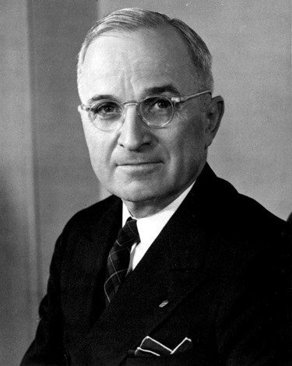
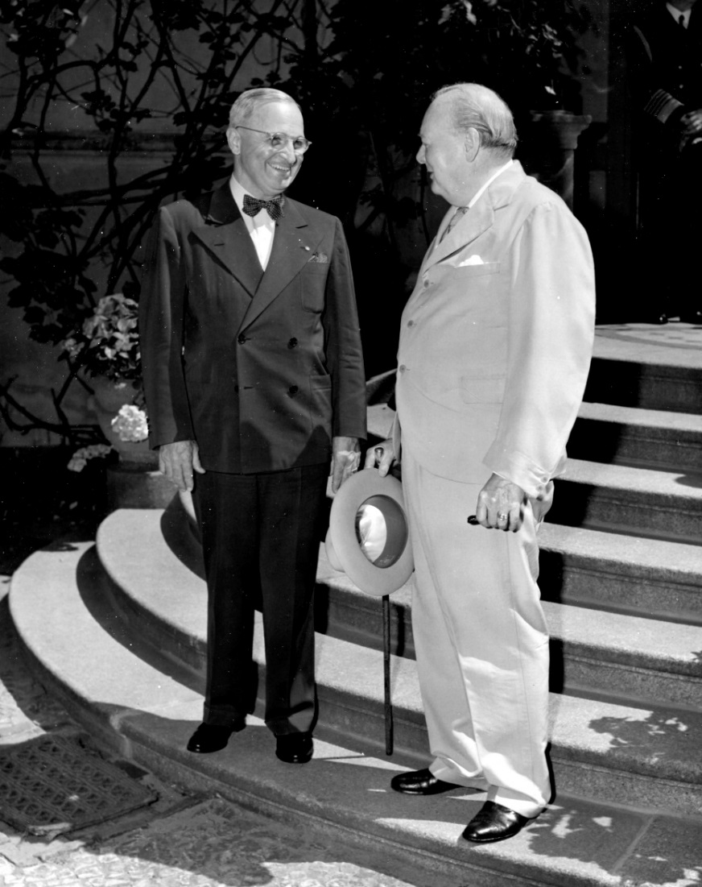
25th July 1945: President Truman gives the order to prepare to drop the atomic bomb on Japan (Britain gave its official consent on 4th July; Truman took over after Roosevelt died in April. The Manhattan Project was so secret that Truman hadn’t been told about it as Vice-President!)
Lord Mariser, https://creativecommons.org/licenses/by-sa/2.0/legalcode
Harry Kidd ; https://creativecommons.org/licenses/by-nc-sa/2.0/legalcode
Notes:
Not many people know about Britain having a say (at least on paper) on the atomic bomb being used. Prime Minister Winston Churchill said he gave our permission without hesitating, though he later had some doubts about whether it was the right thing to do.
[For more information see: http://www.dannen.com/decision/handy.html and https://www.atomicheritage.org/history/british-nuclear-program and https://history.state.gov/historicaldocuments/frus1945v02/d4 and https://richardlangworth.com/churchill-on-bombing-japan
Citizenship teachers: For ideas and resources on lesson activities exploring the varying stances of Theresa May, Jeremy Corbyn, Donald Trump, and Kim Jong-Un on using their country’s contemporary nuclear weapons (and the limits on their power to do so), follow the link at https://cnduk.org/education/truman-cit]

Slide 13
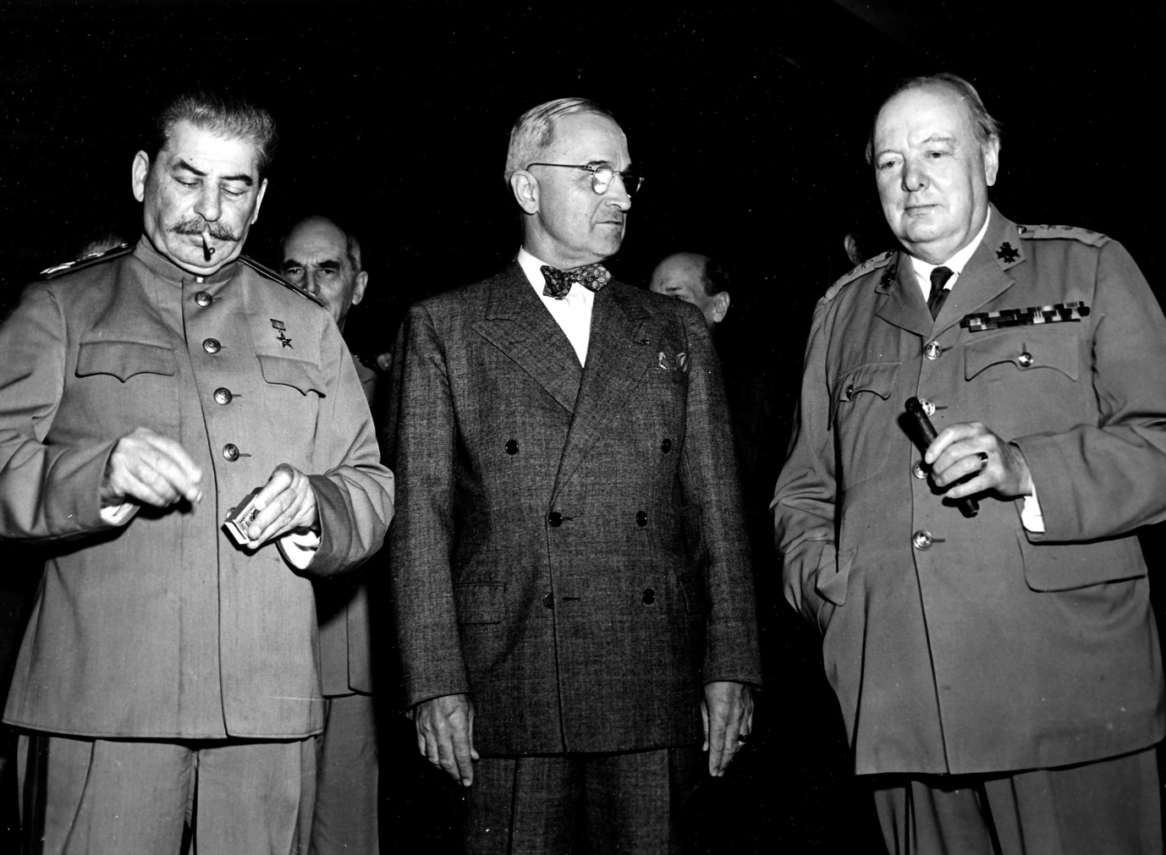
26th July 1945: The USA, UK, and China send the ‘Potsdam Declaration’ to Japan. It finished with the words:
‘We call upon the government of Japan to proclaim now the unconditional surrender of all Japanese armed forces... The alternative for Japan is prompt and utter destruction.’
HarryKidd ; https://creativecommons.org/licenses/by-nc-sa/2.0/legalcode
Notes:
This declaration is usually seen as the USA’s warning to Japan, although it doesn’t specify about nuclear weapons (and it wouldn’t have made sense to most people if it had, as the atomic bomb had been kept very secret). Japan did not accept the demand to surrender, but some scholars argue that it didn’t exactly reject it either [see https://en.wikipedia.org/wiki/Mokusatsu] (The photo shows Soviet leader Joseph Stalin, alongside Harry Truman and Winston Churchill. Stalin didn’t sign the Declaration, as the Soviet Union wasn’t actually at war with Japan until 8th August: China’s leader Chiang Kai-Shek did sign it.) [For more information on the Potsdam Conference, and the ‘Declaration’, see https://history.state.gov/milestones/1937-1945/potsdam-conf and https://www.trumanlibrary.org/whistlestop/study_collections/naval/berlin/index.php?documentid=hst-naval_naid1701729-04&pagenumber=1 respectively (NB: the latter is a draft of the final text) Citizenship teachers: For ideas and resources on lesson activities exploring nuclear tensions between the USA and Russia in 2018-19, and the UK’s role in this context, follow the link at https://cnduk.org/education/truman-cit]

Slide 14
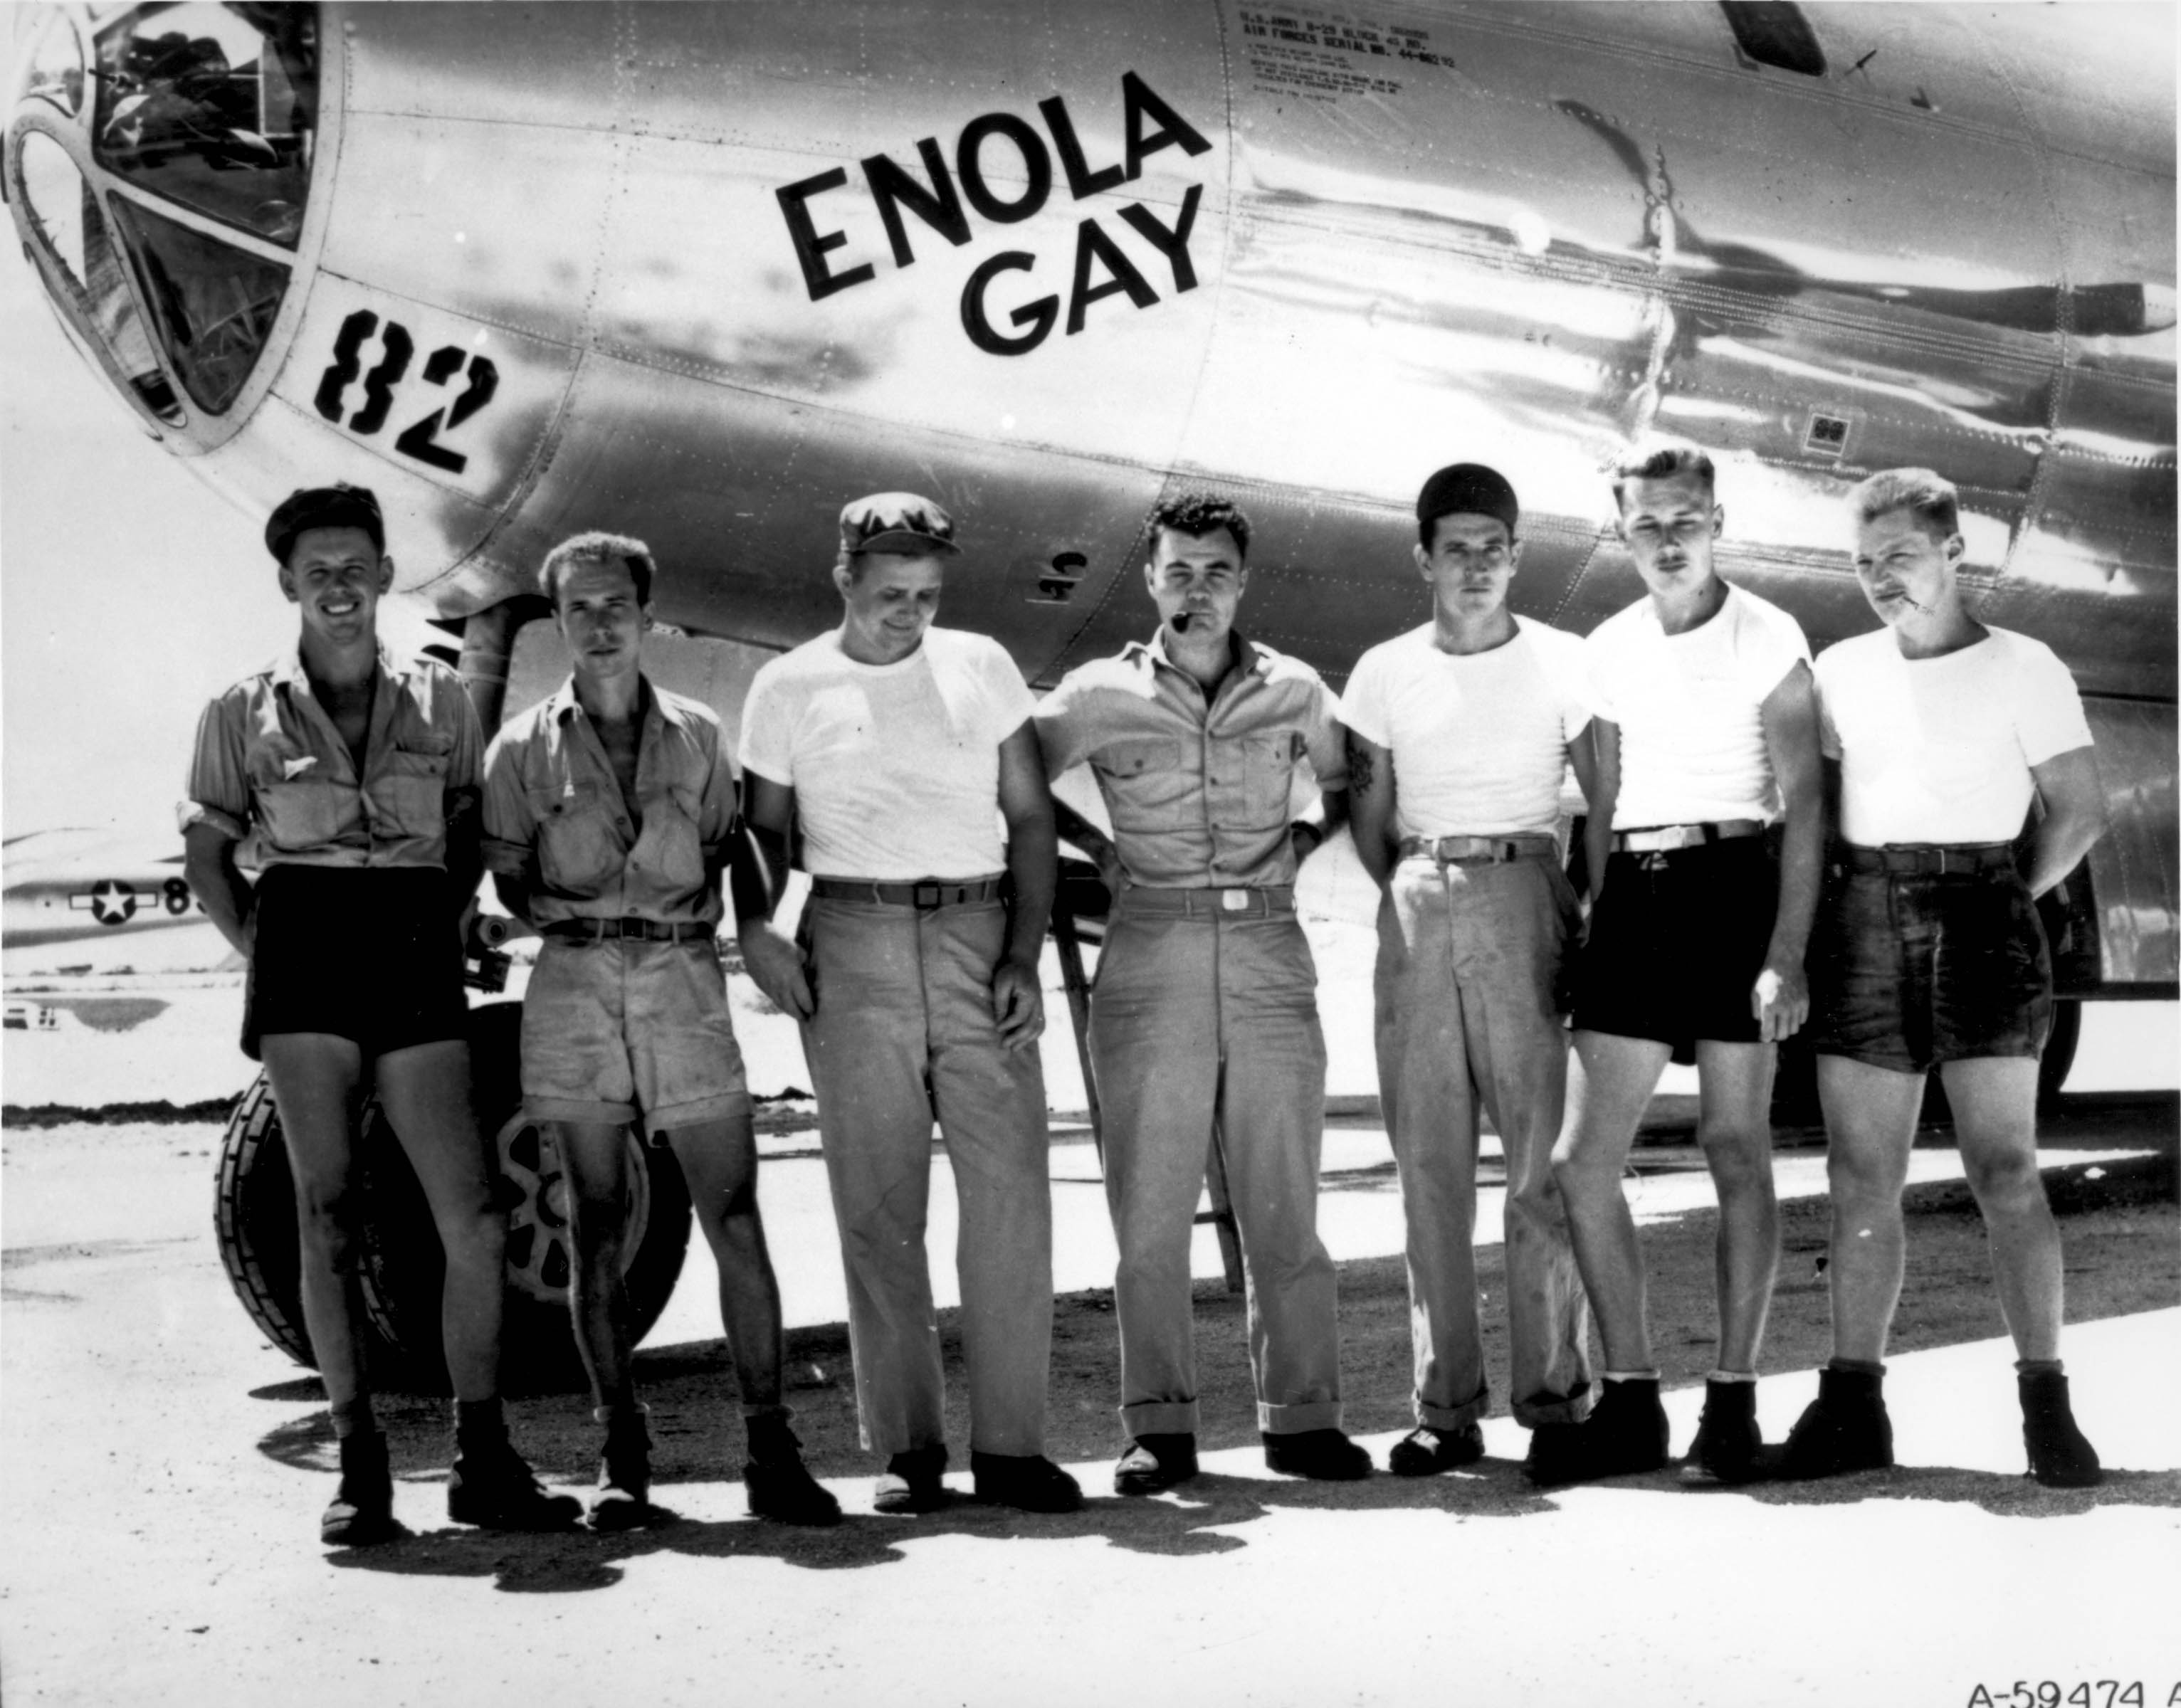
Public domain
Notes:
The crew of the plane that dropped the atomic bomb on Hiroshima.

Slide 15
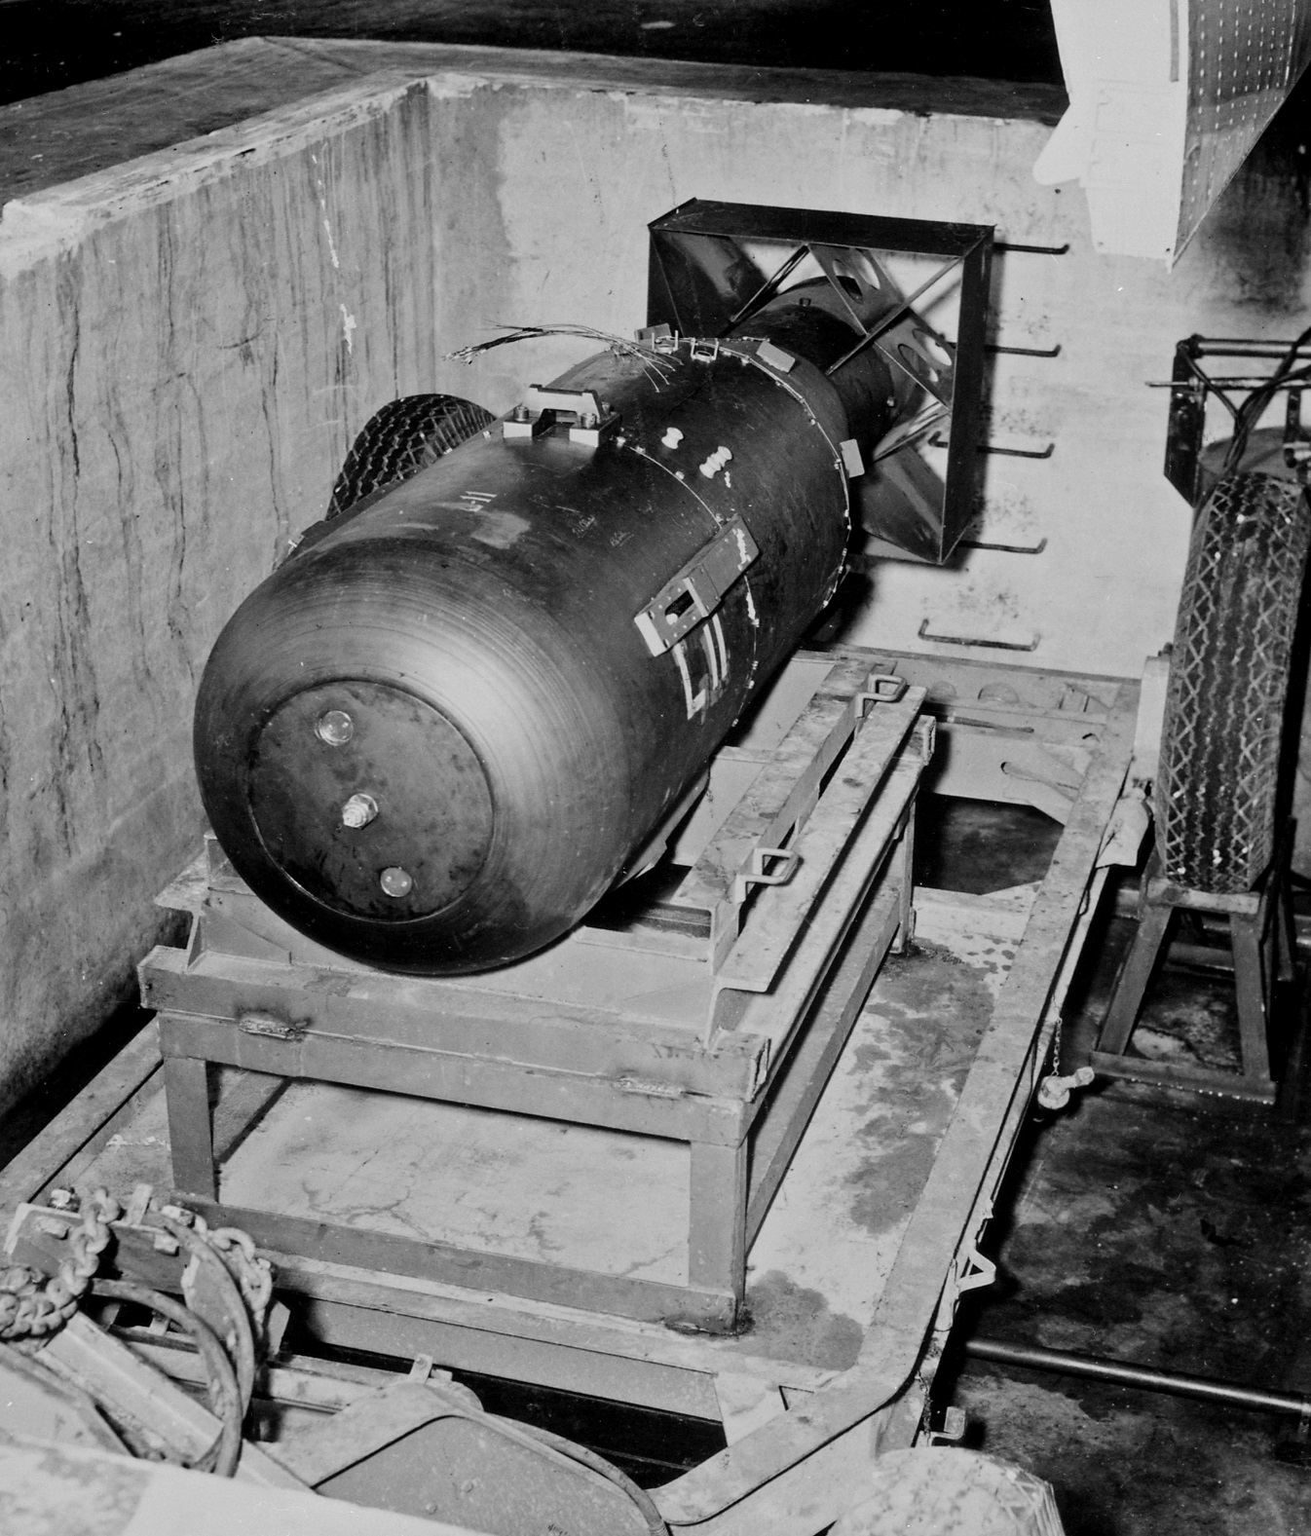
James Vaughan ; https://creativecommons.org/licenses/by-sa/2.0/legalcode
Notes:
Does anyone know what the bomb dropped on Hiroshima was called? [Little Boy]
As Hiroshima is very flat, there were no natural obstacles (like hills) to contain the explosion. It destroyed a huge proportion of the city.

Slide 16
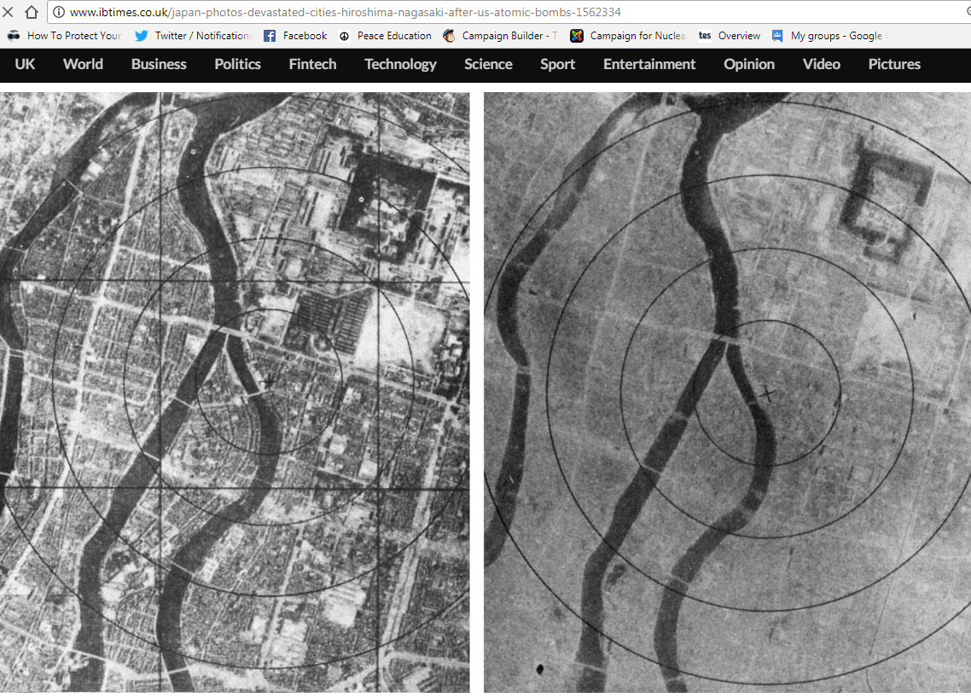
6th August 1945: The atomic bomb is dropped on Hiroshima
Notes:
The photo on the right was taken after the bomb exploded. How can you tell it’s the same place? [The river, plus a few faint outlines of streets and buildings] The ‘x’ marks the centre of the explosion. The bomb was made to explode 600 metres above ground, as it was expected that this would do more damage (although this also meant there was less radioactive fallout than there would have been from a ‘ground-burst’)

Slide 17
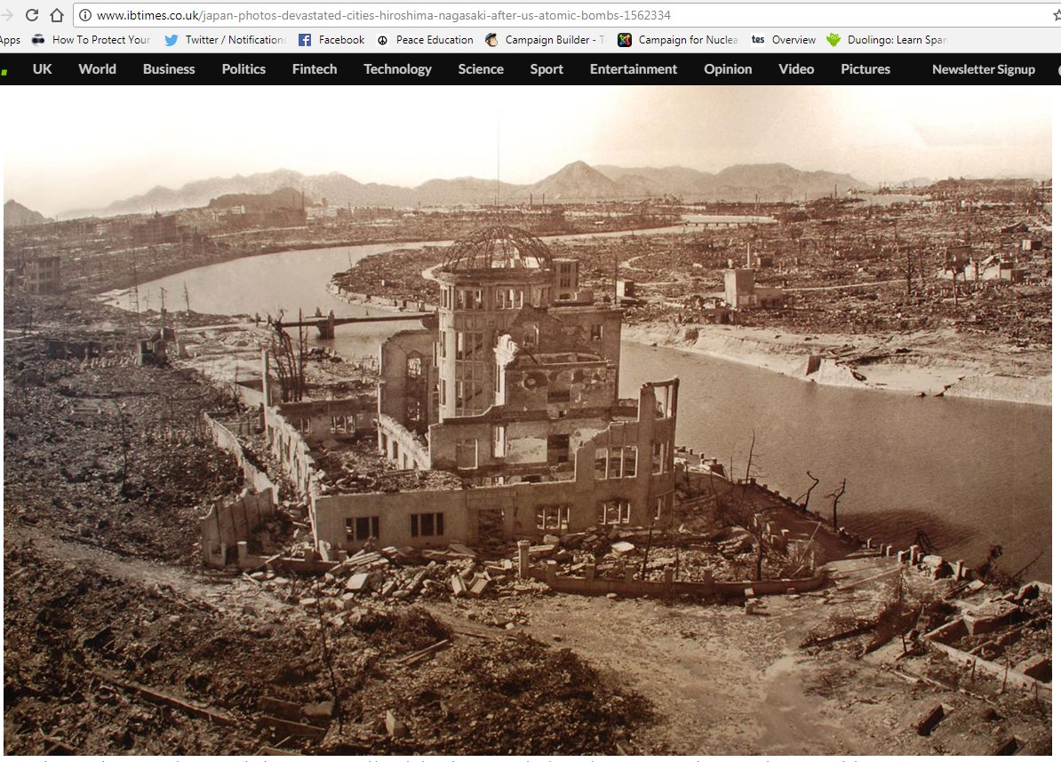
Notes:
This building lasted better than most because it was directly underneath the explosion.
[For more information on the Hiroshima (and Nagasaki) atomic bombing see for example https://www.atomicheritage.org/history/bombings-hiroshima-and-nagasaki-1945]

Slide 18
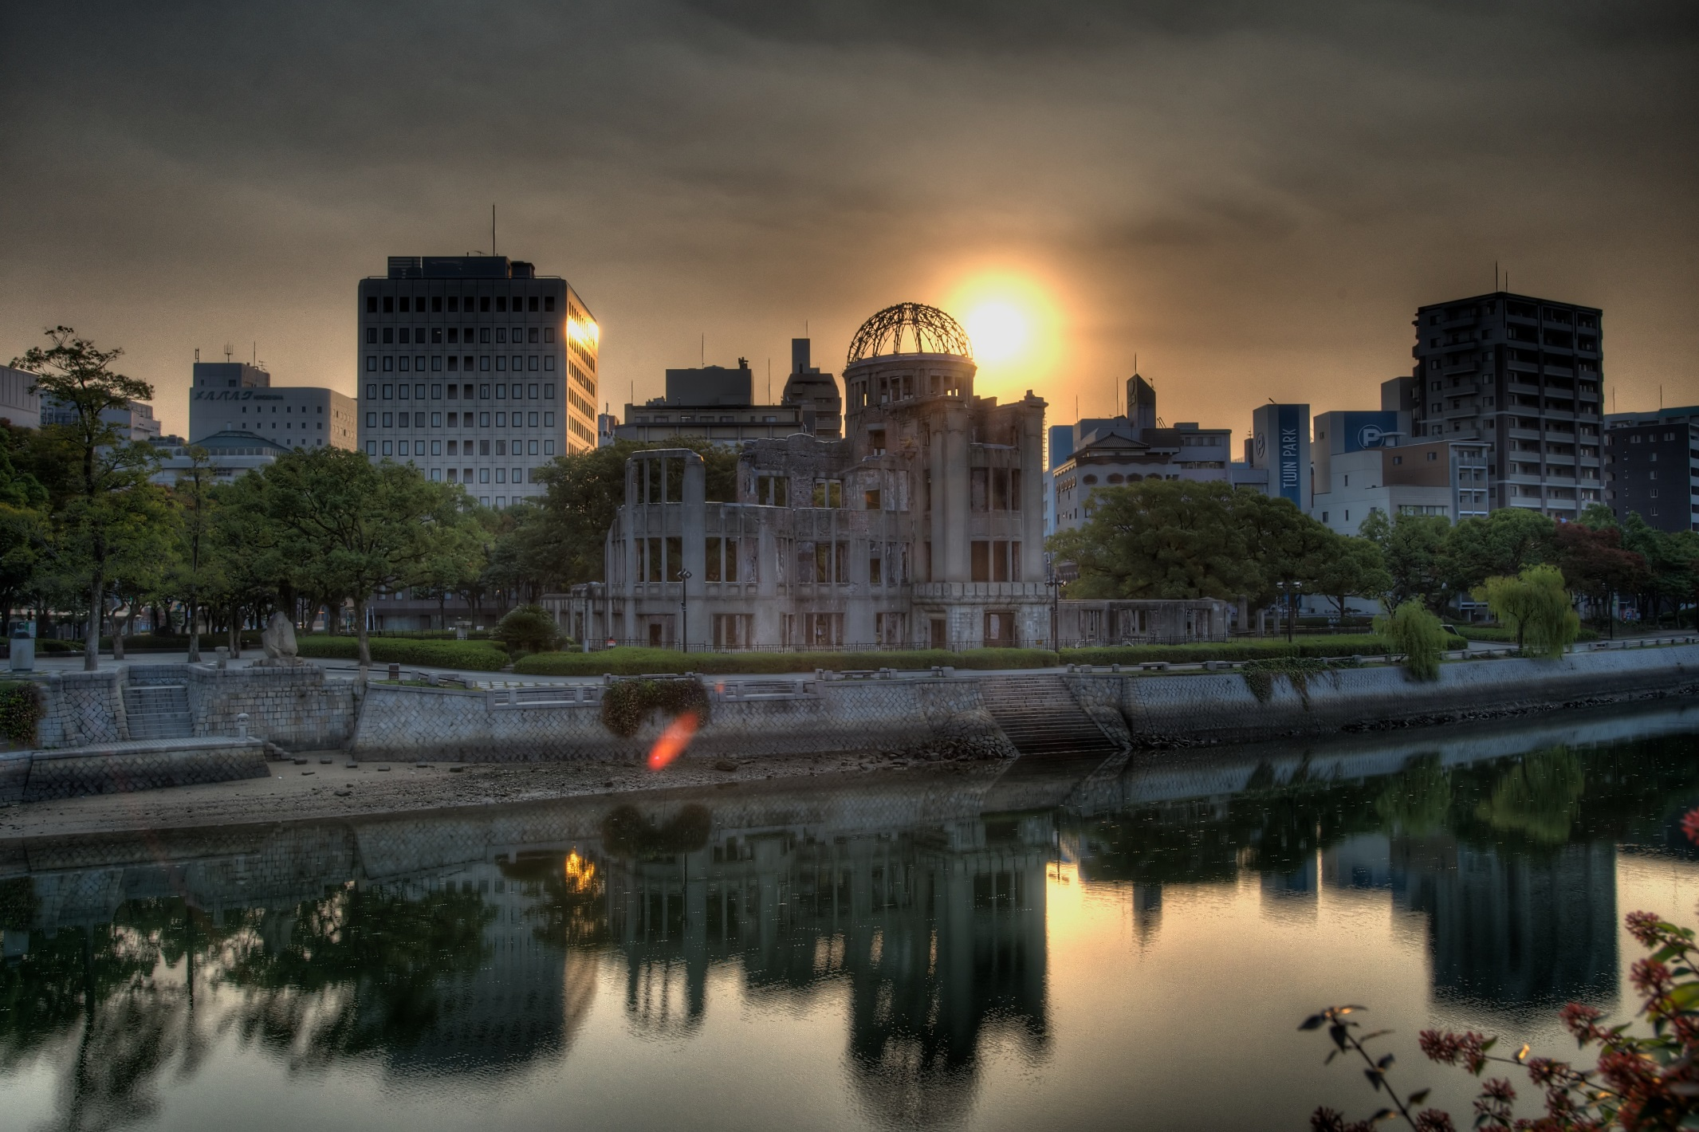
Hairyegg; https://creativecommons.org/licenses/by-sa/2.0/legalcode
Notes:
It’s been preserved to this day, and is part of the Hiroshima Peace Memorial Park.

Slide 19
Notes:
The patch or stain known as a ‘nuclear shadow’ is all that was left of someone who was sitting on the steps. They literally vaporised, because the heat of the bomb was so great: it reaches millions of degrees Centigrade very briefly, and remains at 1000s of degrees Centigrade for slightly longer. These steps are now in the Hiroshima Atomic Bomb Museum.

Slide 20
Hiroshima video clip (reconstruction)
You may find the clip disturbing. Feel free to close your eyes/look away.
Notes:
20
https://www.youtube.com/watch?v=3wxWNAM8Cso (play from 2.30-3.35)
Hiroshima Dropping the Bomb, BBC

Slide 21
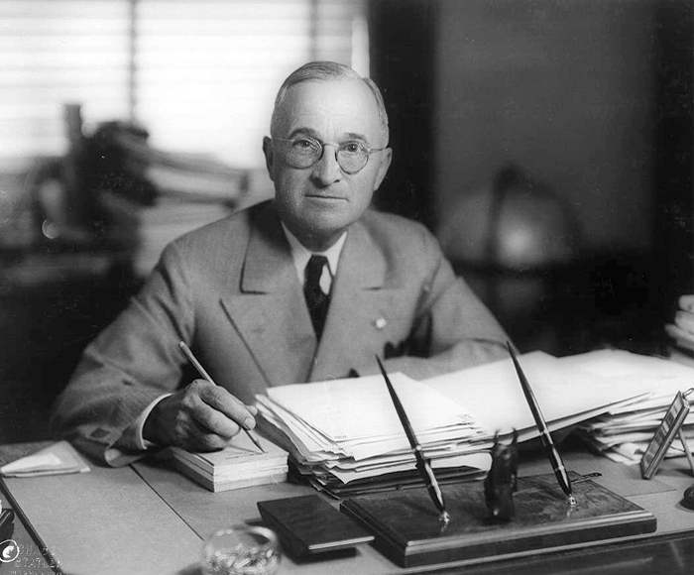
6th August 1945: President Truman promises to drop more atomic bombs on Japan if it doesn’t surrender
Matthew Yglesias ;
https://creativecommons.org/licenses/by-sa/2.0/legalcode
Notes:
watch at https://www.youtube.com/watch?v=FN_UJJ9ObDs
[Citizenship teachers: For ideas and resources on lesson activities on analysing media reporting then and now, follow the link at https://cnduk.org/education/truman-cit ]

Slide 22
Atomic Heritage Project
Notes:
This is the bomb dropped on Nagasaki. Does anyone know what it was called? [Fat Man]

Slide 23
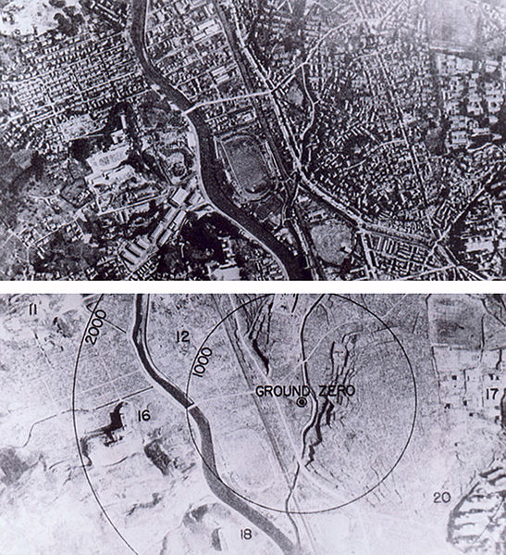
9th August 1945: The bomb is dropped on Nagasaki
Wikimedia Commons
Notes:
It was a different type of bomb to Little Boy, and was actually more powerful, though it killed fewer people, for various reasons (including that the bomb did not fall on the centre of the city)
[For more information on the Nagasaki (and Hiroshima) atomic bombing see for example https://www.atomicheritage.org/history/bombings-hiroshima-and-nagasaki-1945]

Slide 24
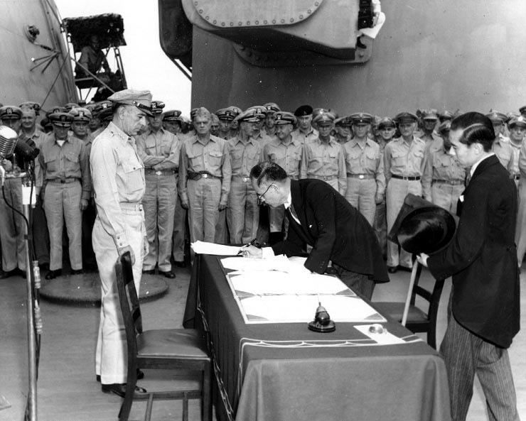
2nd September 1945: Japan formally surrenders. This is the end of the Second World War.
Public domain

Slide 25
The Question:
Was President Truman justified in dropping the atomic bombs on Hiroshima and Nagasaki?
Your Task:
To find out different people’s points of view.
Notes:
What do we mean by ‘justified’? [The right thing to do, in that situation]

Slide 26
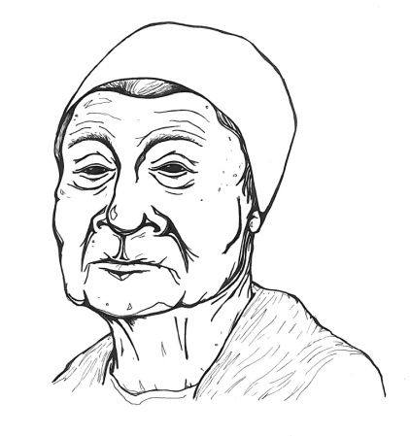
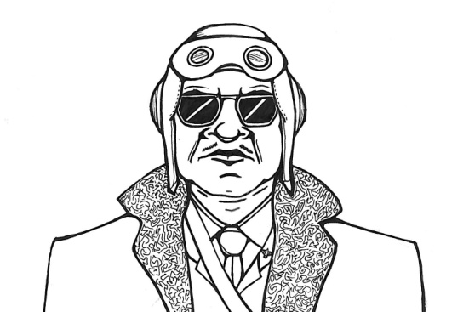
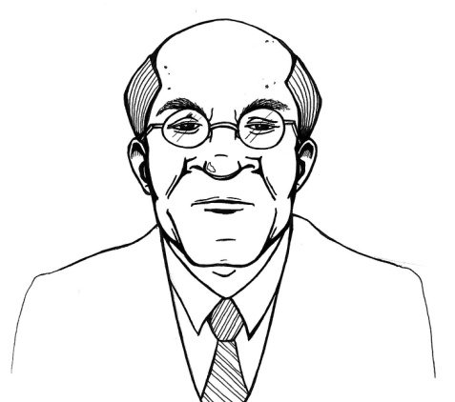
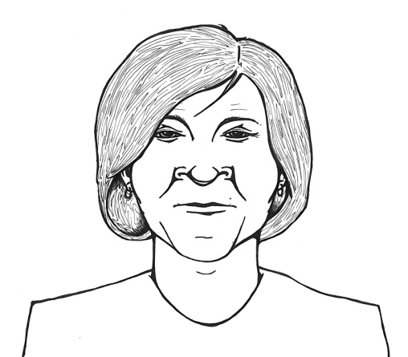
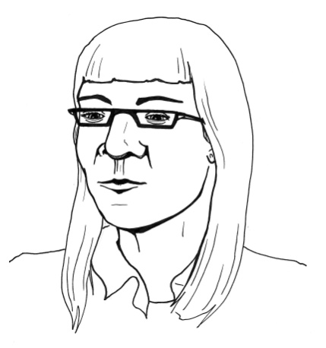
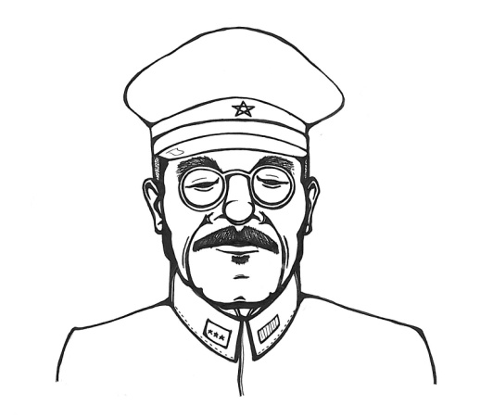
YOU ARE GOING TO MEET THESE
SIX CHARACTERS:
Nagasaki survivor
Bomber pilot
Truman’s advisor
Japanese Army General
American civilian
Nuclear Scientist
Notes:
They are fictional, but there were real people quite like them in 1945.

Slide 27
Your task: Read your card In your group decide if your character is FOR or AGAINST the bombing.

Slide 28
NOW:
Find people in the room who are pretending to be each character, and ask them questions so you can fill in your sheet
- Are they FOR or AGAINST the bombings?
- Why?

Slide 29
SHARE WITH YOUR GROUP WHAT YOU HAVE FOUND OUT!

Slide 30
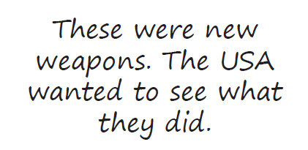
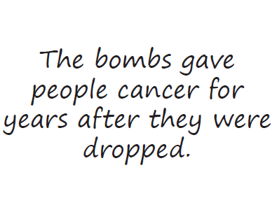
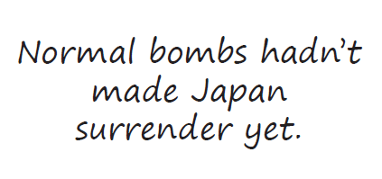
Justified or unjustified?
YOUR TASK:
In your group you will get eight cards
Read each card
Sort the cards into two piles: the ones that suggest Truman was right to drop the atomic bombs, and the ones that suggest he was wrong to do it
Feed back to the class

Slide 31
What do you think? (Spectrum line) Was Truman right to drop the atomic bomb? Why/Why not?
YES
NO
Not sure
Notes:
[Get students to line up across the room, standing at one end if they think Truman was justified in ordering the atomic bombs to be dropped, on the opposite end if they think he was unjustified, and along the ‘spectrum’ if they feel somewhere in between. Then get some students to say why they are standing where they are. The can move along the spectrum if anyone says something that persuades them. If space cannot be made in the classroom for this, a show of hands can work instead.]

