Slide 1
Lesson 3: Citizenship:
Media reporting on nuclear weapons, then and now
Notes:
[CITIZENSHIP TEACHERS: Please note: We have created a collection of additional Citizenship classroom (and homework) activities and resources to extend and enrich the Citizenship content of the Truman On Trial lessons (including this one). To browse and download the materials, go to https://cnduk.org/education/truman-cit Where applicable, we have added advice and guidance on the additional activities and resources, in some of the slides notes in this PowerPoint.]

Slide 2
What we’ll do in this lesson:
Explore media coverage of nuclear weapons (especially looking at bias)
Create our own news reports on the issue
Notes:
[NB: If you have already taught background information on the atomic bombings, and don’t need to re-cap, skip to slide 24]

Slide 3
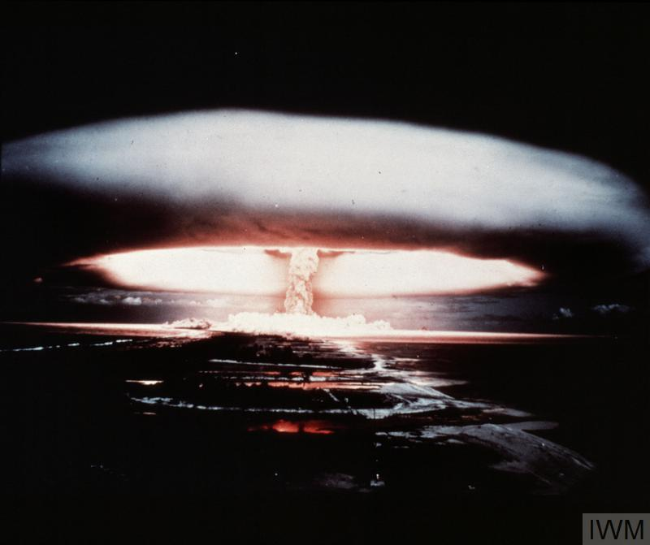
What is a nuclear weapon?
Notes:
Can anyone tell me what a nuclear weapon is, and how it works? [Repeat answers, in case not everyone heard. Add, if necessary:]
It’s an incredibly powerful bomb, known as a Weapon of Mass Destruction. There are two types: the first one discovered is the atomic bomb, which gets its huge explosive power when the nucleus of an atom is split by a neutron, releasing more neutrons, which split more nuclei, in a very fast chain reaction that releases enormous amounts of energy. This reaction is called ‘nuclear fission’.
What do we call the shape in this photo (which, like the photo on the first slide, is a British nuclear weapon test in the 1950s)? [Repeat answer, in case not everyone heard. If no-one knows, clarify:] We call it a mushroom cloud.
[For higher ability or older groups:] Nuclear fission involves isotopes of Uranium or Plutonium – isotopes are atoms of an element with a different number of neutrons. They can be very radioactive.
[Go to next slide]

Slide 4
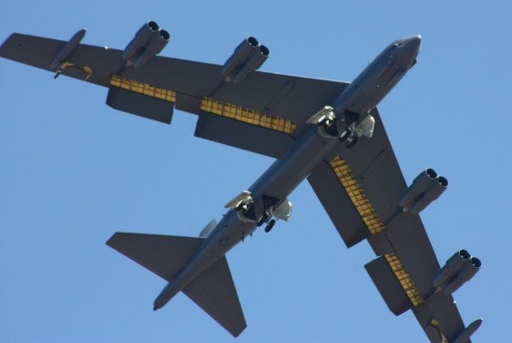
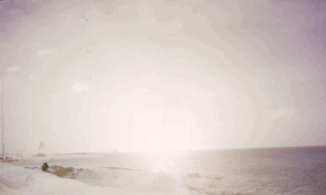
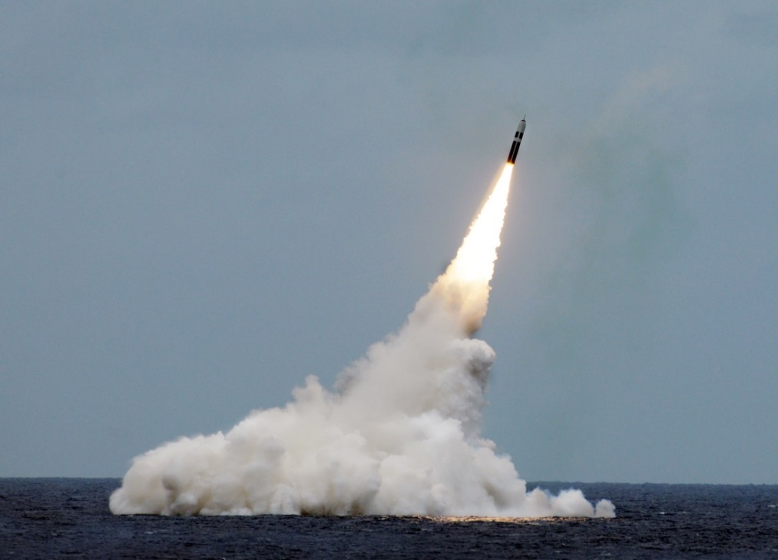
Paul L. McCord Jr. ; https://creativecommons.org/licenses/by-nd/2.0/legalcode ; cropped
Public domain ; National Museum of the US Navy
Notes:
Nuclear weapons can be launched from the ground, air and sea.

Slide 5
= 12,121 in total
Almost 4000 of them could be used at short notice; 5600 are in storage; and 2500 are ‘retired’ and will be dismantled in the coming years.
Big decrease since the 1980s (70,000 warheads!), and 400 less than last year
This is the first time since 1999 that India’s stockpile has surpassed Pakistan’s. China is expanding its nuclear arsenal faster than any other country (from 410 in 2023 to 500 in 2024

Slide 6
Have nuclear weapons ever been used in a war?

Slide 7
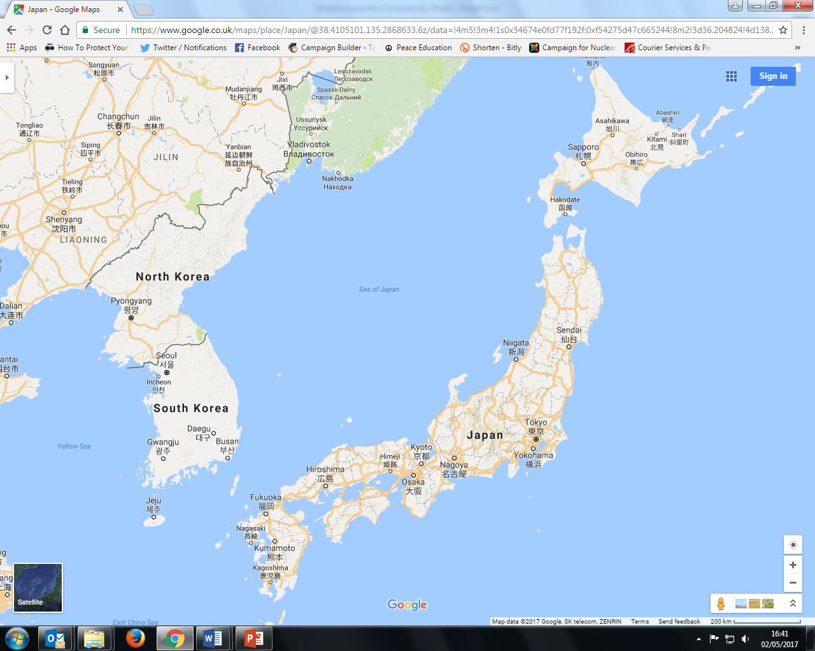

Slide 8
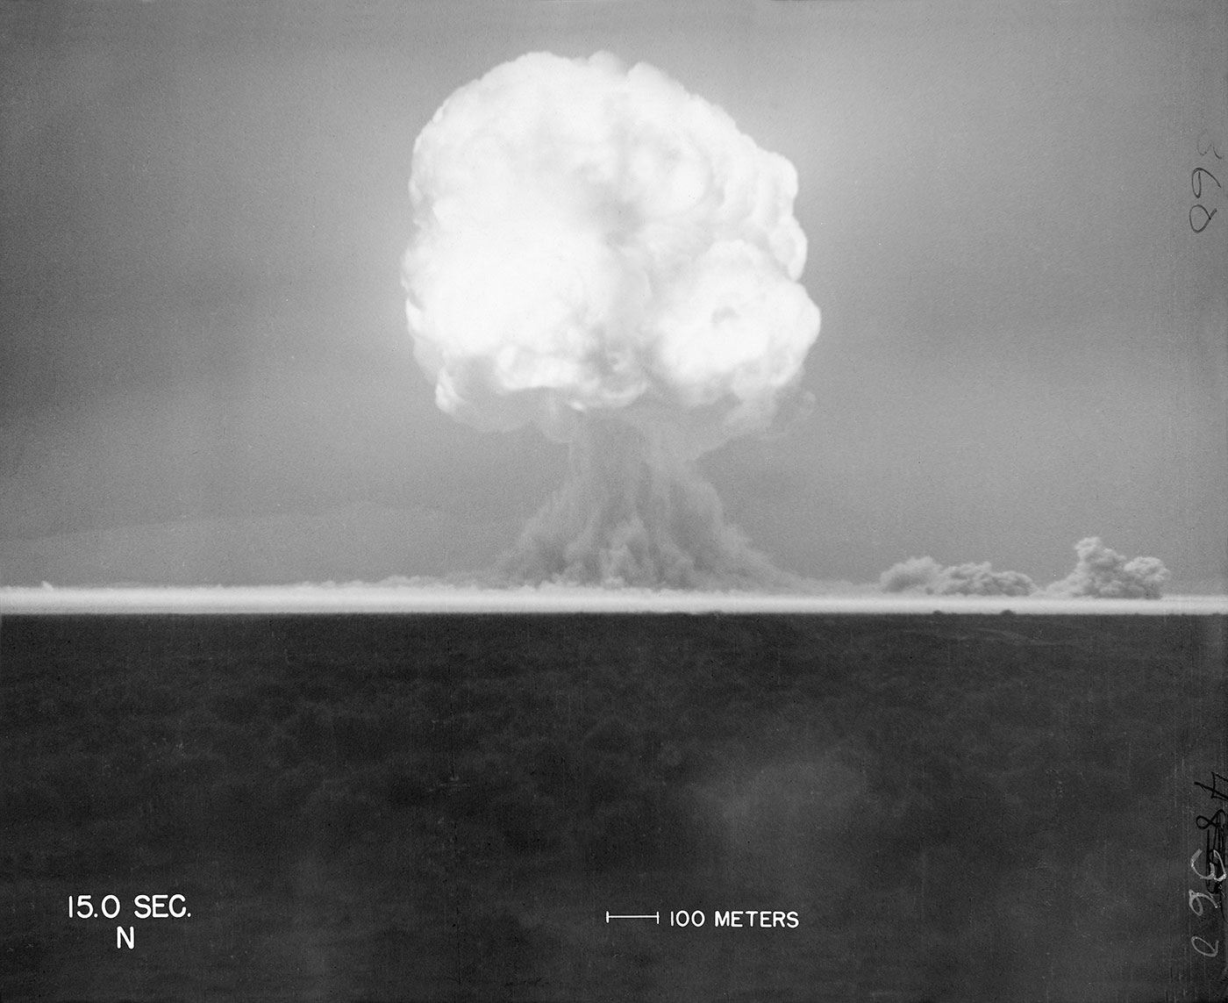
16th July 1945: The United States successfully tests the world’s first ever atomic bomb (researchers 6 miles away are knocked over by the blast wave, and those 10 miles away felt heat on their face. Then, an unbelievably bright flash of light, described as ''beautiful'', then a defeaning roar, and a mushroom cloud 8 miles high in minutes)
trinityremembered.com
Notes:
The USA had spent six years and nearly $2 billion dollars on the ‘Manhattan Project’, which involved thousands of scientists, engineers and others. Nazi Germany was also developing an atomic bomb, but didn’t succeed before their defeat, and the Soviet Union began developing one in 1943 but didn’t finish it until after 1949.
[For more information see for example https://www.atomicheritage.org/history/manhattan-project and https://www.ctbto.org/nuclear-testing/history-of-nuclear-testing/manhattan-project/]

Slide 9
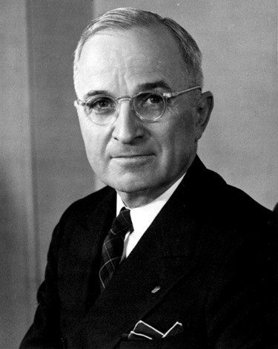
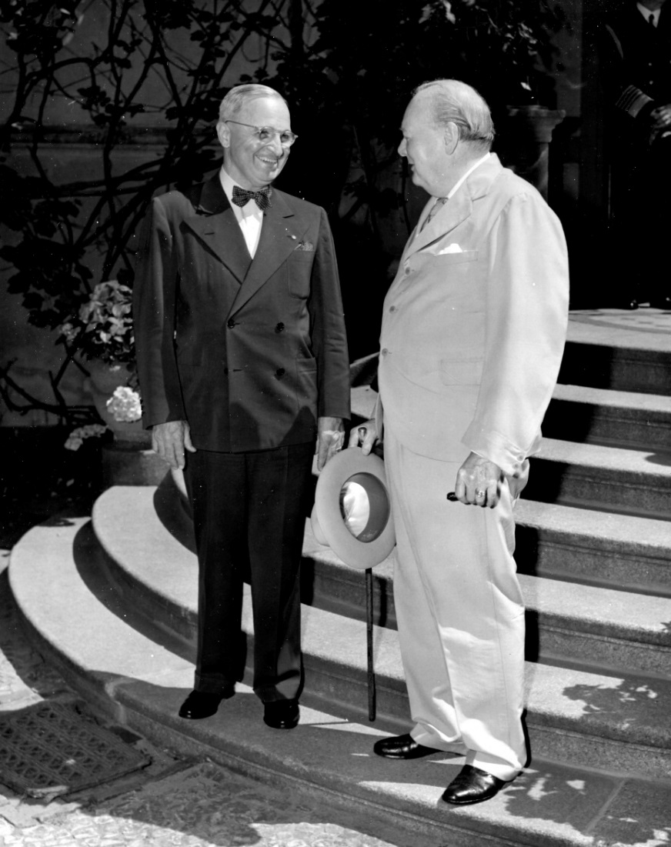
25th July 1945: President Truman gives the order to prepare to drop the atomic bomb on Japan (Britain gave its official consent on 4th July; Truman took over after Roosevelt died in April. The Manhattan Project was so secret that Truman hadn’t been told about it as Vice-President!)
Lord Mariser, https://creativecommons.org/licenses/by-sa/2.0/legalcode
Harry Kidd ; https://creativecommons.org/licenses/by-nc-sa/2.0/legalcode
Notes:
Not many people know about Britain having a say (at least on paper) on the atomic bomb being used. Prime Minister Winston Churchill said he gave our permission without hesitating, though he later had some doubts about whether it was the right thing to do.
[For more information see: http://www.dannen.com/decision/handy.html and https://www.atomicheritage.org/history/british-nuclear-program and https://history.state.gov/historicaldocuments/frus1945v02/d4 and https://richardlangworth.com/churchill-on-bombing-japan
Citizenship teachers: For ideas and resources on lesson activities exploring the varying stances of Theresa May, Jeremy Corbyn, Donald Trump, and Kim Jong-Un on using their country’s contemporary nuclear weapons (and the limits on their power to do so), follow the link at https://cnduk.org/education/truman-cit]

Slide 10
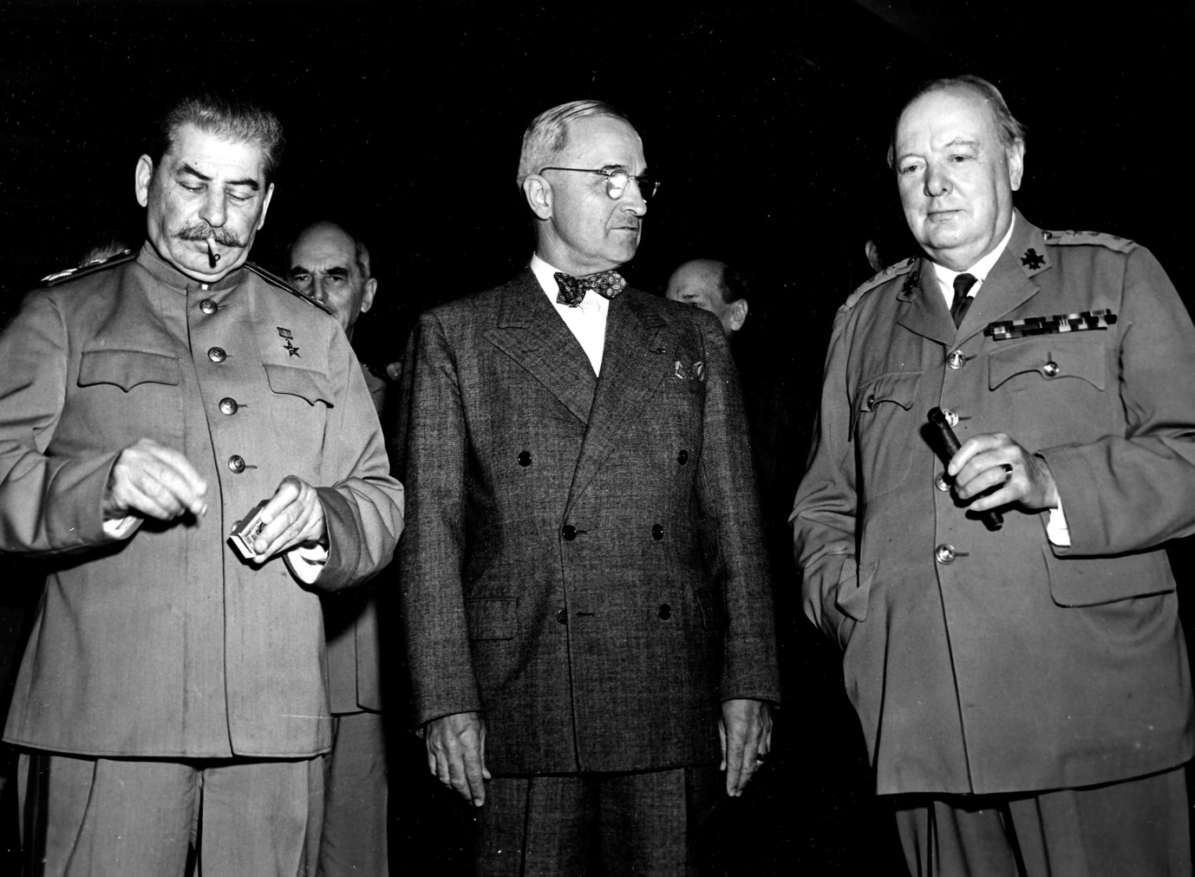
26th July 1945: Truman, Churchill and Chiang Kai-shek issue the ‘Potsdam Declaration’ to Japan, which finished with the words:
‘We call upon the government of Japan to proclaim now the unconditional surrender of all Japanese armed forces... The alternative for Japan is prompt and utter destruction.’
HarryKidd ; https://creativecommons.org/licenses/by-nc-sa/2.0/legalcode
Notes:
This declaration is usually seen as the USA’s warning to Japan, although it doesn’t specify about nuclear weapons (and it wouldn’t have made sense to most people if it had, as the atomic bomb had been kept very secret). Japan did not accept the demand to surrender, but some scholars argue that it didn’t exactly reject it either [see https://en.wikipedia.org/wiki/Mokusatsu] (The photo shows Soviet leader Joseph Stalin, alongside Harry Truman and Winston Churchill. Stalin didn’t sign the Declaration, as the Soviet Union wasn’t actually at war with Japan until 8th August: China’s leader Chiang Kai-Shek did sign it.) [For more information on the Potsdam Conference, and the ‘Declaration’, see https://history.state.gov/milestones/1937-1945/potsdam-conf and https://www.trumanlibrary.org/whistlestop/study_collections/naval/berlin/index.php?documentid=hst-naval_naid1701729-04&pagenumber=1 respectively (NB: the latter is a draft of the final text) Citizenship teachers: For ideas and resources on lesson activities exploring nuclear tensions between the USA and Russia in 2018-19, and the UK’s role in this context, follow the link at https://cnduk.org/education/truman-cit]

Slide 11
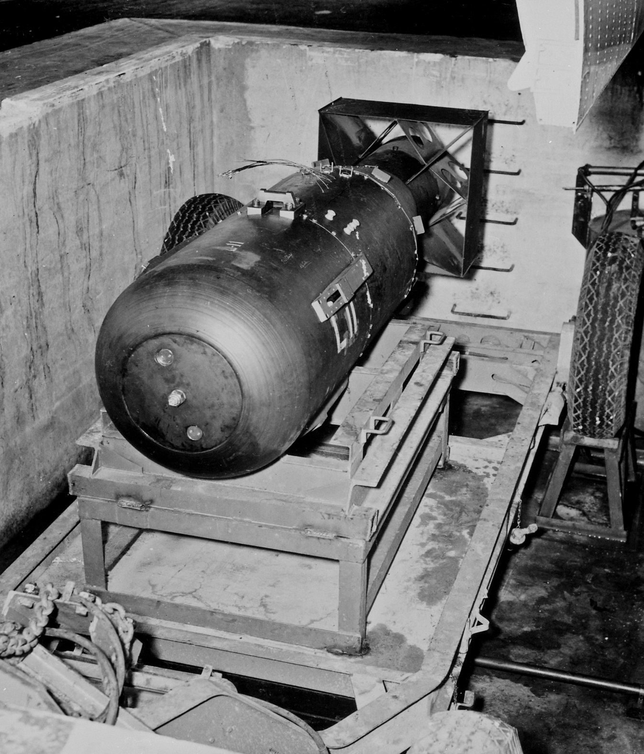
James Vaughan ; https://creativecommons.org/licenses/by-sa/2.0/legalcode
Notes:
Does anyone know what the bomb dropped on Hiroshima was called? [Little Boy]
As Hiroshima is very flat, there were no natural obstacles (like hills) to contain the explosion. It destroyed a huge proportion of the city.

Slide 12
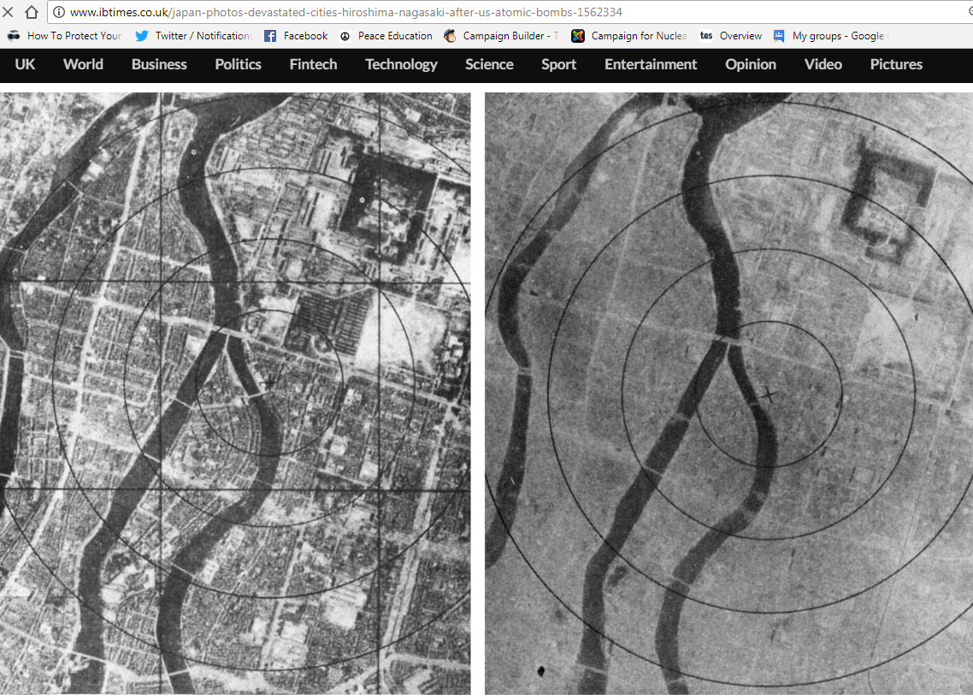
6th August 1945: The atomic bomb is dropped on Hiroshima
Notes:
The photo on the right was taken after the bomb exploded. How can you tell it’s the same place? [The river, plus a few faint outlines of streets and buildings] The ‘x’ marks the centre of the explosion. The bomb was made to explode 600 metres above ground, as it was expected that this would do more damage (although this also meant there was less radioactive fallout than there would have been from a ‘ground-burst’)

Slide 13
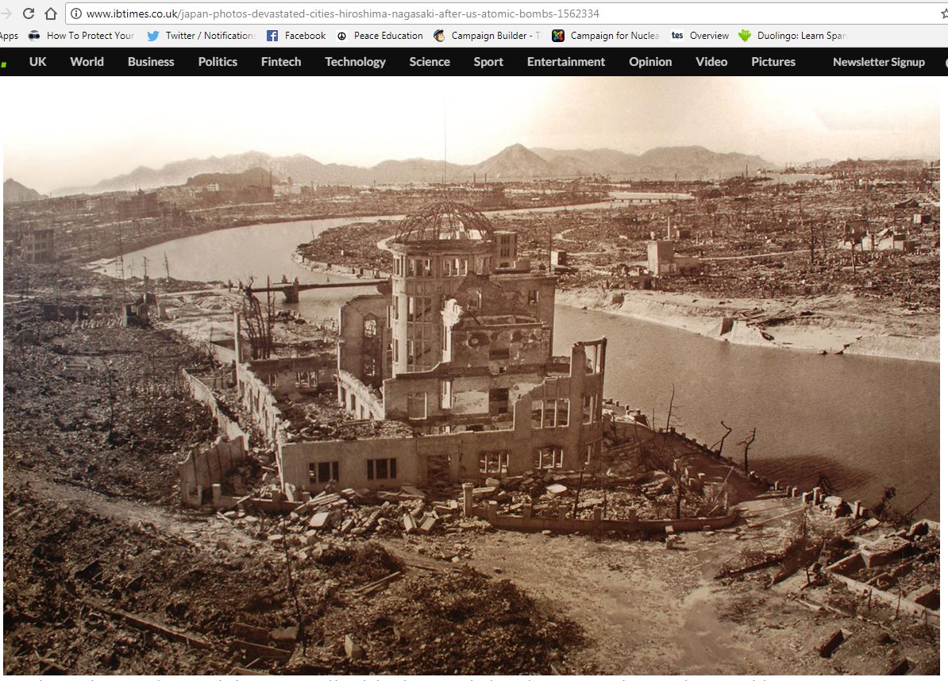
Notes:
This building lasted better than most because it was directly underneath the explosion.
[For more information on the Hiroshima (and Nagasaki) atomic bombing see for example https://www.atomicheritage.org/history/bombings-hiroshima-and-nagasaki-1945]

Slide 14
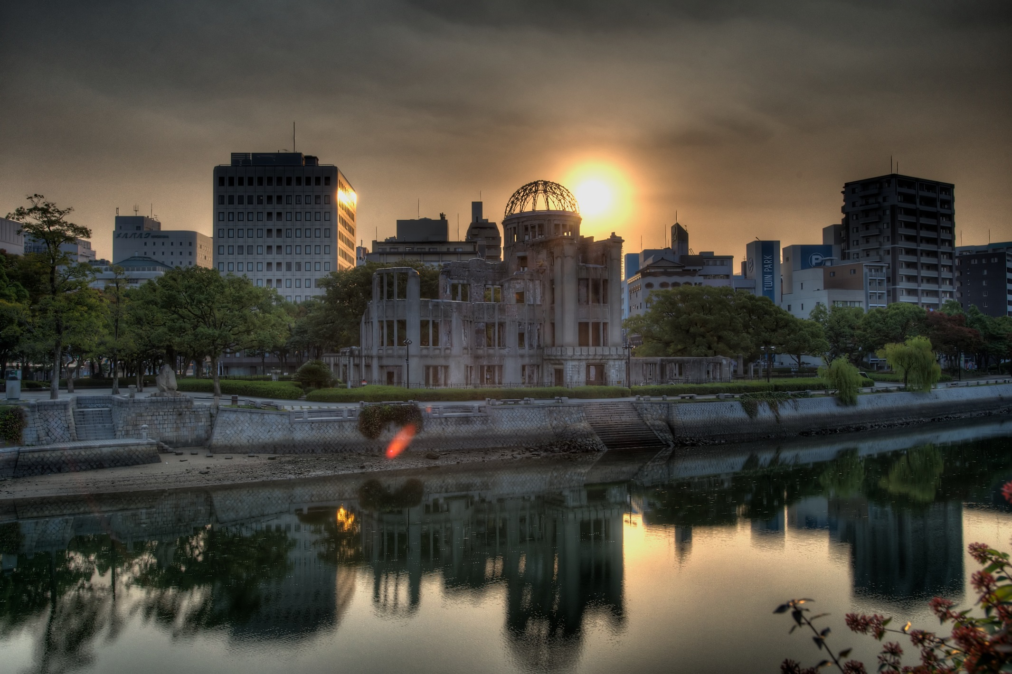
Hairyegg; https://creativecommons.org/licenses/by-sa/2.0/legalcode
Notes:
It’s been preserved to this day, and is part of the Hiroshima Peace Memorial Park.

Slide 15
Notes:
The patch or stain known as a ‘nuclear shadow’ is all that was left of someone who was sitting on the steps. They literally vaporised, because the heat of the bomb was so great: it reaches millions of degrees Centigrade very briefly, and remains at 1000s of degrees Centigrade for slightly longer. These steps are now in the Hiroshima Atomic Bomb Museum.

Slide 16
Hiroshima video clip (reconstruction)
You may find the clip disturbing. Feel free to close your eyes/look away.
Notes:
16
https://www.youtube.com/watch?v=3wxWNAM8Cso (play from 2.30-3.35)
Hiroshima Dropping the Bomb, BBC

Slide 17
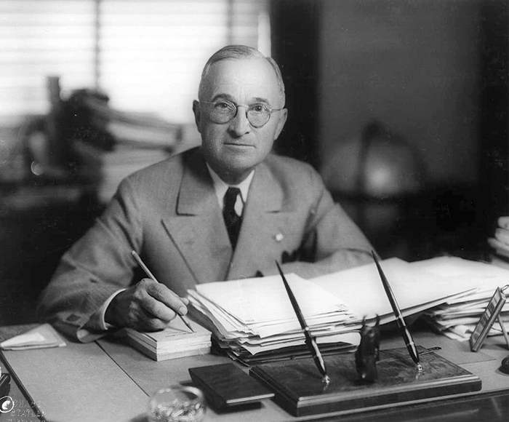
6th August 1945: President Truman gives a statement promising further bombs if Japan doesn’t surrender
Matthew Yglesias ;
https://creativecommons.org/licenses/by-sa/2.0/legalcode
Notes:
watch at https://www.youtube.com/watch?v=FN_UJJ9ObDs [Citizenship teachers: For ideas and resources on lesson activities on analysing media reporting then and now, follow the link at https://cnduk.org/education/truman-cit ]

Slide 18
Atomic Heritage Project
Notes:
This is the bomb dropped on Nagasaki. Does anyone know what it was called? [Fat Man]

Slide 19
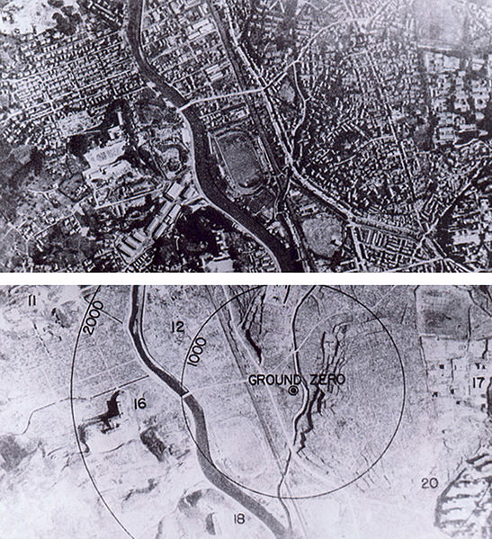
9th August 1945: The bomb is dropped on Nagasaki
Wikimedia Commons
Notes:
It was a different type of bomb to Little Boy, and was actually more powerful, though it killed fewer people, for various reasons (including that the bomb did not fall on the centre of the city)
[For more information on the Nagasaki (and Hiroshima) atomic bombing see for example https://www.atomicheritage.org/history/bombings-hiroshima-and-nagasaki-1945]

Slide 20
9th August 1945: At midnight, the USSR invades Manchuria, in Northern China, which since 1932 had been part of the Japanese Empire. They go on to capture Northern Korea and other Japanese-occupied territories.
histclo.com
Notes:
This was the last campaign of the Second World War. It lasted eleven days, and tens of thousands were killed or injured on both sides. Manchuria and Mengjiang – or Inner Mongolia - were returned to China, and Korea was partitioned along the ‘38th Parallel’, with the Soviet Union occupying the North and the USA the South. [Citizenship teachers: For ideas and resources on exploring the changing nuclear tensions (from 2017-2019) between the USA and Russia, and between the USA and North Korea, and also the UK’s role in these contexts, please go to https://cnduk.org/education/truman-cit ]

Slide 21
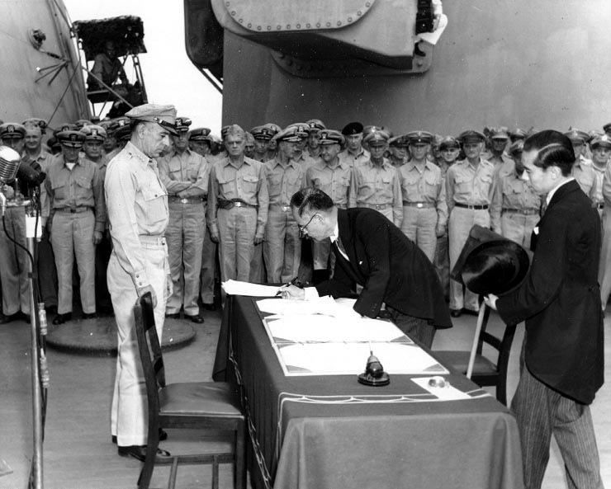
2nd September 1945: Japan formally surrenders. This is the end of the Second World War.
Public domain

Slide 22
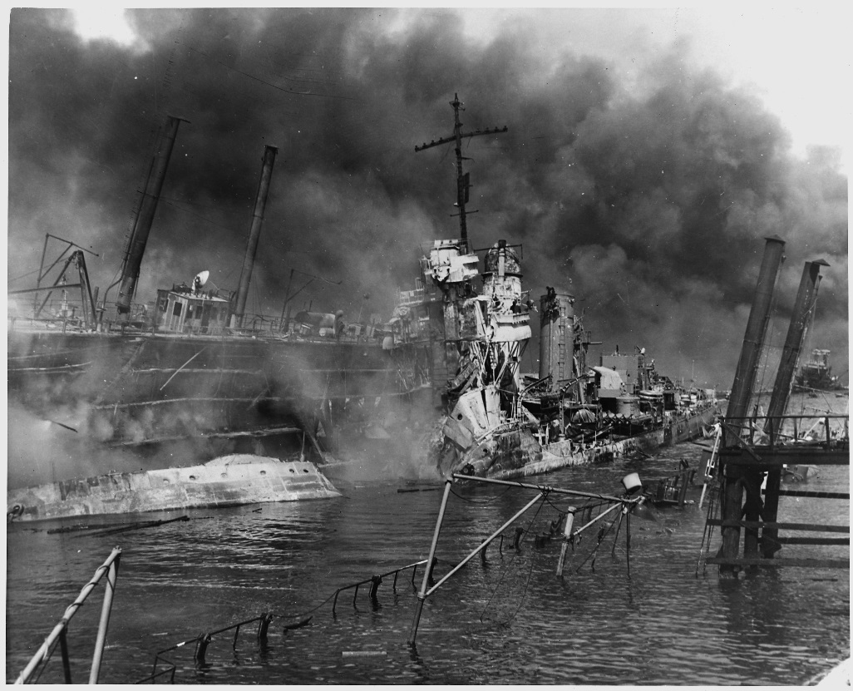
What are the arguments for the bombings?
Saved lives: ended the war ASAP, saving lives overall by avoiding a land invasion (the Okinawa battle saw 1/3 of US landing force killed or wounded; Churchill said the USA and Britain would lose 1 million and 500,000 soldiers respectively)
Revenge for Pearl Harbour
Once the bomb was developed, it was always going to be used
US National Archives
Notes:
.
[For more information see for example https://www.atomicheritage.org/history/debate-over-bomb and https://en.wikipedia.org/wiki/Debate_over_the_atomic_bombings_of_Hiroshima_and_Nagasaki#Opposition]

Slide 23
What are the arguments against the bombings?
Immoral: Killed 185,000-600,000 - mostly civilians (Some of the leading Manhattan Projects scientists had asked decision-makers for the A-bomb to be used on ''uninhabited area'' of Japan instead, as a threat, but Truman had already decided on maximum impact, and couldn't risk failure of bomb demonstration. They only had two bombs, after all.)
Surrender was possible: The US had intercepted telegrams showing that some of the Japanese government wanted Japan to surrender
More about sending a message to the Soviet Union
Notes:
.
[The fatality estimates vary greatly, partly due to the lack of rigorous records and the vaporisation or cremation of many bodies in the explosion, and also because the more conservative figures focus on short short-term deaths, unlike the UN’s upper figure: see for example http://www.aasc.ucla.edu/cab/200708230009.html and https://news.un.org/en/story/2015/08/505812-no-more-hiroshimas-no-more-nagasakis-ban-declares-anniversary-atomic-bombing]

Slide 24
WHAT DO YOU THINK? ‘spectrum line’
Notes:
[(You could also re-cap on the class verdict if you did the mock trial lesson) Get students to line up across the room, standing at one end if they think Truman was justified in ordering the atomic bombs to be dropped, on the opposite end if they think he was unjustified, and along the ‘spectrum’ if they feel somewhere in between. Then get some students to say why they are standing where they are. The can move along the spectrum if anyone says something that persuades them. If space cannot be made in the classroom for this, a show of hands can work instead. To add more nuance to your spectrum/barometer activities, see https://www.facinghistory.org/sites/default/files/viewing-guide-barometer.pdf]

Slide 25
Real newspaper headlines after the Hiroshima bomb…

Slide 26
‘Scientific Gamble Won’ The Manchester Guardian (UK), 7th August 1945 (Full article at www.theguardian.com/world/from-the-archive-blog/2015/aug/06/hiroshima-atomic-bomb-guardian-1945-archive)
What was the gamble?

Slide 27
U.S. Announces Atom Bomb: Hope for Earlier End to War The Albuquerque Journal (US), 7th August 1945 (Full article at https://www.newspapers.com/newspage/156894795/)
Why did they think it may bring an earlier end to the war?

Slide 28
New-Type Bombs Used in Raid on Hiroshima... Considerable Damage Caused Nippon Times (Japan), 8th August 1945 (Full article at www.japantimes.co.jp/news/2015/08/05/national/history/japan-times-reported-atomic-bombings-hiroshima-nagasaki/#.WQCurfnyvcs)
Are the Japanese journalists down-playing the bomb?
Notes:
[Citizenship teachers: An insightful additional source for exploring the nature of contemporary media reports on the Hiroshima and Nagasaki atomic bombings is this passage from the USA’s 1946 ‘Strategic Bombing Survey’: ‘Only in the nearest group of cities, within 40 miles of Hiroshima or Nagasaki, was there a substantial effect on morale… Were the channels of mass communication as readily available to all the population as they are in the United States and had the use of the bomb received anything like the intensive coverage it had here, the effect on [impeding] continued support of the war would probably have been greater.’
As a whole class, or via an individual writing task, the students could discuss the significance of the nature of the Japanese media in 1945 in limiting the impact of the atomic bombings on morale, and whether this would have been different in another country (as the Strategic Bombing Survey suggests) or/and time (such as present-day Japan, or the UK). For some more information and guidance, go to https://cnduk.org/education/free-teaching-resources/truman-on-trial/media-reporting-analysing-media-bias-and-identifying-fake-news ]

Slide 29
Recent media coverage of the bombings (and of nuclear weapons today)…
Notes:
[Citizenship teachers: For ideas and resources on lesson activities exploring (and identifying) media bias and fake news, follow the link at https://cnduk.org/education/truman-cit ]

Slide 30
"This is a changed Labour party and the most important thing is I voted in favour of a nuclear deterrent,” Sir Keir Starmer
BBC News 3 June 2024 (Full article at https://www.bbc.co.uk/news/articles/czvvy0ppdxko )
)

Slide 31
‘Hiroshima student activist calls for abolition of nuclear weapons’
The Japan Times, 7th August 2024
(Full article at https://www.japantimes.co.jp/news/2024/08/07/japan/society/hiroshima-student-activist/)
Notes:
[Citizenship teachers: For ideas and resources on exploring topics such as the changing 2017-2019 nuclear tensions between the USA and Russia/North Korea (including the UK’s role in these contexts), and the differing stances of May, Corbyn, Trump and Jong-un on using their country’s nuclear weapons, please go to https://cnduk.org/education/truman-cit ]

Slide 32
‘Russia to train troops to use nuclear weapons on the battlefield’
The Telegraph 31st July 2024 (Full article at https://www.telegraph.co.uk/world-news/2024/07/31/russia-train-troops-ukraine-nuclear-weapons-battlefield/)
Notes:
[Citizenship teachers: For ideas and resources on exploring topics such as the changing 2017-2019 nuclear tensions between the USA and Russia/North Korea (including the UK’s role in these contexts), and the differing stances of May, Corbyn, Trump and Jong-un on using their country’s nuclear weapons, please go to https://cnduk.org/education/truman-cit ]

Slide 33
In pairs: Read the newspaper article you’ve been given on the issue, and prepare a 30-second presentation on it for the rest of the class: What are the main points that the article makes? Is it biased? If so, how?
Notes:
[Citizenship teachers: For ideas and resources on lesson activities exploring (and identifying) media bias and fake news, follow the link at https://cnduk.org/education/truman-cit ]

Slide 34
YOUR TASK:
* In groups, create a one-minute TV/radio report about the bombing of Hiroshima and/or Nagasaki. * You will be given a card with information on your news agency, and the sort of thing you could say. (examples below)
Notes:
[Citizenship teachers: For ideas and resources on lesson activities exploring (and identifying) media bias and fake news, follow the link at https://cnduk.org/education/truman-cit ]

Slide 35
Things to think about:
Why are you doing this news report?
Where will you be reporting from?
Who will you interview in your report?
What tone and language will you use? (neutral, emotive, etc)
Who is your audience? How are they likely to feel about the bombings?

Slide 36
Present your reports to the class!

Slide 37
DISCUSS:
How were the bombings described differently depending on who was presenting? Why?
Is it possible to report on the bombings in a neutral way?
Notes:
[For Extension and Enrichment activities, see the lesson plan, which can be downloaded at www.cnduk.org/education/free-teaching-resources/. For ideas and resources on Citizenship lesson activities exploring (and identifying) media bias and fake news, follow the link at https://cnduk.org/education/truman-cit ]

