Slide 1
Lesson 3:
RE:
Nuclear weapons and Just War
Notes:
[CITIZENSHIP TEACHERS: Please note: We have created a collection of additional Citizenship classroom (and homework) activities and resources to extend and enrich the Citizenship content of the Truman On Trial lessons (including this one). To browse and download the materials, go to https://cnduk.org/education/truman-cit Where applicable, we have added advice and guidance on the additional activities and resources, in some of the slides notes in this PowerPoint.]

Slide 2
What we’ll do in this lesson:
Decide the situations you think/feel justify a country going to war, and what actions are acceptable during war
Look at the USA’s use of nuclear weapons against Japan in 1945
Decide if these bombings were justified according to Just War theory

Slide 3
Would these be acceptable reasons for the UK to go to war, and why?:
Another country invades
An allied country is invaded
The Prime Minister is assassinated by another country.
A terrorist attack kills 300 people, and the terrorists are protected by another country
A terrorist attack kills 3000 people, and the terrorists are protected by another country
Notes:
[You could use the spectrum activity for this: Get students to line up across the room, standing at one end if they think Truman was justified in ordering the atomic bombs to be dropped, on the opposite end if they think he was unjustified, and along the ‘spectrum’ if they feel somewhere in between. Then get some students to say why they are standing where they are. The can move along the spectrum if anyone says something that persuades them. If space cannot be made in the classroom for this, a show of hands can work instead.]
[Higher-ability students could be challenged by discussing nuances such as the different types of war (between countries/states, civil war, asymmetric warfare, drone warfare, cyber warfare, etc – some of which lack formal declarations)]

Slide 4
Would these be acceptable actions for the UK armed forces during a war, and why?:
Bombing a working hospital/school where enemy soldiers are hiding and training
Using child soldiers (under 18)
Use Weapons of Mass Destruction (e.g. nuclear weapons, chemical weapons, or biological weapons)
Notes:
[Again, you could use the spectrum activity for this]

Slide 5
YOUR TASK:
Choose the six things from the sheet that you think are most important if you were making the rules for war
You can add a rule of your own if you feel it is more important than some of the other options

Slide 6
Which six rules did you choose, and why?

Slide 7
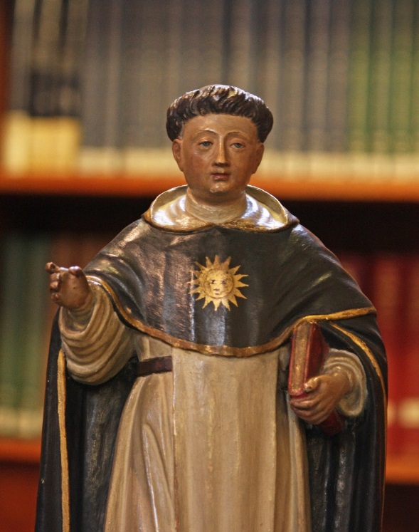
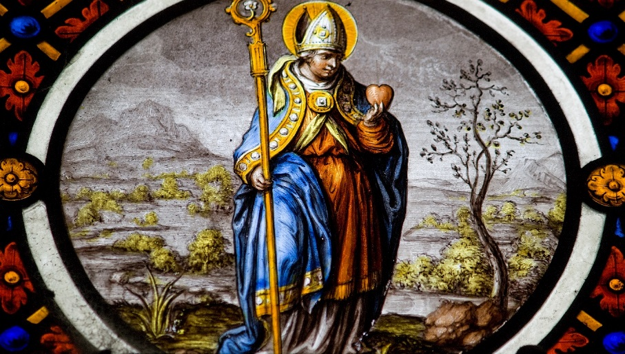
JUST WAR THEORY
St Thomas Aquinas (1255-1274) developed the theory
He built on the ideas of St Augustine of Hippo (354 – 430)
There are two aspects to the Just War theory: Jus ad bellum (Latin for ‘just reasons to go to war’) and Jus in bello (Latin for ‘just actions during war’)
Lawrence OP ; https://creativecommons.org/licenses/by-nc-nd/2.0/legalcode

Slide 8
Just War theory: a war must:
Be declared by a legitimate authority (e.g. a recognised government)
Have a just cause (e.g. defence against invasion)
Have a just intention (e.g. to stop evil, not for self-interest)
Be the last resort
Have a good chance of being successful and bringing about peace
Be in proportion (it should not kill too many people, especially if they are not involved in the fighting)

Slide 9
How do your six rules compare to the Just War criteria?
Notes:
[Citizenship teachers: For lots of ideas and resources on lesson activities on the development of legal recourse regarding war crimes, including an introduction to the International Criminal Court, and how it differs from UK criminal courts), go to https://cnduk.org/education/truman-cit ]

Slide 10
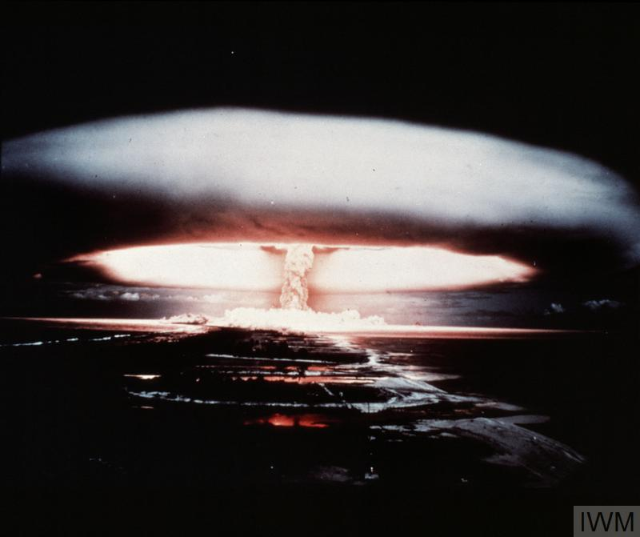
What is a nuclear weapon?
Notes:
Can anyone tell me what a nuclear weapon is, and how it works? [Repeat answers, in case not everyone heard. Add, if necessary:]
It’s an incredibly powerful bomb, known as a Weapon of Mass Destruction. There are two types: the first one discovered is the atomic bomb, which gets its huge explosive power when the nucleus of an atom is split by a neutron, releasing more neutrons, which split more nuclei, in a very fast chain reaction that releases enormous amounts of energy. This reaction is called ‘nuclear fission’.
What do we call the shape in this photo (which, like the photo on the first slide, is a British nuclear weapon test in the 1950s)? [Repeat answer, in case not everyone heard. If no-one knows, clarify:] We call it a mushroom cloud.
[For higher ability or older groups:] Nuclear fission involves isotopes of Uranium or Plutonium – isotopes are atoms of an element with a different number of neutrons. They can be very radioactive.
[Go to next slide]

Slide 11
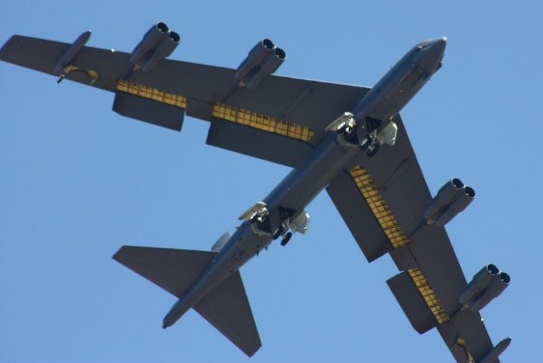
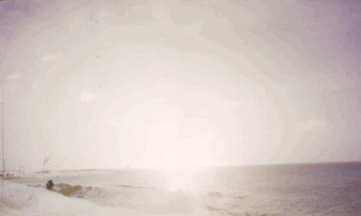
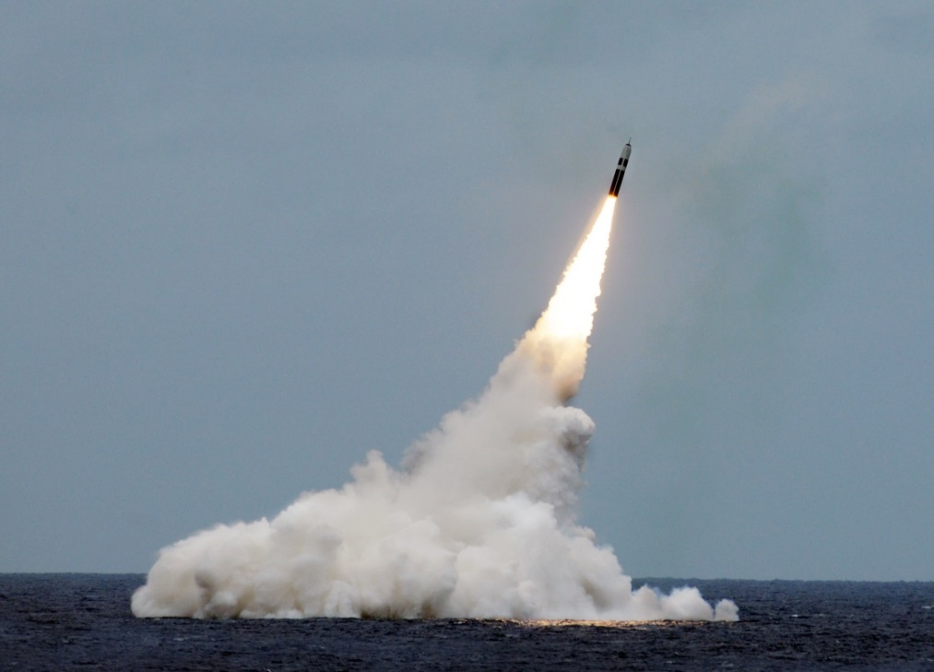
Paul L. McCord Jr. ; https://creativecommons.org/licenses/by-nd/2.0/legalcode ; cropped
Public domain ; National Museum of the US Navy
Notes:
Nuclear weapons can be launched from the ground, air and sea.

Slide 12
= 12,121 in total
Almost 4000 of them could be used at short notice; 5600 are in storage; and 2500 are ‘retired’ and will be dismantled in the coming years.
Big decrease since the 1980s (70,000 warheads!), and 400 less than last year
This is the first time since 1999 that India’s stockpile has surpassed Pakistan’s. China is expanding its nuclear arsenal faster than any other country (from 410 in 2023 to 500 in 2024

Slide 13
Have nuclear weapons ever been used in a war?

Slide 14
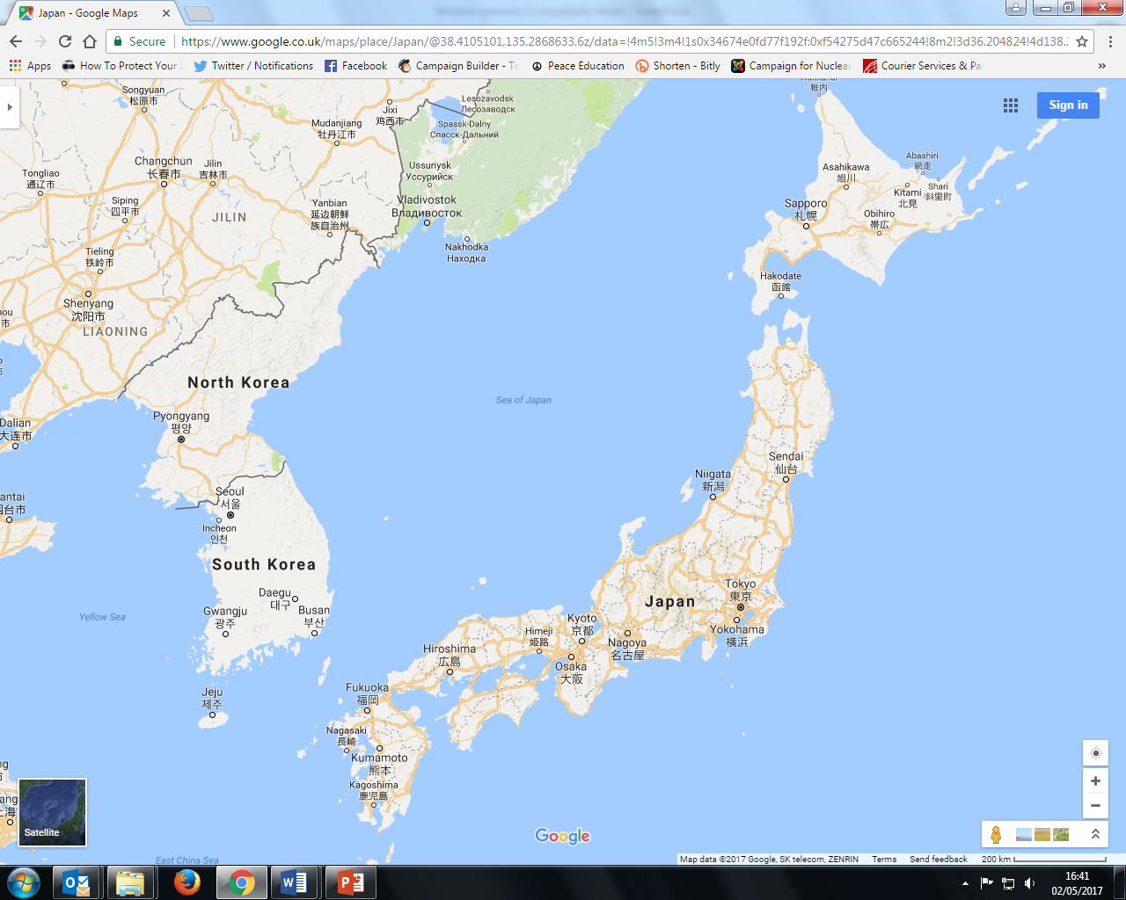

Slide 15
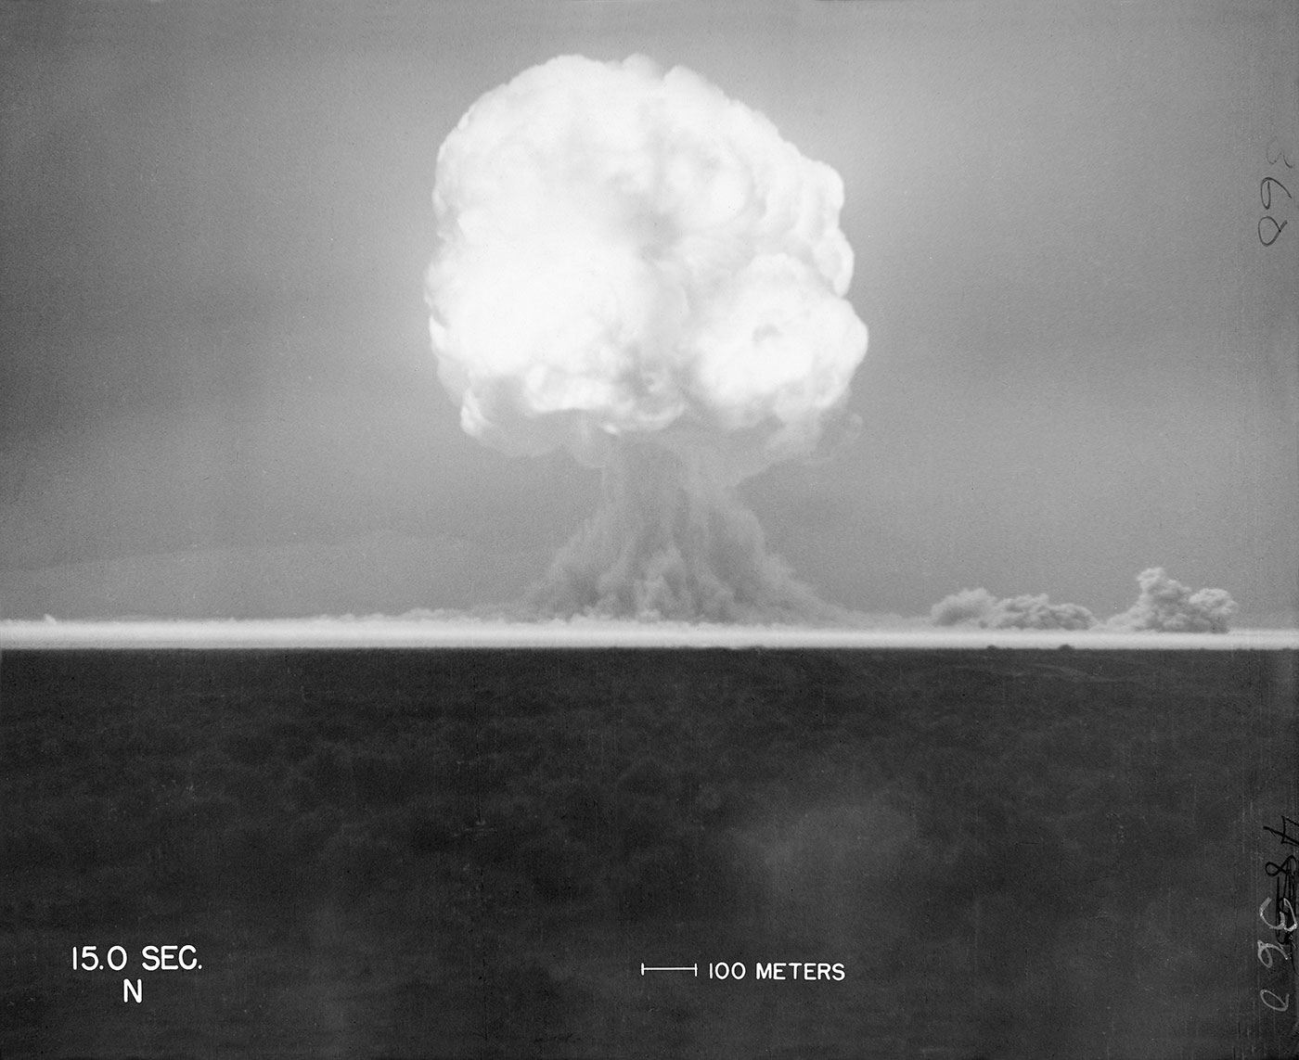
16th July 1945: The United States successfully tests the world’s first ever atomic bomb (researchers 6 miles away are knocked over by the blast wave, and those 10 miles away felt heat on their face. Then, an unbelievably bright flash of light, described as ''beautiful'', then a defeaning roar, and a mushroom cloud 8 miles high in minutes)
trinityremembered.com
Notes:
The USA had spent six years and nearly $2 billion dollars on the ‘Manhattan Project’, which involved thousands of scientists, engineers and others. Nazi Germany was also developing an atomic bomb, but didn’t succeed before their defeat, and the Soviet Union began developing one in 1943 but didn’t finish it until after 1949.
[For more information see for example https://www.atomicheritage.org/history/manhattan-project and https://www.ctbto.org/nuclear-testing/history-of-nuclear-testing/manhattan-project/]

Slide 16
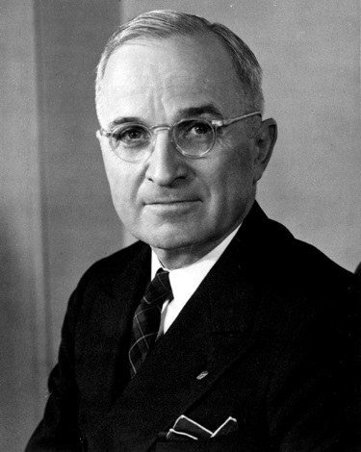
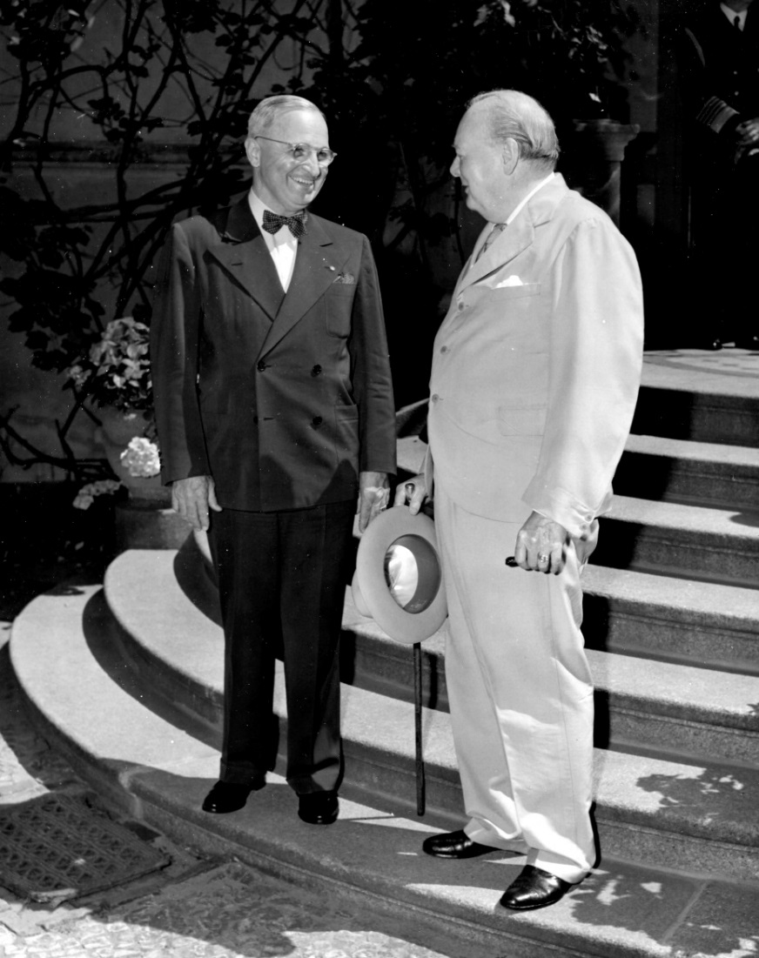
25th July 1945: President Truman gives the order to prepare to drop the atomic bomb on Japan (Britain gave its official consent on 4th July; Truman took over after Roosevelt died in April. The Manhattan Project was so secret that Truman hadn’t been told about it as Vice-President!)
Lord Mariser, https://creativecommons.org/licenses/by-sa/2.0/legalcode
Harry Kidd ; https://creativecommons.org/licenses/by-nc-sa/2.0/legalcode
Notes:
Not many people know about Britain having a say (at least on paper) on the atomic bomb being used. Prime Minister Winston Churchill said he gave our permission without hesitating, though he later had some doubts about whether it was the right thing to do.
[For more information see: http://www.dannen.com/decision/handy.html and https://www.atomicheritage.org/history/british-nuclear-program and https://history.state.gov/historicaldocuments/frus1945v02/d4 and https://richardlangworth.com/churchill-on-bombing-japan
Citizenship teachers: For ideas and resources on lesson activities exploring the varying stances of Theresa May, Jeremy Corbyn, Donald Trump, and Kim Jong-Un on using their country’s contemporary nuclear weapons (and the limits on their power to do so), follow the link at https://cnduk.org/education/truman-cit]

Slide 17
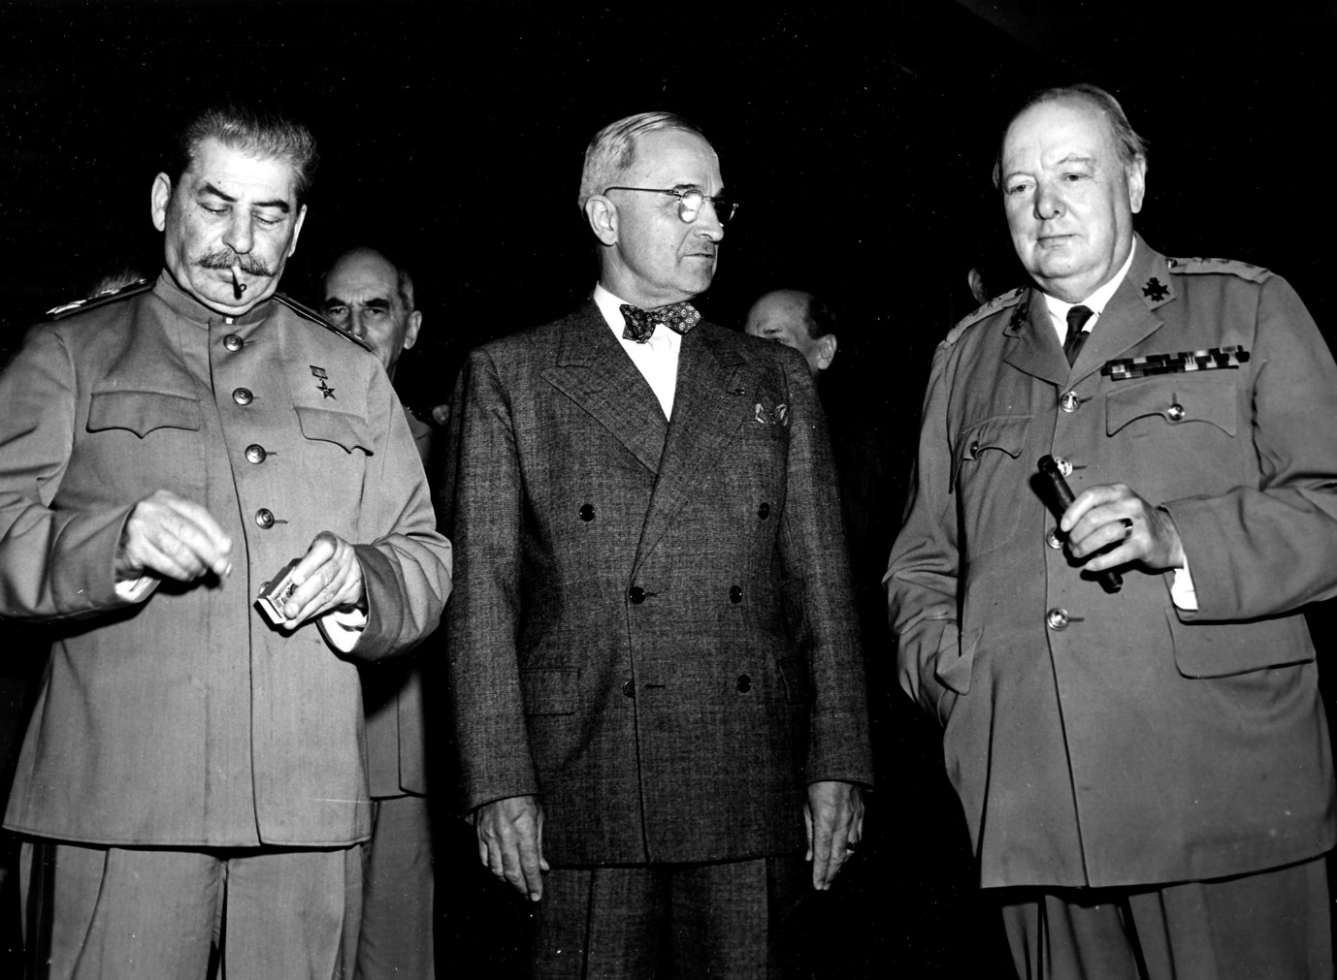
26th July 1945: Truman, Churchill and Chiang Kai-shek issue the ‘Potsdam Declaration’ to Japan, which finished with the words:
‘We call upon the government of Japan to proclaim now the unconditional surrender of all Japanese armed forces... The alternative for Japan is prompt and utter destruction.’
HarryKidd ; https://creativecommons.org/licenses/by-nc-sa/2.0/legalcode
Notes:
This declaration is usually seen as the USA’s warning to Japan, although it doesn’t specify about nuclear weapons (and it wouldn’t have made sense to most people if it had, as the atomic bomb had been kept very secret). Japan did not accept the demand to surrender, but some scholars argue that it didn’t exactly reject it either [see https://en.wikipedia.org/wiki/Mokusatsu] (The photo shows Soviet leader Joseph Stalin, alongside Harry Truman and Winston Churchill. Stalin didn’t sign the Declaration, as the Soviet Union wasn’t actually at war with Japan until 8th August: China’s leader Chiang Kai-Shek did sign it.) [For more information on the Potsdam Conference, and the ‘Declaration’, see https://history.state.gov/milestones/1937-1945/potsdam-conf and https://www.trumanlibrary.org/whistlestop/study_collections/naval/berlin/index.php?documentid=hst-naval_naid1701729-04&pagenumber=1 respectively (NB: the latter is a draft of the final text) Citizenship teachers: For ideas and resources on lesson activities exploring nuclear tensions between the USA and Russia in 2018-19, and the UK’s role in this context, follow the link at https://cnduk.org/education/truman-cit]

Slide 18
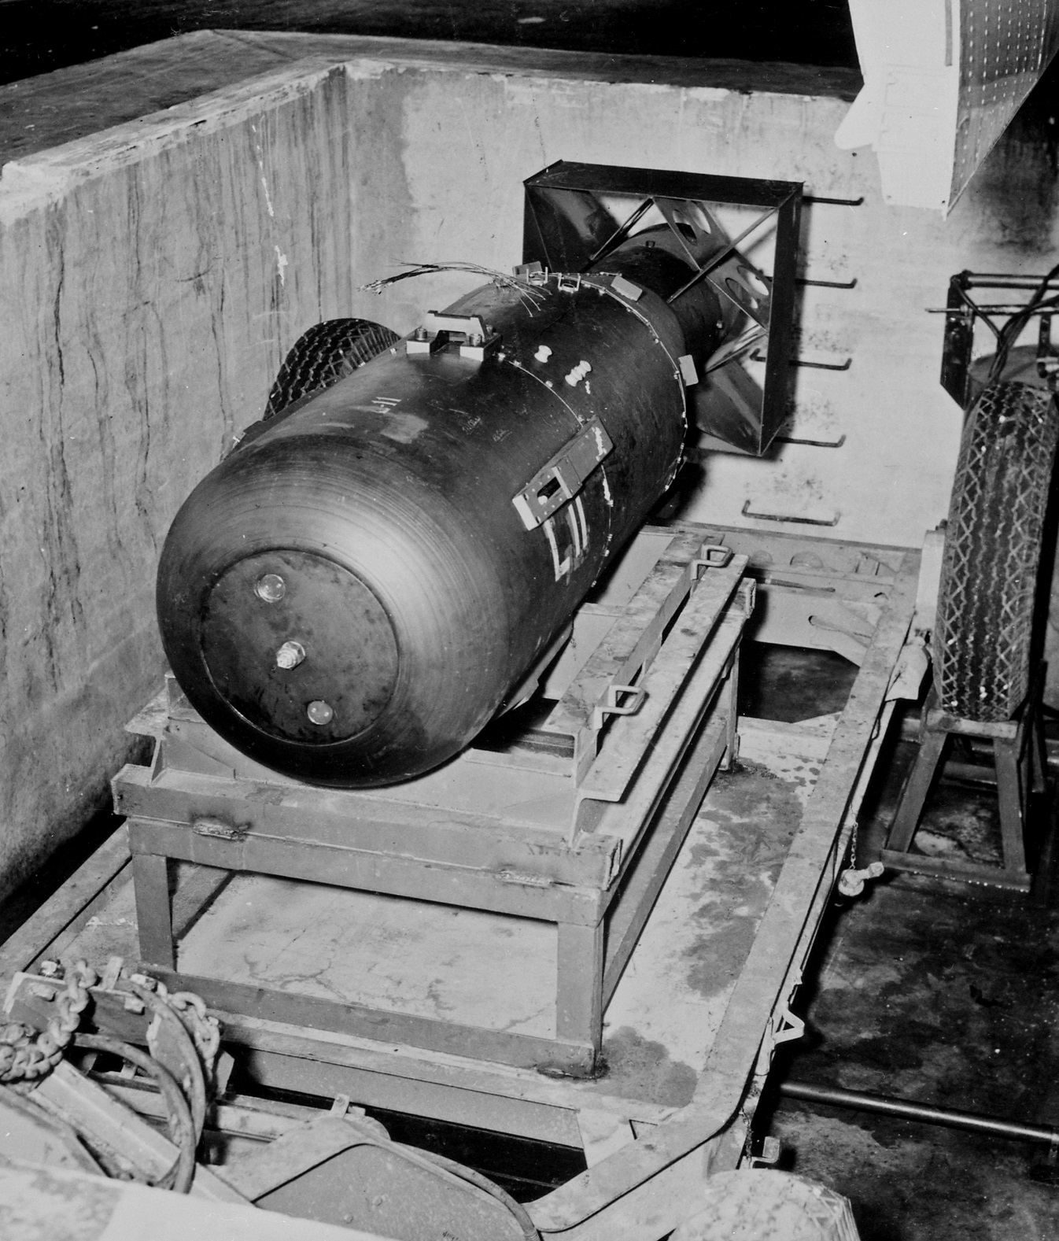
James Vaughan ; https://creativecommons.org/licenses/by-sa/2.0/legalcode
Notes:
Does anyone know what the bomb dropped on Hiroshima was called? [Little Boy]
As Hiroshima is very flat, there were no natural obstacles (like hills) to contain the explosion. It destroyed a huge proportion of the city.

Slide 19
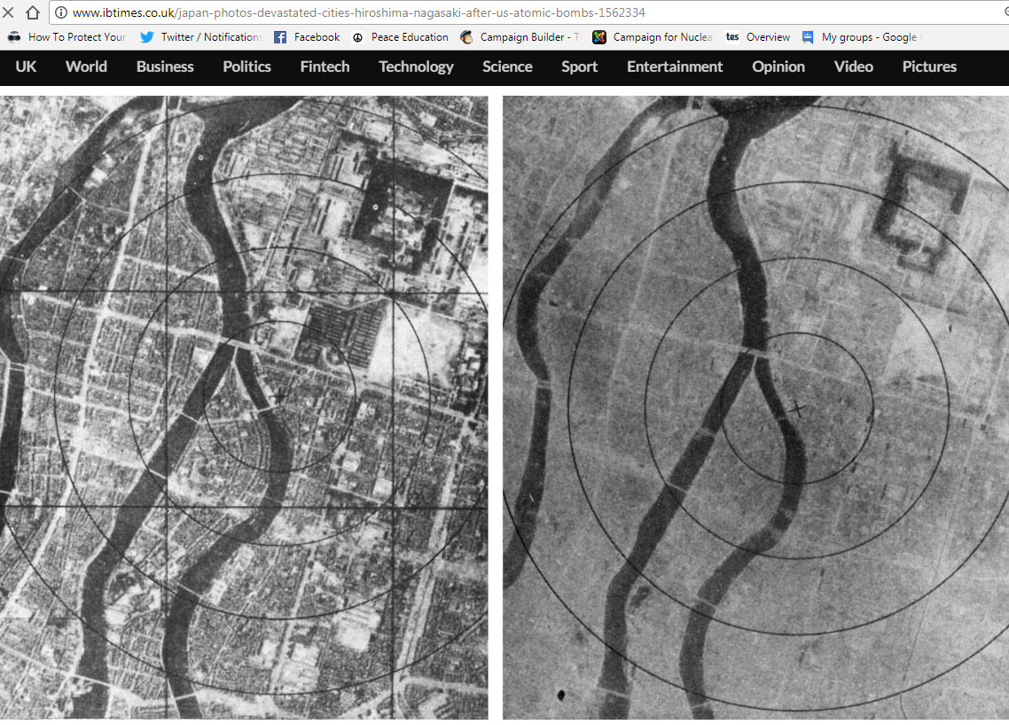
6th August 1945: The atomic bomb is dropped on Hiroshima
Notes:
The photo on the right was taken after the bomb exploded. How can you tell it’s the same place? [The river, plus a few faint outlines of streets and buildings] The ‘x’ marks the centre of the explosion. The bomb was made to explode 600 metres above ground, as it was expected that this would do more damage (although this also meant there was less radioactive fallout than there would have been from a ‘ground-burst’)

Slide 20
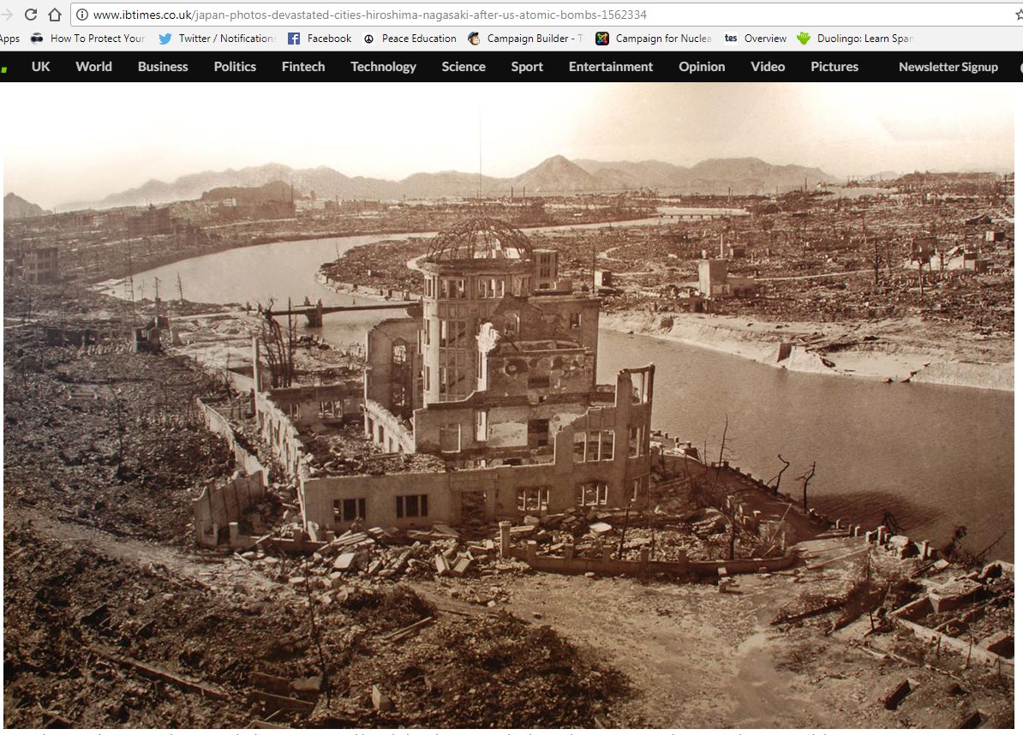
Notes:
This building lasted better than most because it was directly underneath the explosion.
[For more information on the Hiroshima (and Nagasaki) atomic bombing see for example https://www.atomicheritage.org/history/bombings-hiroshima-and-nagasaki-1945]

Slide 21
Notes:
The patch or stain known as a ‘nuclear shadow’ is all that was left of someone who was sitting on the steps. They literally vaporised, because the heat of the bomb was so great: it reaches millions of degrees Centigrade very briefly, and remains at 1000s of degrees Centigrade for slightly longer. These steps are now in the Hiroshima Atomic Bomb Museum.

Slide 22
Hiroshima video clip (reconstruction)
You may find the clip disturbing. Feel free to close your eyes/look away.
Notes:
22
https://www.youtube.com/watch?v=3wxWNAM8Cso (play from 2.30-3.35)
Hiroshima Dropping the Bomb, BBC

Slide 23
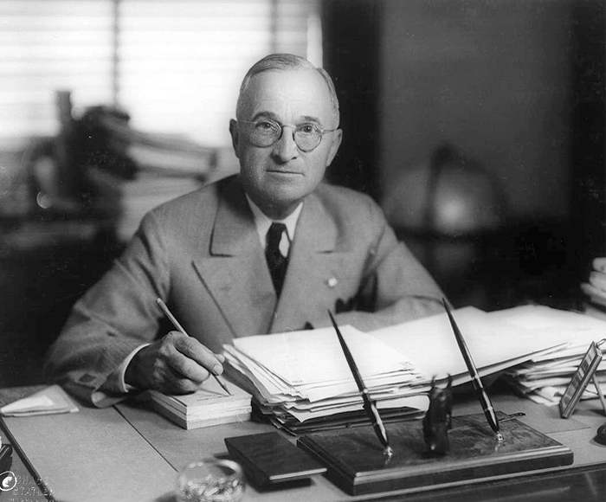
6th August 1945: President Truman gives a statement promising further bombs if Japan doesn’t surrender
Matthew Yglesias ;
https://creativecommons.org/licenses/by-sa/2.0/legalcode
Notes:
watch at https://www.youtube.com/watch?v=FN_UJJ9ObDs [Citizenship teachers: For ideas and resources on lesson activities on analysing media reporting then and now, follow the link at https://cnduk.org/education/truman-cit ]

Slide 24
Atomic Heritage Project
Notes:
This is the bomb dropped on Nagasaki. Does anyone know what it was called? [Fat Man]

Slide 25
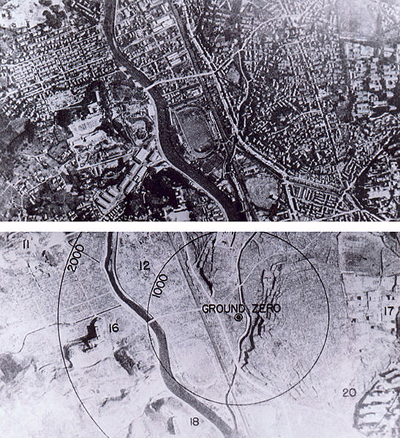
9th August 1945: The bomb is dropped on Nagasaki
Wikimedia Commons
Notes:
It was a different type of bomb to Little Boy, and was actually more powerful, though it killed fewer people, for various reasons (including that the bomb did not fall on the centre of the city)
[For more information on the Nagasaki (and Hiroshima) atomic bombing see for example https://www.atomicheritage.org/history/bombings-hiroshima-and-nagasaki-1945]

Slide 26
9th August 1945: At midnight, the USSR invades Manchuria, in Northern China, which since 1932 had been part of the Japanese Empire. They go on to capture Northern Korea and other Japanese-occupied territories.
histclo.com
Notes:
This was the last campaign of the Second World War. It lasted eleven days, and tens of thousands were killed or injured on both sides. Manchuria and Mengjiang – or Inner Mongolia - were returned to China, and Korea was partitioned along the ‘38th Parallel’, with the Soviet Union occupying the North and the USA the South. [Citizenship teachers: For ideas and resources on exploring the changing nuclear tensions (from 2017-2019) between the USA and Russia, and between the USA and North Korea, and also the UK’s role in these contexts, please go to https://cnduk.org/education/truman-cit ]

Slide 27
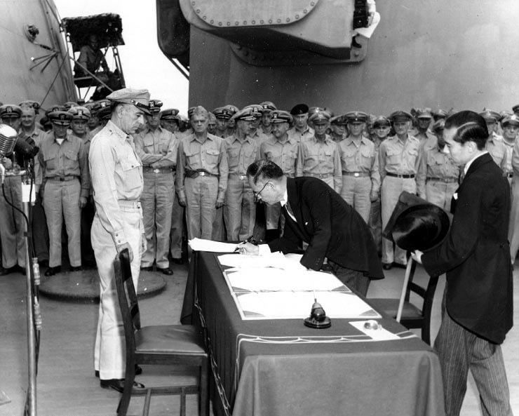
2nd September 1945: Japan formally surrenders. This is the end of the Second World War.
Public domain

Slide 28
What are the arguments given for the bombings?
Saved lives: it ended the war ASAP, saving lives overall because the USA didn’t have to invade Japan
Revenge for Pearl Harbour
Once the atomic bomb was developed, it was always going to be used
Notes:
.
[For more information see for example https://www.atomicheritage.org/history/debate-over-bomb and https://en.wikipedia.org/wiki/Debate_over_the_atomic_bombings_of_Hiroshima_and_Nagasaki#Support]

Slide 29
What are the arguments given against the bombings?
Immoral: Killed 185,000-600,000 - mostly civilians
Surrender was possible: The US knew that some of the Japanese government wanted to surrender
More about sending a message to the Soviet Union
It was to test a nuclear bomb for real
Notes:
.
[For more information see for example https://www.atomicheritage.org/history/debate-over-bomb and https://en.wikipedia.org/wiki/Debate_over_the_atomic_bombings_of_Hiroshima_and_Nagasaki#Opposition]

Slide 30
WHAT DO YOU THINK? ‘spectrum line’
Notes:
[(You could also re-cap on the class verdict if you did the mock trial lesson) Get students to line up across the room, standing at one end if they think Truman was justified in ordering the atomic bombs to be dropped, on the opposite end if they think he was unjustified, and along the ‘spectrum’ if they feel somewhere in between. Then get some students to say why they are standing where they are. The can move along the spectrum if anyone says something that persuades them. If space cannot be made in the classroom for this, a show of hands can work instead. To add more nuance to your spectrum/barometer activities, see https://www.facinghistory.org/sites/default/files/viewing-guide-barometer.pdf]

Slide 31
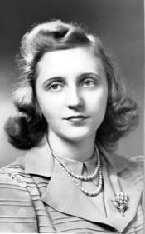
“During our last weeks in the White House [1953], Prime Minister Churchill arrived for a visit. My father gave him a small stag dinner to which he invited Defense Secretary Robert Lovett, [politician] Averell Harriman, [Army] General Omar Bradley, and Secretary of State Dean Acheson. Everyone was in an ebullient mood, especially Dad.
Without warning, Mr Churchill turned to him and said, “Mr President, I hope you have your answer ready for that hour when you and I stand before St Peter and he says, “I understand you two are responsible for putting off those atomic bombs. What have you got to say for yourselves?”
This could have been a rather unpleasant subject. But Bob Lovett came to the rescue. “Are you sure, Prime Minister, that you are going to be in the same place as the President for that interrogation?” Mr Churchill sipped his champagne and then intoned, “Lovett, my vast respect for the Creator of this universe and countless others gives me assurance that He would not condemn a man without a hearing.”
... Now the conversation was really soaring. “Oyez! Oyez!” cried our Secretary of State. “In the matter of the immigration of Winston Spencer Churchill, Mr. Bailiff, will you empanel a jury?” Everyone eagerly accepted historic roles. General Bradley decided he was Alexander the Great. Others played Julius Caesar, Socrates and Aristotle… Dad was appointed judge. The case was tried and the Prime Minister was acquitted.”
(source: Margaret Truman’s biography, ‘Harry S. Truman’, 1972,
cited in Life magazine, 1st December 1972, pp. 69-70)
Notes:
[Citizenship teachers: Getting students to read this out, taking turns, and encouraging them to add emphasis for dramatic effect, is a great way to help develop their oracy skills! It will bring home the striking fact that Truman and Churchill themselves hosted a mock trial on Hiroshima and Nagasaki. ]

Slide 32
YOUR TASK:
Work through the sheet to decide whether the atomic bombing of Hiroshima and Nagasaki meets the Just War criteria
Notes:
[Citizenship teachers: For lots of ideas and resources on lesson activities on: the development of legal recourse regarding war crimes (including an introduction to the International Criminal Court, and how it differs from UK criminal courts); on the debate as to the legality of the Hiroshima and Nagasaki bombings (and whether or not it would be a war crime for the UK to use its nuclear weapons); and on various world leaders’ stances on using their country’s nuclear weapons (and limits on their power to do so), follow the links at https://cnduk.org/education/truman-cit ]

Slide 33
DISCUSS
Would the bombings of Hiroshima and Nagasaki have met your Just War criteria?
Why do people have different ideas of what is ‘just’?
Is Just War theory be reliable if people can interpret it in such different ways?
Notes:
[Citizenship teachers: Please see the previous slide’s notes. There are also lesson ideas and resources available on the UN ‘Treaty on the Prohibition of Nuclear Weapons’ (including the work of civil society groups in the UK and worldwide in persistently raising the humanitarian and other arguments in favour of the Treaty). These too are available via https://cnduk.org/education/truman-cit ]

