Slide 1
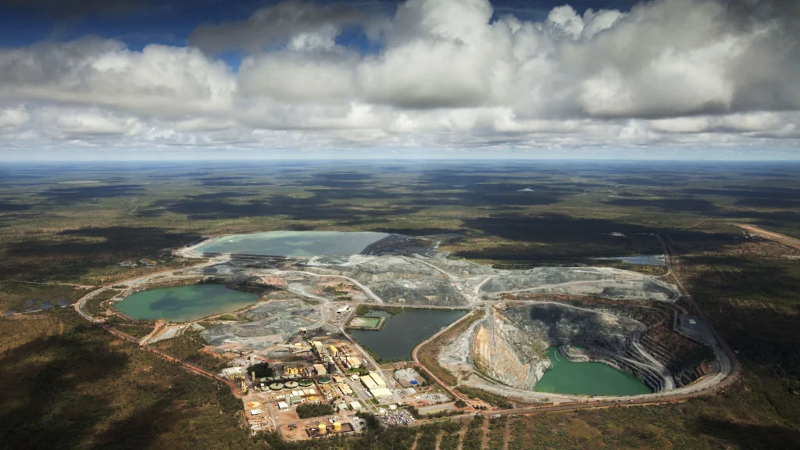
Uranium Mining in Northern Australia

Slide 2
What we’re going to do in this session
Learn some facts about uranium mining
Find out more about Ranger Uranium Mine and Indigenous Australians’ land
Hold an emergency meeting to decide the future of a town affected by uranium mining

Slide 3
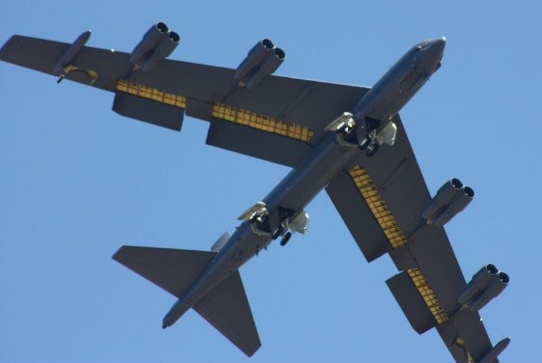
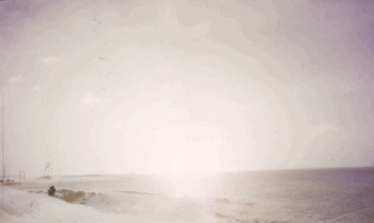
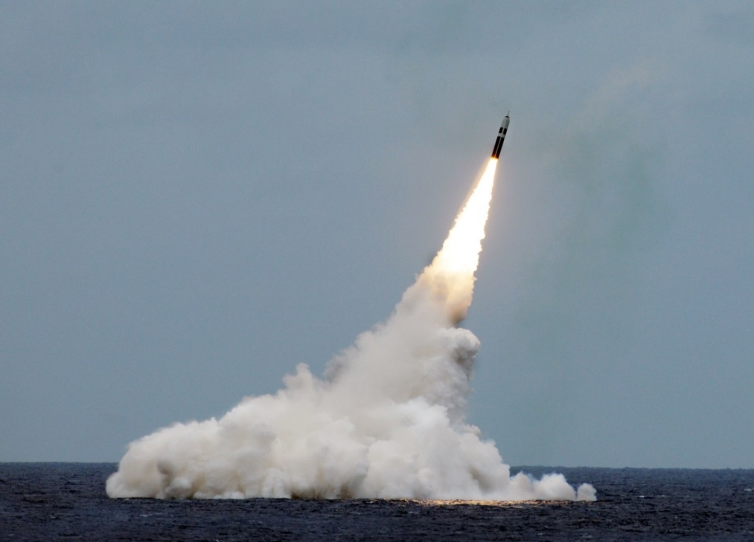
Paul L. McCord Jr. ; https://creativecommons.org/licenses/by-nd/2.0/legalcode ; cropped
Public domain ; National Museum of the US Navy
Notes:
Nuclear weapons can be launched from the ground, air and sea.

Slide 4
5. How many countries in the world have nuclear weapons?
12
9
5
114
Notes:
4

Slide 5
6. Name the 9 countries that have nuclear weapons
Notes:
5

Slide 6
Name the 9 countries that have nuclear weapons
UK
US
France
China
Russia
Israel
India
Pakistan
North Korea
Notes:
6

Slide 7
7. How many nuclear weapons are there in the world?
200
1250
14,000
67,000
Notes:
7

Slide 8
= 12,121 in total
Almost 4000 of them could be used at short notice; 5600 are in storage; and 2500 are ‘retired’ and will be dismantled in the coming years.
Big decrease since the 1980s (70,000 warheads!), and 400 less than last year
This is the first time since 1999 that India’s stockpile has surpassed Pakistan’s. China is expanding its nuclear arsenal faster than any other country (from 410 in 2023 to 500 in 2024

Slide 9
8. Which of these are nuclear weapons made from?
Radon
Plutonium
Thorium
Uranium
Notes:
Trick question! A: All but Radon.
Both uranium and plutonium are used in nuclear weapons. The Hiroshima bomb was used uranium for example, whilst the Nagasaki bomb used plutonium. Thorium can be said to be a nuclear fuel, as it produces heavy uranium ready for use in nuclear weapons as a by-product of it’s use in nuclear energy production.

Slide 10
8. Which of these are nuclear weapons made from?
Radon
Plutonium
Thorium
Uranium
Notes:
Trick question! A: All but Radon.
Both uranium and plutonium are used in nuclear weapons. The Hiroshima bomb was used uranium for example, whilst the Nagasaki bomb used plutonium. Thorium can be said to be a nuclear fuel, as it produces heavy uranium ready for use in nuclear weapons as a by-product of it’s use in nuclear energy production.

Slide 11
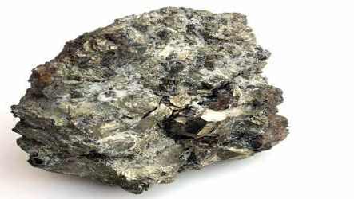
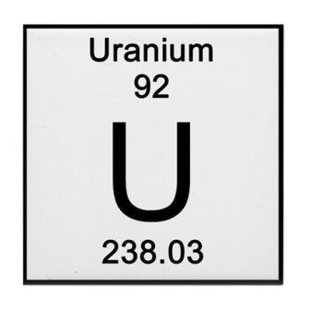
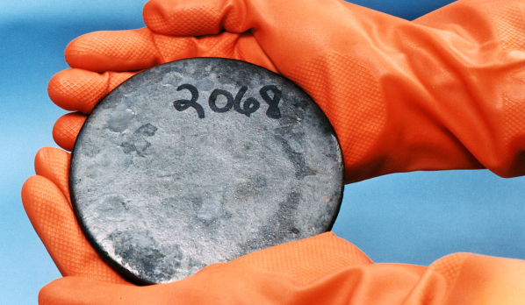
What is Uranium?
A metal, and a radioactive element.
Occurs in an ‘ore’ (a mixture in the ground)
Can be enriched and refined when it’s turned into highly-enriched uranium
It can also become plutonium (another element) once highly-enriched.
Notes:
For more information on how uranium becomes a fuel:
Video – https://www.youtube.com/watch?v=apODDbgFFPI
Website - https://www.world-nuclear.org/nuclear-basics/how-is-uranium-ore-made-into-nuclear-fuel.aspx

Slide 12
Radiation exposure
Can be very costly to process
Produces very few emissions (when used as an energy fuel)
Risk
Unexpected reaction or explosion e.g. Fukushima
What are the pro’s and con’s of using uranium?
Nuclear waste
Environmental damage via quarrying
Linked to nuclear weapons production
Produces vast quantities of energy

Slide 13
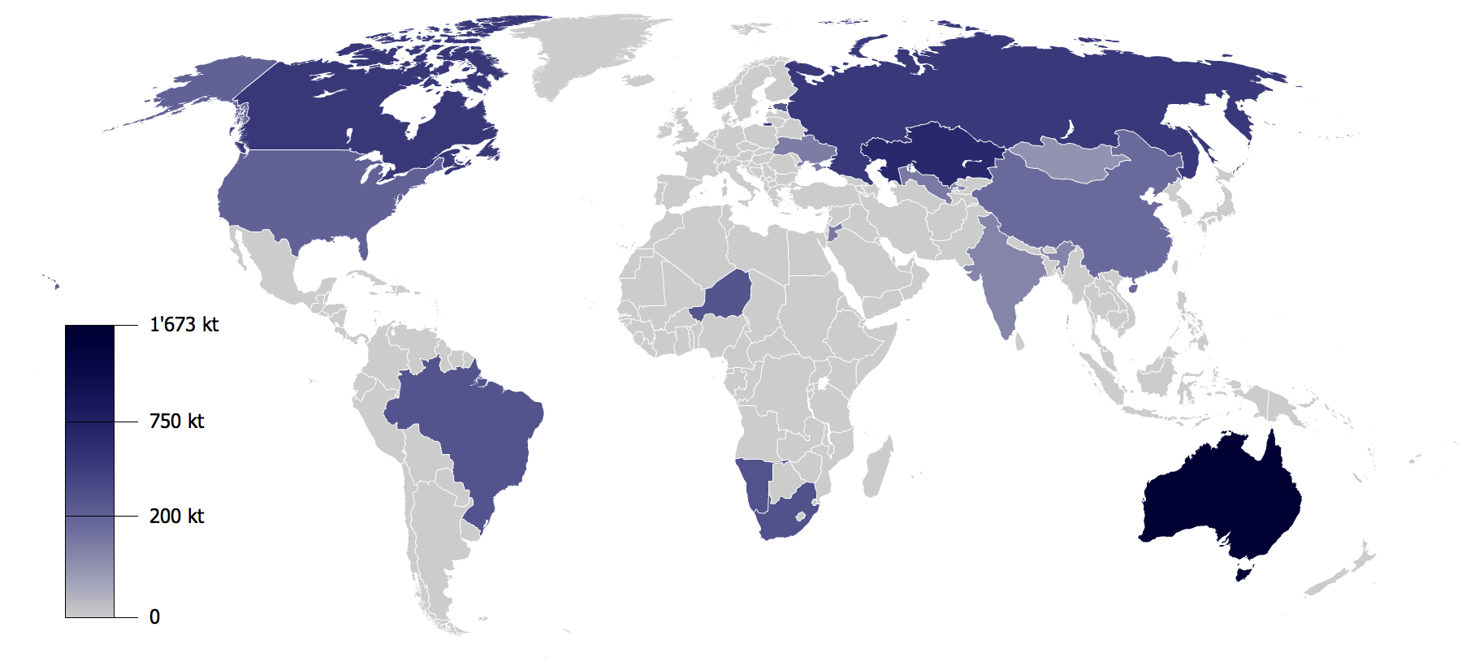
Notes:
Map: world uranium reserves 2010. You may want to remind students of the difference between resources and reserves (the latter being accessible resources which can be extracted!).
Indicate Australia on the map: did you know that Australia has one-third of the world’s uranium resources? And according to this map, published in 2010, it has the most reserves.
Source: https://upload.wikimedia.org/wikipedia/commons/f/f8/Uranium_Reserves.png

Slide 14
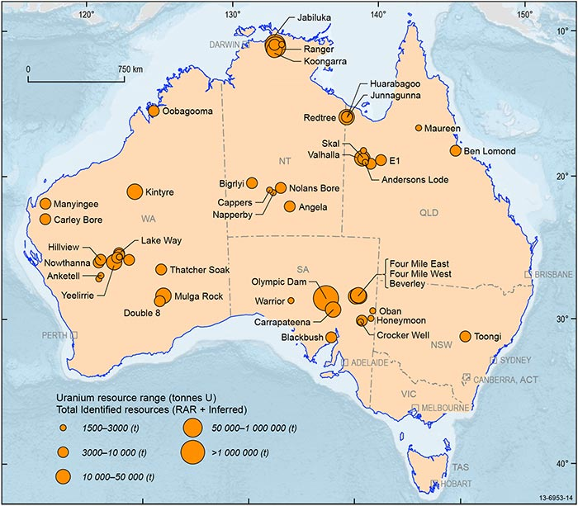
Australia and Uranium
Ever since 1906 uranium has been mined in Australia – it was begun by the British.
Even before this uranium was mined elsewhere.
Demand skyrocketed in WWII, as countries tried to develop nuclear weapons technology.
Australia is the world’s 3rd biggest producer of uranium (after Kazakhstan and Canada).
It doesn’t have nuclear weapons or nuclear power stations, so it must export what it produces.
Notes:
Source: http://www.australianminesatlas.gov.au/aimr/commodity/uranium.html

Slide 15
Australia and Uranium
Today we’re going to learn about RANGER URANIUM MINE
Located in the Northern Territory, Australia
Notes:
Source: http://www.australianminesatlas.gov.au/aimr/commodity/uranium.html

Slide 16
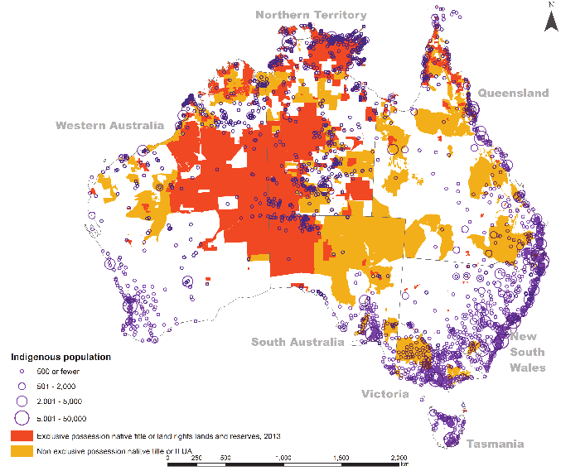
Notes:
On the right is a map showing the distribution of Indigenous Australians in Australia – is the a correlation between where uranium mines are, and where indigenous Australians (commonly known as Aboriginal people) live?

Slide 17
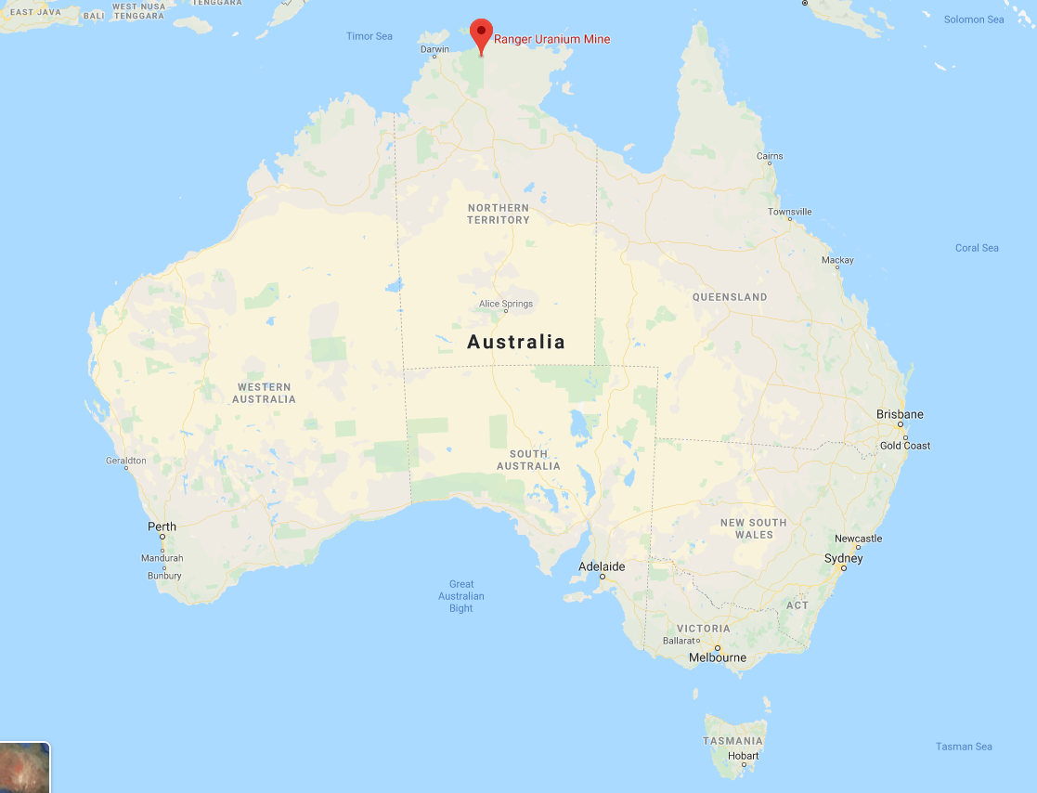
Ranger Uranium Mine

Slide 18
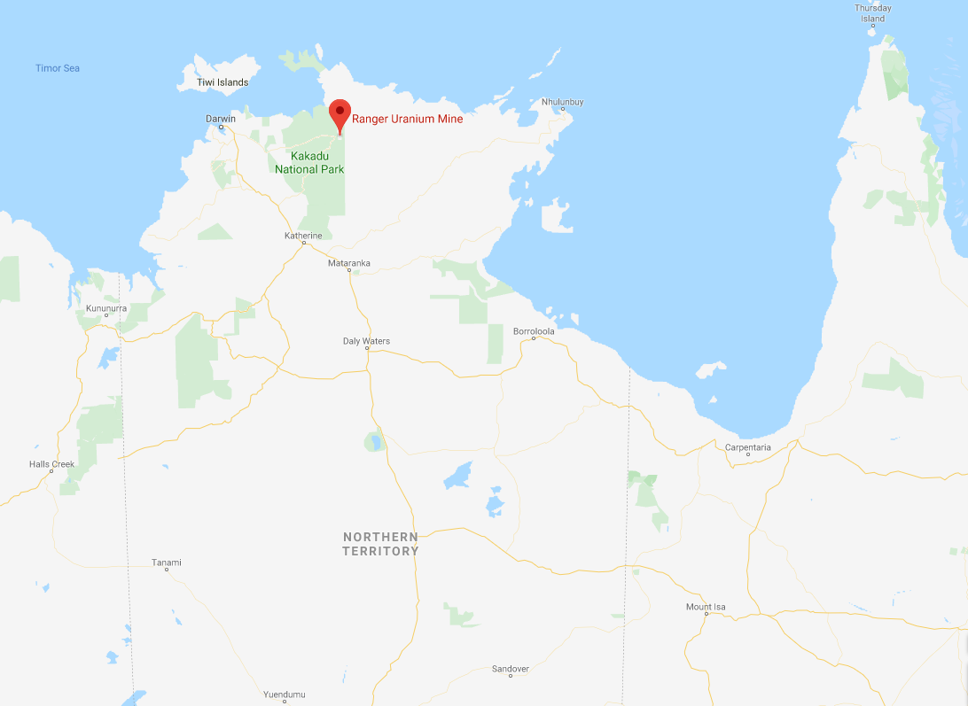
Ranger Uranium Mine

Slide 19
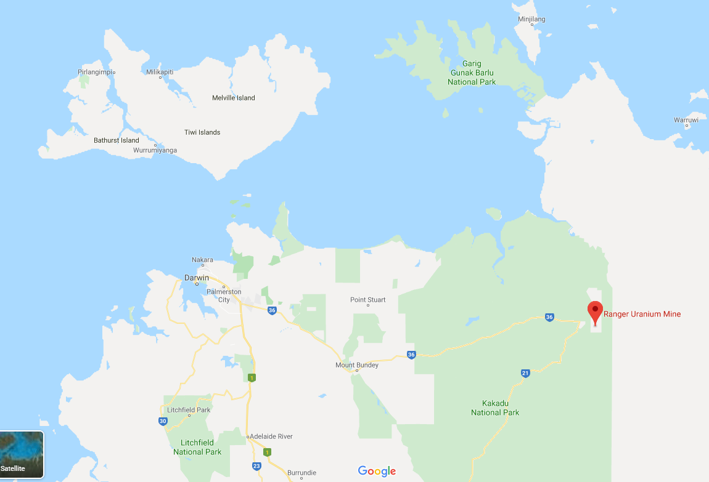
Ranger Uranium Mine
Notes:
Note that the mine is 230km East of Darwin (one of Australia’s major cities), and is located in a National park. At this point you might want to give the students a feel of what the area looks like (locational knowledge), and could show this tourism advert: https://parksaustralia.gov.au/kakadu/, or https://www.youtube.com/watch?v=Mgvql5uG66M

Slide 20
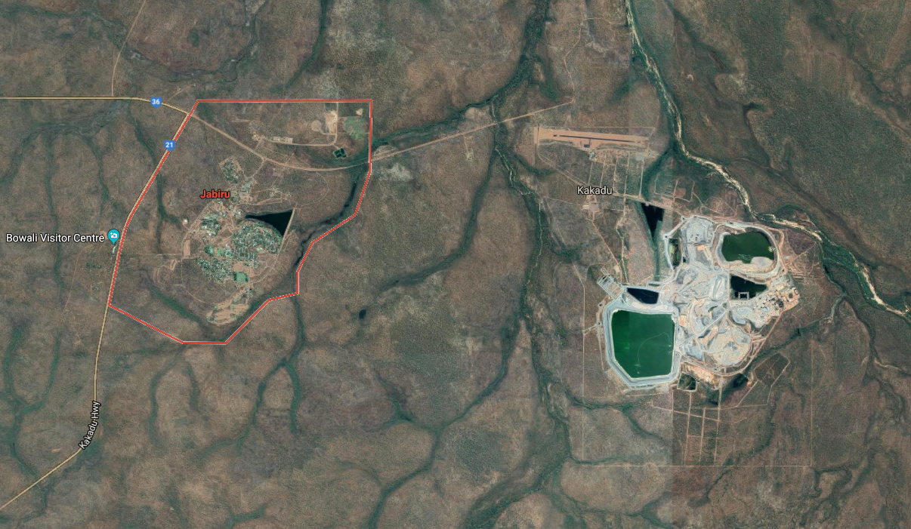
Ranger Uranium Mine

Slide 21
Ranger Ranger!
Emergency town meeting activity
We need FIVE groups
Anti-nuclear activists
Business people (Energy Resources of Australia)
Town locals
State government
Traditional Owners/Indigenous Australians
You will hear about the town of Jabiru, and recent developments at Ranger Uranium Mine.
In groups: look over your stakeholder briefing, do your own research, and fill in your worksheets!
Notes:
You may choose not to allow students to do their own research on phones or computers. Please choose what is right for your class.

Slide 22
The lease of the uranium mine is due to come to an end in 2021
Energy Resources of Australia (ERA) manages the mine, but this is owned by Rio Tinto, a global mining business.
Because the uranium mine is located on Aboriginal land, the indigenous community must decide whether the mine can keep going beyond 2021.
It doesn’t look likely that the mine will continue operating….
Notes:
The Mirrar are the traditional owners of the land (both for the mine, and for the nearby town of Jabiru), more info here: http://www.mirarr.net/

Slide 23
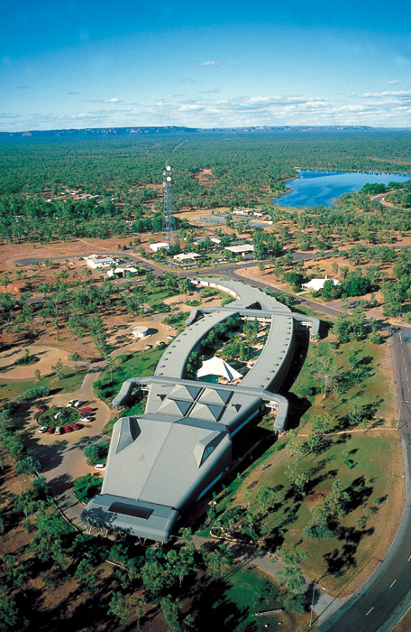
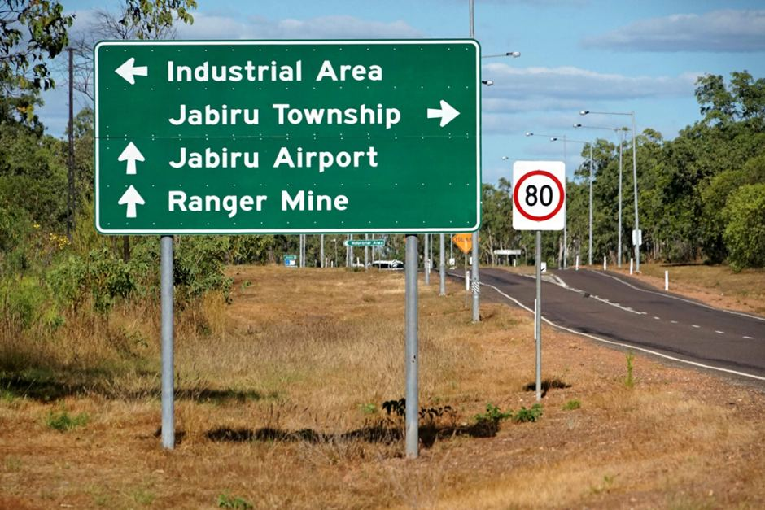
This has consequences for the town of Jabiru
Population: Just over 1,000
The town was created to serve the mine, but has since found a good tourism economy.
Without the mine, the town will struggle to survive
(technically, the town should be ‘rehabilitated’ just like the mine will be!)
So what will happen to the people of Jabiru?

Slide 24
YOUR TASK
Decide on what your ideal future would be for your town (from the perspective of your stakeholder group).
Refer to your stakeholder briefing – and do your own research (if the teacher allows it!)
Use facts and figures to make your case (2 min presentation)
What do you want to happen? What would you not agree to?
YOU HAVE 10 MINUTES TO PREPARE YOUR CASE
Notes:
Note: you might wish to change the timings, or the line on student-led research, at your discretion.

Slide 25
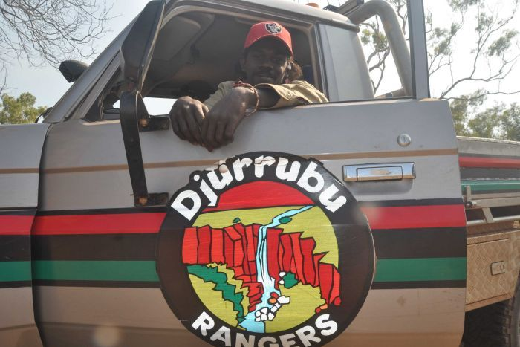
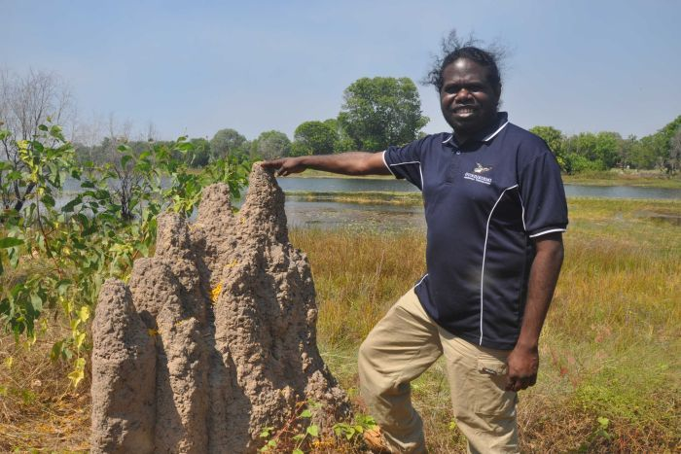
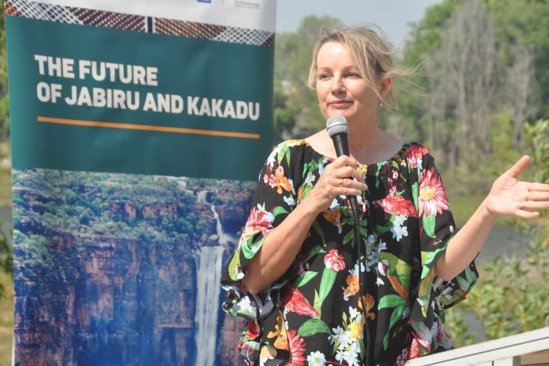
TOWN MEETING TIME
The traditional owners will give their position first – this is because they hold the land rights to these lands.
Other groups then give their views in turn.
The traditional owners will rank each groups suggestion in order of preference. Then, we’ll vote on which suggestion wins, by adding this to the traditional owners’ scores.
Notes:
The teacher would chair this meeting and could write each group’s suggestions and ‘red lines’ on the board. Students could also do this by themselves in their books.
If possible, factor in some time for students to ask questions of each other’s suggestions.

Slide 26
So what’s actually happened in Jabiru?
Notes:
Students research may have uncovered this already, so it’s worth asking the question above.

Slide 27
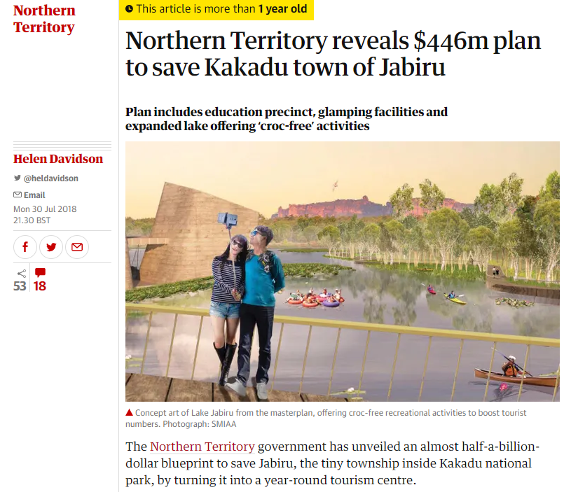
So what’s actually happened in Jabiru?
2018:
The Northern Territory government offers almost half a billion dollars to invest in Jabiru’s tourism industry.
Notes:
Source: https://www.theguardian.com/australia-news/2018/jul/31/northern-territory-reveals-446m-plan-to-save-kakadu-town-of-jabiru

Slide 28
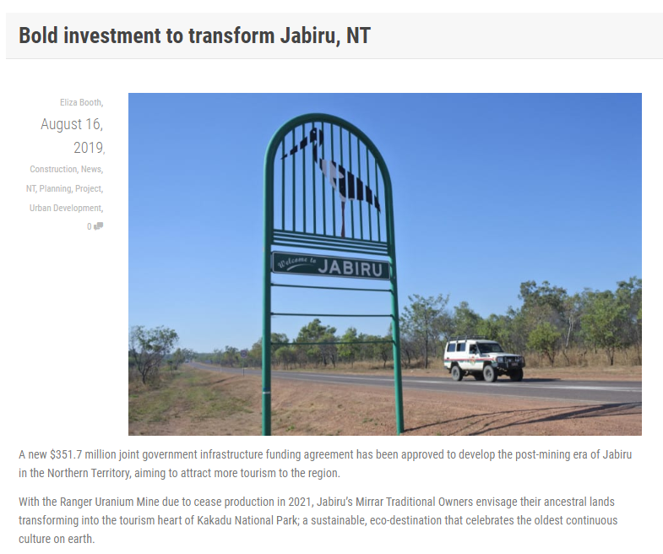
So what’s actually happened in Jabiru?
2019:
The ‘Jabiru Masterplan’ is approved.
The Mirrar people gave a lot of guidance to this plan, and had to agree it was suitable.
The project invests $350 million, and hopes to increase visitor numbers by 100,000 in the first year.
125 jobs will be secured too
Notes:
Source: https://infrastructuremagazine.com.au/2019/08/16/bold-investment-to-transform-jabiru-nt/

Slide 29
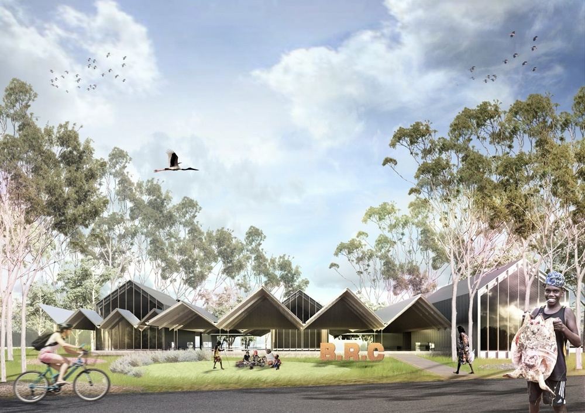
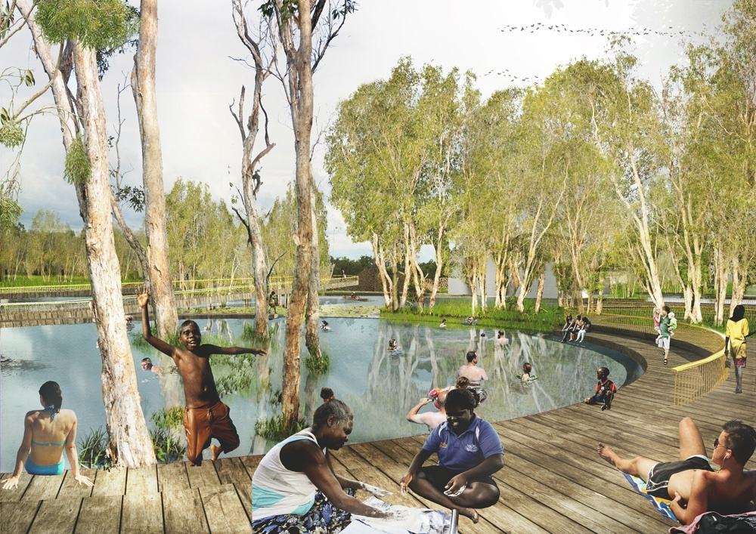
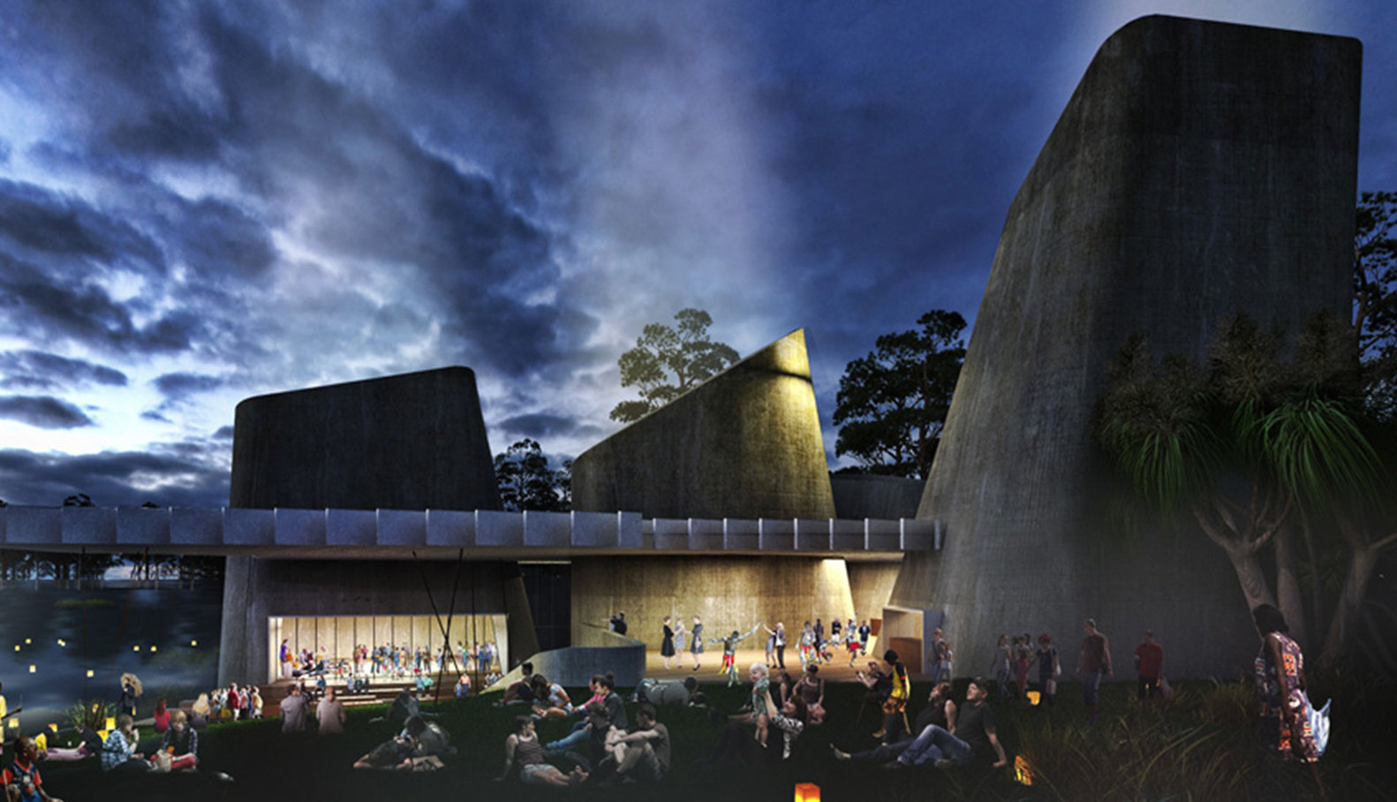
So what’s actually happened in Jabiru?
The future?
The ‘Jabiru Masterplan’ will:
Improve mobile phone coverage
Build: new houses and hotels
And provide education and health services
As well as attractions e.g. a ‘croc-proof’ pool!
And a World Heritage Aboriginal Culture Centre
Notes:
NB these pictures are an artists’ impression of the developments in Jabiru.
Source: https://www.archdaily.com/909957/naau-and-enlocus-to-transform-australias-jabiru-mining-town

Slide 30
If you were a labourer in the Northern Territory, would you support these plans?
Is uranium an essential resource for today?
Which is more unfair? The use of the creation of nuclear weapons?
Notes:
Trick question! A: All but Radon.
Both uranium and plutonium are used in nuclear weapons. The Hiroshima bomb was used uranium for example, whilst the Nagasaki bomb used plutonium. Thorium can be said to be a nuclear fuel, as it produces heavy uranium ready for use in nuclear weapons as a by-product of it’s use in nuclear energy production.

Slide 31
What we’ve done in this lesson
Learnt some facts about uranium mining
Learnt about Ranger Uranium Mine and Indigenous Australians’ land
Held an emergency meeting to decide the future of a town affected by uranium mining (and found out what’s happened recently)

