Slide 1
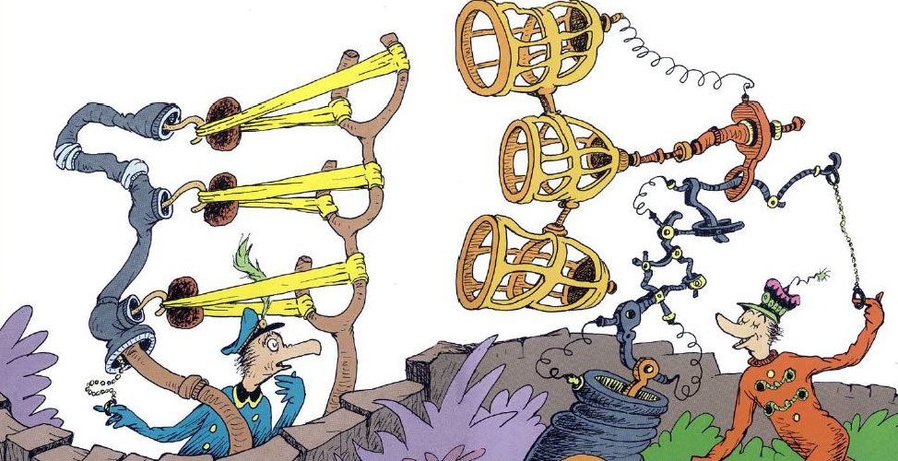
Stimulus
Text/Video: The Butter Battle Book (1989)
By Dr Seuss
Video animated by Ralph Bakshi, 20 minutes.
Notes:
VIDEO LINK: https://www.youtube.com/watch?v=prL1uva22Do Accessed 08/08/19
‘The Butter Battle Book’ is an illustrated tale about the Yooks and the Zooks, who live on opposite sides of a wall. Because of a butter-related disagreement, the rivalry of the groups leads to something akin to an arms race, resulting in an incredibly powerful weapon being produced on both sides. Threatening each other with destruction, the story ends with ‘The End?’
When it was released in 1984, some people took issue with the story, saying it was too critical of Ronald Reagan and the arms race occurring at the time. This meant it was banned in some libraries and bookshops. In response to calls that the book was ‘brainwashing’ children, Seuss made his opinion clear: ‘I just want people to think’. The book was turned into an animated TV short, which aired in 1989.

Slide 2
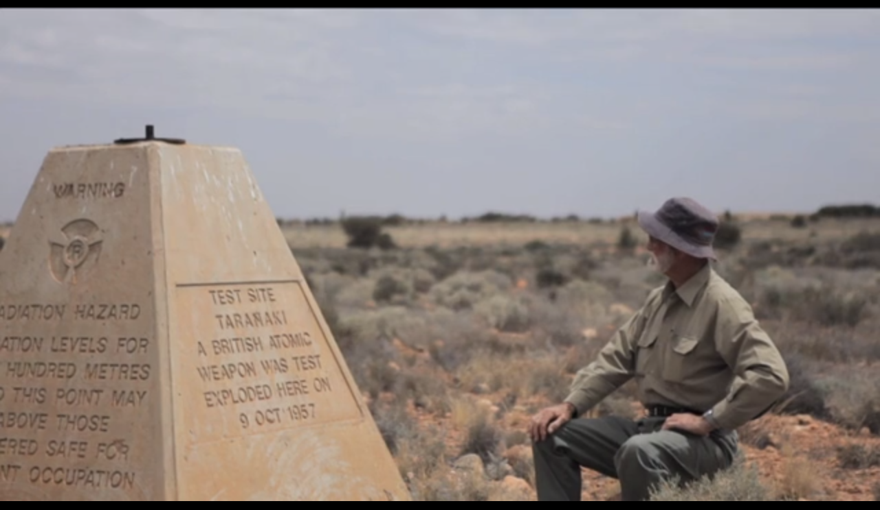
Stimulus
Video: ‘Maralinga Pieces’ (2011)
By Jessie Boylan, 12 minutes.
Notes:
VIDEO LINK: http://jessieboylan.com/maralinga-pieces/ Screenshot reproduced with permission of the artist.
‘Between 1952 and 1963 the British Government performed highly secretive nuclear weapons tests at Maralinga and Emu Field in South Australia and on the Monte Bello Islands off the coast of Western Australia. A total of twelve major nuclear tests were performed, and up to 700 minor ‘dirty’ trials were also conducted. The area was massively contaminated with radioactive materials and cleanups were attempted in 1967 and 2000. However, examinations after these cleanups found that many of these sites still remain radioactive.
Shot on location at Maralinga in 2011, this short film takes the viewer through a haunting landscape of the places these bombs were exploded, as well as extracts snippets of memories of Aboriginal elders and an Australian nuclear veteran, whose lives have been deeply impacted by these tests.’
– Jessie Boylan

Slide 3
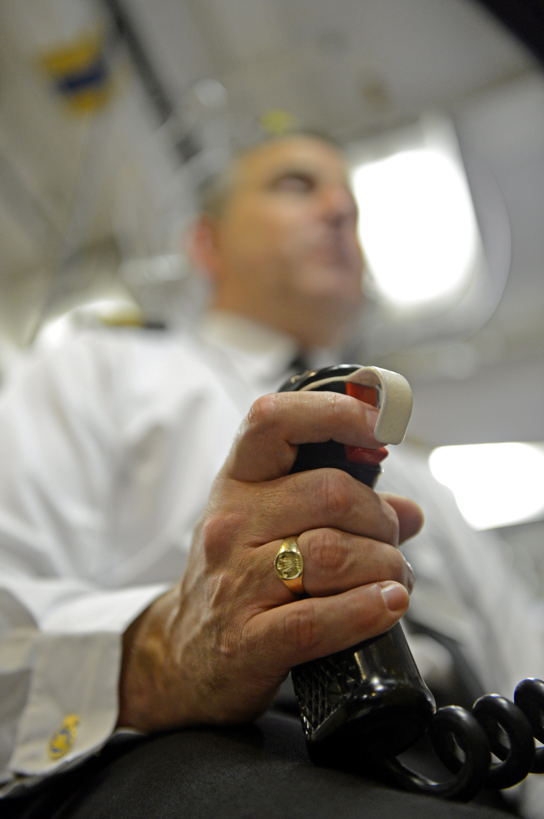
Stimulus
Photograph: Courtesy of the Royal Navy (2012)
Notes:
Pictured: The ‘Weapons Engineer Officer’s Tactical Trigger’ used to launch a Trident Missile.
UK Ministry of Defence © Crown Copyright 2019

