Slide 1
Lesson 3:
English:
Haiku, Senryu, and nuclear weapons
Notes:
[CITIZENSHIP TEACHERS: Please note: We have created a collection of additional Citizenship classroom (and homework) activities and resources to extend and enrich the Citizenship content of the Truman On Trial lessons (including this one). To browse and download the materials, go to https://cnduk.org/education/truman-cit Where applicable, we have added advice and guidance on the additional activities and resources, in some of the slides notes in this PowerPoint.]

Slide 2
What we’ll do in this lesson:
Explore at the USA’s use of nuclear weapons against Japan in August 1945
Learn about Haiku and Senryu
Try writing our own haiku and senryu about the bombings
Notes:
[NB: If you’ve already taught background information on the atomic bombings, and don’t need to re-cap, skip to slide 22]

Slide 3
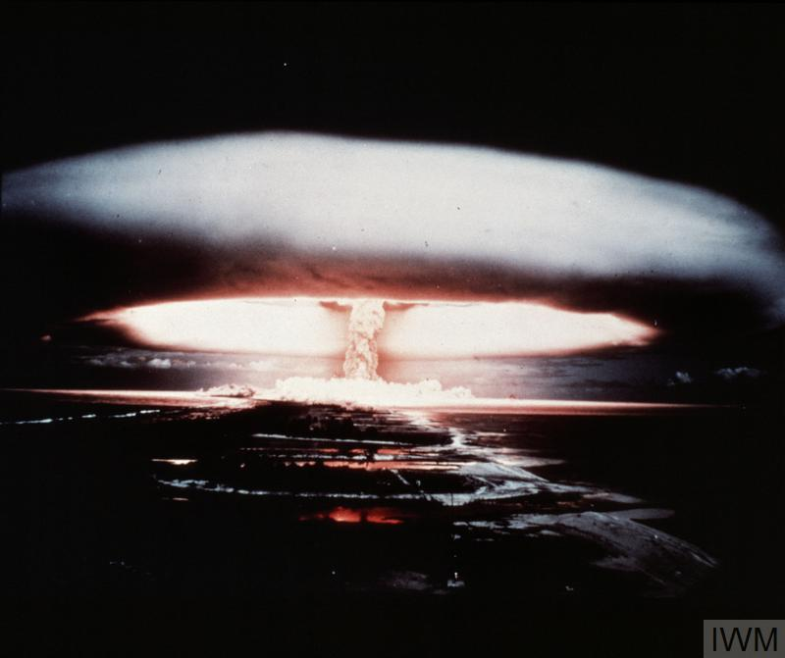
What is a nuclear weapon?
Notes:
[NB: If you’ve already taught background information on the atomic bombings, and don’t need to re-cap, skip to slide 22]
[Otherwise:] It’s an incredibly-powerful bomb (or ‘warhead’), known as a Weapon of Mass Destruction. There are two types: the first one made is the atomic bomb, which gets its huge explosive power when the nucleus of an atom is split by a neutron, releasing more neutrons which split more nuclei, in an extremely fast chain reaction that releases enormous amounts of energy. This reaction is called ‘nuclear fission’. What can we see in this atomic bomb test (which is a British nuclear weapon test in the 1950s)? [Mushroom cloud, fireball, shock-waves making water waves]
[For higher ability/older groups:] Nuclear fission involves isotopes of Uranium or Plutonium – isotopes are atoms of an element with a different number of neutrons. They can be very unstable, and therefore very radioactive. [For more information see: https://www.atomicheritage.org/history/science-behind-atom-bomb and https://www.ucsusa.org/nuclear-weapons/how-do-nuclear-weapons-work#.W_1kpdv7Tcs]

Slide 4
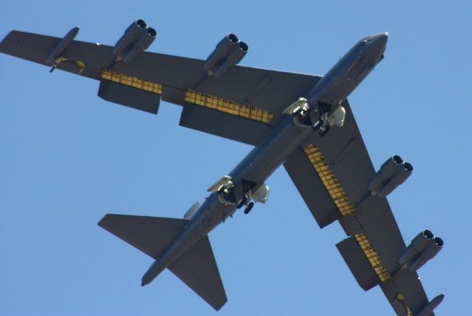
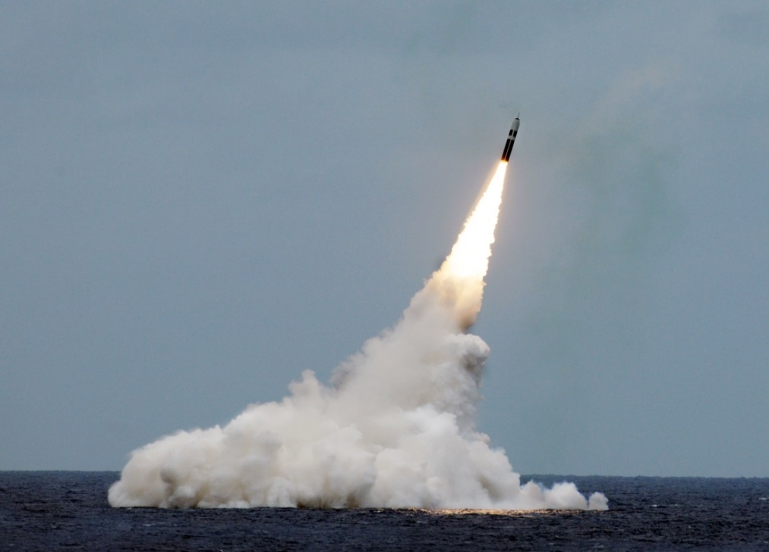
Paul L. McCord Jr. ; https://creativecommons.org/licenses/by-nd/2.0/legalcode ; cropped
Public domain ; National Museum of the US Navy
Notes:
Nowadays, nuclear warheads would usually be put on missiles, rather than dropped from planes as bombs.

Slide 5
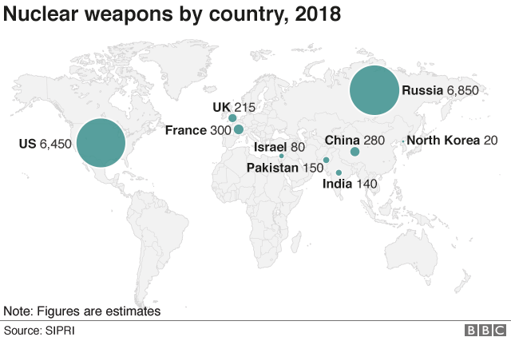
How many nuclear weapons are there in the world today?
Nearly 14,500 in total, but not divided equally between the 9 countries
Big decrease since the 1980s (70,000 warheads!), and 500 less than last year
Almost 4000 of them could be used at short notice; 5500 are in storage; and 5000 are ‘retired’ and will be dismantled in the coming years.
But: several of the countries are increasing or ‘upgrading’ theirs
Notes:
[Citizenship teachers: For ideas and resources on exploring topics such as the changing 2017-2019 nuclear tensions between the USA and Russia/North Korea, and the UK’s role in these contexts, please go to https://cnduk.org/education/truman-cit ]

Slide 6
Have nuclear weapons ever been used in a war?

Slide 7
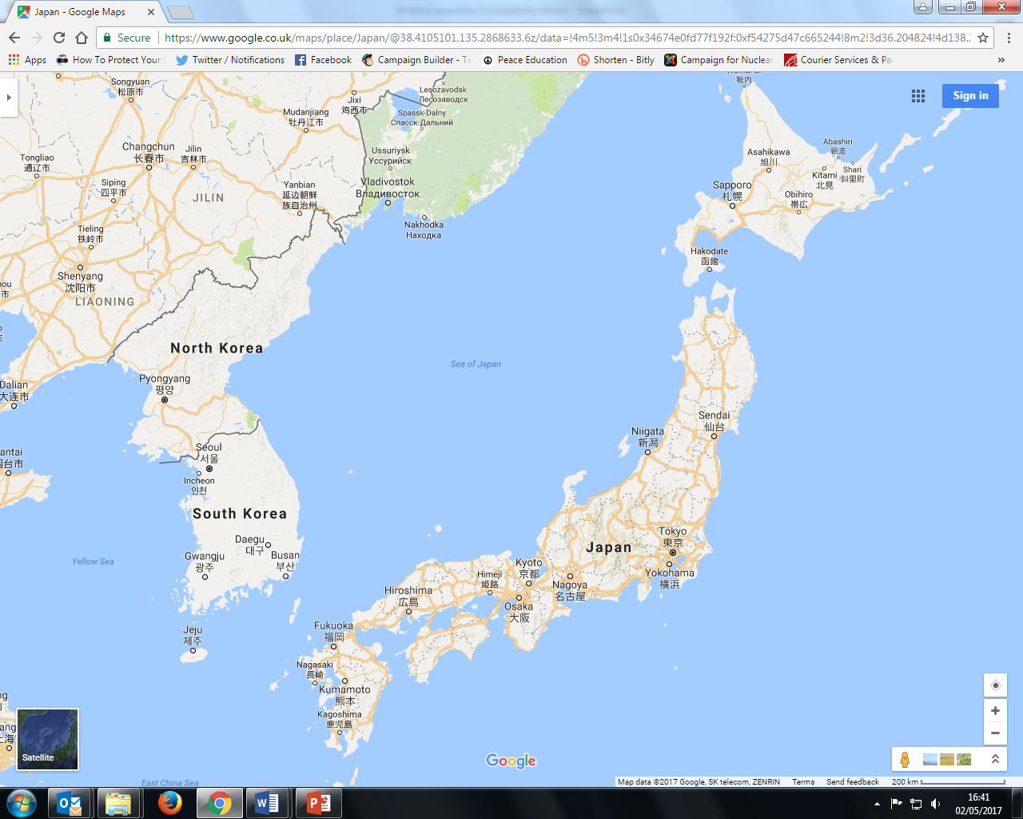

Slide 8
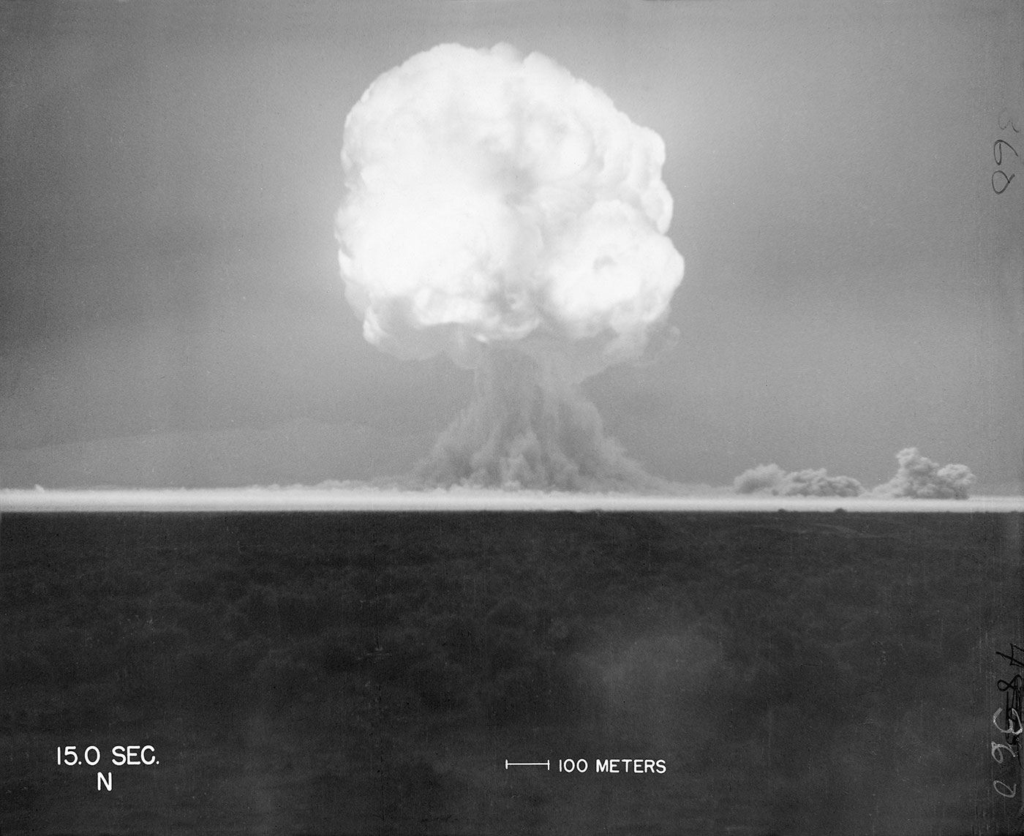
16th July 1945: The United States successfully tests the world’s first ever atomic bomb (researchers 6 miles away are knocked over by the blast wave, and those 10 miles away felt heat on their face. Then, an unbelievably bright flash of light, described as ''beautiful'', then a defeaning roar, and a mushroom cloud 8 miles high in minutes)
trinityremembered.com
Notes:
The USA had spent six years and nearly $2 billion dollars on the ‘Manhattan Project’, which involved thousands of scientists, engineers and others. Nazi Germany was also developing an atomic bomb, but didn’t succeed before their defeat, and the Soviet Union began developing one in 1943 but didn’t finish it until after 1949.
[For more information see for example https://www.atomicheritage.org/history/manhattan-project and https://www.ctbto.org/nuclear-testing/history-of-nuclear-testing/manhattan-project/]

Slide 9
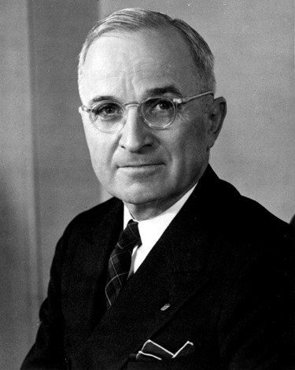
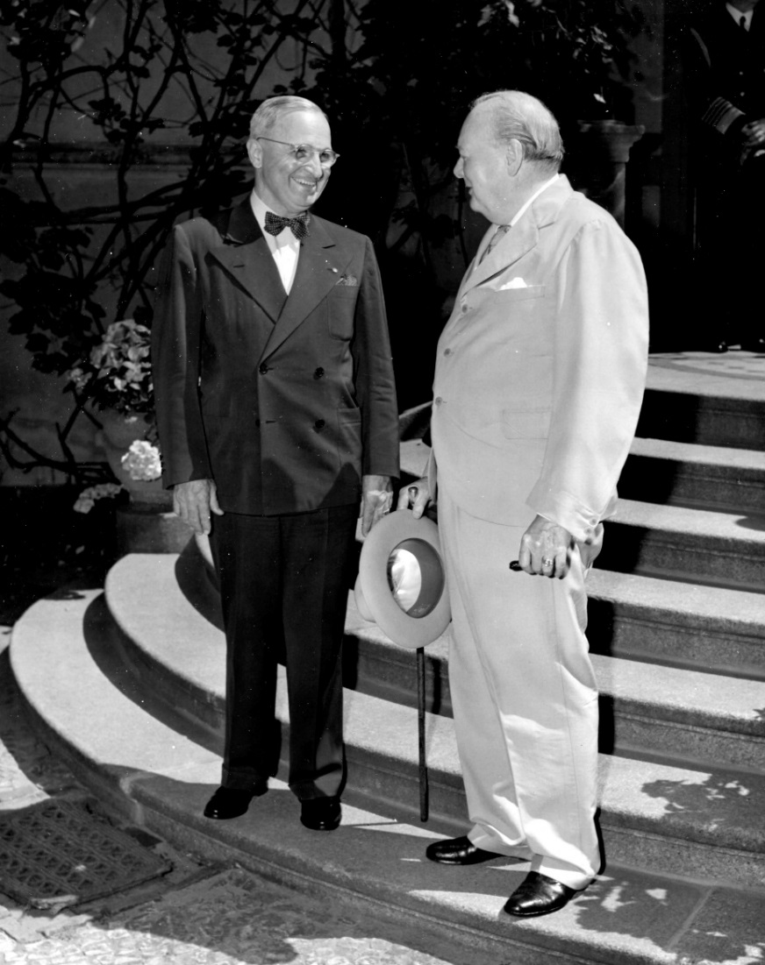
25th July 1945: President Truman gives the order to prepare to drop the atomic bomb on Japan (Britain gave its official consent on 4th July; Truman took over after Roosevelt died in April. The Manhattan Project was so secret that Truman hadn’t been told about it as Vice-President!)
Lord Mariser, https://creativecommons.org/licenses/by-sa/2.0/legalcode
Harry Kidd ; https://creativecommons.org/licenses/by-nc-sa/2.0/legalcode
Notes:
Not many people know about Britain having a say (at least on paper) on the atomic bomb being used. Prime Minister Winston Churchill said he gave our permission without hesitating, though he later had some doubts about whether it was the right thing to do.
[For more information see: http://www.dannen.com/decision/handy.html and https://www.atomicheritage.org/history/british-nuclear-program and https://history.state.gov/historicaldocuments/frus1945v02/d4 and https://richardlangworth.com/churchill-on-bombing-japan
Citizenship teachers: For ideas and resources on lesson activities exploring the varying stances of Theresa May, Jeremy Corbyn, Donald Trump, and Kim Jong-Un on using their country’s contemporary nuclear weapons (and the limits on their power to do so), follow the link at https://cnduk.org/education/truman-cit]

Slide 10
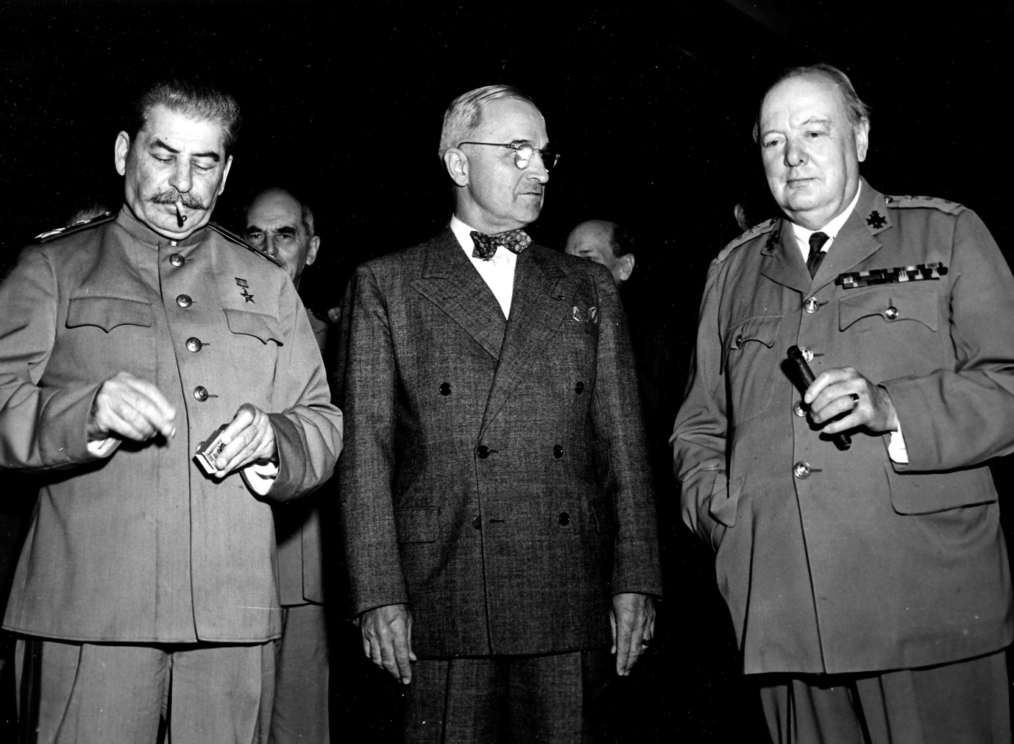
26th July 1945: Truman, Churchill and Chiang Kai-shek issue the ‘Potsdam Declaration’ to Japan, which finished with the words:
‘We call upon the government of Japan to proclaim now the unconditional surrender of all Japanese armed forces... The alternative for Japan is prompt and utter destruction.’
HarryKidd ; https://creativecommons.org/licenses/by-nc-sa/2.0/legalcode
Notes:
This declaration is usually seen as the USA’s warning to Japan, although it doesn’t specify about nuclear weapons (and it wouldn’t have made sense to most people if it had, as the atomic bomb had been kept very secret). Japan did not accept the demand to surrender, but some scholars argue that it didn’t exactly reject it either [see https://en.wikipedia.org/wiki/Mokusatsu] (The photo shows Soviet leader Joseph Stalin, alongside Harry Truman and Winston Churchill. Stalin didn’t sign the Declaration, as the Soviet Union wasn’t actually at war with Japan until 8th August: China’s leader Chiang Kai-Shek did sign it.) [For more information on the Potsdam Conference, and the ‘Declaration’, see https://history.state.gov/milestones/1937-1945/potsdam-conf and https://www.trumanlibrary.org/whistlestop/study_collections/naval/berlin/index.php?documentid=hst-naval_naid1701729-04&pagenumber=1 respectively (NB: the latter is a draft of the final text) Citizenship teachers: For ideas and resources on lesson activities exploring nuclear tensions between the USA and Russia in 2018-19, and the UK’s role in this context, follow the link at https://cnduk.org/education/truman-cit]

Slide 11
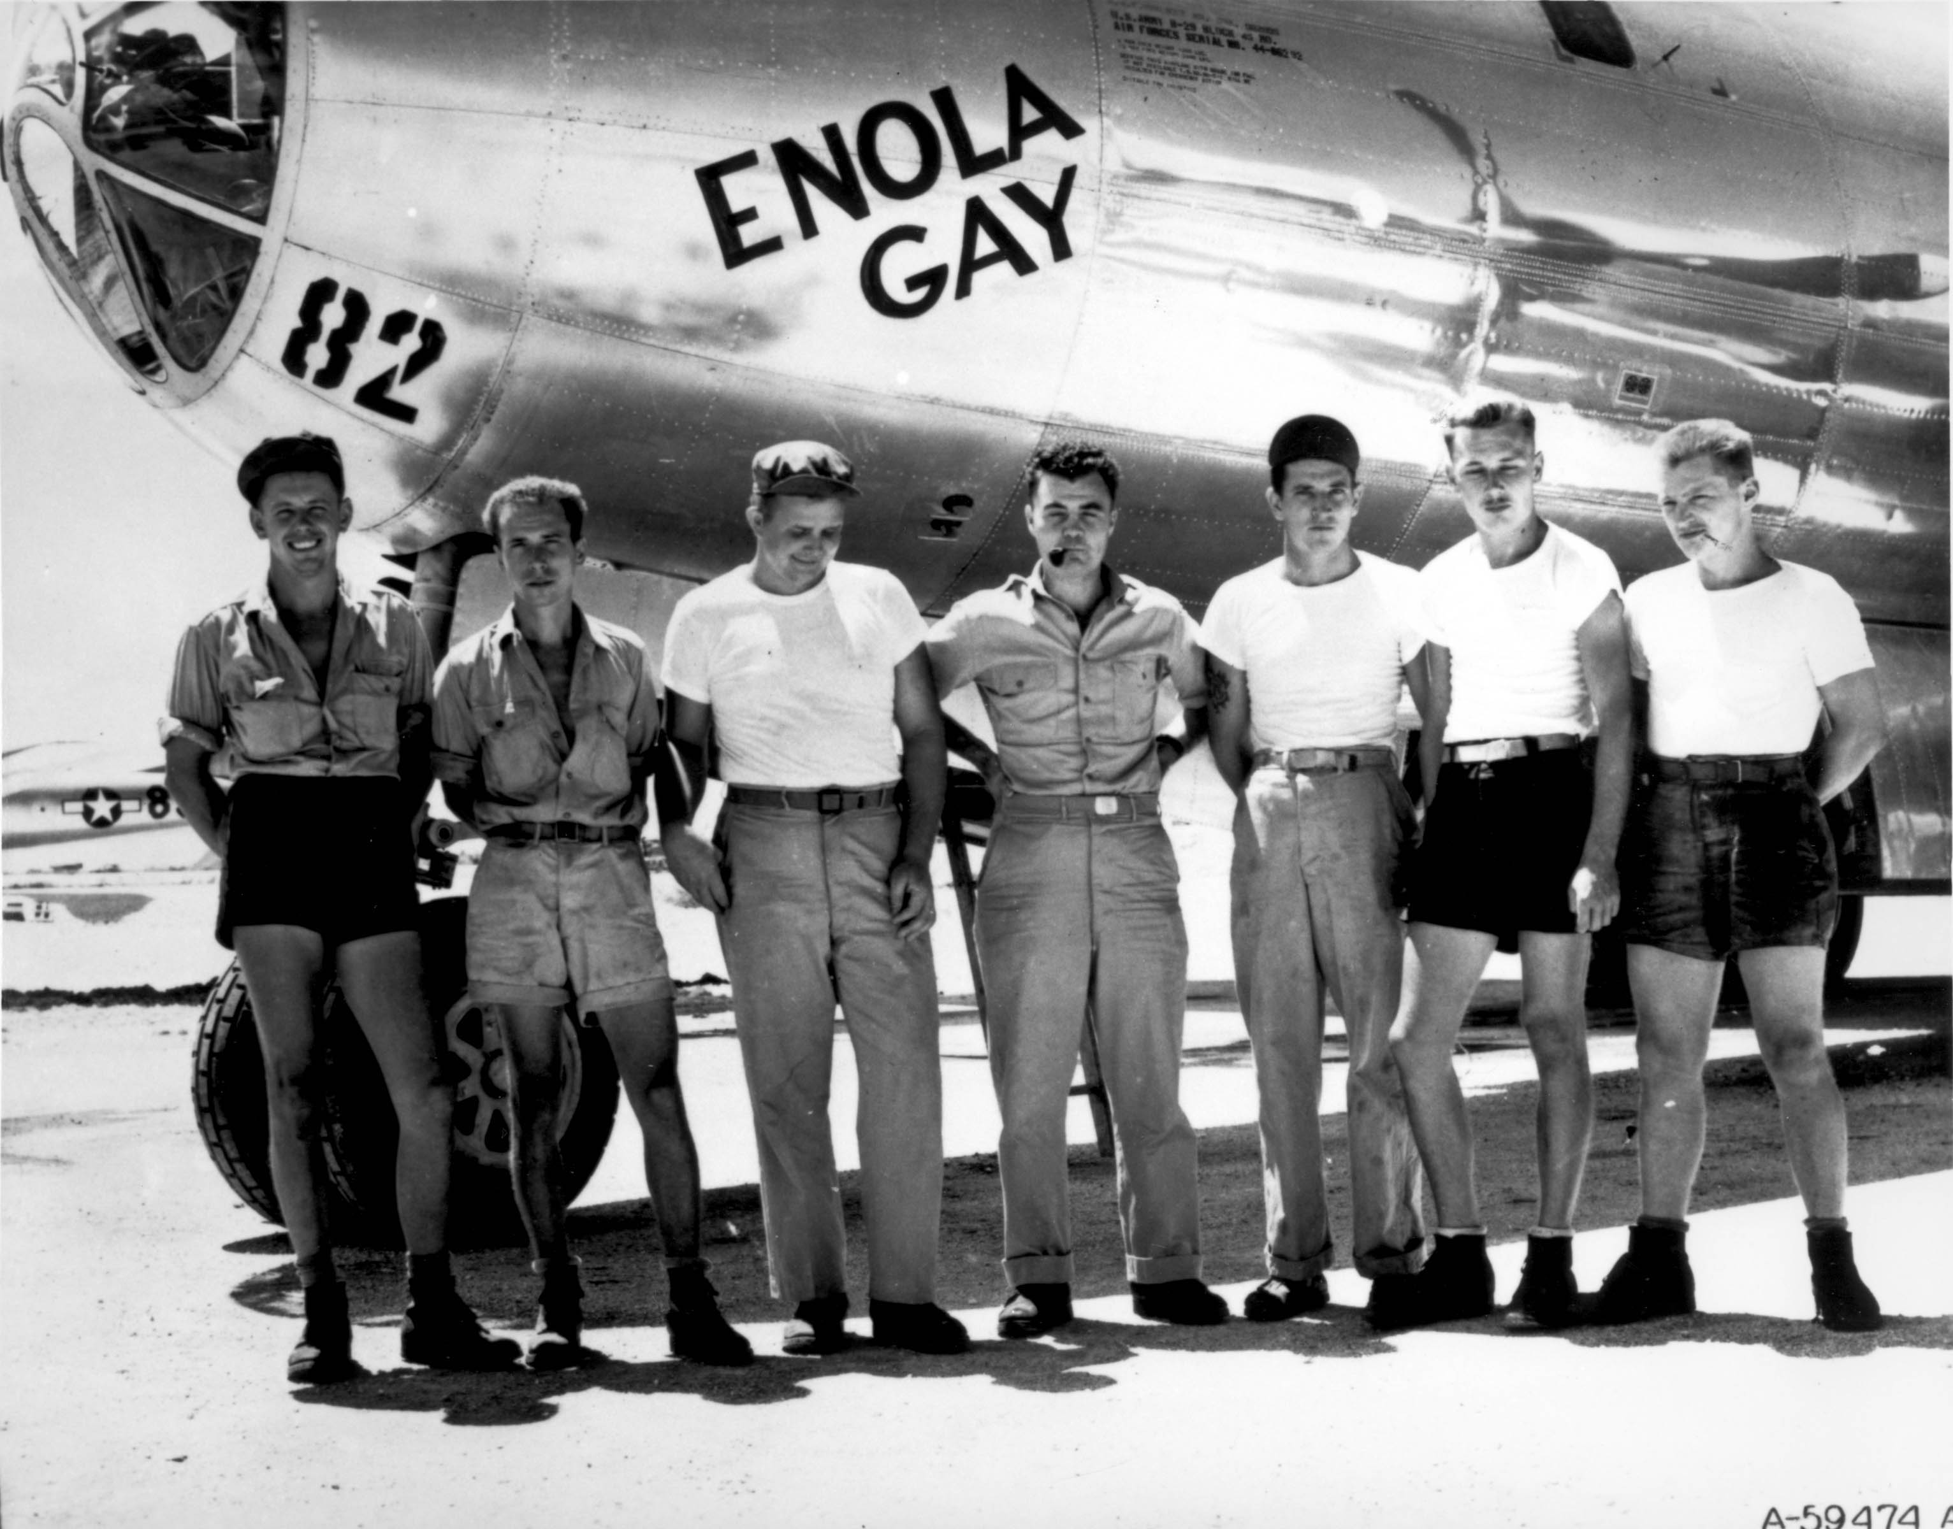
Public domain
Notes:
The crew of the plane that dropped the atomic bomb on Hiroshima.

Slide 12
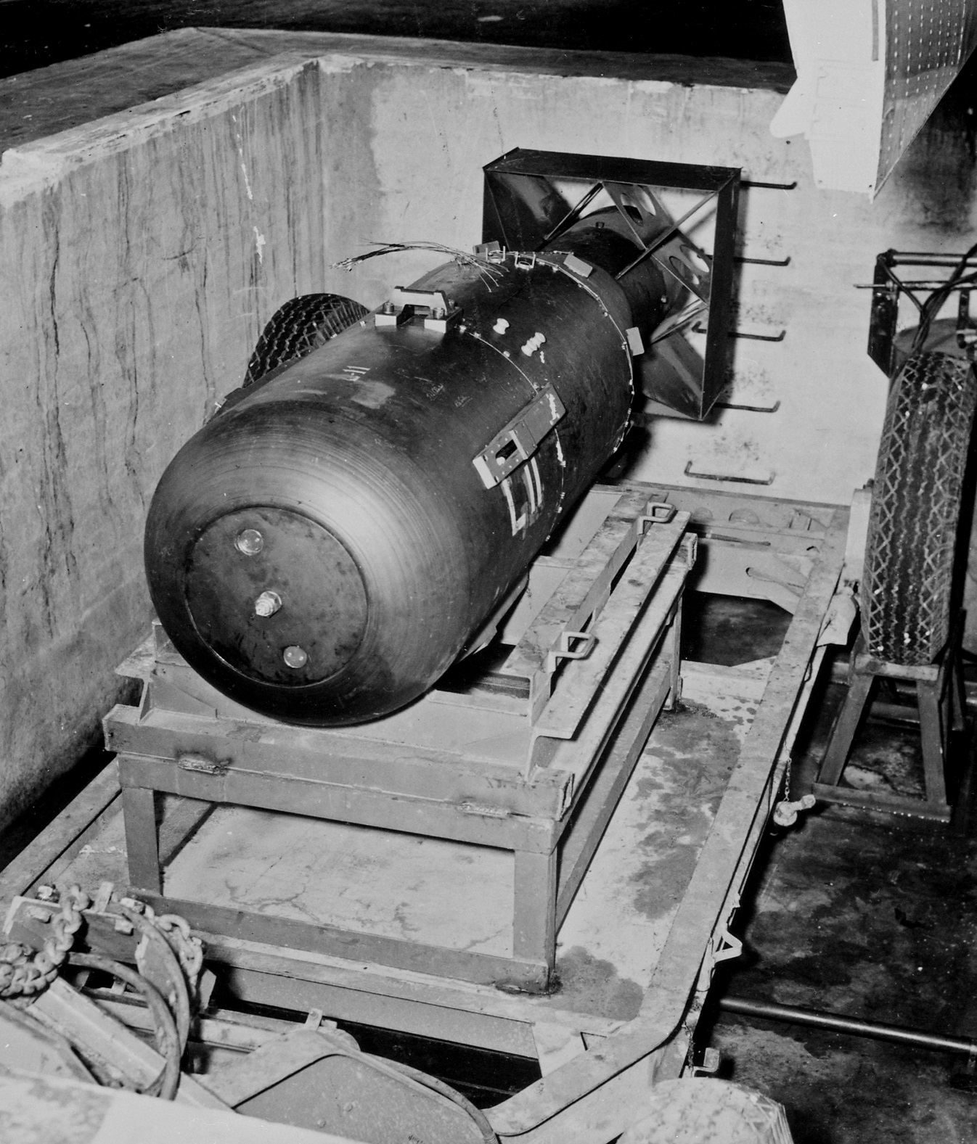
James Vaughan ; https://creativecommons.org/licenses/by-sa/2.0/legalcode
Notes:
Does anyone know what the bomb dropped on Hiroshima was called? [Little Boy]
As Hiroshima is very flat, there were no natural obstacles (like hills) to contain the explosion. It destroyed a huge proportion of the city.

Slide 13
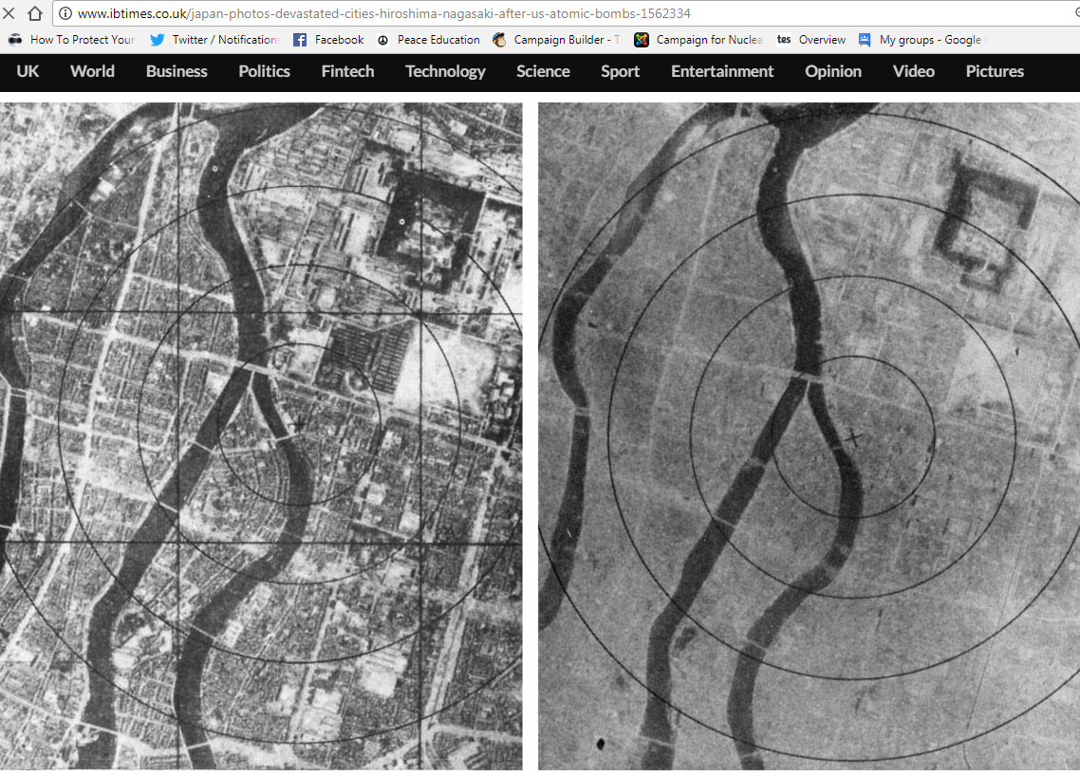
6th August 1945: The atomic bomb is dropped on Hiroshima
Notes:
The photo on the right was taken after the bomb exploded. How can you tell it’s the same place? [The river, plus a few faint outlines of streets and buildings] The ‘x’ marks the centre of the explosion. The bomb was made to explode 600 metres above ground, as it was expected that this would do more damage (although this also meant there was less radioactive fallout than there would have been from a ‘ground-burst’)

Slide 14
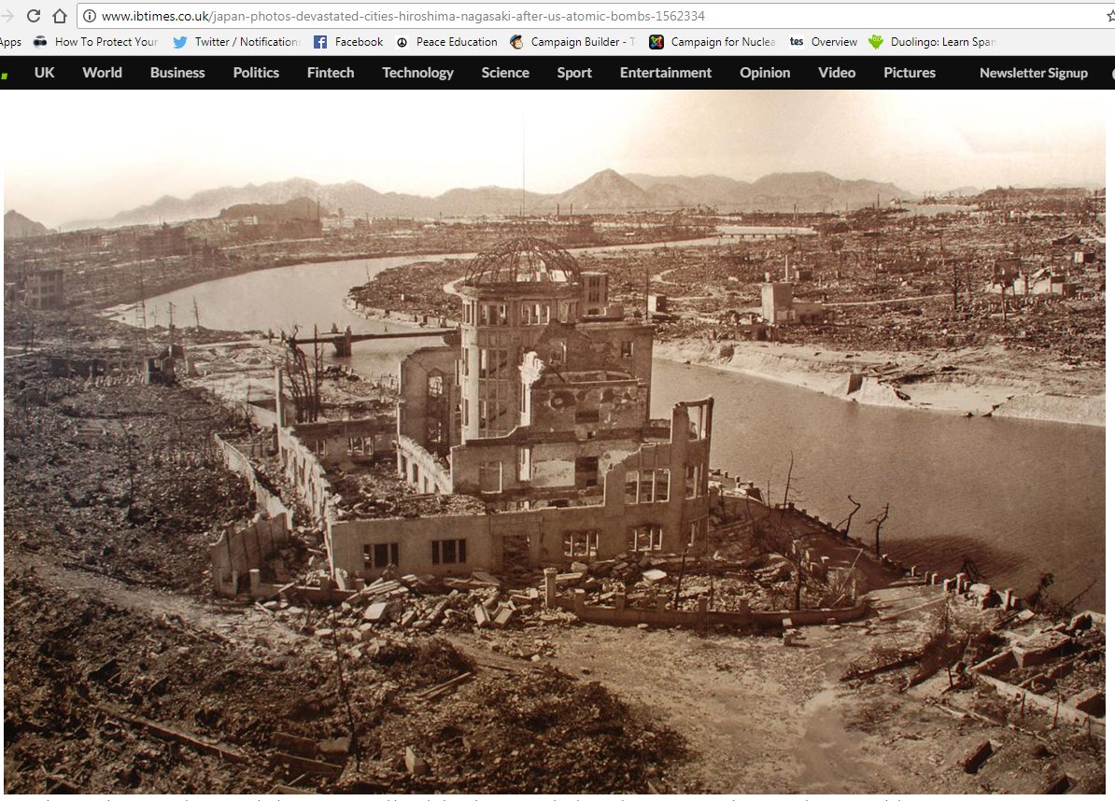
Notes:
This building lasted better than most because it was directly underneath the explosion.
[For more information on the Hiroshima (and Nagasaki) atomic bombing see for example https://www.atomicheritage.org/history/bombings-hiroshima-and-nagasaki-1945]

Slide 15
Notes:
The patch or stain known as a ‘nuclear shadow’ is all that was left of someone who was sitting on the steps. They literally vaporised, because the heat of the bomb was so great: it reaches millions of degrees Centigrade very briefly, and remains at 1000s of degrees Centigrade for slightly longer. These steps are now in the Hiroshima Atomic Bomb Museum.

Slide 16
Hiroshima video clip (reconstruction)
You may find the clip disturbing. Feel free to close your eyes/look away.
Notes:
16
[Watch the clip at https://www.youtube.com/watch?v=3wxWNAM8Cso&t=154s (from 2.35-3.35)]

Slide 17
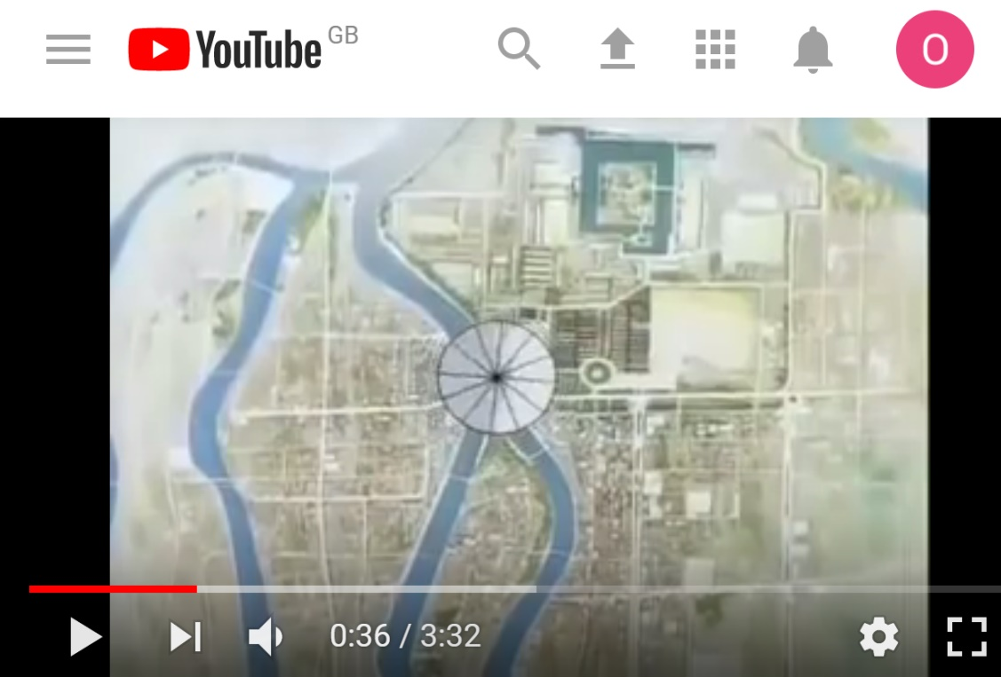
Barefoot Gen
Animated film made in 1983, based on the graphic novel by the famous Japanese manga artist Keiji Nakazawa, who survived the Hiroshima bomb (he was 6 at the time)
You may find the clip disturbing! Feel free to close your eyes/look away.
Notes:
17
[Watch the English-dubbed clip at https://www.youtube.com/watch?v=c8XT5kRlDrU from 28.15-36.00, or (if you have less time) for example from 31.00-34.00. NB: although rated a 12, some 12+ students may find the clips very disturbing, so make sure to watch it yourself first!]

Slide 18
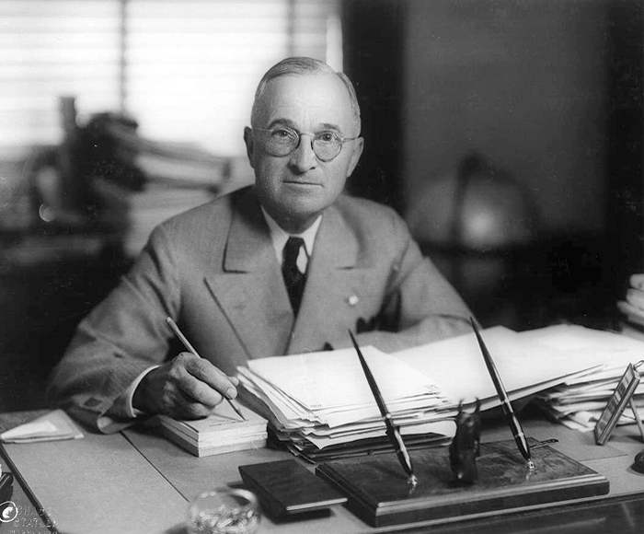
6th August 1945: President Truman gives a statement promising further bombs if Japan doesn’t surrender
Matthew Yglesias ;
https://creativecommons.org/licenses/by-sa/2.0/legalcode
Notes:
watch at https://www.youtube.com/watch?v=FN_UJJ9ObDs [Citizenship teachers: For ideas and resources on lesson activities on analysing media reporting then and now, follow the link at https://cnduk.org/education/truman-cit ]

Slide 19
Atomic Heritage Project
Notes:
This is the bomb dropped on Nagasaki. Does anyone know what it was called? [Fat Man]

Slide 20
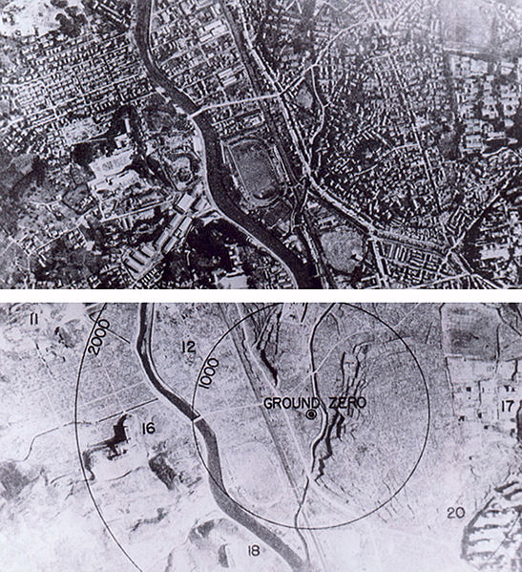
9th August 1945: The bomb is dropped on Nagasaki
Wikimedia Commons
Notes:
It was a different type of bomb to Little Boy, and was actually more powerful, though it killed fewer people, for various reasons (including that the bomb did not fall on the centre of the city)
[For more information on the Nagasaki (and Hiroshima) atomic bombing see for example https://www.atomicheritage.org/history/bombings-hiroshima-and-nagasaki-1945]

Slide 21
9th August 1945: At midnight, the USSR invades Manchuria, in Northern China, which since 1932 had been part of the Japanese Empire. They go on to capture Northern Korea and other Japanese-occupied territories.
histclo.com
Notes:
This was the last campaign of the Second World War. It lasted eleven days, and tens of thousands were killed or injured on both sides. Manchuria and Mengjiang – or Inner Mongolia - were returned to China, and Korea was partitioned along the ‘38th Parallel’, with the Soviet Union occupying the North and the USA the South. [Citizenship teachers: For ideas and resources on exploring the changing nuclear tensions (from 2017-2019) between the USA and Russia, and between the USA and North Korea, and also the UK’s role in these contexts, please go to https://cnduk.org/education/truman-cit ]

Slide 22
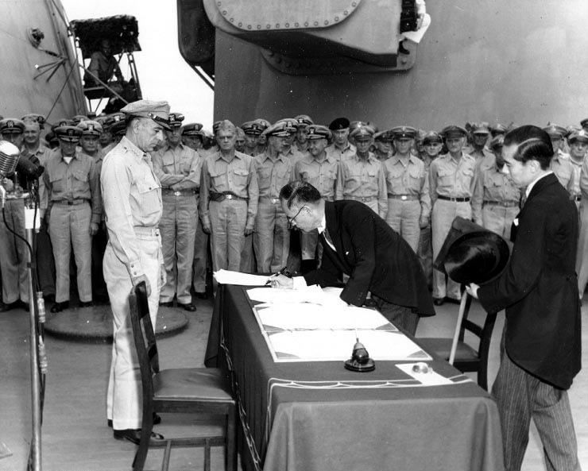
2nd September 1945: Japan formally surrenders. This is the end of the Second World War.
Public domain

Slide 23
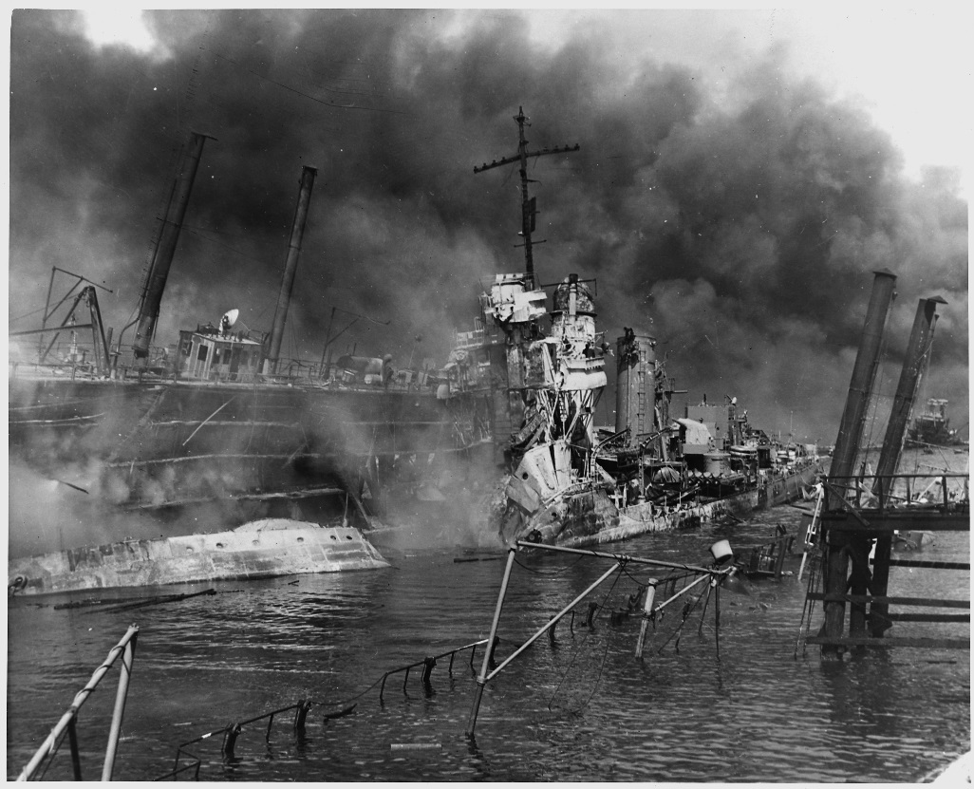
What are the arguments for the bombings?
Saved lives: ended the war ASAP, saving lives overall by avoiding a land invasion (the Okinawa battle saw 1/3 of US landing force killed or wounded; Churchill said the USA and Britain would lose 1 million and 500,000 soldiers respectively)
Revenge for Pearl Harbour
Once the bomb was developed, it was always going to be used
US National Archives
Notes:
.
[For more information see for example https://www.atomicheritage.org/history/debate-over-bomb and https://en.wikipedia.org/wiki/Debate_over_the_atomic_bombings_of_Hiroshima_and_Nagasaki#Opposition]

Slide 24
What are the arguments against the bombings?
Immoral: Killed 185,000-600,000 - mostly civilians (Some of the leading Manhattan Projects scientists had asked decision-makers for the A-bomb to be used on ''uninhabited area'' of Japan instead, as a threat, but Truman had already decided on maximum impact, and couldn't risk failure of bomb demonstration. They only had two bombs, after all.)
Surrender was possible: The US had intercepted telegrams showing that some of the Japanese government wanted Japan to surrender
More about sending a message to the Soviet Union
Notes:
.
[The fatality estimates vary greatly, partly due to the lack of rigorous records and the vaporisation or cremation of many bodies in the explosion, and also because the more conservative figures focus on short short-term deaths, unlike the UN’s upper figure: see for example http://www.aasc.ucla.edu/cab/200708230009.html and https://news.un.org/en/story/2015/08/505812-no-more-hiroshimas-no-more-nagasakis-ban-declares-anniversary-atomic-bombing]

Slide 25
WHAT DO YOU THINK? ‘spectrum line’
Notes:
[Get students to line up across the room, standing at one end if they think Truman was justified in ordering the atomic bombs to be dropped, on the opposite end if they think he was unjustified, and along the ‘spectrum’ if they feel somewhere in between. Then get some students to say why they are standing where they are. The can move along the spectrum if anyone says something that persuades them. If space cannot be made in the classroom for this, a show of hands can work instead. To add more nuance to your spectrum/barometer activities, see https://www.facinghistory.org/sites/default/files/viewing-guide-barometer.pdf]

Slide 26
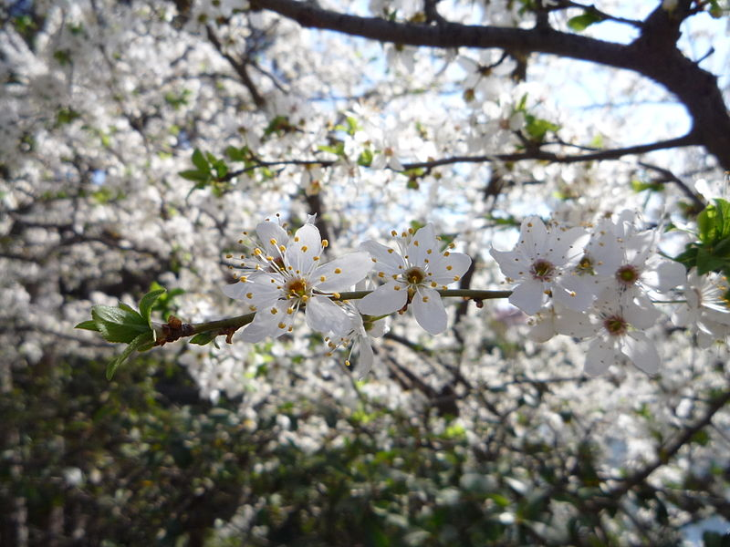
俳句
‘Haiku’ in Japanese

Slide 27
What is a Haiku?
A haiku is a type of Japanese poem
It’s (usually) 3 lines and 17 syllables long: 5 syllables in the first line, 7 in the second, and 5 in the third
Haikus say something epic in a few words. They were first written 100s of years ago, as the start of longer poems
Usually about nature and human nature, with a ‘season’ word, and a pause at end of the 1st or 2nd line
Note: a haiku that is just about humans/human nature is called a Senryu

Slide 28
Toward those short trees We saw a hawk descending On a day in spring.
by Masaoka Shiki (1867-1902)
To/ ward/ those/ short/ trees – 5 syllables
We/ saw/ a/ hawk/ de/ scend/ ing – 7
On/ a/ day/ in/ spring – 5
‘spring’ = season word
cerrodelaslombarda ; https://creativecommons.org/licenses/by-sa/2.0/legalcode

Slide 29
The day it ended
Oh what else was there to do?
Peace bought with the bomb
by Anonymous
The/ day/ it/ end/ed – 5 syllables
Oh/ what/ else/ was/ there/ to/ do? - 7
Peace/ bought/ with/ the/ bomb – 5
= Haiku or senryu? Why?

Slide 30
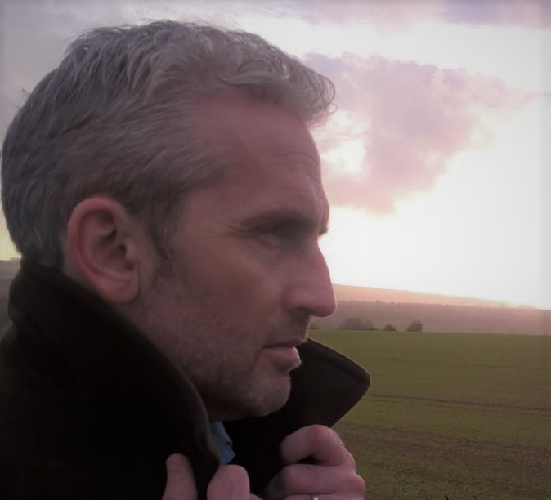
Little boy humming
Dragonfly strumming, gamma
numbing, black rain coming.
by Anthony Owen
Lit/ tle/ boy/ humm/ ing – 5 syllables
Dra/ gon/ fly/ strumm/ ing/ gam/ ma – 7
numb/ ing,/ black/ rain/ com/ ing – 6 (← This shows that there can be exceptions!)
‘rain’ = season word
Notes:
What do you think ‘Little boy humming’ refers to? [Probably the bomb dropped on Hiroshima, but could also literally be a little boy humming – a scene of normality before the devastation of the bomb] What do you think ‘Dragonfly strumming’ refers to? [Probably the plane that dropped the bomb – the ‘Enola Gay’ in the case of Hiroshima]
What do ‘gamma numbing’ and ‘black rain coming’ mean? [Gamma is the most harmful form of radiation, which is released by nuclear detonations. ‘Black rain’ was the phrase used to describe the rain that fell after the bombings, which was darkened by a mixture of soot and tiny radioactive particles released and mixed up by the explosions. People who came into contact with it often got radiation sickness or long-term health problems.]

Slide 31
YOUR TASK:
Write your own haiku/senryu about Hiroshima and Nagasaki
Write a haiku or senryu about the bombings from the point of view of someone alive at the time (you’ll be given a ‘Witness Statement’)
Think about how that person felt about the bombings.
If you have time, write a haiku/senryu from your own point of view, too
Notes:
[Higher-ability students should write the two haiku/senryu. Lower-ability students may find it easier just to write the one from their own perspective]

Slide 32
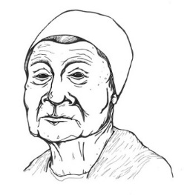
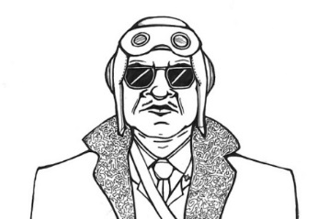
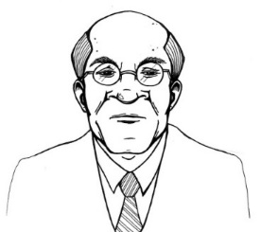
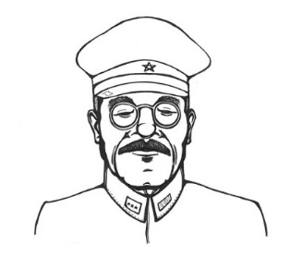
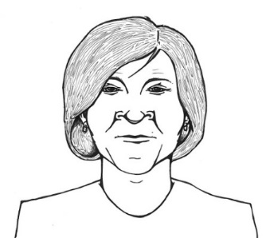
You will write your haiku/senryu from the point of view of one of these people (you may remember them as witnesses in the trial!):
Nagasaki survivor
Bomber pilot
Truman’s advisor
Japanese Army General
American civilian
Nuclear Scientist

Slide 33
Notes:
[Higher-ability students could be given a more challenging word bank]

Slide 34
Share your haiku/senryu with the rest of the class !
Notes:
[As they are so short, it can be a good idea to ask people to read theirs twice. You can encourage the second reading to be particularly clear, and emphatic, to help develop students’ oracy skills. And then invite feedback from other students]

